Slide 1
September 1, 2020 | RC WEBEX
revised
Tie Benefits Study Results For Capacity Commitment Period 2024-2025 Fifteenth Forward Capacity Auction (FCA 15)
Reliability Committee Meeting
Quan Chen and Fei Zeng
Resource Studies and Assessments

Slide 2
Objective
To review the tie benefits study results for FCA 15 for the Capacity Commitment Period (CCP) 2024-2025
Total tie benefits for New England
Tie benefits contribution associated with individual or group of interconnection(s)
Maritimes (MT)
HQ Phase II (PhII)
Highgate
New York AC ties (NY-AC)
Cross Sound Cable (CSC)

Slide 3
Background
Determination of Capacity Zones for FCA 15 was presented to the Power Supply Planning Committee (PSPC) on May 28, 2020
https://www.iso-ne.com/static-assets/documents/2020/05/a05_pspc_2020_05_28_fca_15_cap_zone_formation.pdf
Import-constrained Capacity Zone of Southeast New England (SENE) (includes the NEMA/Boston and SEMA/RI Load Zones)
Export-constrained Capacity Zones of:
Maine, and
Northern New England (NNE) (includes Maine, New Hampshire and Vermont Load Zones)
Rest-of-Pool Capacity Zone
Transmission transfer capability limits associated with Capacity Zones are relaxed in the tie benefits study
Detailed study assumptions were presented to the PSPC on June 30, 2020
https://www.iso-ne.com/static-assets/documents/2020/06/a02c_pspc_2020_06_30_tie_benefits_study_assumptions.pdf
Detailed study methodology and assumptions are included in Appendix I to this presentation

Slide 4
Summary of Tie Benefits Study Results
Interface | FCA 15 Tie Benefits Amount (MW)
Maritimes | 454
HQ Phase II | 883
Highgate | 140
New York AC ties | 258
CSC | 0
Total Tie Benefits | 1,735

Slide 5
Recap of Tie Benefits Calculation Process*
Process 1
Calculate the tie benefits values for all possible interconnection states using isolated New England system as the reference
Process 2
Calculate initial total tie benefits for New England from all neighboring Control Areas
Process 3
Calculate initial tie benefits for each individual neighboring control area
Pro-rate tie benefits values of individual Control Areas based on the total tie benefits, if necessary
Process 4
Calculate initial tie benefits for individual interconnection or group of interconnections
Pro-rate tie benefits values of individual interconnection or group of interconnections based on the individual Control Area tie benefits, if necessary
Process 5
Adjust tie benefits of individual interconnection or group of interconnections to account for firm capacity imports
Process 6
Calculate the final tie benefits for each individual neighboring Control Area
Process 7
Sum the final total tie benefits for New England from each individual neighboring Control Areas
*The tie benefits calculation process is documented in Section III.12.9 of the Tariff. For a copy please see: https://www.iso-ne.com/static-assets/documents/2014/12/mr1_sec_1_12.pdf

Slide 6
FCA 15 Tie Benefits Study detailed calculations

Slide 7
Process 1 Calculation of Tie Benefits for All Interconnection States
Interconnection State | Discription | Interconnection Status |  |  |  |  |  | FCA15 Equivalent TB (MW)
 |  | Maritimes | Ph II | Highgate | NY-AC | CSC | FCA15 LOLE after cut
1 | Cut All | x | x | x | x | x | 0.35468 | 0
2 | Cut None | √ | √ | √ | √ | √ | 0.09999 | 1,735
3 | Cut MT | x | √ | √ | √ | √ | 0.13033 | 1,330
4 | Cut Ph II | √ | x | √ | √ | √ | 0.16948 | 935
5 | Cut Highgate | √ | √ | x | √ | √ | 0.10797 | 1,595
6 | Cut NY-AC | √ | √ | √ | x | √ | 0.10653 | 1,615
7 | Cut CSC | √ | √ | √ | √ | x | 0.09999 | 1,735
8 | Cut MT & Ph II | x | x | √ | √ | √ | 0.21909 | 600
9 | Cut MT & Highgate | x | √ | x | √ | √ | 0.14110 | 1,210
10 | Cut MT & NY-AC | x | √ | √ | x | √ | 0.14322 | 1,190
11 | Cut MT & CSC | x | √ | √ | √ | x | 0.13033 | 1,330
12 | Cut Ph II & Highgate | √ | x | x | √ | √ | 0.18307 | 830
13 | Cut Ph II & NY-AC | √ | x | √ | x | √ | 0.19869 | 725
14 | Cut Ph II & CSC | √ | x | √ | √ | x | 0.16948 | 935
15 | Cut Highgate & NY-AC | √ | √ | x | x | √ | 0.11624 | 1,485
16 | Cut Highgate & CSC | √ | √ | x | √ | x | 0.10797 | 1,595
17 | Cut NY-AC & CSC | √ | √ | √ | x | x | 0.10653 | 1,615
18 | Cut MT, Ph II & Highgate | x | x | x | √ | √ | 0.23657 | 495
19 | Cut MT, Ph II & NY-AC | x | x | √ | x | √ | 0.30045 | 200
20 | Cut MT, Ph II & CSC | x | x | √ | √ | x | 0.21909 | 600
21 | Cut MT, Highgate & NY-AC | x | √ | x | x | √ | 0.15777 | 1,040
22 | Cut MT, Highgate & CSC | x | √ | x | √ | x | 0.14110 | 1,210
23 | Cut MT, NY-AC & CSC | x | √ | √ | x | x | 0.14322 | 1,190
24 | Cut Ph II, Highgate & NY-AC | √ | x | x | x | √ | 0.22123 | 590
25 | Cut Ph II, Highgate & CSC | √ | x | x | √ | x | 0.18307 | 830
26 | Cut Ph II, NY-AC & CSC | √ | x | √ | x | x | 0.19869 | 725
27 | Cut Highgate, NY-AC & CSC | √ | √ | x | x | x | 0.11624 | 1,485
28 | Cut MT, Ph II, Highgate & NY-AC | x | x | x | x | √ | 0.35468 | 0
29 | Cut MT, Ph II, Highgate & CSC | x | x | x | √ | x | 0.23657 | 495
30 | Cut MT, Ph II, NY-AC & CSC | x | x | √ | x | x | 0.30045 | 200
31 | Cut MT, Highgate, NY-AC & CSC | x | √ | x | x | x | 0.15777 | 1,040
32 | Cut Ph II, Highgate, NY-AC & CSC | √ | x | x | x | x | 0.22123 | 590
X – disconnected √ - connected

Slide 8
Process 2 Calculation of Initial Total Tie Benefits
Compare state 1 (without any ties) and state 2 (with all the ties)
Total tie benefits = 1,735 MW
This value is subject to the adjustment later to account for firm capacity imports

Slide 9
Process 3 Calculation of Initial Tie Benefits for Neighboring Control Areas
All interconnections connected to a given neighboring Control Area are grouped together to represent the state of interconnection between New England and that neighboring Control Area. The simple average of values for all the interconnection states represents the tie benefits of the target neighboring Control Area (four states for each area)
Tie benefits from Maritimes
1 vs. 32 = 590 2 vs. 3 = 405 12 vs. 18 = 335 17 vs. 23 = 425
Average = 438.8 MW
Tie benefits from Quebec
1 vs. 23 = 1,190 2 vs. 12 = 905 3 vs. 18 = 835 17 vs. 32 = 1,025
Average = 988.8 MW
Tie benefits from New York
1 vs. 18 = 495 2 vs. 17 = 120 3 vs. 23 = 140 12 vs. 32 = 240
Average =248.8 MW
Tie benefits after proration (since 438.8 + 988.8 + 248.8 = 1,676 ≠ 1,735)
Maritimes initial tie benefits = 1,735 * 438.8 / (438.8 + 988.8 + 248.8) = 1,735 * 0.2617 = 454 MW
Hydro Quebec initial tie benefits = 1,735 * 988.8 / (438.8 + 988.8 + 248.8 ) = 1,735 * 0.5899 = 1,023 MW
NY initial tie benefits = 1,735 * 248.8 / (438.8 + 988.8 + 248.8 ) = 1,735 * 0.1484 = 258 MW

Slide 10
Process 4 Calculation of Tie Benefits for Individual or Group of Interconnections
Each individual interconnection or group of interconnections subject to the individual tie benefits contribution calculation is treated independently. The simple average of values for all the interconnection states represents tie benefits of the target interconnection or group of interconnections
Interconnections with Maritimes
No individual interconnections subject to the calculation
Interconnections with Quebec
HQ Phase II and Highgate are subject to the calculation
HQ Phase II
1 vs. 31 = 1040 2 vs. 4 = 800 3 vs. 8 = 730 5 vs. 12 = 765
9 vs. 18 = 715 17 vs. 26 = 890 23 vs. 30 = 990 27 vs. 32 = 895
Average = 853.1 MW
Highgate
1 vs. 30 = 200 2 vs. 5 = 140 3 vs. 9 = 120 4 vs. 12 = 105
8 vs. 18 = 105 17 vs. 27 = 130 23 vs. 31 = 150 26 vs. 32 = 135
Average = 135.6 MW
Tie benefits after proration (since 853.1 + 135.6 = 988.7 ≠ 1,023)
HQ Phase II initial tie benefits = 1,023 * 853.1 / (853.1 + 135.6) = 1,023 * 0.8628 = 883 MW
Highgate initial tie benefits = 1,023 * 135.6 / (853.1 + 135.6) = 1,023 * 0.1372 = 140 MW

Slide 11
Process 4 (cont.)
Interconnections with New York
NY AC ties and Cross Sound Cable (CSC) are subject to the calculation
NY AC ties
1 vs. 29 = 495 2 vs. 6 = 120 3 vs. 10 = 140 7 vs. 17 = 120
11 vs. 23 = 140 12 vs. 24 = 240 18 vs. 28 = 495 25 vs. 32 = 240
Average = 248.8 MW
CSC
1 vs. 28 = 0 2 vs. 7 = 0 3 vs. 11 = 0 6 vs. 17 = 0
10 vs. 23 = 0 12 vs. 25 = 0 18 vs. 29 = 0 24 vs. 32 = 0
Average = 0 MW
Tie benefits after proration (since 248.8+ 0 = 248.8 ≠ 258 )
NY AC initial tie benefits = 258 * 248.8 / (248.8 + 0) = 258 * 1.0 = 258 MW
CSC initial tie benefits = 258 * 0 / (248.8 + 0) = 258 * 0 = 0 MW

Slide 12
Process 5 Adjustment to Initial Tie Benefits Values to Account for Firm Capacity Imports
Tie benefits determined in Process 4 for individual interconnection or group of interconnections are adjusted to account for firm capacity imports
Interconnections with Maritimes
No adjustments required as no existing firm capacity imports
Interconnections with Quebec
HQ Phase II
No adjustments required as no existing firm capacity imports
Highgate
No adjustments required as no existing firm capacity imports
Interconnections with New York
NY AC Ties (NY ACT)
Existing import = 82.8 MW
Assumed total import capability = 1,400 MW
Remaining import capability after import = 1,400 – 82.8 = 1,317.2 MW
Tie benefits value calculated in Process 4 = 258 MW
Since 258 < 1,317.2 MW, no adjustment is required
NY ACT tie benefits = 258 MW
CSC
No adjustments required since there are no tie benefits
CSC tie benefits = 0 MW

Slide 13
Process 6 Calculate Final Tie Benefits for Individual Neighboring Control Area
Final tie benefits for each neighboring Control Area are the sum of the tie benefits from the individual interconnections or groups of interconnections with that Control Area, after accounting for the adjustments for firm capacity imports as determined in Process 5
Maritimes = 454 MW
Quebec = 883 + 140 = 1,023 MW
New York = 258 + 0 = 258 MW

Slide 14
Process 7 Sum the Final Total Tie Benefits for New England (Revised)
Final total tie benefits from all neighboring control areas are the sum of the Control Area tie benefits after accounting for any adjustment for capacity imports as determined in Process 6
Total tie benefits = 454 + 1,023 + 258 = 1,735 MW

Slide 15
Summary of Tie Benefits Study Results
For FCA 15, the total tie benefits are 1,735 MW, with the following contributions:
Interface | Tie Benefits Amount (MW)
Maritimes | 454
HQ Phase II | 883
Highgate | 140
New York AC ties | 258
CSC | 0

Slide 16
Comparison of FCA 15 & FCA 14 Tie benefits

Slide 17
Comparison of FCA 15 & FCA 14 Tie Benefits
Interface | FCA 15 (MW) | FCA 14 (MW) | DELTA (MW) (FCA 15 minus FCA 14)
Maritimes | 454 | 501 | -47
HQ Phase II | 883 | 941 | -58
Highgate | 140 | 136 | 4
New York AC ties | 258 | 362 | -104
CSC | 0 | 0 | 0
Total Tie Benefits | 1,735 | 1,940 | -205
Note: FERC accepted the tie benefits for the 2023-2024 Capacity Commitment Period associated with the fourteenth Forward Capacity Auction (FCA 14) on January 3, 2020. The accepted values included Mystic 8 & 9. See: https://www.iso-ne.com/static-assets/documents/2020/01/er20-311-000_1-3-20_order_accept_icr_for_fca_14.pdf

Slide 18
Key Assumption Changes affecting Tie Benefits
The ISO has conducted a comparison of this year’s and last year’s tie benefits calculations
There are various factors that contribute to the decrease in tie benefits
See next slide
Each assumption change was evaluated independently. Thus, the assumptions changes are not additive
The remaining MW difference is attributable to a combination of minor assumption updates since last year

Slide 19
Key Assumption Changes affecting Tie Benefits (cont.)
The following table tabulates the simulation results of key assumptions changes that contributed to lowering total tie benefits for FCA 15:
 | Key Assumption Changes | Amount of Decrease
1 | Retirement of Mystic 8 & 9 | 25 MW
2 | A 550 MW Lower NEMA/Boston transmission import capability 5,150 MW for FCA 15 vs. 5,700 MW for FCA 14 See February 20, 2020 PAC presentation (CEII) available at: https://smd.iso-ne.com/operations-services/ceii/pac/2020/02/a4_boston_import_transfer.pdf | 40 MW
3 | NY Behind-the-meter photovoltaic (BTM PV) model | 50 MW
4 | NY load forecast uncertainty | 40 MW
Notes:
Methodology: Using the FCA 15 base case, change the assumption of interest by using its FCA 14 value and simulate the tie benefits
Please note the impact of each assumption change on tie benefits is not additive since they are evaluated one assumption at a time. This approach would not capture the compound effects of these assumptions changes when modeled together

Slide 20
Observations of Tie Benefits Study Results
The lower import limit into Boston decreases the calculated amount of tie benefits assistance that can be delivered throughout New England
The retirement of Mystic 8 & 9 in Boston diminishes the need for emergency assistance to provide replacement capacity to meet the forced outages associated with Mystic 8 & 9
The change in the amount of tie benefits contribution of the individual or group of ties is consistent with the change in the forced outage rate assumptions of the external transmission interfaces
No change in NY AC ties availability assumptions so forced outage rate did not impact the change in NY AC tie benefits
Interface | FCA 15 Forced Outage Rate (%) | FCA 14 Forced Outage Rate (%) | DELTA (%) (FCA 15 minus FCA 14) | DELTA (MW) (FCA 15 minus FCA 14)
Maritimes | 0.1 | 0.0 | 0.1 | -47
HQ Phase II | 1.3 | 0.9 | 0.4 | -58
Highgate | 0.0 | 0.1 | -0.1 | 4
New York AC ties | 0.5 | 0.5 | 0.0 | -104

Slide 21
Observations of Tie Benefits Study Results (cont.)
Higher tie benefit reductions from NY AC ties as compared with the other Control Area contributions may be due to New York’s need to meet higher peak and energy demand forecast as a result of higher load forecast uncertainty assumptions
The increase in uncertainty of the load forecast means that New York’s need of emergency assistance available from the Canadian Control Areas increases lowering the amount of assistance available to New England
Change in New York’s BTM-PV penetration and hourly shape in this year’s study result in more correlated hourly loads between NY and NE. This reduced load diversity resulting in less opportunity to help each other out, thus further lowering the tie benefits contribution from New York

Slide 22
Conclusions of Tie Benefits Study
Given the changes in assumptions, the ISO considers the results of the FCA 15 tie benefits study to be reasonable
Total tie benefits for FCA 15 ICR and related values* calculations are 1,735 MW
Hydro Quebec Interconnection Capability Credits (HQICCs) for FCA 15 are 883 MW
* The ICR, net ICR, Local Resource Adequacy, Transmission Security Analysis, Local Sourcing Requirement, Maximum Capacity Limit, the Marginal Reliability Impact system and zonal Demand Curves and the HQICCs are collectively referred to as the ICR and related values

Slide 24
Appendix I FCA 15 tie Benefits study Methodology and assumptions

Slide 25
Study Methodology Calculation Process 1
Calculation of tie benefits values for all possible interconnection states
Bring all interconnected areas to LOLE of 0.1 days/year simultaneously
Calculate New England’s LOLE for all the possible interconnection states, e.g.
with no interconnections (isolated state)
With any single interconnection only
With any of two interconnections
With any of three interconnections
…
Calculate the equivalent tie benefits values for each interconnection state using the isolated state as reference
As the equivalent MW to bridge the LOLE delta between these two states

Slide 26
Study Methodology Calculation Process 2
Calculation of initial total tie benefits for New England
Compare the following two interconnection states
New England System with all interconnections with neighboring Control Areas connected
New England System with all interconnections with neighboring Control Areas disconnected
Total tie benefits for New England is the equivalent MW value to bridge the LOLE delta between these two states
This initial total tie benefits value is subject to adjustment to account for firm capacity imports in Process 5

Slide 27
Study Methodology Calculation Process 3
Calculation of initial tie benefits for each individual neighboring Control Area
All interconnections connected to a given neighboring Control Area are grouped together to represent the state of interconnection between New England and that neighboring Control Area
For each target neighboring Control Area, identify all the related interconnection states and calculate the equivalent tie benefits values for each of those states
With a total of three neighboring control areas, there are four interconnection states for each neighboring Control Area
Use the simple average of values for all the interconnection states to represent the tie benefits of the target neighboring Control Area
If the sum of the individual control area tie benefits calculated above is different than the total tie benefits calculated in Process 2, each Control Area’s tie benefits shall be adjusted based on the ratio of the individual Control Area tie benefits to the total tie benefits
These initial individual Control Area tie benefits are subject to further adjustment to account for firm capacity imports in Process 5

Slide 28
Study Methodology Calculation Process 4
Calculation of initial tie benefits for individual interconnection or group of interconnections
Each individual interconnection or group of interconnections subject to individual tie benefits contribution calculation is treated independently
For each target interconnection or group of interconnections, identify all the related interconnection states and calculate the equivalent tie benefits values for each of these states
Use the simple average of values for all the interconnection states to represent the tie benefits of the target interconnection or group of interconnections
If the sum of tie benefits of the individual interconnections or group of interconnections calculated above is different than the relative Control Area’s tie benefits calculated in Process 3, tie benefits of the individual interconnection or group of interconnections shall be an adjusted ratio of the tie benefits of the individual interconnection or group of interconnections to the relative Control Area’s tie benefits
These initial individual interconnection or group of interconnections’ tie benefits are subject to further adjustment to account for firm capacity imports in Process 5

Slide 29
Study Methodology Calculation Process 5
Adjustment to the initial tie benefits for individual interconnection or group of interconnections to account for firm capacity imports
Deduct firm capacity imports from the import capability of each individual interconnection or group of interconnections to determine the remaining available import capability to support tie benefits
Firm capacity imports are the Qualified Existing Import Capacity for FCA 2024-2025
Compare the tie benefits value of an individual interconnection or group of interconnections as determined in Process 4 to its remaining transmission import capability
If the tie benefits value is greater than the remaining transmission import capability, the tie benefit value of the individual interconnection or group of interconnections is capped to the remaining transmission import capability value
Otherwise, no adjustments are made

Slide 30
Study Methodology Calculation Process 6
Calculate the final tie benefits for individual neighboring Control Areas
Final tie benefits for each neighboring Control Area are the sum of the tie benefits from the individual interconnection or groups of interconnections with that Control Area, after accounting for any adjustment for firm capacity imports as determined in Process 5

Slide 31
Study Methodology Calculation Process 7
Sum the final total tie benefits for New England
Final total tie benefits from all neighboring control areas are the sum of the Control Area tie benefits after accounting for any adjustment for firm capacity imports as determined in Process 6

Slide 32
Resource Assumptions
New England
Model all FCA 15 Existing Capacity Resources
Ratings, EFORd and maintenance weeks consistent with assumptions for the FCA 15 Installed Capacity Requirement (ICR) calculations
Neighboring Control Areas
Model resources based on
2019 Northeast Power Coordinating Council (NPCC) Long Range Adequacy Overview data & 2020 NPCC Summer Assessment
Quebec
Maritimes
New York
2020 New York Gold Book
Ontario & PJM (for the purpose of modeling the impacts of capacity imports/exports with Quebec and New York)

Slide 33
Load Assumptions
New England
Load Forecast
Based on the 2020 Forecast Report of Capacity, Energy, Loads and Transmission Report* (2020 CELT)
Load Shape
2002 hourly shape; consistent with current NPCC studies
Load Forecast Uncertainty
The load forecast weather-related uncertainty is represented by specifying a series of multipliers on the peak load and the associated probabilities of each load level occurring
The multipliers used to describe the load forecast uncertainty are derived from the 52 weekly peak load distributions described by the expected value (mean), the standard deviation and the skewness
*The 2020 CELT load forecast is available at https://www.iso-ne.com/static-assets/documents/2020/04/2020_celt_report.xlsx

Slide 34
Load Assumptions, cont.
New England, cont.
Load forecast components
The 2020 CELT load forecast contains two new components relating to electrification (covered in later slides), in addition to the behind-the-meter photovoltaic (BTM PV)
Modeling of BTM PV
FCA 15 tie benefits calculations will use an hourly profile of BTM PV corresponding to the load shape for the year 2002, used by the NPCC for reliability studies. For more information on the development of the hourly profile see: https://www.iso-ne.com/static-assets/documents/2017/06/pspc_6_22_2017_2002_PV_profile.pdf
Used for all probabilistic ICR-related values calculations
Modeled in GE MARS by groupings using the Regional System Plan (RSP) 13-subarea representation
Includes an 8% transmission and distribution gross-up
Peak load reduction uncertainty is modeled (randomly selected by MARS from a seven day window distribution)
Note:
For more info on the PV forecast, see https://www.iso-ne.com/static-assets/documents/2020/04/final_2020_pv_forecast.pdf

Slide 35
Load Assumptions, cont.
Modeling transportation electrification
The tie benefits calculations will use an hourly profile for transportation electrification forecast
Includes an 8% transmission and distribution gross-up
Uncertainty is currently not modeled due to lack of performance data
More information on the development of the transportation electrification forecast can be found at : https://www.iso-ne.com/static-assets/documents/2020/04/final_2020_transp_elec_forecast.pdf
Modeling heating electrification
The tie benefits calculations will use the 2020 CELT gross load forecast that include the heating electrification loads which occur during the winter months
The hourly gross load forecast (2020 Forecast Data workbook) is inclusive of heating electrification forecast. The heating electrification loads are weather-sensitive and, therefore, the uncertainties relating to weather also apply to these loads
More information on the development of the heating electrification forecast can be found at: https://www.iso-ne.com/static-assets/documents/2020/04/final_2020_heat_elec_forecast.pdf

Slide 36
Load Assumptions, cont.
Neighboring Control Areas
Load Forecast
Based on their latest load models used in NPCC studies for the year 2024
2002 hourly shape; consistent with current NPCC studies

Slide 37
Control Area Modeling
Quebec, Maritimes, New England, and New York are simulated using a multi-area transportation model
An equivalent model is used to reflect the impacts of the known firm capacity imports/exports between New England’s directly interconnected neighboring Control Areas and their respective neighboring Control Areas (i.e., PJM and Ontario)

Slide 38
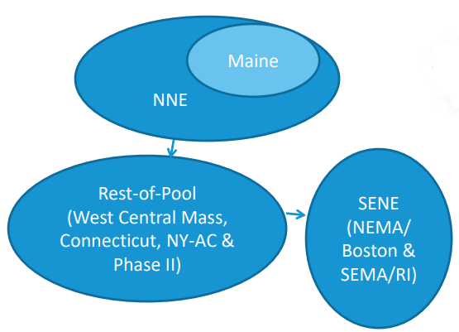
FCA 15 Transmission Interfaces and Transfer Capabilities
New England
Regional System Plan (RSP) subarea representation
Transfer capabilities consistent with FCA 15 transmission transfer capabilities* reviewed at the Planning Advisory Committee (PAC)
Interfaces associated with FCA 15 Capacity Zones** are not modeled
Northern New England (“NNE” - Vermont, New
Hampshire & Maine) – export-constrained
Maine – nested within NNE, export-constrained
Southeast New England (“SENE” - Northeastern
Massachusetts/Boston & Southeastern
Massachusetts/Rhode Island) – import-constrained
Neighboring Control Areas
Consistent with their latest model used in NPCC studies
* Based on transmission transfer capability limits presented at the March 17, 2020 Reliability Committee meeting. The presentation is available at: https://www.iso-ne.com/static-assets/documents/2020/03/a08.0_rc_2020_03_17_presentation.pdf
** For more info on the development of FCA 15 Capacity Zones, see https://www.iso-ne.com/static-assets/documents/2020/05/a05_pspc_2020_05_28_fca_15_cap_zone_formation.pdf

Slide 39
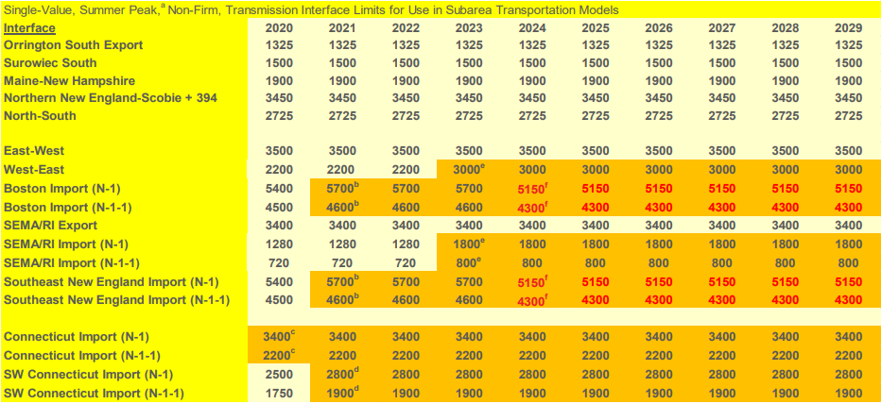
FCA 15 Internal Transmission Interface Transfer Capability (MW)
Notes are discussed in the following presentation:
https://www.iso-ne.com/static-assets/documents/2020/03/a08.0_rc_2020_03_17_presentation.pdf

Slide 40
FCA 15 Internal Transmission Interface Transfer Capability (Notes)
a) Limits are for the summer period, except where noted to be winter
The limits may not include possible simultaneous impacts and should not be considered as “firm”
For the years within the FCM horizon (CCP 2024-2025 and sooner), only accepted certified transmission projects are included when identifying transfer limits
For the years beyond the FCM horizon (CCP 2025-2026 and later), transmission upgrades with an approved proposed plan are included according to their expected in-service dates

Slide 41
FCA 15 Internal Transmission Interface Transfer Capability (Notes) (cont.)
b) Increase associated with the Greater Boston upgrades, with the Wakefield – Woburn 345 kV line in service (CCP 2021-2022 and later)
c) Increase associated with the Greater Hartford/Central Connecticut upgrades
d) Increase associated with the Southwest Connecticut (SWCT) upgrades
e) Increase associated with the Southeast Massachusetts/Rhode Island (SEMA/RI) Reliability project upgrades
f) Decrease associated with the updated load assumptions, updated Northern New England (NNE)-Scobie transfer capability and retirement of Mystic 7, 8 & 9

Slide 42
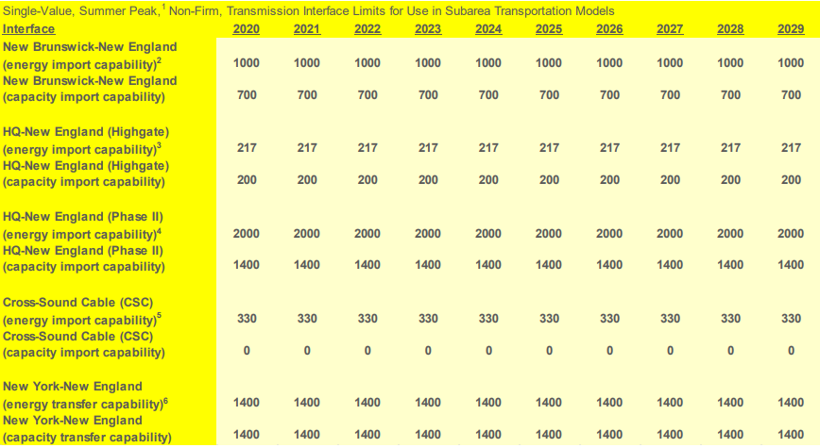
FCA 15 External Transmission Interface Import Capability (MW)
Notes are discussed in the following presentation:
https://www.iso-ne.com/static-assets/documents/2020/03/a08.0_rc_2020_03_17_presentation.pdf

Slide 43
FCA 15 External Interface Transmission Import Capability (Notes)
Limits are for the summer period
The limits may not include possible simultaneous impacts and should not be considered as “firm” (the bases for these limits are subject to more detailed review in the future)
The electrical limit of the New Brunswick-New England (NB-NE) tie is 1,000 MW
When adjusted for the ability to deliver capacity to the greater New England Control area, the NB-NE transfer capability is 700 MW
This is because of downstream constraints; in particular Orrington South
The capability for the Highgate facility is listed at the New England AC side of the Highgate terminal

Slide 44
FCA 15 External Transmission Interface Import Capability (Notes) (cont.)
The Hydro-Quebec Phase II interconnection is a DC tie with equipment ratings of 2,000 MW. Due to the need to protect for the loss of this line at full import level in the PJM and NY Control Areas’ systems, ISO-NE has assumed its transfer capability for capacity and reliability calculation purposes to be 1,400 MW
This assumption is based on the results of loss-of-source analyses conducted by PJM and NY
Import capability on the Cross Sound Cable (CSC) is dependent on the level of local generation in CT
New York interface limits
These are without CSC and with the Northport-Norwalk Cable at 0 MW flow
Simultaneously importing into NE and SWCT or CT can lower the NY-NE capability (very rough decrease = 200 MW)

Slide 45
FCA 15 Transmission Interfaces Availability Assumptions
New England
Internal transmission interfaces are modeled 100 % available because the power can be delivered using multiple paths
External transmission interface availability assumptions are based on values updated this year. The previous values used in FCA 14 are listed for comparison.
Please note that the MARS program only allows modeling the forced outage rate of a transmission interface. It is assumed that maintenance needs will have minimum reliability impact because they are scheduled during periods when the system is deemed reliable
Neighboring Control Areas
Consistent with their latest model used in NPCC studies

Slide 46
Other Assumptions: Operating Reserves and Relief from Voltage Reduction
New England
Assume 2,305 MW of system-wide operating reserves
Allowed to deplete to a minimum of 700 MW as OP-4 actions progress prior to firm load shedding
Local reserve requirements are based on the latest Forward Reserve Market auction requirements
CT: 0 MW (summer); 0 MW (winter)
SWCT: 0 MW (summer); 0 MW (winter)
BOSTON: 0 MW (summer); 0 MW (winter)
Voltage reductions
Consistent with the ICR calculation, and the amount for subareas calculated as
(90/10 subarea net peak load* MW minus all Active Demand Capacity Resources and Passive Demand Resources) x 1.0%
Neighboring Control Areas
Consistent with their latest model in NPCC studies
*Net peak load is the gross load (including both transportation and heating electrification forecast) minus the load reduction associated with BTM PV

Slide 47
Appendix II
System diagrams for informational purposes

Slide 48
Interconnected System Representation for 2024 (MW)
Quebec
Chur.
5,200
Maritimes
2,250
JB
15,050
12,900
MAN
300
PEI
ND
900 S
1,000 W
300
1,200 S
0 W
Que
Cent.
575 S
575 W
NB
150
9,999
350
NS
2,138
22,290
NM
550
1,000
Mtl
100
100
199
700
1
1,500
Cedars
New
York
190 S
198 W
1,400
BHE
A
D
0
200
G
600
0
VT
CMA
140
C
RECO
425
0
F
800
600
300
150
J
660
800
200
0
W-MA
9999
1,045
815
J3
1,000
315
J4
J3
0
K
330
800
315
660
414
0
CT
200
2,000
0
385
300
315
K2
0
New
England
0
660
NOR
0
Equivalent for PJM-NY boundary
660
660
1,400
1,400
Total NY-NE
(Excludes CSC)

Slide 49
New York System Representation for 2024 (MW)
To Quebec
1,000
To Cedars
0
To VT
270 (s)
278 (w)
1,500
D
2,770 -
3,100*
800
800
0
CE Group
F
To WMA
1,600
3,400
5,000-5,650*
1,999
2,650
UPNY-SENY
AG
1,999
1,700
1,999
1,999
1,999
5,600
3,475
A
B
1,300
C
E
1,600
2,275
2,275
9,999
800
1,600
5,650
G
600
To CT
Total East
CPVVEC
9,999
1,999
600
300
2,000
9,999
9,999
9,999
0
1,850
PJM to G&J
1000
140
425
150
6,000
1,000
RECO
H
200
300
1,999
385
1,000
0
8,450
LI Sum
Equivalent for PJM-NY boundary
1,000
J2
660
DSY49Y50
I
9999
HTP
29 –282 *
1,528
9999
0
0
1,999
1,999
315
0
5,693
342
VFT
500
315
0
600
J3
315
4,400
1,293
0
330
815
CSC
J
K
235- 505 *
320
414
0
To NOR
660
LI West
* Rating a function of unit availabilities and/or area loads.
196
99,999

Slide 50
New England System Representation for 2024 (MW)
To NB
To Quebec
East – West
3,500/3.000
550
Highgate
To Quebec
100
NB - NE
200
VT
1,200 S
0 W
ME - NH
Surowiec South
Orrington South
0
0
Phase II
700
To D
(relaxed)
1,900
SME
ME
1,325
BHE
Total NY-NE
(Excludes CSC)
1,500
NH
North – South
2,725 (relaxed)
1,400
1,400
To F
1,400
Boston
Boston Import
5,150
800
800
CMA/
NEMA
WMA
Southeast Import
5,150 (relaxed)
To G
600
To K
330 (CSC)
800
0
CT
RI
SEMA
Connecticut
(Excludes CSC) 3,400
Norwalk - Stamford
9,999 In
SEMA/RI Export/Import
3,400/1,800
NOR
SWCT
414
0
Southwest CT Import
2,800
To K
* Rating a function of unit availabilities and/or area loads.

Slide 51
Abbreviations of Subareas in Diagram
Maritimes
NB 'NEW BRUNSWICK'
NS 'NOVA SCOTIA'
PEI 'PRINCE EDWARD ISLAND'
NM 'NORTHERN MAINE ISA'
Quebec
JB 'JAMES BAY'
Chur 'CHURCHILL'
MAN 'NORTH COAST/MANIC'
Que Cent. 'CENTRE (Que.)'
Mtl 'SOUTHWEST/MTL'
ND 'NICOLET-DESCANTONS'
CEDARS ' for cedar sale'
New York
A 'AREA_A'
B 'AREA_B '
C 'AREA_C'
D 'AREA_D'
E 'AREA_E'
F 'AREA_F'
G 'AREA_G'
CPVVEC 'AREA FOR CPV VEC'
H 'AREA_H '
I 'AREA_I '
J 'AREA_J '
J3 'LINDEN VFT CABLE'
J4 'HTP CABLE'
K 'AREA_K'
RECO 'RECO PJM'

Slide 52
Abbreviations of Subareas in Diagram (cont.)
New England
BHE ‘Northeastern Maine’
ME ‘Western and central Maine and Saco Valley, New Hampshire’
SME ‘Southeastern Maine’
NH ‘Northern, eastern, and central New Hampshire; eastern Vermont; and southwestern Maine’
VT ‘Vermont and southwestern New Hampshire’
Boston ‘Greater Boston, including the North Shore’
CMA/NEMA ‘Central Massachusetts and northeastern Massachusetts’
WMA ‘Western Massachusetts’
SEMA ‘Southeastern Massachusetts and Newport, Rhode Island’
RI ‘Part of Rhode Island bordering Massachusetts’
CT ‘Northern and eastern Connecticut’
SWCT ‘Southwestern Connecticut’
NOR ‘Norwalk and Stamford, Connecticut’

Slide 53
Appendix III
FCA 14 Tie Benefits Internal Interface Transfer Capability Assumptions*

Slide 54
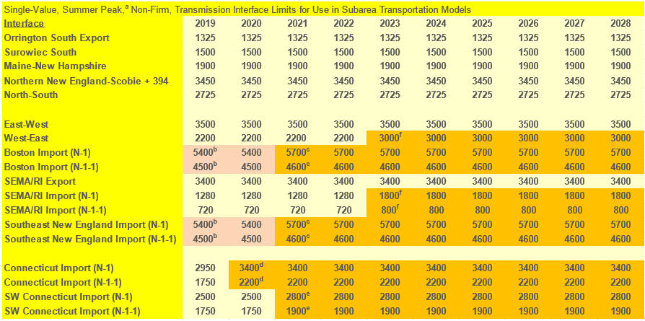
FCA 14 Internal Transmission Interface Transfer Capability (MW)
Notes are discussed in the following presentation:

Slide 55
FCA 14 Internal Transmission Interface Transfer Capability (Notes)
a) Limits are for the summer period, except where noted to be winter
The limits may not include possible simultaneous impacts and should not be considered as “firm”
For the years within the FCM horizon (CCP 2023-2024 and sooner), only accepted certified transmission projects are included when identifying transfer limits
For the years beyond the FCM horizon (CCP 2024-2025 and later), transmission upgrades with an approved proposed plan are included according to their expected in-service dates

Slide 56
FCA 14 Internal Transmission Interface Transfer Capability (Notes) (cont.)
b) Increase associated with the Greater Boston upgrades, without the Wakefield – Woburn 345 kV line (CCPs 2019-2020 and 2020-2021)
c) Increase associated with the Greater Boston upgrades, with the Wakefield – Woburn 345 kV line in service (CCP 2021-2022 and later)
d) Increase associated with the Greater Hartford/Central Connecticut upgrades
e) Increase associated with the Southwest Connecticut upgrades
f) Increase associated with the SEMA/RI Reliability project upgrades

