Slide 1
August 11-13, 2020 | MC TELECONFERENCE
Cost of New Entry and
Offer Review Trigger Prices
Modeling the system at equilibrium for the Net Cost of New Entry
Estimated revenue offsets associated with Energy Security Improvements
Deborah Cooke
413.540.4488 | dcooke@iso-ne.com

Slide 2
Cost of New Entry and Offer Review Trigger Prices
WMPP ID: 139
Proposed Effective Date: June 1, 2025 (CCP 16)
The recalculation of the Cost of New Entry (CONE), Net CONE, and Offer Review Trigger Prices (ORTPs) is being performed for the 2025-2026 Capacity Commitment Period (CCP)
Net CONE and ORTPs include energy and ancillary services (E&AS) revenue offsets
E&AS revenue offsets will include two adjustments
Net CONE: Level of Excess adjustment to the energy prices, to reflect a system at the equilibrium (i.e., at ICR)
Net CONE and ORTPs: Estimated revenues associated with the proposed Energy Security Improvements (ESI)
This presentation will:
Discuss the assumption of modeling Net CONE “at criterion” versus “as is”
Respond to several stakeholder questions from the July MC meeting
Provide the estimated revenue offsets associated with Energy Security Improvements

Slide 3
E&AS revenue offsets will account for (future) market conditions in CCP16
The Level of Excess (LOE) reflects the system at criterion
In accordance with the underlying design principles of the Forward Capacity Market and its MRI demand curve
E&AS revenues will be provided both with and without ESI revenue adjustments
Preliminary values based on most recent Concentric Energy Advisors (CEA) dispatch models are provided
E&AS revenues will also be provided both with and without Forward Reserve Market revenues
To account for the proposed sunset of the Forward Reserve Market beginning in CCP 16

Slide 4
Net CONE Modeling Assumptions
Modeling the system “at criterion” versus “as is”

Slide 5
Stakeholder question: Should Net CONE estimate assume the system has surplus capacity, rather than being at criterion?
ISO’s approach assumes that the system is at criterion for purposes of estimating Net CONE
More specifically, the ISO’s methodology calculates Gross CONE and then subtracts the resource’s expected energy and ancillary service revenues when the system is at net ICR (NICR) to calculate Net CONE
Stakeholders have asked if it is more appropriate to calculate these energy and ancillary service revenues reflecting the system at surplus (as it is presently)
Similar observations were raised in a presentation made by Robert Stoddard on behalf of NEPGA at the July Markets Committee

Slide 6
Using current (surplus) conditions would tend to increase Net CONE calculation relative to at criterion
The ISO does not propose to make such a change
Such an assumption will tend to reduce the expected energy and ancillary service revenues (as energy and ancillary service revenues decrease with capacity levels), and increase the Net CONE estimate above the ISO’s proposed value
This in turn would induce new competitive entry – even in cases where the system already has more capacity resources than necessary to meet its 1-day-in-10 reliability standard
Such an outcome is inconsistent with the FCM’s objectives of incenting sufficient capacity to meet the 1-in-10 reliability standard, on average over time ¹
Next: Illustrate this result using a simple numerical example
¹ As noted in the Design Principles for the FCM Zonal Demand Curve Methodology. See ISO New England Inc. and New England Power Pool, Filing of Demand Curve Design Improvements, Docket Nos. ER16-1434-000 (filed April 5, 2016), Attachment 2 (Technical Memo re Zonal Demand Curves)

Slide 7
A simple numerical example demonstrates the differences in the current and the alternative approach
Imagine that Gross CONE is $15/kW-mo. ¹
A competitive new entrant must expect to recover at least $15 in total between the capacity, energy, and ancillary service markets to enter
The table below highlights several (hypothetical) expected energy and ancillary service (E&AS) revenues and Marginal Reliability Impact (MRI) values (which are used to derive the FCM demand curve) as a function of total system capacity
System Capacity | Expected E&AS | MRI value
NICR – 500 MW | $8 | 0.11
NICR | $7 | 0.10
NICR + 500 MW | $6 | 0.09
NICR + 1000 MW | $5 | 0.08
¹ The numbers in this example are illustrative, and are not based on actual Net CONE and MRI parameter values

Slide 8
Calculating Net CONE under the ISO’s approach
Expected E&AS revenues at NICR are equal to $7
Subtracting this from the Gross CONE value of $15 yields a (hypothetical) Net CONE value of $8, and this yields the FCM demand curve values in the table below
Recall: The demand curve value is set so (i) the price is Net CONE at NICR, and (ii) all prices are proportional to the capacity’s MRI value
System Capacity | Demand curve value | E&AS | MRI value
NICR – 500 MW | $8.80 | $8 | 0.11
NICR | $8.00 (Net CONE) | $7 | 0.10
NICR + 500 MW | $7.20 | $6 | 0.09
NICR + 1000 MW | $6.60 | $5 | 0.08

Slide 9
ISO’s approach does not support competitive entry when system resources exceed NICR
Expect that entry will occur when the sum of FCM revenues (as specified by the demand curve) and E&AS revenues exceed Gross CONE of $15
System Capacity | Total Revenues | Demand curve value | E&AS
NICR – 500 MW | $16.80 | $8.80 | $8
NICR | $15.00 (Gross CONE) | $8.00 (Net CONE) | $7
NICR + 500 MW | $13.20 | $7.20 | $6
NICR + 1000 MW | $11.60 | $6.60 | $5
Generally supports entry when capacity levels are less than NICR
Importantly, does not support entry when capacity levels exceed NICR
Consistent with the intent of the capacity market, which is to ensure that the region has enough capacity to meet its 1-day-in-10 reliability standard

Slide 10
Net CONE under the alternate approach
Consider the E&AS value at a surplus of 1,000 MW
Analyzing other surplus values would show the same qualitative result
Subtract the expected (hypothetical) $5 in E&AS revenues at this surplus capacity quantity from the $15 Gross CONE to get a Net CONE value of $10, which produces the following demand curve values
System Capacity | Demand curve value | E&AS | MRI value
NICR – 500 MW | $11 | $8 | 0.11
NICR | $10 (Alt. Net CONE) | $7 | 0.10
NICR + 500 MW | $9 | $6 | 0.09
NICR + 1000 MW | $8 | $5 | 0.08

Slide 11
This alternative approach supports new entry even when system capacity exceeds NICR
Expect that entry will occur when the sum of FCM revenues (as specified by the demand curve), energy, and ancillary service revenues exceed (hypothetical) Gross CONE value of $15
System Capacity | Total Revenues | Demand curve value | E&AS
NICR – 500 MW | $19 | $11 | $8
NICR | $17 | $10 (Alt. Net CONE) | $7
NICR + 500 MW | $15 (Gross CONE) | $9 | $6
NICR + 1000 MW | $13 | $8 | $5
The alternative approach will tend to induce entry even when total system capacity resources are 500 MW over NICR, and no new entry is needed

Slide 12
Current approach is consistent with objectives of capacity market
The current approach is intended to lead to capacity procurements that meet the region’s 1-day-in-10 reliability standard, and not incent entry when existing capacity resources exceed this level
The alternative proposed would produce an “inflated” estimate of Net CONE that over-procures (unneeded) capacity
As shown in the numerical example, the FCM would procure an additional 500 MW of capacity in excess of NICR in equilibrium
This outcome is inconsistent with the objectives of the FCM

Slide 13
This example also extends to other Net CONE parameters, with similar conclusions
For example, stakeholders have questioned if the expected scarcity hours (H) used to estimate Net CONE should be calculated “at criterion” or “as is”, i.e., under current conditions
Using a value based on current conditions will tend to incent entry when system capacity exceeds the 1-in-10 reliability level, contrary to the FCM’s design objectives
Numerical example illustrating this point is included in Appendix A
Therefore, the current approach uses values for H and other Net CONE parameters based on a system at criterion

Slide 14
Additional observations regarding NEPGA’s July MC Presentation

Slide 15
NEPGA’s presentation offered several observations about the Net CONE calculation
The Stoddard presentation suggests that, in principle, the MRI-based demand curves should be set using Gross CONE, rather than Net CONE
This would tend to produce a “flatter” demand curve that specifies higher prices at capacity levels above NICR
Rather than seeking to modify the demand curves, NEPGA suggests estimating Net CONE using current conditions and suggests this methodology change will produce results similar to making the demand curve adjustment
NEPGA notes that Tariff language and FERC orders do not require the ISO to estimate Net CONE based on at criterion conditions
Next: The ISO offers initial observations and responses to NEPGA’s presentation

Slide 16
ISO has consistently maintained that Net CONE is set reflecting an at criterion system
Previous Net CONE filings clearly indicated the intent to set Net CONE in a system at criterion, and consistent with the demand curve objectives.
In 2014 (initial Net CONE calculation) the Newell/Ungate testimony noted:
“The prices and quantities of the proposed curve are premised on the assumption that, in a long-term economic equilibrium, new entrants will set average capacity market prices at Net CONE—where Net CONE is the first-year capacity revenue a new generation resource would need (in combination with expected energy and ancillary services margins) to recover its capital and fixed costs, given reasonable expectations about future cost recovery under continued equilibrium conditions.”
“Given that understanding of the role of the Net CONE in the sloped demand curve, our Net CONE estimation objective is to set capacity market prices just high enough to meet resource adequacy objectives by calculating Net CONE as accurately as possible, with particular care not to significantly understate it.”

Slide 17
ISO has consistently maintained that Net CONE is set reflecting an at criterion system (cont.)
In the ISO’s 2017 Net CONE filing:
Screening criteria applied to the Net CONE technology states it “Must be likely to be economic for merchant entry under long-term equilibrium conditions”
The final CEA report also states numerous times that the compensation received by the reference technology was evaluated under long-term equilibrium conditions, for example:
“...the CONE and Net CONE values are parameters used in the Forward Capacity Auctions (“FCA”) that are intended to reflect the compensation a new entrant would need from the capacity market (net of expected revenues) in the first year of operation to recover its capital and fixed costs under long-term equilibrium conditions...” (pg. 5)
FERC approved Net CONE based on this ‘at criterion’ methodology

Slide 18
NEPGA’s logic connecting the demand curves to an “as is” Net CONE calculation has other effects
Gross CONE-based demand curve would tend to produce a flatter demand curve (at least as constructed in Stoddard’s July MC presentation on slide 15)
However, using NEPGA’s proposed “as is” estimate of Net CONE would produce a steeper demand curve
This “steepening” of the demand curve does not seem to approximate the “flattening” Gross CONE-based demand curve concept
Moreover, as discussed earlier, using an “inflated” estimate of Net CONE will incent new entry even when the region already has more capacity than NICR, contrary to the reliability objective of the FCM

Slide 19
Stakeholder Questions
Responses to stakeholder questions from the July 14-15, 2020 Markets Committee
Level of excess (LOE) adjustment
Energy Security Improvements

Slide 20
Can the ISO provide more specifics on how Aurora modeled the system at equilibrium in the 2016 review?
Aurora modeled the system for the years from 2021 – 2040
Initial amount of capacity was based on actual supply (but was not assumed to be in excess in 2021)
New resources added:
New resources with a Capacity Supply Obligation
Offshore wind
Onshore wind up to RPS targets were added to the extent needed to meet the 15% reserve margin requirement in each load zone
Retired resources (scheduled, assumed, economic) were removed
Generic gas-fired generation was added if the system did not meet the level of equilibrium in each load zone (load forecast + 15%)
“... generic gas-fired generation was added to the capacity mix to maintain a reserve margin of 15% in each load zone for reliability purposes. Such resources were added in 2021, 2023, 2025, 2026, 2030, 2031, 2033, 2036, and 2037.”¹
¹ ISO-NE CONE and ORTP Analysis report dated January 13, 2017, pg. 56)

Slide 21
Can the ISO apply load-weightings to the LOE adjustment factor calculations?
The level-of-excess adjustment is calculated for three periods:
On-peak hours: HE 08 through HE 23, non-holiday weekdays
High on-peak hours: subset of on-peak hours, coincident with summer and winter intermittent reliability hours and all summer hours with a system-wide capacity scarcity condition
Off-peak hours: all non-on-peak hours
These three periods generally reflect different levels of load, and therefore already reflect some amount of load-weighting
The ISO does not expect that more precise load-weightings will have a material impact on the average hourly/monthly values calculated for each period type

Slide 22
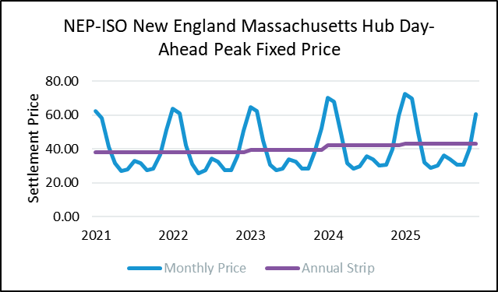
Has the ISO considered adjusting the LOE adjustment for fuel prices?
The LOE-AF calculation is based on differences in energy clearing prices using two different energy clearing price solutions
Fuel prices are not varied in that model
Inputs are consistent with the approach used to determine energy prices used in the dispatch models
Historical prices from the calendar years 2017, 2018, and 2019
No adjustment for future fuel prices
5-year power futures prices show little to no annual change
For these reasons, no adjustment is made to assume future fuel prices changes
Source: ICE NEP Futures Daily Market Report as of July 31, 2020

Slide 23
Can ISO detail the total LOE adjustment impact for the Net CONE technologies?
The table below summarizes the impact of the LOE adjustments for each candidate Net CONE technology
Technology | Average E&AS offset with LOE ($/kW-mo., 2025$) | Average E&AS offset without LOE ($/kW-mo., 2025$) | Difference ($/kW-mo., 2025$)
Simple Cycle, FRM Sunset | $2.85 | $2.56 | $0.29
Simple Cycle with FRM | $3.49 | $3.30 | $0.18
Combined Cycle | $5.08 | $4.58 | $0.50
Aeroderivative, FRM Sunset | $2.42 | $2.19 | $0.22
Aeroderivative, with FRM | $3.28 | $3.11 | $0.17
Note: values may reflect rounding

Slide 24
Please clarify what is included in the energy options category of the ESI adjustment
Expected changes in total payments for day-ahead (DA) energy options from ESI are based on the following formula:
$DA Energy Option Net Revenues$ ($/MW) = Net DA Energy Option Revenues ($/MW) - Incremental Holding Costs ($/MW)
Where:
Net DA Energy Option Revenues estimates the average net revenue across the different energy option products
Incremental Holding Costs estimates costs associated with holding incremental oil inventory to support the sale of the options (for resources with oil tanks)
This methodology captures estimated net energy option revenues, accounting for option revenues and closeout costs, and product allocation across Energy Imbalance Reserve, Generation Contingency Reserve, and Replacement Energy Reserve
See FCA15 Energy Security Estimate for FCM Offers for more detail

Slide 25
Can the ISO provide more detail on how historical winter and non-winter seasons were classified for purposes of weighting the ESI revenue offsets?
The Central Case scenarios used in the ESI Impact Analysis included three winter season cases and two non-winter season cases:
ISO evaluated temperature profiles of the past 20 seasons (winter/non-winter) and categorized each season into one of these categories
Details regarding the analysis performed and category criteria applied are included in Appendix D
Season | Category
Winter | Extended Stressed
 | Frequently Stressed
 | Infrequently Stressed
Non-Winter | Severe
 | Moderate

Slide 26
Energy Security Improvements
Incremental revenue offsets for the Net CONE and ORTP modeled technologies
ISO proposal
NEPOOL proposal

Slide 27
Estimated ESI revenues will be included in the Net CONE and ORTP calculations
As discussed in the July 2020 Markets Committee meeting, ESI revenue offsets will be estimated under both the ISO and NEPOOL filed proposals
Revenues will be estimated using results of the Energy Security Improvements Impact Analysis
Examples for weighting results from the three winter and two non-winter cases were provided
The following slides provide preliminary estimated revenue offsets for each modeled Net CONE and ORTP technology

Slide 28
Summary of estimated ESI revenue offsets Net CONE Technologies – ISO Proposal
Technology Type | Incr. Payments to Generation ($/kW-mo.) | Incr. Payments to Capacity ($/kW-mo.) | Total 2020$ ($/kW-mo.) | Total 2025$ ($/kW-mo.)
Combustion Turbine – FRM Sunset | -$0.207 | $0.589 | $0.383 | $0.423
Combustion Turbine – with FRM | -$0.104 | $0.589 | $0.485 | $0.535
Combined Cycle | 0.290 | $0.001 | $0.291 | $0.321
Aeroderivative – FRM Sunset | -$0.164 | $0.612 | $0.448 | $0.495
Aeroderivative – with FRM | -$0.091 | $0.612 | $0.521 | $0.575
Incremental Payments to Generation = revenue from LMPs and Forecast Energy Requirement
Incremental Payments to Capacity = net option revenue minus holding costs
Detailed calculations are in Appendix B
Note: values may reflect rounding

Slide 29
Summary of estimated ESI revenue offsets Net CONE Technologies – NEPOOL Proposal
Technology Type | Incr. Payments to Generation ($/kW-mo.) | Incr. Payments to Capacity ($/kW-mo.) | Total 2020$ ($/kW-mo.) | Total 2025$ ($/kW-mo.)
Combustion Turbine – FRM Sunset | $0.081 | $0.265 | $0.346 | $0.382
Combustion Turbine – with FRM | $0.043 | $0.265 | $0.307 | $0.339
Combined Cycle | $0.200 | $0.000 | $0.200 | $0.221
Aeroderivative – FRM Sunset | $0.062 | $0.289 | $0.351 | $0.388
Aeroderivative – with FRM | $0.038 | $0.289 | $0.327 | $0.361
Incremental Payments to Generation = revenue from LMPs and Forecast Energy Requirement
Incremental Payments to Capacity = net option revenue minus holding costs
Detailed calculations are in Appendix C
Note: values may reflect rounding

Slide 30
Summary of estimated ESI revenue offsets ORTP Technologies - ISO proposal
Technology Type | Incr. Payments to Generation ($/kW-mo.) | Incr. Payments to Capacity ($/kW-mo.) | Total 2020$ ($/kW-mo.) | Total 2025$ ($/kW-mo.)
Combustion Turbine – FRM Sunset | $0.019 | $0.310 | $0.329 | $0.363
Combustion Turbine – with FRM | $0.009 | $0.310 | $0.319 | $0.352
Combined Cycle | $0.347 | $0.015 | $0.363 | $0.401
On-Shore Wind | $0.067 | $0.000 | $0.067 | $0.074
Off-Shore Wind | $0.074 | $0.000 | $0.074 | $0.082
Solar | $0.023 | $0.000 | $0.023 | $0.025
Battery – FRM Sunset | $0.002 | $0.000 | $0.003 | $0.003
Battery – with FRM | $0.001 | $0.000 | $0.001 | $0.001
Combined Solar/Battery | $0.019 | $0.000 | $0.019 | $0.021
Incremental Payments to Generation = revenue from LMPs and Forecast Energy Requirement
Incremental Payments to Capacity = net option revenue minus holding costs
Detailed calculations are in Appendix B Note: values may reflect rounding

Slide 31
Summary of estimated ESI revenue offsets ORTP Technologies – NEPOOL proposal
Technology Type | Incr. Payments to Generation ($/kW-mo.) | Incr. Payments to Capacity ($/kW-mo.) | Total 2020$ ($/kW-mo.) | Total 2025$ ($/kW-mo.)
Combustion Turbine – FRM Sunset | $0.009 | $0.001 | $0.009 | $0.010
Combustion Turbine – with FRM | $0.004 | $0.001 | $0.005 | $0.006
Combined Cycle | $0.198 | $0.000 | $0.198 | $0.219
On-Shore Wind | $0.042 | $0.000 | $0.042 | $0.046
Off-Shore Wind | $0.050 | $0.000 | $0.050 | $0.055
Solar | $0.010 | $0.000 | $0.010 | $0.011
Battery – FRM Sunset | $0.002 | $0.000 | $0.002 | $0.002
Battery – with FRM | $0.001 | $0.000 | $0.001 | $0.001
Combined Solar/Battery | $0.014 | $0.000 | $0.014 | $0.015
Incremental Payments to Generation = revenue from LMPs and Forecast Energy Requirement
Incremental Payments to Capacity = net option revenue minus holding costs
Detailed calculations are in Appendix C Note: values may reflect rounding

Slide 32
Conclusion & Next Steps
A Level of Excess adjustment will be applied in the E&AS revenue calculations for Net CONE technologies, to reflect the system at equilibrium
In accordance with the underlying design principles of the Forward Capacity Market
E&AS revenue offsets will be calculated to reflect both current and proposed (future) market conditions in CCP16, including:
Revenue impacts from ESI, both as proposed by ISO and as proposed by NEPOOL
With and without estimated Forward Reserve Market revenue due to the proposed sunset of the Forward Reserve Market

Slide 33
Stakeholder Schedule
Stakeholder Committee and Date | Scheduled Project Milestone
Markets Committee June 10, 2020 | Review initial projections of potential revenue offsets associated with FRM sunset
Markets Committee July 14-16, 2020 | Review initial projections of potential revenue offsets associated with ESI and initial discussion of proposed level of excess adjustment methodology
Markets Committee August 11-13, 2020 | Review modeling the system at equilibrium for the Net Cost of New Entry Continued discussion of revenue offsets
Markets Committee September 8-10, 2020 | Continued discussion of revenue offsets
Markets Committee October 6-7, 2020 | Final review and MC vote on FCM parameter updates
Participants Committee November 5, 2020 | PC vote
December 2020 | FERC Filing

Slide 35
Acronyms Used in this Presentation
CCP = Capacity Commitment Period
CPP = Capacity Performance Payment
CONE = Cost of New Entry
E&AS = Energy & Ancillary Services
ESI = Energy Security Improvements
FCM = Forward Capacity Market
FRM = Forward Reserve Market
ICR = Installed Capacity Requirement
LMP = Locational Marginal Price
LOE = Level of Excess
MRI = Marginal Reliability Impact
NICR = Net Installed Capacity Requirement
ORTP = Offer Review Trigger Price

Slide 36
Appendix A
Additional numerical example that considers impact of using expected scarcity hours (H) “at criterion” versus “as is”

Slide 37
Capacity performance payments affect Net CONE much like energy and ancillary service revenues
Capacity performance payments represent (a) a credit to resources that “overperform” during scarcity conditions, and (b) a charge to resources that “underperform”
Generally, a resource’s expected annual credit or charge will depend on two factors:
The resource’s expected performance during scarcity conditions
The expected quantity of scarcity hours, H
Much like energy or ancillary service revenues, expected capacity performance payment (CPP) credits impact the Net CONE value as any such credits reduce the “missing money” that must be recovered via the FCM clearing price

Slide 38
Calculating H based on the current system will produce a lower quantity of scarcity hours and higher Net CONE than at criterion
If the Net CONE methodology estimates the quantity of scarcity hours based on the current “long” system conditions, it will produce a lower H value than at criterion
Because the candidate Net CONE technologies are assumed to earn positive CPPs during scarcity conditions, this reduction in H decreases their estimated CPPs and thereby increases the “missing money” that the resource must recover via the FCM
This logic is similar to that explained earlier in the presentation regarding energy and ancillary service revenue
Next: Numerical example that illustrates how estimating H based on current “as is” conditions incents competitive new entry when the system is “long” of its 1-day-in-10 reliability standard

Slide 39
Appendix Example: Numerical Assumptions
Assume a Gross CONE value of $15
Assume the (hypothetical) E&AS revenues, expected CPP credits, and MRI values at various total capacity supply levels shown below
Assume H value “as is” corresponds to NICR + 1000 MW
System Capacity | E&AS + CPP | MRI value
NICR – 500 MW | $10 | 0.09
NICR | $9 | 0.08
NICR + 500 MW | $8 | 0.07
NICR + 1000 MW | $7 | 0.06

Slide 40
ISO’s proposed approach to setting Net CONE
System Capacity | Total Revenues | Demand curve value | E&AS + CPP | MRI value
NICR – 500 MW | $16.75 | $6.75 | $10 | 0.09
NICR | $15 | $6 | $9 | 0.08
NICR + 500 MW | $13.25 | $5.25 | $8 | 0.07
NICR + 1000 MW | $11.50 | $4.50 | $7 | 0.06
Net CONE (hypothetical) is set at $6, though ‘as is’ capacity is NICR + 1000 MW with fewer scarcity hours (so lower E&AS + CPP by $2)
This value supports competitive new entry up to point where system is at NICR
At this capacity level, the net revenues produced by the demand curve, energy and AS, and CPP sum to Gross CONE value of $15
This result is consistent with ‘1-in-10’ reliability objectives of the FCM

Slide 41
Alternate approach to setting Net CONE
System Capacity | Total Revenues | Demand curve value | E&AS + CPP | MRI value
NICR – 500 MW | $19 | $9 | $10 | 0.09
NICR | $17 | $8 | $9 | 0.08
NICR + 500 MW | $15 | $7 | $8 | 0.07
NICR + 1000 MW | $13 | $6 | $7 | 0.06
Supports competitive new entry up to point where system is at NICR+500 MW, as the net revenues at this capacity level sum to Gross CONE value of $15
This result is not consistent with FCM’s objectives, as it would tend to systematically over-procure (unneeded) capacity in the FCM

Slide 42
ISO’s proposal more appropriately accounts for resources without a CSO
Stakeholders questioned if the Net CONE calculation should account for the impacts of resources that may sell energy and ancillary services, but do not acquire CSOs
As noted previously, the ISO’s approach does not support competitive new entry when total system capacity exceeds NICR
An alternate proposal considering these contributions when estimating Net CONE:
Reduces energy and ancillary service revenues
Increases Net CONE estimate and will therefore procure more capacity than ISO’s approach
Will tend to procure more capacity than the ISO’s approach, leading to a system that will over-procure capacity that is unneeded to meet the 1-in-10 standard
ISO’s approach is more aligned with FCM’s objectives

Slide 43
Appendix B
Incremental Energy Security Improvements revenue offsets for the Net CONE and ORTP modeled technologies
ISO proposal

Slide 44
Incremental ESI revenue offsets Net CONE Technologies – ISO Proposal
 | Technology
Description | New Entrant - CT, FRM Sunset | New Entrant - CT, With FRM | New Entrant - Combined Cycle | New Entrant - Aero, FRM Sunset | New Entrant - Aero, With FRM
Nominal Capacity (MW) | 376.0 | 376.0 | 535.0 | 94.0 | 94.0
Winter Dispatch Capacity (MW) | 394.1 | 394.1 | 584.6 | 110.7 | 110.7
Summer Dispatch Capacity (MW) | 363.8 | 363.8 | 539.4 | 89.1 | 89.1
Incremental Payments to Generation
Winter: Weighted Final Value ($/MWh) | -$1.79 | -$1.79 | $0.58 | -$1.79 | -$1.79
Day-Ahead Generation (MWh) | 55,180 | 24,831 | 864,634 | 11,771 | 5,203
Weighted Final Incremental Payments ($, 3-Month) | -$98,652 | -$44,393 | $505,807 | -$21,044 | -$9,302
Non-Winter: Weighted Final Value ($/MWh) | -$8.27 | -$8.27 | $0.52 | -$8.27 | -$8.27
Day-Ahead Generation (MWh) | 100,959 | 51,443 | 2,602,399 | 19,763 | 11,295
Weighted Final Incremental Payments ($, 9-Month) | -$834,840 | -$425,387 | $1,356,892 | -$163,422 | -$93,399
Combined Weighted Final Incremental Payments ($, 12-Month) | -$933,492 | -$469,781 | $1,862,699 | -$184,467 | -$102,701
Combined Weighted Final Incremental Payments ($/kW-mo.) | -$0.207 | -$0.104 | $0.290 | -$0.164 | -$0.091
Incremental Payments to Capacity
Winter: Weighted Final Payments ($/MW, 3-Month) | $2,730 | $2,730 | $0 | $2,730 | $2,730
Weighted Final Incremental Payments ($, 3-Month) | $1,075,778 | $1,075,778 | $0 | $302,179 | $302,179
Non-Winter: Weighted Final Payments ($/MW, 9-Month) | $4,353 | $4,353 | $8 | $4,353 | $4,353
Weighted Final Incremental Payments ($, 9-Month) | $1,583,656 | $1,583,656 | $4,277 | $387,861 | $387,861
Combined Weighted Final Payments ($, 12-Month) | $2,659,434 | $2,659,434 | $4,277 | $690,039 | $690,039
Combined Weighted Final Payments ($/kW-mo.) | $0.589 | $0.589 | $0.001 | $0.612 | $0.612
Change In Total Payments ($, 12-Month) | $1,725,942 | $2,189,654 | $1,866,975 | $505,573 | $587,338
Change In Total Payments ($/kW-mo.) | $0.383 | $0.485 | $0.291 | $0.448 | $0.521

Slide 45
Incremental ESI revenue offsets ORTP Technologies – ISO Proposal
 | Technology
Description | CT, FRM Sunset | NCT, With FRM | Combined Cycle
Nominal Capacity (MW) | 376.0 | 376.0 | 535.0
Winter Dispatch Capacity (MW) | 394.1 | 394.1 | 584.6
Summer Dispatch Capacity (MW) | 363.8 | 363.8 | 539.4
Incremental Payments to Generation
Winter: Weighted Final Value ($/MWh) | $0.27 | $0.27 | $0.42
Day-Ahead Generation (MWh) | 45,195 | 22,598 | 791,567
Weighted Final Incremental Payments ($, 3-Month) | $12,103 | $6,052 | $335,916
Non-Winter: Weighted Final Value ($/MWh) | $0.87 | $0.87 | $0.71
Day-Ahead Generation (MWh) | 83,009 | 39,904 | 2,659,194
Weighted Final Incremental Payments ($, 9-Month) | $72,122 | $34,670 | $1,892,423
Combined Weighted Final Incremental Payments ($, 12-Month) | $84,224 | $40,722 | $2,228,339
Combined Weighted Final Incremental Payments ($/kW-mo.) | $0.019 | $0.009 | $0.347
Incremental Payments to Capacity
Winter: Weighted Final Payments ($/MW, 3-Month) | $1,178 | $1,178 | $0
Weighted Final Incremental Payments ($, 3-Month) | $464,316 | $464,316 | $0
Non-Winter: Weighted Final Payments ($/MW, 9-Month) | $2,571 | $2,571 | $184
Weighted Final Incremental Payments ($, 9-Month) | $935,432 | $935,432 | $99,499
Combined Weighted Final Payments ($, 12-Month) | $1,399,748 | $1,399,748 | $99,499
Combined Weighted Final Payments ($/kW-mo.) | $0.310 | $0.310 | $0.015
Change In Total Payments ($, 12-Month) | $1,483,972 | $1,440,469 | $2,327,838
Change In Total Payments ($/kW-mo.) | $0.329 | $0.319 | $0.363

Slide 46
Incremental ESI revenue offsets ORTPs Technologies – ISO Proposal (cont.)
 | Technology
Description | On-Shore Wind | Offshore Wind | Solar
Nominal Capacity (MW) | 82.5 | 800.0 | 20.0
Winter Dispatch Capacity (MW) | 82.5 | 800.0 | 20.0
Summer Dispatch Capacity (MW) | 82.5 | 800.0 | 20.0
Incremental Payments to Generation
Winter: Weighted Final Value ($/MWh) | $0.22 | $0.34 | $0.05
Day-Ahead Generation (MWh) | 51,125 | 511,684 | 2,336
Weighted Final Incremental Payments ($, 3-Month) | $11,054 | $172,140 | $123
Non-Winter: Weighted Final Value ($/MWh) | $0.48 | $0.42 | $0.41
Day-Ahead Generation (MWh) | 113,960 | 1,278,661 | 13,603
Weighted Final Incremental Payments ($, 9-Month) | $55,031 | $541,721 | $5,510
Combined Weighted Final Incremental Payments ($, 12-Month) | $66,086 | $713,861 | $5,633
Combined Weighted Final Incremental Payments ($/kW-mo.) | $0.067 | $0.074 | $0.023
Incremental Payments to Capacity
Winter: Weighted Final Payments ($/MW, 3-Month) | $0 | $0 | $0
Weighted Final Incremental Payments ($, 3-Month) | $0 | $0 | $0
Non-Winter: Weighted Final Payments ($/MW, 9-Month) | $0 | $0 | $0
Weighted Final Incremental Payments ($, 9-Month) | $0 | $0 | $0
Combined Weighted Final Payments ($, 12-Month) | $0 | $0 | $0
Combined Weighted Final Payments ($/kW-mo.) | $0.000 | $0.000 | $0.000
Change In Total Payments ($, 12-Month) | $66,086 | $713,861 | $5,633
Change In Total Payments ($/kW-mo.) | $0.067 | $0.074 | $0.023

Slide 47
Incremental ESI revenue offsets ORTPs Technologies – ISO Proposal (cont.)
 | Technology
Description | Battery, FRM Sunset | Battery, with FRM | Combined Solar/Battery
Nominal Capacity (MW) | 150.0 | 150.0 | 15.0
Winter Dispatch Capacity (MW) | 150.0 | 150.0 | 15.0
Summer Dispatch Capacity (MW) | 150.0 | 150.0 | 15.0
Incremental Payments to Generation
Winter: Weighted Final Value ($/MWh) | $0.27 | $0.27 | $0.27
Day-Ahead Generation (MWh) | 7,300 | 2,300 | 970
Weighted Final Incremental Payments ($, 3-Month) | $1,940 | $611 | $258
Non-Winter: Weighted Final Value ($/MWh) | $0.54 | $0.54 | $0.54
Day-Ahead Generation (MWh) | 3,950 | 2,250 | 6,031
Weighted Final Incremental Payments ($, 9-Month) | $2,125 | $1,211 | $3,245
Combined Weighted Final Incremental Payments ($, 12-Month) | $4,066 | $1,822 | $3,503
Combined Weighted Final Incremental Payments ($/kW-mo.) | $0.002 | $0.001 | $0.019
Incremental Payments to Capacity
Winter: Weighted Final Payments ($/MW, 3-Month) | $3 | $3 | $0
Weighted Final Incremental Payments ($, 3-Month) | $464 | $464 | $0
Non-Winter: Weighted Final Payments ($/MW, 9-Month) | $2 | $2 | $0
Weighted Final Incremental Payments ($, 9-Month) | $251 | $251 | $0
Combined Weighted Final Payments ($, 12-Month) | $714 | $714 | $0
Combined Weighted Final Payments ($/kW-mo.) | $0.000 | $0.000 | $0.000
Change In Total Payments ($, 12-Month) | $4,780 | $2,536 | $3,503
Change In Total Payments ($/kW-mo.) | $0.003 | $0.001 | $0.019

Slide 48
Appendix C
Incremental Energy Security Improvements revenue offsets for the Net CONE and ORTP modeled technologies
NEPOOL proposal

Slide 49
Incremental ESI revenue offsets Net CONE Technologies – NEPOOL Proposal
 | Technology
Description | New Entrant - CT, FRM Sunset | New Entrant - CT, With FRM | New Entrant - Combined Cycle | New Entrant - Aero, FRM Sunset | New Entrant - Aero, With FRM
Nominal Capacity (MW) | 376.0 | 376.0 | 535.0 | 94.0 | 94.0
Winter Dispatch Capacity (MW) | 394.1 | 394.1 | 584.6 | 110.7 | 110.7
Summer Dispatch Capacity (MW) | 363.8 | 363.8 | 539.4 | 89.1 | 89.1
Incremental Payments to Generation
Winter: Weighted Final Value ($/MWh) | -$1.91 | -$1.91 | $0.48 | -$1.91 | -$1.91
Day-Ahead Generation (MWh) | 55,180 | 24,831 | 864,634 | 11,845 | 5,203
Weighted Final Incremental Payments ($, 3-Month) | -$105,309 | -$47,389 | $414,856 | -$22,606 | -$9,930
Non-Winter: Weighted Final Value ($/MWh) | $4.67 | $4.67 | $0.33 | $4.67 | $4.67
Day-Ahead Generation (MWh) | 100,959 | 51,443 | 2,602,399 | 19,763 | 11,295
Weighted Final Incremental Payments ($, 9-Month) | $471,716 | $240,360 | $869,269 | $92,340 | $52,774
Combined Weighted Final Incremental Payments ($, 12-Month) | $366,407 | $192,971 | $1,284,125 | $69,734 | $42,844
Combined Weighted Final Incremental Payments ($/kW-mo.) | $0.081 | $0.043 | $0.200 | $0.062 | $0.038
Incremental Payments to Capacity
Winter: Weighted Final Payments ($/MW, 3-Month) | $2,366 | $2,366 | $0 | $2,366 | $2,366
Weighted Final Incremental Payments ($, 3-Month) | $932,288 | $932,288 | $0 | $261,873 | $261,873
Non-Winter: Weighted Final Payments ($/MW, 9-Month) | $718 | $718 | $2 | $718 | $718
Weighted Final Incremental Payments ($, 9-Month) | $261,213 | $261,213 | $964 | $63,975 | $63,975
Combined Weighted Final Payments ($, 12-Month) | $1,193,501 | $1,193,501 | $964 | $325,848 | $325,848
Combined Weighted Final Payments ($/kW-mo.) | $0.265 | $0.265 | $0.000 | $0.289 | $0.289
Change In Total Payments ($, 12-Month) | $1,559,907 | $1,386,471 | $1,285,089 | $395,582 | $368,693
Change In Total Payments ($/kW-mo.) | $0.346 | $0.307 | $0.200 | $0.351 | $0.327

Slide 50
Incremental ESI revenue offsets ORTPs Technologies – NEPOOL Proposal
 | Technology
Description | CT, FRM Sunset | CT, With FRM | Combined Cycle
Nominal Capacity (MW) | 394.1 | 394.1 | 584.6
Winter Dispatch Capacity (MW) | 394.1 | 394.1 | 584.6
Summer Dispatch Capacity (MW) | 363.8 | 363.8 | 539.4
Incremental Payments to Generation
Winter: Weighted Final Value ($/MWh) | $0.09 | $0.09 | $0.24
Day-Ahead Generation (MWh) | 45,195 | 22,598 | 791,567
Weighted Final Incremental Payments ($, 3-Month) | $3,847 | $1,924 | $191,035
Non-Winter: Weighted Final Value ($/MWh) | $0.42 | $0.42 | $0.41
Day-Ahead Generation (MWh) | 83,009 | 39,904 | 2,659,194
Weighted Final Incremental Payments ($, 9-Month) | $35,001 | $16,826 | $1,080,926
Combined Weighted Final Incremental Payments ($, 12-Month) | $38,848 | $18,749 | $1,271,962
Combined Weighted Final Incremental Payments ($/kW-mo.) | $0.008 | $0.004 | $0.181
Incremental Payments to Capacity
Winter: Weighted Final Payments ($/MW, 3-Month) | $984 | $984 | $0
Weighted Final Incremental Payments ($, 3-Month) | $387,977 | $387,977 | $0
Non-Winter: Weighted Final Payments ($/MW, 9-Month) | $615 | $615 | $53
Weighted Final Incremental Payments ($, 9-Month) | $223,782 | $223,782 | $28,635
Combined Weighted Final Payments ($, 12-Month) | $2,571 | $2,571 | $184
Combined Weighted Final Payments ($/kW-mo.) | $0.001 | $0.001 | $0.000
Change In Total Payments ($, 12-Month) | $41,420 | $21,321 | $1,272,146
Change In Total Payments ($/kW-mo.) | $0.009 | $0.005 | $0.181

Slide 51
Incremental ESI revenue offsets ORTPs Technologies – NEPOOL Proposal (cont.)
 | Technology
Description | On-shore Wind | Offshore Wind | Solar
Nominal Capacity (MW) | 82.5 | 800.0 | 20.0
Winter Dispatch Capacity (MW) | 82.5 | 800.0 | 20.0
Summer Dispatch Capacity (MW) | 82.5 | 800.0 | 20.0
Incremental Payments to Generation
Winter: Weighted Final Value ($/MWh) | $0.09 | $0.22 | -$0.05
Day-Ahead Generation (MWh) | 48,232 | 511,684 | 2,336
Weighted Final Incremental Payments ($, 3-Month) | $4,482 | $112,383 | -$111
Non-Winter: Weighted Final Value ($/MWh) | $0.33 | $0.29 | $0.18
Day-Ahead Generation (MWh) | 107,510 | 1,278,661 | 13,603
Weighted Final Incremental Payments ($, 9-Month) | $35,026 | $368,976 | $2,442
Combined Weighted Final Incremental Payments ($, 12-Month) | $39,508 | $481,359 | $2,332
Combined Weighted Final Incremental Payments ($/kW-mo.) | $0.040 | $0.050 | $0.010
Incremental Payments to Capacity
Winter: Weighted Final Payments ($/MW, 3-Month) | $0 | $0 | $0
Weighted Final Incremental Payments ($, 3-Month) | $0 | $0 | $0
Non-Winter: Weighted Final Payments ($/MW, 9-Month) | $0 | $0 | $0
Weighted Final Incremental Payments ($, 9-Month) | $0 | $0 | $0
Combined Weighted Final Payments ($, 12-Month) | $0 | $0 | $0
Combined Weighted Final Payments ($/kW-mo.) | $0.000 | $0.000 | $0.000
Change In Total Payments ($, 12-Month) | $39,508 | $481,359 | $2,332
Change In Total Payments ($/kW-mo.) | $0.040 | $0.050 | $0.010

Slide 52
Incremental ESI revenue offsets ORTPs Technologies – NEPOOL Proposal (cont.)
 | Technology
Description | Battery Storage, FRM Sunset | Battery Storage, No FRM | Combined Solar/Battery
Nominal Capacity (MW) | 150.0 | 150.0 | 15.0
Winter Dispatch Capacity (MW) | 150.0 | 150.0 | 15.0
Summer Dispatch Capacity (MW) | 150.0 | 150.0 | 15.0
Incremental Payments to Generation
Winter: Weighted Final Value ($/MWh) | $0.20 | $0.20 | $0.20
Day-Ahead Generation (MWh) | 7,300 | 2,300 | 970
Weighted Final Incremental Payments ($, 3-Month) | $1,482 | $467 | $197
Non-Winter: Weighted Final Value ($/MWh) | $0.38 | $0.38 | $0.38
Day-Ahead Generation (MWh) | 3,950 | 2,250 | 6,031
Weighted Final Incremental Payments ($, 9-Month) | $1,511 | $861 | $2,307
Combined Weighted Final Incremental Payments ($, 12-Month) | $2,993 | $1,328 | $2,504
Combined Weighted Final Incremental Payments ($/kW-mo.) | $0.002 | $0.001 | $0.014
Incremental Payments to Capacity
Winter: Weighted Final Payments ($/MW, 3-Month) | $3 | $3 | $0
Weighted Final Incremental Payments ($, 3-Month) | $416 | $416 | $0
Non-Winter: Weighted Final Payments ($/MW, 9-Month) | $1 | $1 | $0
Weighted Final Incremental Payments ($, 9-Month) | $167 | $0 | $0
Combined Weighted Final Payments ($, 12-Month) | $0 | $0 | $0
Combined Weighted Final Payments ($/kW-mo.) | $0.000 | $0.000 | $0.000
Change In Total Payments ($, 12-Month) | $2,993 | $1,328 | $2,504
Change In Total Payments ($/kW-mo.) | $0.002 | $0.001 | $0.014

Slide 53
Appendix D
Analysis to derive Winter and Non-Winter category ratings for Energy Security Improvements revenue offsets

Slide 54
Approach to developing season weightings
An analysis of the temperature profiles of the seasons used in the ESI Impact Analysis was performed
The analysis focused on two weather measures that affect load and system operations in New England: temperature and dew points.
Data from 8 New England airport locations
Season | Central Case Category
Winter | Extended Stressed
 | Frequently Stressed
 | Infrequently Stressed
Non-Winter | Severe
 | Moderate

Slide 55
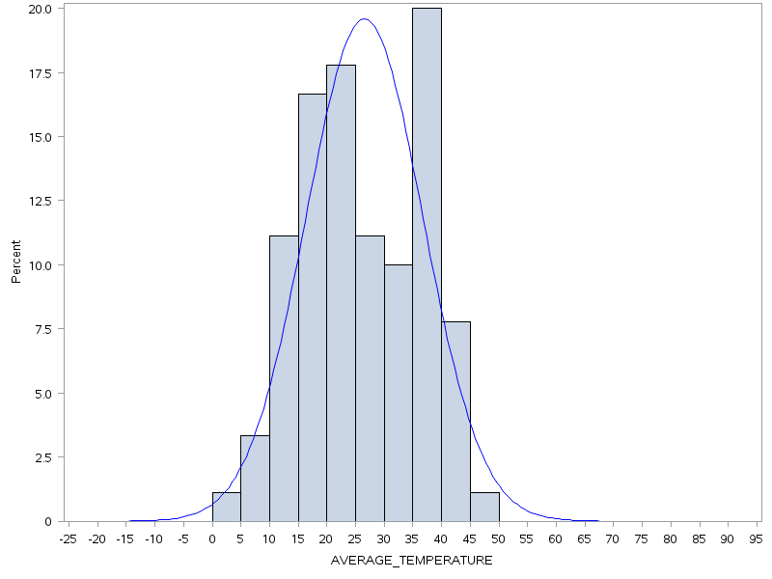
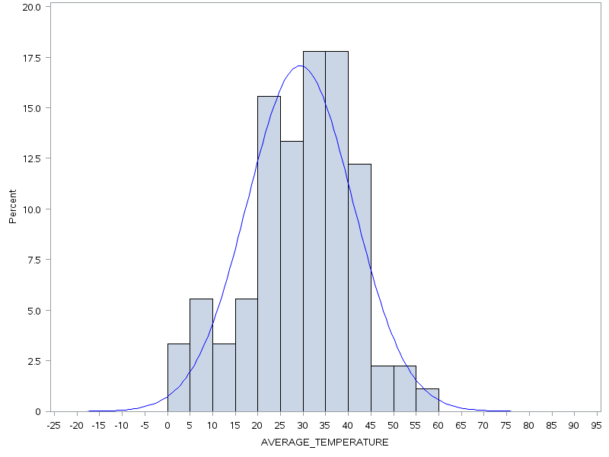
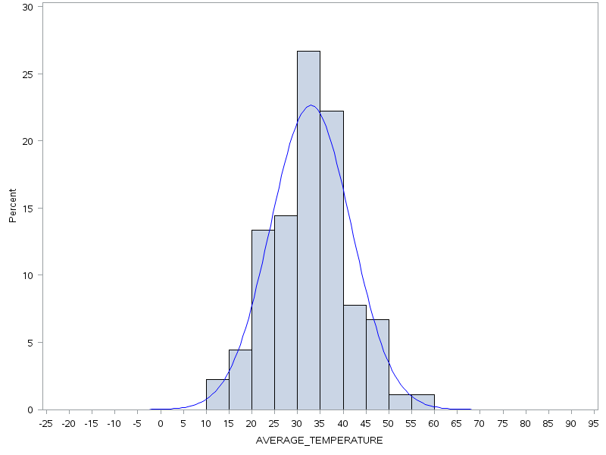
Approach to developing season weightings: Winter season
Temperature profiles were analyzed for each winter Central Case
Analyses highlighted that the frequently stressed season (2013-14) had numerous days with temperatures less than 10°F and the extended stressed season (2017-18) showed consecutive days with temperatures less than 10°F
Average Temperatures
Frequently Stressed Winter (2013-14)
Average Temperatures
Extended Stressed Winter (2017-18)
Average Temperatures
Infrequently Stressed Winter (2016-17)

Slide 56
Approach to developing season weightings: Winter season (cont.)
The following criteria were developed and applied to classify all other winter seasons in the 20-year review period into one of the three categories
Category | Winter Season Criteria
Extended Stressed | A winter period with five or more consecutive days with an average daily temperature of 10°F or less
Frequently Stressed | A winter period not classified as Extended, with 15 or more days with a minimum daily temperature of 10°F or less
Infrequently Stressed | All winter periods not classified as Extended or Frequent

Slide 57
Approach to developing season weightings: Non-winter seasons
Temperature profiles were analyzed for each non-winter Central Case
Analyses (next slide) identified that the severe non-winter season (2018) had numerous days with temperatures consecutive days with temperatures at or above 85°F and/or dew points at or above 70
The following criteria were applied to classify all other non-winter seasons in the 20-year review period into one of the two categories
Category | Criteria
Severe | Contains both: two or more three-day events with temperatures at or above 85°F and two or more three-day events with dew points at or above 70; or Contains three or more four-day events with temperatures at or above 85°F and/or dew points at or above 70
Moderate | All non-winter periods not classified as Severe

Slide 58
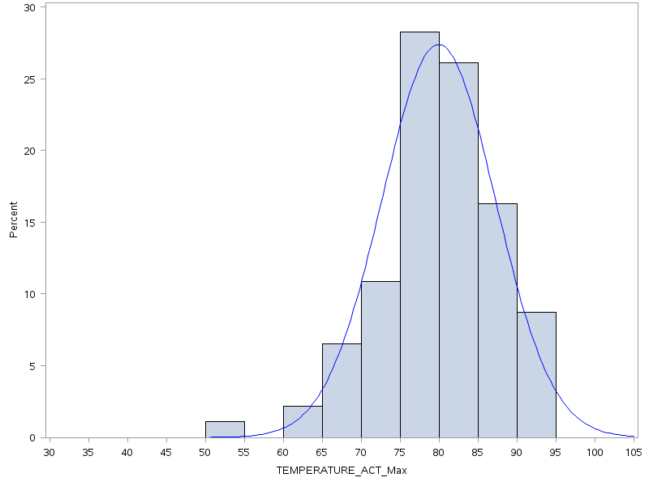
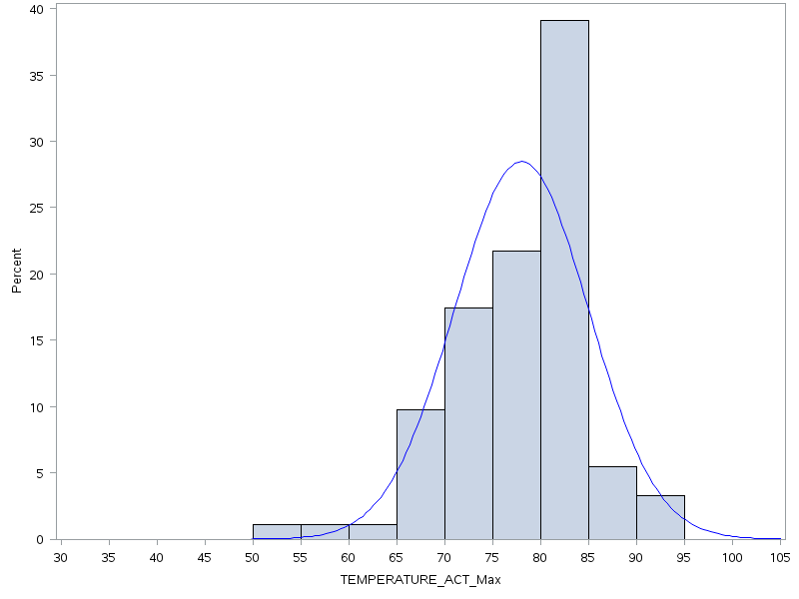
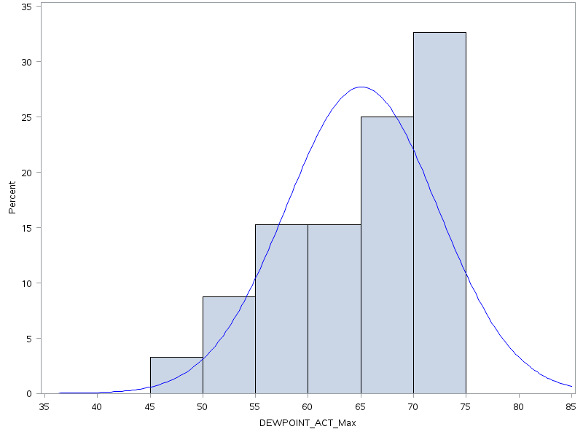
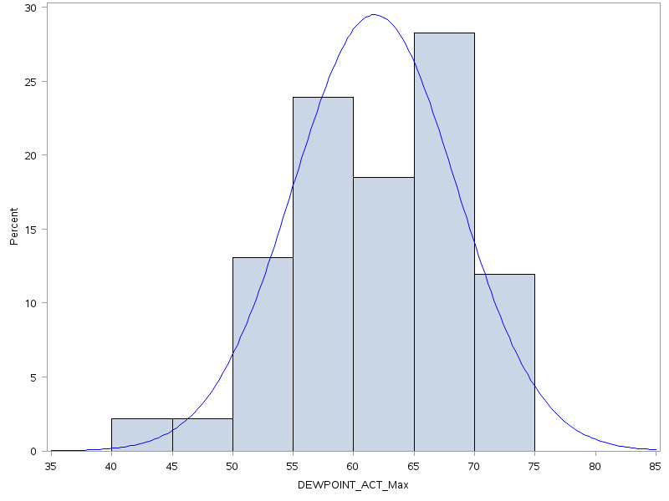
Approach to developing season weightings: Non-winter seasons (cont.)
Maximum Temperatures
Severe Non-Winter Season (2018)
Maximum Temperatures
Moderate Non-Winter Season (2017)
Maximum Dew Points
Severe Non-Winter Season (2018)
Maximum Dew Points
Moderate Non-Winter Season (2017)

Slide 59
Summary of season results
Season | Category | Total Seasons Evaluated | Category Seasons | Percent
Winter | Extended Stressed | 20 | 2 | 10%
 | Frequently Stressed | 20 | 3 | 15%
 | Infrequently Stressed | 20 | 15 | 75%
Non-Winter | Severe | 20 | 3 | 15%
 | Moderate | 20 | 17 | 85%

Slide 60
Winter season analysis results
Season/Year Evaluated | Extended Stressed: 5-Day Event Count Avg Temp <= 10°F | Frequently Stressed: Number of Days, Minimum Temp <= 10°F
WINTER 00-01 | 0 | 4
WINTER 01-02 | 0 | 0
WINTER 02-03 | 4 | 19
WINTER 03-04 | 5 | 14
WINTER 04-05 | 4 | 13
WINTER 05-06 | 0 | 7
WINTER 06-07 | 0 | 8
WINTER 07-08 | 0 | 5
WINTER 08-09 | 1 | 11
WINTER 09-10 | 0 | 6
WINTER 10-11 | 0 | 8
WINTER 11-12 | 0 | 4
WINTER 12-13 | 1 | 6
WINTER 13-14 | 1 | 16
WINTER 14-15 * | 1 | 23
WINTER 15-16 | 1 | 5
WINTER 16-17 | 0 | 5
WINTER 17-18 * | 6 | 14
WINTER 18-19 | 0 | 7
WINTER 19-20 | 0 | 1
Legend:
BLUE – Frequently stressed winter periods
RED – Extended stressed winter periods
* Seasons modeled in the Impact Analysis

Slide 61
Non-Winter season analysis results
Season/Year Evaluated | 3-Day Event Count Temp >=85°F | 3-day Event Count Dew Point >=70 | 4-Day Event Count Temp >=85°F | 4-Day Event Count Dew Point >=70
SUMMER 00
SUMMER 01 | 2 |  | 1
SUMMER 02 | 3 |  | 1
SUMMER 03 | 1 | 1 |  | 1
SUMMER 04 |  | 1
SUMMER 05 | 1 | 1 |  | 1
SUMMER 06 | 1
SUMMER 07
SUMMER 08 | 1
SUMMER 09 | 1 | 1 | 1
SUMMER 10 | 2 | 1 | 2 | 1
SUMMER 11 | 1 |  | 1
SUMMER 12 | 2 | 1 | 1
SUMMER 13 | 2 | 2 | 2 | 1
SUMMER 14 | 1 | 1
SUMMER 15 | 2 |  | 2
SUMMER 16 | 1 | 1 | 1 | 1
SUMMER 17
SUMMER 18 * | 3 | 5 | 1 | 2
SUMMER 19 | 2 | 1 |  | 1
Legend:
RED - Severe non-winter period
* Season modeled in the Impact Analysis

