Slide 1
August 11-13, 2020 | MC TELECONFERENCE
Forward Capacity Auction
Dynamic De-List Bid Threshold
DDBT Update Proposal for FCA16+ (2025-26)
Matt Brewster
413-540-4547 mbrewster@iso-ne.com

Slide 2
Project Title: DDBT (FCA16)
WMPP ID:
143
Proposed Effective Date: For FCA16
The Tariff requires a recalculation of the Dynamic De-List Bid Threshold (DDBT) for the 2025-26 period (FCA16)
The latest update occurred in 2017/18 and has applied since FCA13
The scope of this proposal is limited to this Tariff requirement
Today’s discussion will address the purpose and design objectives of the DDBT and will outline the ISO’s proposal to recalculate the DDBT using an improved methodology
The proposed method will recalculate the DDBT annually as a Tariff-defined process using publicly available data

Slide 3
Design Objectives
Summary of design objectives and follow-up from July

Slide 4
Background Three design objectives for the DDBT recalculation
Design objectives:
Identify for review FCA de-list bids that may reflect an exercise of market power
Limit unnecessary administrative interference in competitive price formation
Use a transparent and robust calculation methodology
These objectives are in a degree of tension, requiring a balance between (1) and (2) in particular
Concerns with (3) have arisen with past DDBT revision methodologies, which we seek to address and improve

Slide 5
Follow-up The role of the pivotal supplier test in relation to the DDBT
The DDBT defines the price range above which Static De-List Bids are subject to pre-submittal and cost review
The pivotal supplier test subsequently determines (for Static De-List Bids) if the supplier controls enough capacity to benefit from an exercise of market power (MR1 Sec. III.A.23)
If so (and the Static De-List Bid was not withdrawn or reduced by the supplier), then the lower IMM-determined price applies in the FCA
Otherwise, the Static De-List Bid enters the FCA at the supplier’s submitted price (again, if it was not withdrawn or reduced)
The organization of the process this way uses the DDBT as a screen to begin (months before the FCA) the detailed cost review, and the pivotal supplier test (just before the FCA) as the final determinant of whether mitigation is necessary

Slide 6
Follow-up Stakeholder concerns relating to trade-offs among design objectives (1) and (2)
Concern: DCA rounds below the DDBT won’t occur
Possibly, but that is not (intentionally) different from the outcome anticipated with the manually-estimated DDBT
Both recalibration and manual-estimation attempt to estimate the competitive clearing price where the auction will conclude
An accurate DDBT estimate also does not “turn the FCA into a sealed-bid auction” since it is already structured as sealed-bid within rounds (which may be wide)
See ISO’s 2016 discussion paper on FCA formats (LINK)
The DDBT is estimate to support mitigation reviews, but if conditions change then DCA rounds below the DDBT allow remaining existing supply to respond
The DDBT’s purpose was met even if supply competes to a lower price

Slide 7
Follow-up Stakeholder concerns relating to trade-offs among design objectives (1) and (2)
Concern: All existing resources will need Static De-List Bids
No. Regardless of the DDBT calculation method, Static De-List Bids are only required for offers above the DDBT
When the expected FCA clearing price is “high,” there would be fewer Static De-List Bids, and visa versa
Annual DDBT recalibration will help to align the mitigation review threshold with the expected market conditions
In any case, the economic logic behind which bids should be reviewed to protect against market power is the same

Slide 8
Follow-up Stakeholder concerns relating to trade-offs among design objectives (1) and (2)
Concern: An accurate DDBT estimate will create (downward) pressure on clearing prices
The concern is more related to how suppliers with costs close to the DDBT respond to the trade-offs between submitting a Static De-List Bid and having flexibility in the FCA
In other words, it does not particularly matter what the DDBT price is, only that this trade-off may exist for a supplier at any DDBT price
Recalibration helps to alleviate these concerns to the extent that manually-estimated DDBTs (triennial calculation) might otherwise be stale and too low for current conditions
Manual-estimation uses FCA_{t-1} data to set the DDBT for FCA_{t+1..3}

Slide 9
Historical Analysis
Estimates of recalibration DDBTs (if it had applied historically) and comparison to past manually-estimated DDBTs

Slide 10
Analysis Historically, the proposed recalibration method supports accurate estimates of the FCA clearing price
Recalibration appears to produce more accurate ex ante estimates of the FCA clearing price, on average, than the manually-estimated DDBT values used historically
Understandably, the competitive FCA clearing price cannot be determined precisely ~11 months in advance
The recalibration DDBT is not a price forecast, but a mechanical method to estimate the next FCA price using public information
A reasonably accurate estimate will appropriately balance design objectives (1) and (2)
Using recent and transparent market parameters (in a repeatable calculation) all supports design objective (3)

Slide 11
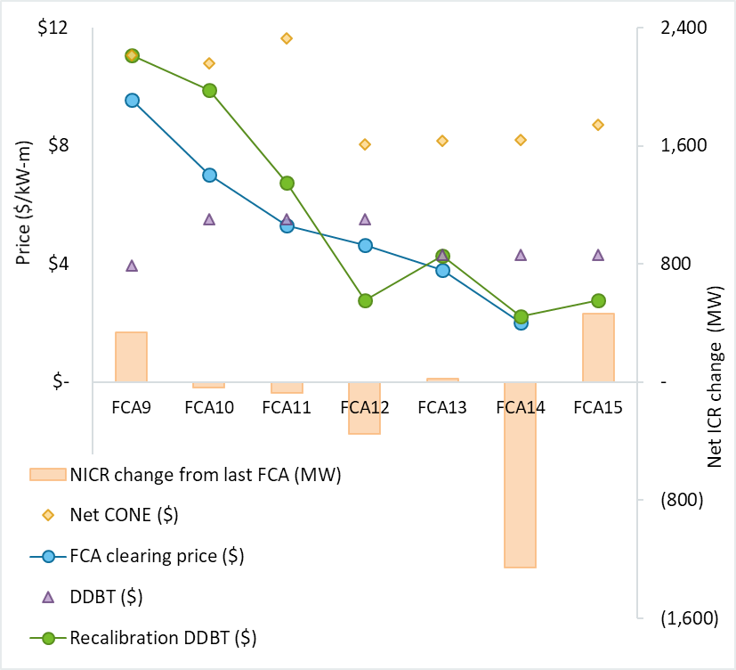
Analysis Estimates of recalibration DDBT beginning with FCA9*
The chart values are on the next slide
Recalibration DDBT (green series) tracks well with FCA clearing price (blue series)
Past DDBT method (purple) becomes stale
Net ICR and Net CONE changes help explain short-run market conditions and the recalibration DDBT
*Inputs to FCA9 and FCA10 include outcomes of administrative pricing conditions in the preceding auction

Slide 12
Analysis On average, the recalibration estimate has 25% error, over this period, compared to 39% error with manual-estimation
 |  | FCA9 | FCA10 | FCA11 | FCA12 | FCA13 | FCA14 | FCA15 | AVG.
(A) | System CCP ($) | $9.55 | $7.03 | $5.30 | $4.63 | $3.80 | $2.00 | tbd
(B) | Actual DDBT ($) | $3.94 | $5.50 | $5.50 | $5.50 | $4.30 | $4.30 | $4.30
(C) | Abs. % Error Actual DDBT = |(B-A)/A)| | 59% | 22% | 4% | 19% | 13% | 115% | tbd | 39%
(D) | Recalibration DDBT ($) | $11.08 | $9.90 | $6.74 | $2.78 | $4.27 | $2.22 | $2.76
(E) | Abs. % Error Recal. DDBT = |(D-A)/A)| | 16% | 41% | 27% | 40% | 12% | 11% | tbd | 25%
(F) | Net CONE ($) | $11.08 | $10.81 | $11.64 | $8.04 | $8.16 | $8.19 | $8.71
(G) | Net ICR change (MW) = (NICR_{t} - NICR_{t-1}) | 334 | -38 | -76 | -350 | 25 | -1260 | 460*
(H) | CVC lower-bound on Recalibration DDBT ($) | $0.54 | $0.54 | $0.51 | $1.24 | $1.07 | $0.73 | $1.65
*FCA15 Net ICR estimate (32,950 MW) is from the 2019 RSP, Table 4-1 p.52 (LINK)

Slide 13
Analysis A few qualitative observations on the analysis
The FCA demand specification underwent pretty significant changes over the period we have to analyze
Nevertheless, the recalibration DDBT method exhibits better ex ante accuracy than the manual estimation method
Recalibrations ability to use current and forward-looking market information should support its accuracy
Recalibration also “catches up” with unforeseen market changes by the next period
The performance of recalibration should improve with the recent transition to fully MRI demand curves

Slide 14
Design Detail
Mechanics of the recalibration DDBT method

Slide 15
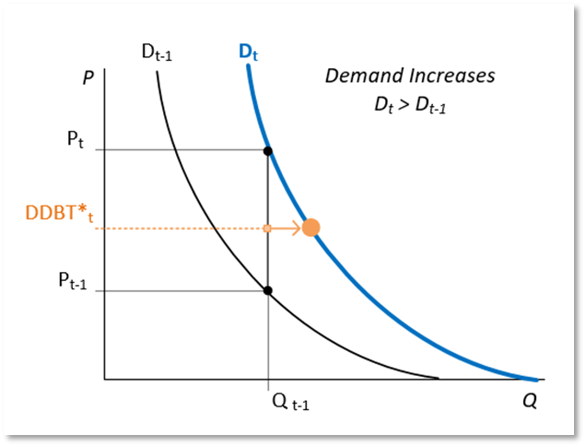
Concept Recalibration is a formulaic method to set the DDBT annually
This module explains the various technical details of how DDBT recalibration is performed
The concept, though, is straightforward and produces sensible estimates based on supply and demand characteristics
Recalibration estimates the competitive clearing price for the next FCA using:
The last FCA cleared supply and clearing price; and
The next FCA forecasted demand changes (i.e., Net ICR, Net CONE)
All of the inputs are from public sources

Slide 16
Detail Timeline for posting the DDBT
Recalibration DDBT for the next FCA will be calculated annually in the (short) window:
After the last FCA results are finalized (posted and ready to file); and
Before retirement bids are due for the next FCA
These two constraints imply the DDBT will be calculated and posted around March 1st
The last FCA results provide inputs (total CSO and clearing price) to the DDBT calculation
The DDBT is used in the retirement bid review process, and may be relevant to supplier decisions about the next FCA

Slide 17
Detail Estimate the next FCA system demand curve
Due to timing constraints, the next FCA demand is estimated
Net ICR anchors the quantity dimension of the system-wide demand curve (i.e., changes in Net ICR shift the demand curve left or right as Net ICR increases or decreases, respectively)
The next FCA Net ICR estimate uses “representative Net ICR” values the ISO prepares as a Regional System Plan supplement
Presently, the ISO is evaluating changing when representative Net ICR calculations are performed in order to reflect the most current load forecast and ICR assumptions for the DDBT
Representative Net ICR values would be developed in January, the month before the DDBT recalibration occurs (February)

Slide 18
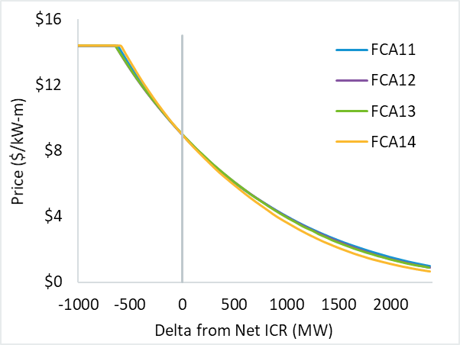
Detail Estimate the next FCA system demand curve (cont.)
Next FCA system MRI values are estimated using the last FCA MRI values
The relationship between capacity levels and MRI values is very stable (as shown in the figure at the right)
Note: the scaling factor for the estimated demand curve will use the next FCA’s published Net CONE and starting price
Comparison of system MRI demand values scaled using a common Net CONE and Net ICR

Slide 19
Detail Calculate the next FCA system demand price at the last FCA awarded CSO amount
At the total quantity of CSO cleared in the last FCA, get the demand price from the estimated system demand curve (“P_{t}”)
The last FCA total CSO (“Q_{t-1}”) is the summer-period awards at the conclusion of the primary auction, substitution auction, and re-run of the primary auction (if applicable) for proxy bids
Summer-period awards align with the FCA clearing price and do not reflect after auction winter-period adjustments for IPRs, etc.
The last FCA total CSO is not adjusted for possible retirements
There is no certainty about potential retirements that may occur in the next FCA (due to qualification, review, and regulatory processes) by the time that the DDBT must be set (i.e., by March ~1st)
Recalibration will reflect unforeseen changes in the next period DDBT

Slide 20
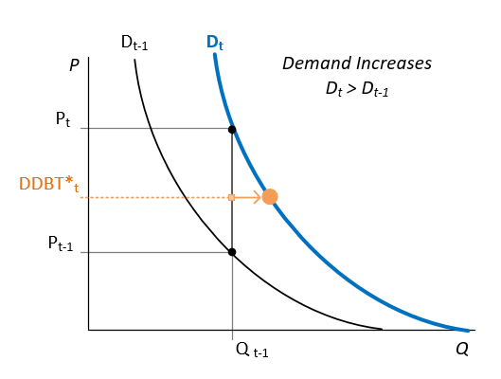
Detail Average the next FCA demand price (“P_{t}”) and the last FCA system clearing price (“P_{t-1}”)
The average of the last FCA clearing price (“P_{t-1}”) and next FCA demand price (“P_{t}”) is the preliminary DDBT (“DDBT*_{t}”)
Preliminary meaning before applying the cap and floor
The last FCA clearing price (“P_{t-1}”) is the rest-of-pool clearing price from the primary auction
Or the rest-of-pool clearing price from the re-run of the primary auction (if applicable) for proxy bids
Illustration of the average value (DDBT*_{t}) found with P_{t} and P_{t-1}

Slide 21
Detail Set the final DDBT value within upper and lower bounds
Final DDBT value (“DDBT_{t}”) is limited to a range:
DDBT_{t} = min[ Net CONE_{t} , max( DDBT*_{t} , CVC Limit_{t} )]
Upper bound is the next FCA Net CONE
Competitive prices are expected to be near (but not typically exceed) Net CONE to support competitive new entry
Existing resources will generally have lower going-forward costs
Lower bound is the estimated price where the next FCA demand curve prices become less than the CVC (next slide)
Suppliers are not expected to sell CSO for less than the expected cost to cover their share-of-system obligation under PFP

Slide 22
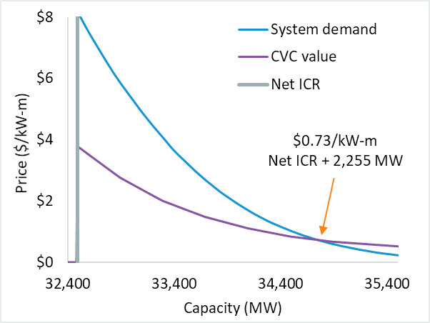
Detail Determine the CVC limit (i.e., the DDBT lower bound)
System demand curve prices generally exceed the CVC value, except at large capacity surplus
The CVC limit would, therefore, not be binding except with a large surplus
The CVC equals (PPR x BR(Q) x H(Q))
The PPR is fixed and set in advance
The H and BR values decrease as capacity increases and, thus, the CVC also is a decreasing function
For DDBT calculations, H is interpolated from the GE-MARS simulations and at-criterion BRs are scaled down in the same manner as explained for the FCA16 ORTP update assumptions
Illustration of the CVC value at varying capacity levels and relative to system demand prices
This illustration is constructed using FCA14 data

Slide 23
Other Follow-up
On discussions aside from DDBT calculation mechanics

Slide 24
Follow-up Discussion of changing the mitigation design or FCA format
Stakeholders had observations and concerns about the overall de-list mitigation design, procedural requirements, and FCA format:
Revising the pivotal supplier test
Creating minimum MW thresholds for Static De-List Bid cost reviews
Difficulties experienced during the cost review process
Converting to a full sealed-bid FCA design
While these may merit further consideration, these topics are beyond the present scope to recalculate the DDBT for FCA16
These would also require assessment and prioritization
Note, though, several questions about the role of the DDBT and the FCA format were addressed in discussion and materials from the Descending Clock Auction Forum in 2015/16 (LINK)

Slide 25
Conclusion
Summary and stakeholder schedule

Slide 26
The ISO proposes to apply the DDBT recalibration method beginning with FCA16
The Tariff requires a recalculation of the DDBT for FCA16
Recalibration is an improved method to calculate the DDBT annually with current and forward-looking data
The method is simple, transparent, and uses public data
Recalibration appropriately balances the design objectives for the DDBT and supports the efficient administration of the FCA
DDBT recalibration would apply beginning with FCA16

Slide 27
Stakeholder Schedule
Stakeholder Committee and Date | Scheduled Project Milestone
Markets Committee July 14-15, 2020 | Design objectives and proposal
Markets Committee August 11-12, 2020 | Design detail
Markets Committee September 9-10, 2020 | Continued review of design, Tariff provisions
Markets Committee October 6-7, 2020 | Vote
Participants Committee November 5, 2020 | Vote

Slide 29
Acronyms Used in this Presentation
BR = Capacity Balancing Ratio
CSO = Capacity Supply Obligation
CVC = Common Value Component
DDBT = Dynamic De-List Bid Threshold
FCA = Forward Capacity Auction
H = Capacity Scarcity Condition hours
IPR = Intermittent Power Resource
Net CONE = Net Cost of New Entry
PFP = Pay for Performance
PPR = Capacity Performance Payment Rate

