Slide 1
October 6-8, 2020 | MC TELECONFERENCE
Forward Capacity Auction
Dynamic De-List Bid Threshold
DDBT Update Proposal for FCA16+ (2025-26)
Matt Brewster
413-540-4547
mbrewster@iso-ne.com

Slide 2
Project Title: DDBT (FCA16)
WMPP ID:
143
Proposed Effective Date: For FCA16
The Tariff requires a recalculation of the Dynamic De-List Bid Threshold (DDBT) for the 2025-26 period (FCA16)
  The latest update occurred in 2017/18 and has applied since FCA13
  The scope of this proposal is limited to this Tariff requirement
The ISO is proposing an improved methodology to recalculate the DDBT annually using publicly available data
Today’s topics:
  Technical correction to Tariff
  Vote

Slide 3
Tariff Correction
Brief review of the technical correction

Slide 4
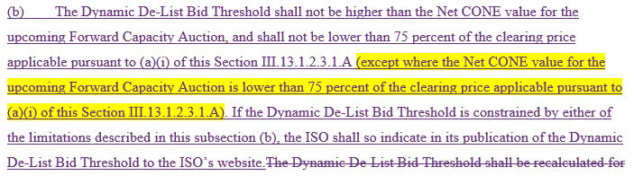
Tariff technical fix is to clarify how the two limits on the DDBT value apply if these overlap
Design discussions in August and September explained the limits to the range of DDBT values:
DDBT_{t} = min [Net CONE, max (DDBT*, 75% FCA_{t-1} price)]
ISO’s original Tariff draft did not clarify the order of operations
  i.e., the “shall not be higher” (i.e., outer min function) could supersede the “shall not be lower” (i.e., inner max function)
The corrected Tariff includes this detail (in yellow highlight)

Slide 5
Conclusion
Summary and stakeholder schedule

Slide 6
Three design objectives for the DDBT recalculation
Design objectives:
  Identify for review FCA de-list bids that may reflect an exercise of market power
  Limit unnecessary administrative interference in competitive price formation
  Use a transparent and robust calculation methodology
These objectives are in a degree of tension, requiring a balance between (1) and (2) in particular
Concerns with (3) have arisen with past DDBT revision methodologies, which we seek to address and improve

Slide 7
Recalibration is an improved DDBT calculation method
Recalibration appropriately balances the design objectives for the DDBT and supports the efficient administration of the FCA
Annual updates keep the DDBT aligned with current and expected market conditions
  And allow the value to quickly catch-up to unforeseen changes
The calculation is transparent and uses public data
The method supports a broad range of market conditions
Historically, the method exhibits good ex-ante accuracy and its performance may be better with the full MRI demand design

Slide 8
DDBT recalibration will apply beginning with FCA16
The Tariff requires a recalculation of the DDBT for FCA16
DDBT recalibration will apply beginning with FCA16
Recalibration is a Tariff-defined, annual update process
  “Manual” DDBT updates will no longer be part of the triennial parameters update

Slide 9
Stakeholder Schedule
Stakeholder Committee and Date | Scheduled Project Milestone
Markets Committee July 14-15, 2020 | Design objectives and proposal
Markets Committee August 11-12, 2020 | Design detail
Markets Committee September 8-10, 2020 | Continued review of design, Tariff provisions
Markets Committee October 6-8, 2020 | Vote
Participants Committee November 5, 2020 | Vote

Slide 11
Appendix
Tariff revisions

Slide 12
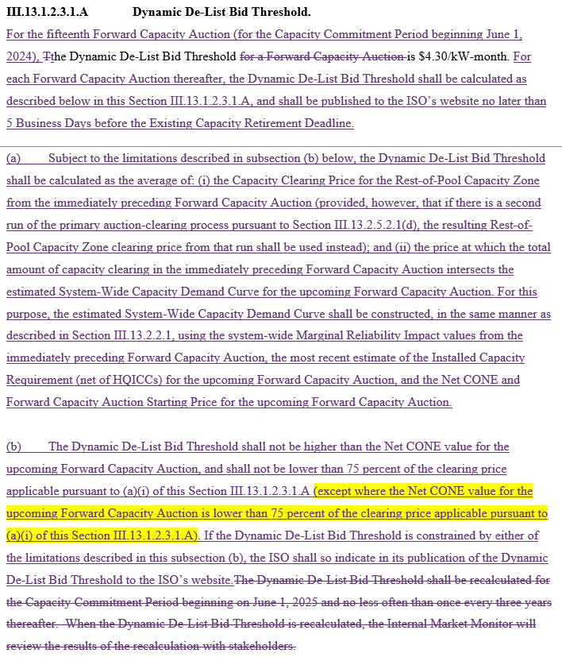
Tariff revisions in Section III.13.1.2.3.1.A

Slide 13
Summary of Tariff revisions
Tariff Section | Description
III.13.1.2.3.1.A | Retain the current statement of the DDBT value for the upcoming FCA15 (can be removed after FCA15) Remove the description of the old triennial DDBT updating process (i.e., “manual recalibration”) Define that the new recalibration DDBT method: Is specified in the new subsections (a) and (b), Requires annual calculation for each FCA, and Requires the DDBT value to be published 5 business days before the retirement bid deadline (i.e., early March)

Slide 14
Summary of Tariff revisions (cont.)
Tariff Section | Description
III.13.1.2.3.1.A (a) | Define that the DDBT is the average of two prices: Clause (a)(i) defines the preceding FCA price Clause (a)(ii) defines that the preceding FCA’s CSO awards are used to determine a price on the estimated system-wide demand curve for the upcoming FCA Define the parameters used and method to construct the estimated system-wide demand curve for the upcoming FCA
III.13.1.2.3.1.A (b) | Define Net CONE as the maximum Define 75% of the preceding FCA price as the minimum Clarify the Net CONE limit supersedes if these limits overlap Require that the DDBT value publication identify if the lower bound or upper bound was applied

Slide 15
Summary of Tariff revisions (cont.)
Tariff Section | Description
III.13.2.3.2 (a)(v) | Typo correction

Slide 16
Acronyms Used in this Presentation
DDBT = Dynamic De-List Bid Threshold
FCA = Forward Capacity Auction

