Slide 1


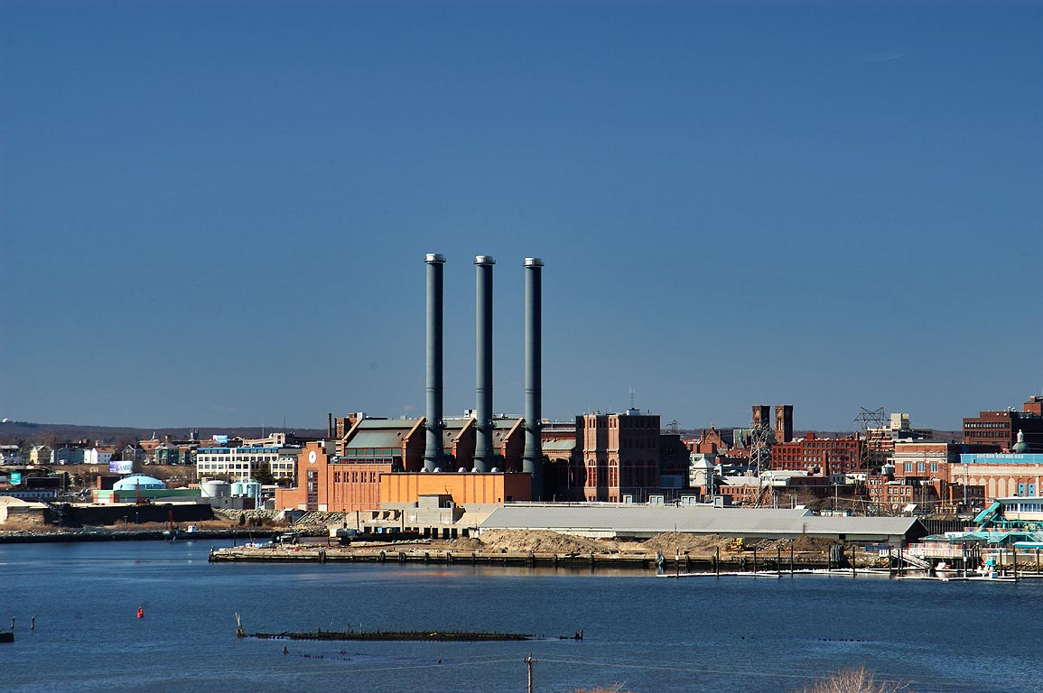


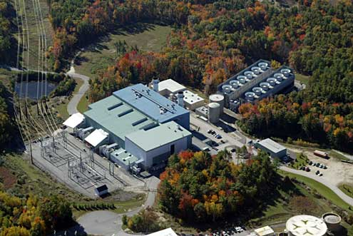

ISO-NE CONE and ORTP Analysis
September 9, 2020
Danielle Powers, Meredith Stone
Emma Nicholson, Keith Paul, Joe Farrell
REVISION 1

Slide 2
Overview & Purpose:
Agenda
Review of Changes Since the July MC
Review of Posted Documents
Recommended Annual Updates
Proposed Net CONE & ORTP Values by Market Scenario
  FRM Sunset & ISO-NE ESI Proposal
  FRM Sunset & NEPOOL ESI Proposal
  With FRM & No ESI

Slide 3
Changes to Analysis Since Last MC

Slide 4
Changes to the Analysis Based on Stakeholder Feedback
Lower Cost of Debt and Return on Equity for ORTP
  We have reduced the Cost of Debt from 6% to 4.5%
  We reduced the Return on Equity from 12% to11%
ITC for Offshore Wind
  Inclusion of an 18% ITC for offshore wind requires bending the parameters that have been established for offshore wind’s development period
  Whether or not it is included, the ORTP remains above the auction starting price
  Offshore wind does not pass the screening criteria under any combination of reasonable adjustments to our assumptions
Use of DNV for Renewables
  Offshore and onshore wind E&AS dispatch models utilize hourly shapes from DNV data adjusted upwards to appropriate capacity factor expected for the technology and locations specified
  CEA attempted to use DNV data for solar resources; this data has not been vetted and ISO-NE believes it includes data from behind-the-meter resources
  The resulting capacity factors were lower than the data from recently installed front of the meter resources
  CEA continues to rely on data presented in July/August

Slide 5
REVISED
Changes to the Analysis Based on Stakeholder Feedback
Gross Earnings Tax
  We have included a gross earnings tax of 5% to the gas costs assumed in the E&AS dispatch models based on stakeholder feedback
O&M Expense for Network Upgrades
  We have included a cost of $2500/MW/yr in our O&M assumption to account for the cost of maintenance allocated to generators that fund network upgrades pursuant to the OATT based on stakeholder feedback
Regulation Revenues for Battery
  We have added regulation revenues to the battery E&AS revenues based on stakeholder feedback
Qualified Capacity
  Qualified capacity for renewable resources was adjusted to represent a weighted capacity value of summer and winter reliability hour output
Heat Rates
  Heat rates for gas units in E&AS dispatch models were revised to reflect higher heating value (HHV)
ESI and PPR
  Revised to correct the calculation of PFP and Scarcity revenues for the CONE gas units
  This correction impacts the PPR rate, PFP offset, and Scarcity offset

Slide 6
Annual Updates

Slide 7
Annual Updates
Market Rule 1, Section III.13.2.4
  CONE, Net CONE, and ORTPs will be adjusted for each Forward Capacity Auction pursuant to Section III.A.21.1.2 (e) of Market Rule 1
Concentric recommends a simplified annual update process
  Reduces the number of indices needed to update costs
  Relevant values are updated to reflect high level changes in cost and revenue expectations
Four components to the recommended updates:
  Capital Costs
  E&AS and ESI Offsets
  REC Offsets
  Bonus Depreciation

Slide 8
Annual Updates – Capital Costs
Concentric recommends that the capital cost component of gross CONE be updated by adjusting capital costs in the financial model using Bureau of Labor Statistics index WPU114
  WPU114 is an index representing changes to general purpose machinery and equipment
Capital costs adjusted by a multiplier that is equal to:
  The average of values published during the most recent 12 month period available at the time of making the adjustment divided by the average of the most recent 12 month period available at the time of establishing the Net CONE and ORTP values.

Slide 9
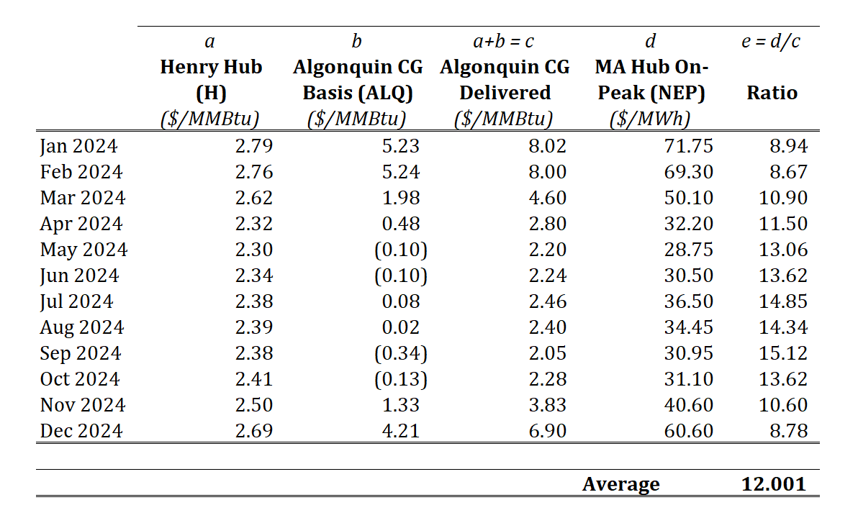
Annual Updates – E&AS and ESI Offsets - Gas Units
E&AS update for gas units will be based on changes to the relationship between electric forwards and gas forwards
Calculations should be based on settlements for the farthest date forward in time for which power settlements are available, as available from ICE
Preceding an update, these calculations will be performed using the same indices and for the settlement period closest to the capacity commitment period. The average ratio that results will be compared to the ratio shown above
The percentage difference (positive or negative) in the ratios will be applied to the E&AS and ESI offsets

Slide 10
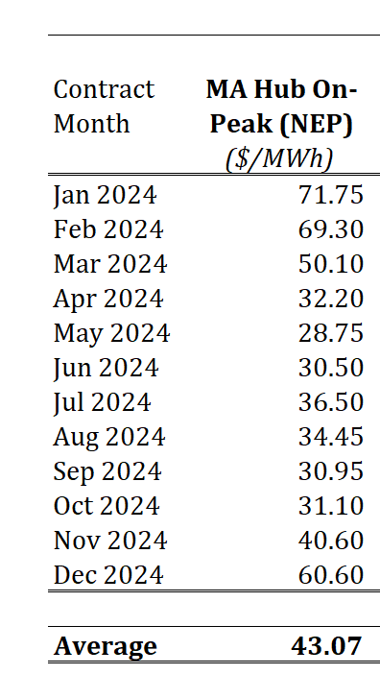
Annual Updates – E&AS and ESI Offsets – Non-Gas ORTPs
For non-gas ORTP units, profitability is a function of the overall level of energy prices, not the spread between energy and gas prices
Therefore, the calculation supporting the adjustment of the E&AS and ESI portions of the revenue offset is based only on power futures
The MA Hub On-Peak (NEP) futures contracts from ICE averages $43.07/MWh for all 2024 contracts
In the future, that average will be calculated again. The percentage difference (positive or negative) in the averages will be applied to the E&AS and ESI portions of the revenue offset for each non-gas ORTP resource

Slide 11
Annual Updates – REC Offsets
REC prices are currently updated based on the most recent MA Class 1 REC price for the vintage closest to the first year of the Capacity Commitment Period associated with the relevant FCA as published by SNL Financial
This has resulted in significant swings in ORTP values and in addition does not necessarily reflect the final average REC price for the vintage in question if that vintage has not finished trading
Therefore, Concentric recommends that ISO-NE update REC prices based on a rolling 5-year average MA Class 1 REC price using vintages available for the periods closest to the beginning of the capacity commitment period

Slide 12
Annual Updates – Bonus Depreciation
Concentric recommends that ISO-NE account for declining bonus depreciation in subsequent years
Current available guidance is that 20% bonus depreciation will be available for units placed in service in calendar year 2026, and will expire thereafter
Therefore, a 20 percentage point reduction in bonus depreciation be reflected in the financial model each year until the allowance expires
Property Placed in Service | Bonus Depreciation Allowance
Property placed in service after December 31, 2024 and before January 1, 2026 | 40%
Property placed in service after December 31, 2025 and before January 1, 2027 | 20%
Property placed in service after December 31, 2026 and before January 1, 2028 | 0%

Slide 13
Draft CONE and ORTP Values

Slide 14
Draft Net CONE & ORTP Values
FRM Sunset & ISO-NE ESI Proposal
REVISED

Slide 15
Draft Net CONE & ORTP Values – DR/EE
FRM Sunset & ISO-NE ESI Proposal
REVISED

Slide 16
Appendix

Slide 17
Draft Net CONE & ORTP Values
FRM Sunset & NEPOOL ESI Proposal
REVISED

Slide 18
Draft Net CONE & ORTP Values
FRM Sunset & NEPOOL ESI Proposal – EE/DR
REVISED

Slide 19
Draft Net CONE & ORTP Values
With FRM & No ESI
REVISED

Slide 20
Draft Net CONE & ORTP Values
With FRM & No ESI – EE/DR
REVISED

