Slide 1


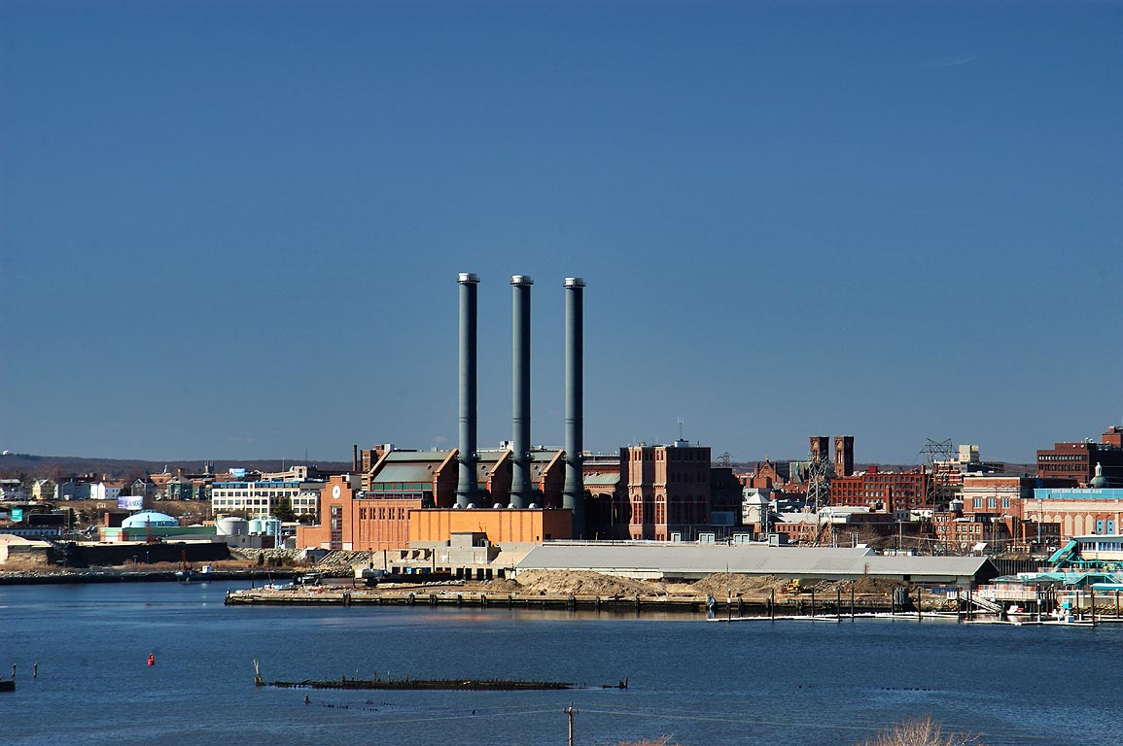
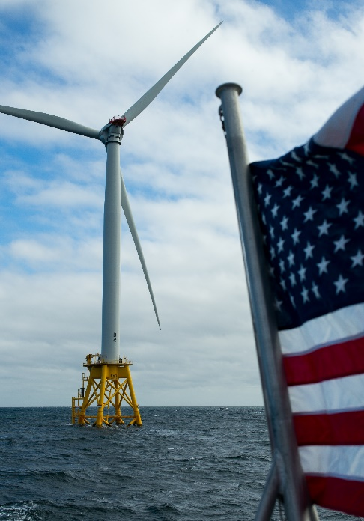
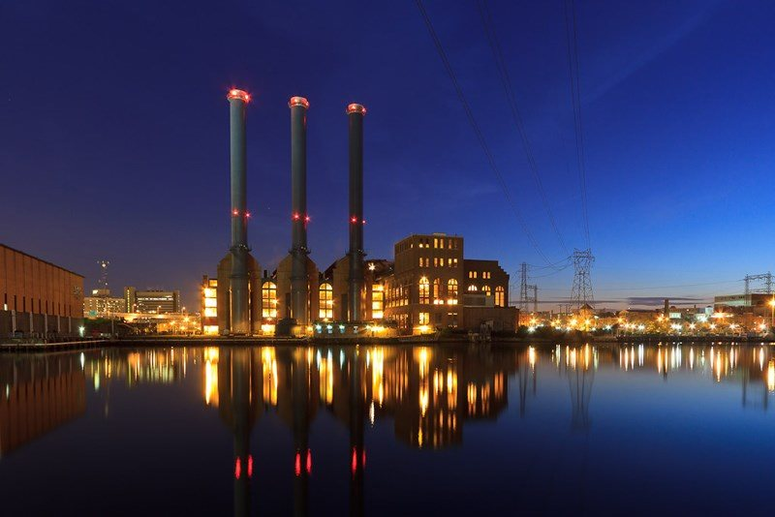
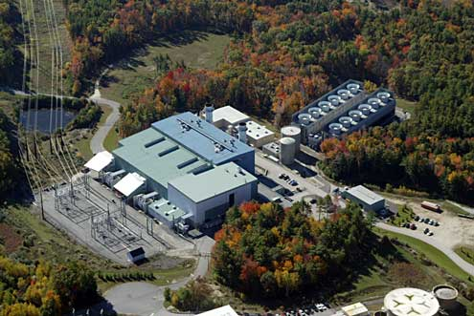

ISO-NE CONE and ORTP Analysis
October 26, 2020
Danielle Powers, Keith Paul, Al Ferrer
Revision 1

Slide 2
Overview & Purpose: Agenda
Review of Changes and Clarifications Since the October 6-8 MC
Owner Costs and Contingency Costs
Adjustments to O&M Costs
Degradation
Interconnection Costs
Bonus Depreciation
Offshore Wind Capital Costs
Changes to be discussed by ISO-NE:
Scarcity Hours
PPR Escalation
Updated PPR & ESI values
Current CONE/ORTP Values

Slide 3
Follow-up Items

Slide 4
Owners Costs and Contingency Costs
The existing CONE/ORTP model reflects an Owner’s Contingency of $7M and an EPC Project Contingency of $14.31M for the 7HA.02 simple cycle unit (total of $21.31M)
However, there are additional inherent contingencies in the total overnight capital costs that don’t appear as separate line items due to the methodology that was used in developing the construction estimates by sub-package
In reviewing the estimate for the 7HA.02 simple cycle unit, each individual cost line item reflected in the estimate was analyzed to determine how and where contingencies were addressed in the estimate sourcing document
Due to current market trends in New England, it was assumed that the project would involve a subcontract structure, meaning that the prime EPC Contractor would be expected to outsource major portions of the project to local specialized subcontractors who are able to better control labor costs
Therefore, the total scope of the project would be contracted out by major disciplines to a Mechanical Contractor, an Electrical and Controls Contractor, a Civil Structural and Architectural Contractor, and a Construction/Erection Contractor
Each of these Contractors were assumed to add their own contingency equal to 5% of each contractors’ costs
These contingencies represent the subcontractors’ portion of the EPC bid and total $10.2M
Factoring in the $10.22M to the separate line items for Owner’s Contingency and EPC Project Contingency line items ($21.31M) results in a total Owner’s Contingency and EPC Project Contingency cost of $31.53M, as further detailed on the next slide

Slide 5
Owners Cost and Contingency Cost (cont’d)
Contingency – Simple Cycle | $2019 (Millions)
Owner's | $7.00
EPC Overall Project | $14.31
Mechanical Contract | $6.89
Electrical and I&C Contract | $1.39
Civil Struct Arch Contract | $0.94
Construction Management | $0.38
Other Project Costs | $0.62
Total Contingency | $31.53

Slide 6
Degradation
Degradation assumptions associated with the CONE candidate units have been incorporated into the CONE analysis on a lifecycle basis
Non-recoverable degradation for the CONE units representing both heat rate degradation and capacity degradation
The lifecycle degradation factors in the table below were applied in the CONE E&AS dispatch models
Lifecycle capacity degradation factors were applied to reduce the unit capacity in each month, decreasing the size of the plant and resulting in decreased E&AS revenues
Lifecycle heat rate degradation factors were applied to increase the unit heat rate in each month, resulting in lower dispatch rates and decreased E&AS revenues
Unit | Lifecycle Non-Recoverable Capacity Degradation | Lifecycle Non-Recoverable Heat Rate Degradation | CONE Impact ($/kW-mo)
GE 7HA.02 Simple Cycle | 1.41% | 1.00% | $0.16
GE 7HA.02 Combined Cycle | 2.43% | 1.63% | $0.55
Aeroderivative | 2.70% | 0.50% | $0.52

Slide 7
Degradation (cont’d)
Capacity degradation factors were applied to the Qualified Capacity used in the financial model for the CONE units
Degradation was not applied to the ORTP units since these values represent the low end of the range

Slide 8
Adjustments to O&M Costs
Changes to the heat rate and intraday gas prices have resulted in a lower dispatch rate for the simple cycle and aeroderivative machines since the original O&M costs were developed
A lower dispatch rate translates to lower variable and fixed O&M
MM has reviewed the variable and fixed O&M expenses for the gas-fired units
The dispatch rate for the CC did not materially change so the fixed and variable O&M numbers will remain the same as originally proposed
Fossil Unit Type | Original O&M |  | Revised O&M |  | CONE Impact
 | Variable O&M ($2019/MWh) | Fixed O&M ($2019/kW-yr) | Variable O&M ($2019/MWh) | Fixed O&M ($2019/kW-yr) | ($/kW-mo)
Simple Cycle CT | $4.63 | $40.08 | $1.75 | $35.00 | ($0.71)
Aeroderivative | $5.14 | $85.92 | $1.16 | $75.00 | ($1.35)
Combined Cycle (no change ) | $3.60 | $55.20 |  |  | ($0.00)

Slide 9
Interconnection Costs – Fossil Units
Interconnection cost assumptions/definitions
Interconnection Facilities: Equipment (transformers, transmission feeder lines) from the generator itself to the interconnection point plus network upgrades beyond the point of interconnection to meet the minimum interconnection standard (1.a.)
Network Upgrades: Upgrades to transmission lines (rebuilds/re-conductoring etc.), transformers or substations beyond the point of interconnection that include “remote” interconnection costs to meet the capacity interconnection standard (1.b.)
Killingly interconnection costs
1.a. – $31.2M
1.b. - $0.0M
CONE interconnection costs for the combined cycle unit:
1.a. - $27.0M
1.b. - $0.0M
CONE interconnection costs for the simple cycle unit:
1.a. - $20.5M
1.b. - $0.0M
We conclude that our interconnection cost assumptions are reasonable

Slide 10
Bonus Deprecation
We have reviewed the analysis conducted by NEPGA’s consultant and discussed the details around bonus depreciation internally
Further discussion around investment in fossil generation confirmed several challenges in attracting tax equity investors
Prolonged slump in gas prices
Uncertainty around future demand
Lack of long-term contracts
NEPGA models show tax equity investors may be unable to claim bonus depreciation and support the required return for the tax equity investor
Based on these discussions, we have removed bonus depreciation for the CONE units only
ORTP units represent low end of the range, therefore bonus depreciation still applies

Slide 11
Offshore Wind Capital Costs
Mott MacDonald has been asked to review the capital costs for the Offshore Wind unit under the condition that costs represent the “absolute lowest end of the range of feasible costs”
The estimated capital cost has been reduced to the lowest level that could reasonably be expected for an 800 MW Offshore Wind project with a point of interconnection at Brayton Point
Revisions:
Reduced inter-array 66 kV submarine cabling quantity to the minimum
Reduced the onshore cabling to the minimum by assuming the submarine
cable can land in the nearest vicinity of the Brayton Point 345 kV Substation
Reduced the project contingency from 10% to 5%
This is the absolute minimum bottoms-up cost for an offshore wind project providing 800 MW at the Brayton Point location
These costs do not include or address infrastructure improvements required for compliance with the Jones Act
Risks associated with major unforeseen grid system improvements for reliability purposes beyond Brayton Point are also not addressed in this estimate
Lowest End of the Range Capital Cost Estimate
$5,358/kW

Slide 12
Current CONE/ORTP Values

Slide 13
Net CONE Results – All Scenarios

Slide 14
ORTP Results
FRM Sunset, ISO-NE ESI
FRM Sunset, NEPOOL ESI
With FRM, No ESI

Slide 15
EE/DR Results
FRM Sunset, ISO-NE ESI
FRM Sunset, NEPOOL ESI
With FRM, No ESI

