Slide 1
October 26, 2020 | MC TELECONFERENCE
REVISION 1
Cost of New Entry,
Offer Review Trigger Prices, and
Performance Payment Rate
Parameter input assumptions and updated values
Tariff language revisions
Deborah Cooke
413.540.4488 | dcooke@iso-ne.com

Slide 2
Cost of New Entry, Offer Review Trigger Prices,
And Performance Payment Rate
WMPP IDs: 139 & 144
Proposed Effective Date: June 1, 2025 (CCP 16)
The recalculation of the Cost of New Entry (CONE), Net CONE, and Offer Review Trigger Prices (ORTPs) is being performed for the 2025-2026 Capacity Commitment Period (CCP 16)
The Performance Payment Rate (PPR) is being updated concurrently for CCP 16
This rate depends upon the values used to derive the Net CONE
This presentation:
Provides the updated Performance Payment Rate
Provides updated revenue offsets associated with Energy Security Improvements (ESI)
Provides a summary of Tariff revisions since the October 6-8 MC meeting

Slide 3
E&AS revenue offsets, Net CONE values, ORTPs, and PPR values are provided for several future scenarios
From October 6-8 presentation
E&AS revenues are provided both with and without ESI revenue adjustments (for ISO’s and NEPOOL’s ESI alternatives)
ESI revenue adjustments reflect the most recent Concentric Energy Advisors (CEA) dispatch models
E&AS revenues are provided both with and without Forward Reserve Market revenues (accounting for ESI)
To account for the proposed sunset of the Forward Reserve Market beginning in CCP 16, contingent on ESI
This results in three sets of potential Net CONE, ORTP, and PPR values and Tariff redlines (see slide 17)

Slide 4
Performance Payment Rate
Updated values reflecting latest CEA Net CONE inputs, E&AS revenue adjustments, and revised scarcity hours

Slide 5
Changes in peak load scarcity hours and the reference technology assumptions required updates to the PPR
Revised
Scarcity hours were revised from 15.3 hours to 11.3 hours
Due to update in peak load hours including incorporation of smoothing (4-year averaging) mechanism
See Expected Capacity Scarcity Condition Hours presentation
Capacity values and E&AS revenues were adjusted to reflect degradation over the life of the unit for the Net CONE reference unit
See latest CEA presentation for this MC meeting
Gross CONE was adjusted to reflect revised fixed Operation and Maintenance costs for the Net CONE reference unit
Operation and Maintenance costs were revised to reflect decreased dispatch activity consistent with the unit’s Low Heat Value (LHV), as adopted in September
Gross CONE was adjusted to reflect the removal of the bonus depreciation

Slide 6

Inputs to the PPR formula reflect the proposed Net CONE unit (Combustion Turbine)
Revised from October 6-8 presentation
The PPR formula* is:
$$PPR=\frac{(Gross CONE −E\&AS)}{{Hours}_{new} × {Actual}_{new}}$$
* Details for deriving the PPR formula can be found in the FCM Performance Incentives – Performance Payment Rate memo dated September 3, 2013
Input Description | Value | Description and source of data
Gross CONE | $ /kW-mo. | Estimated cost of new entry for the combustion turbine
E&AS Revenues | $ /kW-mo. | Energy and ancillary services revenues (excluding Capacity Performance Payments) for the combustion turbine
Hours | 11.3 | Expected annual scarcity hours (‘at criteria’) from the ISO scarcity hours review
Actual Performance | 0.98 | Average performance for the GE 7HA.02 combustion turbine

Slide 7
PPR values reflecting revised inputs to the Net CONE discounted cash flow model
Revised
 | Scenario
Input | ESI (ISO), no FRM | ESI (NEPOOL) no FRM | FRM (no ESI)
Gross CONE ($/kW-mo. of Qualified Capacity) | $10.97 $11.68 | $10.97 $11.68 | $10.97 $11.68
E&AS Revenues:
Energy & Reserves ($/kW-mo. of QC) | $1.83$1.91 | $1.83$1.91 | $2.89$3.01
Scarcity ($/kW-mo. of QC) | $0.77$0.80 | $0.77$0.80 | $0.77$0.80
ESI Revenues ($/kW-mo. of QC) | $0.52$0.54 | $0.37$0.39 | $0.00
Total E&AS Revenue ($/kW-mo. of QC) | $3.11$3.25 | $2.97$3.09 | $3.66$3.81
Gross CONE – E&AS ($/kW-mo. of QC) | $7.85$8.44 | $7.99$8.59 | $7.31$7.87
Hours (per year) | 11.3 | 11.3 | 11.3
Actual Performance (per MW) | 0.98 | 0.98 | 0.98
PPR ($/MWh) | $8,856 $9,140 | $9,023 $9,307 | $8,247 $8,530
Notes: Values are in 2025$ and are based on qualified capacity.
Intermediate values may reflect rounding

Slide 8
Comparison of PPR Values, October 6-8 and October 26
Revised
 | October 6-8 |  |  | October 26
Input | ESI (ISO), no FRM | ESI (NEPOOL) no FRM | FRM (no ESI) | ESI (ISO), no FRM | ESI (NEPOOL) no FRM | FRM (no ESI)
Qualified Capacity (MW) | 361 |  |  | 361356
Gross CONE ($/kW-mo. of Qualified Capacity) | $11.77 | $11.77 | $11.77 | $10.97 $11.68 | $10.97 $11.68 | $10.97 $11.68
E&AS Revenues:
Energy & Reserves ($/kW-mo. of QC) | $1.67 | $1.67 | $2.86 | $1.83$1.91 | $1.83$1.91 | $2.89$3.01
Scarcity ($/kW-mo. of QC) | $1.08 | $1.08 | $1.08 | $0.77$0.80 | $0.77$0.80 | $0.77$0.80
ESI Revenues ($/kW-mo. of QC) | $0.56 | $0.37 | $0.00 | $0.52$0.54 | $0.37$0.39 | $0.00
Total E&AS Revenue ($/kW-mo. of QC) | $3.31 | $3.12 | $3.94 | $3.11 $3.25 | $2.97 $3.09 | $3.66 $3.81
Gross CONE – E&AS ($/kW-mo. of QC) | $8.46 | $8.65 | $7.83 | $7.85 $8.44 | $7.99 8.59 | $7.31 $7.87
Hours (per year) | 15.3 | 15.3 | 15.3 | 11.3 | 11.3 | 11.3
Actual Performance (per MW) | 0.98 | 0.98 | 0.98 | 0.98 | 0.98 | 0.98
PPR ($/MWh) | $6,773 | $6,927 | $6,266 | $8,856 $9,140 | $9,023 $9,307 | $8,247 $8,530

Slide 9
Energy Security Improvements
Incremental revenue offsets for the Net CONE and ORTP modeled technologies
ISO proposal
NEPOOL proposal

Slide 10
ESI revenues are estimated and incorporated in the Net CONE and ORTP calculations
From October 6-8 presentation
As discussed in past Markets Committee meetings, ESI revenue offsets are estimated under both the ISO and NEPOOL filed proposals
Both scenarios assume the sunset of the Forward Reserve Market
Modifications to the dispatch models for the simple cycle, combined cycle, and aeroderivative technologies resulted in minor updates to the ESI revenue offsets
To account for degradation over the life of the technology

Slide 11
Updated Summary of estimated ESI revenue offsets Net CONE Technologies – ISO Proposal
Technology Type | Incr. Payments to Energy ($/kW-mo.) | Incr. Payments to Options ($/kW-mo.) | Total 2020$ ($/kW-mo.) | Total 2025$ ($/kW-mo.)
Combustion Turbine | $-0.125 | $0.589 | $0.464 | $0.512
Combined Cycle | $0.224 | $0.001 | $0.225 | $0.248
Aeroderivative | $-0.090 | $0.586 | $0.497 | $0.548
Changes from October 6-8
Combustion Turbine: $-0.025
Combined Cycle: $-0.015
Aeroderivative: $-0.019
Incremental Payments to Energy = revenue from LMPs and Forecast Energy Requirement
Incremental Payments to Options = net option revenue minus holding costs
Detailed calculations are in Appendix B
Note: values may reflect rounding

Slide 12
Updated Summary of estimated ESI revenue offsets Net CONE Technologies – NEPOOL Proposal
Technology Type | Incr. Payments to Energy ($/kW-mo.) | Incr. Payments to Options ($/kW-mo.) | Total 2020$ ($/kW-mo.) | Total 2025$ ($/kW-mo.)
Combustion Turbine | $0.067 | $0.265 | $0.331 | $0.366
Combined Cycle | $0.153 | $0.000 | $0.153 | $0.169
Aeroderivative | $0.048 | $0.277 | $0.325 | $0.358
Changes from October 6-8
Combustion Turbine: $0.014
Combined Cycle: $-0.010
Aeroderivative: $0.009
Incremental Payments to Energy = revenue from LMPs and Forecast Energy Requirement
Incremental Payments to Options = net option revenue minus holding costs
Detailed calculations are in Appendix B
Note: values may reflect rounding

Slide 13
Updated Summary of estimated ESI revenue offsets: Combustion Turbine ORTP, ISO and NEPOOL Proposals
New
Technology Type (ISO Proposal) | Incr. Payments to Energy ($/kW-mo.) | Incr. Payments to Options ($/kW-mo.) | Total 2020$ ($/kW-mo.) | Total 2025$ ($/kW-mo.)
Combustion Turbine | $0.011 | $0.310 | $0.321 | $0.354
Technology Type (NEPOOL Proposal) | Incr. Payments to Energy ($/kW-mo.) | Incr. Payments to Options ($/kW-mo.) | Total 2020$ ($/kW-mo.) | Total 2025$ ($/kW-mo.)
Combustion Turbine | $0.005 | $0.136 | $0.141 | $0.155
Change from October 6-8
ISO Proposal: $0.003
NEPOOL Proposal: $0.002
Incremental Payments to Energy = revenue from LMPs and Forecast Energy Requirement
Incremental Payments to Options = net option revenue minus holding costs
Detailed calculations are in Appendix B Note: values may reflect rounding

Slide 14
Proposed Tariff Revisions
Review of Tariff revisions since the October 6-8 MC Meeting

Slide 15
Summary of reasons for latest updates to the Net CONE, PPR, and ORTP proposed values in the Tariff
Revised
The PPR rate is escalated for inflation every three years
Impacts PFP revenues
Scarcity hours were revised to reflect the update in peak load hours and the smoothing (4-year averaging) mechanism
Impacts PFP and energy scarcity revenue
Capacity values and E&AS revenues were adjusted to reflect degradation over the life of the unit for the Net CONE reference unit, in response to stakeholder feedback
Impacts Gross CONE, Net CONE, and PPR
Operation and Maintenance costs for the Net CONE reference technology were revised to reflect decreased dispatch activity consistent with the unit’s Low Heat Value (LHV) adopted in September
Impacts Gross CONE and PPR
Bonus depreciation was removed
Impacts Gross CONE and PPR
The site leasing rate for the battery technology was revised
Impacts battery ORTP only

Slide 16
Summary of Revisions to the Tariff
The Net CONE, PPR, and ORTP calculated values in the Tariff were revised to reflect the modified gross CONE and E&AS revenues
The dates used for the electric and gas forward indices used in the interim updates of E&AS revenue offsets is now specified in the Tariff, as requested by stakeholders
Values published on the first five trading days of February will be used
Provides transparency and year-to-year consistency
This change is reflected in Section III.A.21.1.2(e)(3) of the updated Tariff documents

Slide 17
Three sets of Tariff redlines are provided
From October 6-8 presentation
As discussed previously, E&AS revenue offsets and the Performance Payment Rate have been calculated for three scenarios:
ESI market changes filed by ISO and the sunset of FRM
ESI market changes filed by NEPOOL and the sunset of FRM
Without ESI and with the continuation of FRM
Summary of the Tariff red-lines are included in Appendix C
Tariff redlines are identical other than the Net CONE, ORTP, and PPR numerical values

Slide 18
Summary of Proposed Tariff Changes Performance Payment Rate
Revised from October 6-8 presentation
Tariff Section | Reason for Change
III.13.7.2.5 Capacity Performance Payment Rate | Indicate that the Capacity Performance Payment Rate of $5,455/MWh applies to the Capacity Commitment Period beginning on June 1, 2024 and ending on May 31, 2025 Update the Capacity Performance Payment Rate for the Capacity Commitment Periods beginning on or after June 1, 2025 to $9,140 8,856/MWh
Note: Three sets of Tariff redlines have been provided reflecting the Performance Payment Rate under the three scenarios. The value above reflects the ESI market changes filed by ISO and the sunset of FRM.

Slide 19
Summary of Proposed Tariff Changes ORTPs
Revised from October 6-8 presentation
Tariff Section | Description of Change
III.A.21.1.1 Offer Review Trigger Prices for the Forward Capacity Auction | Update ORTP values for the Capacity Commitment Period beginning June 1, 2025 Add Battery as a new technology for Generating Capacity Resources Add Solar (in the ISO-ESI and NEPOOL ESI cases) as a new technology for Generating Capacity Resources Add On-Peak Solar and Solar + Battery as new technologies for Demand Capacity Resources Remove the Load Management ORTP categories for Demand Capacity Resources – Residential Combine the Demand Capacity Resources - Commercial and Industrial and Demand Capacity Resources – Residential into one Demand Capacity Resources category

Slide 20
Summary of Proposed Tariff Changes ORTPs
Revised from October 6-8 presentation
Tariff Section | Description of Change
III.A.21.2 (e)(3) | Include ESI revenue offsets in the E&AS revenues update Indicate that Henry Hub natural gas prices, Algonquin Citygates Basis natural gas futures prices, and Massachusetts Hub Day-Ahead Peak electricity prices published by ICE on the first five trading days in February will be input to the capital budgeting model to update E&AS revenues Change the dates of the indices from the CCP beginning June 1, 2021, to the months of the commitment period to which the values will apply
Note: Appendix D contains an example of the calculation for updating E&AS revenues in the current interim update process

Slide 21
Conclusion
E&AS revenue offsets are calculated to reflect both current and proposed (future) market conditions in CCP16, including:
Revenue impacts from ESI, both as proposed by ISO and as proposed by NEPOOL
With and without estimated Forward Reserve Market revenue due to the proposed sunset of the Forward Reserve Market
The updated PPR value will be effective beginning June 1, 2025 (CCP16)
The value is based upon the Combustion Turbine technology recommended for Net CONE
Tariff revisions will:
Support the new values for CONE, Net CONE, ORTPs and PPR
Reflect changes in the methodology for updating Net CONE and ORTP values in periods between major recalculations

Slide 22
November Markets Committee Voting – Assessing the Impacts of Amendments
New
As previously noted, there are many interdependencies among the FCM parameters
This presents unique challenges when trying to calculate the combined effect of more than one amendment on the CONE, Net CONE, ORTP, and PPR values, as many amendments will impact more than one parameter
For example, a change in Gross CONE for the reference technology has downstream impacts on the PPR and therefore all ORTP values
See next slide for the impact of each amendment presented at the October 6-8 MC (excludes amendments dropped or adopted prior to that meeting)
ISO will endeavor to validate the impact of individual amendments prior to the November 9-10 MC meeting
Given the challenges of calculating the combined effect of amendments and the numerous permutations required to assess all combinations, the ISO cannot determine the impact of hypothetical combinations of amendments ahead of the November MC meeting nor calculate results in real-time at that meeting
If any amendments pass at the MC, the ISO will calculate their combined impacts on the CONE, Net CONE, ORTP, and PPR values shortly after the meeting and publish them prior to the December 3 Participants Committee meeting

Slide 23
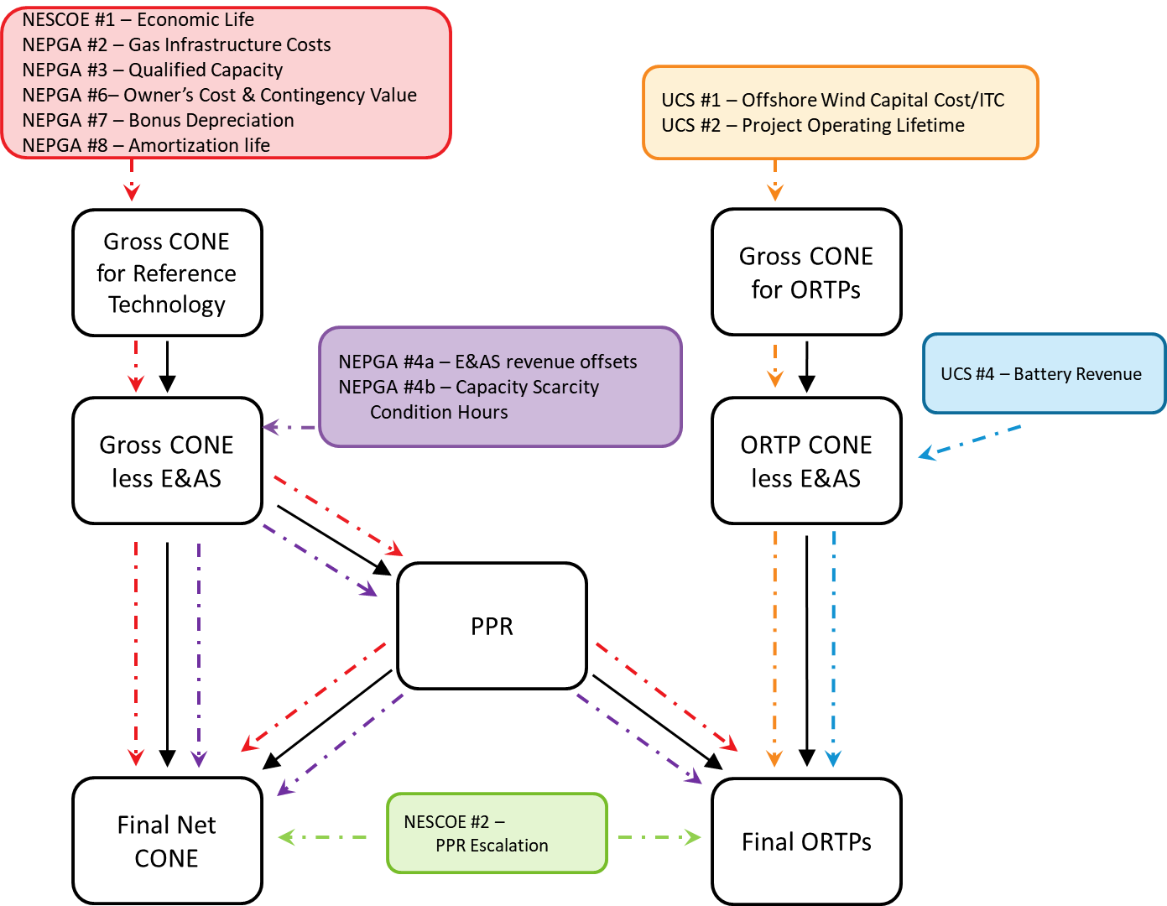
Impacts of Amendments on FCM Parameters
New
Amendment numbers reflect those presented at the October 6-8 meeting

Slide 24
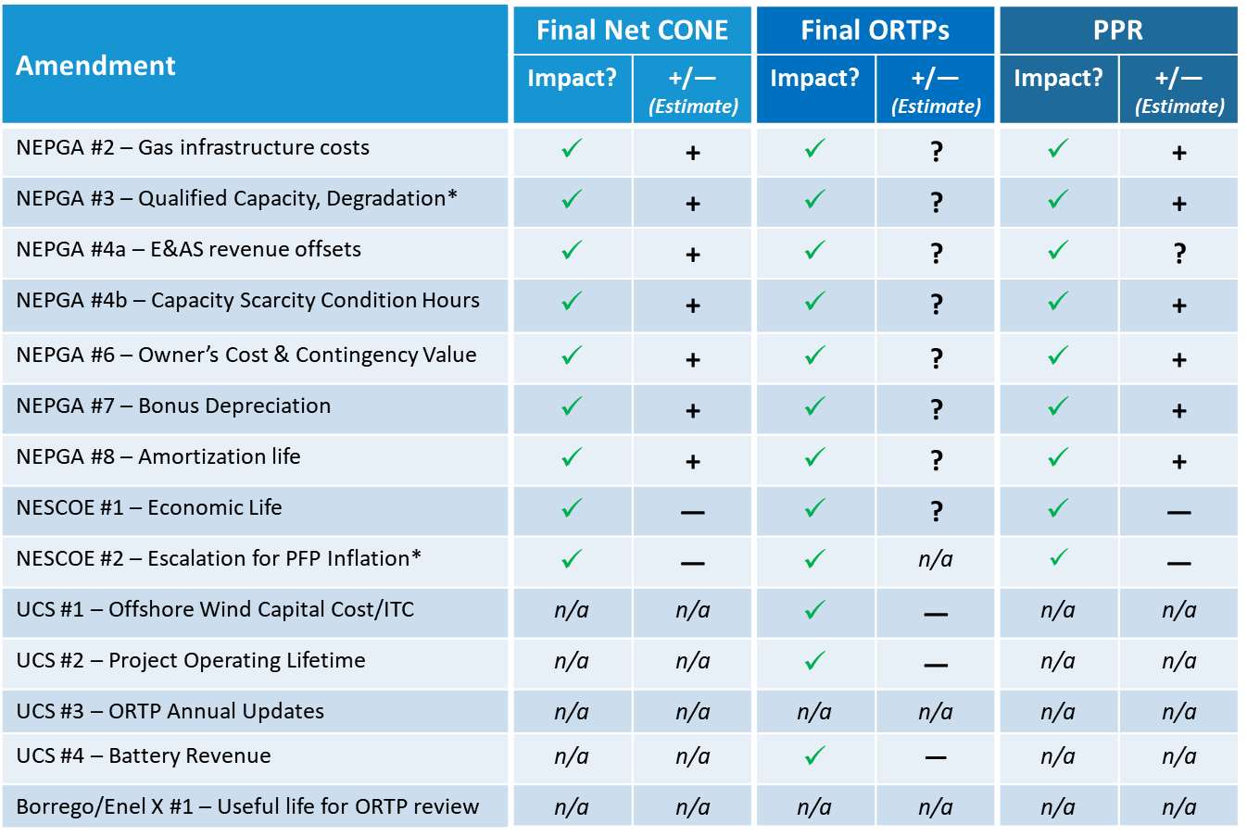
Estimated impacts of the Net CONE and ORTP amendments
New
Notes:
“?” indicates the impact is unknown or could vary among technology types
*Since the October 6-8 MC meeting, the ISO has incorporated degradation and escalation for PFP inflation into its proposal.

Slide 25
Stakeholder Schedule
Stakeholder Committee and Date | Scheduled Project Milestone
Markets Committee June 10, 2020 | Review initial projections of potential revenue offsets associated with FRM sunset
Markets Committee July 14-16, 2020 | Review initial projections of potential revenue offsets associated with ESI and initial discussion of proposed level of excess adjustment methodology PPR introduction and overview
Markets Committee August 11-13, 2020 | Review modeling the system at equilibrium for the Net Cost of New Entry Continued discussion of revenue offsets Review PPR inputs and calculation Discuss the indicative PPR
Markets Committee September 8-10, 2020 | Updated values for Energy Security Improvement revenue impacts Review the indicative PPR Discuss proposed Tariff revisions
Markets Committee October 6-8, 2020 | Updated values for Energy Security Improvement revenue impacts Review the indicative PPR Discuss proposed Tariff revisions

Slide 26
Stakeholder Schedule
Stakeholder Committee and Date | Scheduled Project Milestone
Markets Committee October 26, 2020 | Updated Net CONE, PPR, and ORTP values Discuss proposed Tariff revisions
Markets Committee November 9-10, 2020 | MC vote on FCM parameter updates and associated amendments
Participants Committee December 3, 2020 | PC vote on FCM parameter updates and associated amendments
December 2020 | FERC Filing

Slide 28
Acronyms Used in this Presentation
CCP = Capacity Commitment Period
CONE = Cost of New Entry
E&AS = Energy & Ancillary Services
ESI = Energy Security Improvements
FCM = Forward Capacity Market
FRM = Forward Reserve Market
LMP = Locational Marginal Price
LOE = Level of Excess
MRI = Marginal Reliability Impact
NICR = Net Installed Capacity Requirement
ORTP = Offer Review Trigger Price
PPR = Performance Payment Rate
QC = Qualified Capacity

Slide 29
Appendix A
Impacts on Net CONE and ORTP Values
Escalated Performance Payment Rate
Revised Scarcity Hours: Average Approach
Revised Scarcity Hours: FCA 15 Values

Slide 30
Impact of PPR Escalation on Net CONE and ORTP values: Changes from Oct. 6-8 values due to PPR Escalation Alone

Slide 31
Impact of Scarcity Hour change on Net CONE and ORTP values: Changes from Oct. 6-8 values due to revised scarcity hours alone, with smoothing (averaging) as proposed

Slide 32
Impact of Scarcity Hour change on Net CONE and ORTP values: Changes from Oct. 6-8 values using FCA15 scarcity values alone (NOT proposed, for information only)

Slide 33
Appendix B
Incremental Energy Security Improvements revenue offsets for the Net CONE and ORTP modeled technologies
ISO proposal
NEPOOL proposal

Slide 34
Incremental ESI revenue offsets Net CONE Technologies – ISO Proposal

Slide 35
Incremental ESI revenue offsets Net CONE Technologies – NEPOOL Proposal

Slide 36
Incremental ESI revenue offsets Combustion Turbine ORTP – ISO and NEPOOL Proposal
New

Slide 37
Appendix C
Tariff Revisions for CONE, Net CONE, PPR, and ORTPs

Slide 38
Summary of Proposed Tariff Changes Definitions
From October 6-8 presentation
Tariff Section | Description of Change
I.2.2 – Net CONE | Update existing definition to more clearly reflect calculation of Net CONE
I.2.2 – Offer Review Trigger Prices | New defined term

Slide 39
Summary of Proposed Tariff Changes CONE and Net CONE
From October 6-8 presentation
Tariff Section | Description of Change
III.13.2.4 Forward Capacity Auction Starting Price and the Cost of New Entry | Update CONE and Net CONE values for the Capacity Commitment Period beginning June 1, 2025 Note the next CONE and Net CONE recalculation will be for the Capacity Commitment Period beginning June 1, 2028

Slide 40
Summary of Proposed Tariff Changes Performance Payment Rate
Revised from October 6-8 presentation
Tariff Section | Reason for Change
III.13.7.2.5 Capacity Performance Payment Rate | Indicate that the Capacity Performance Payment Rate of $5,455/MWh applies to the Capacity Commitment Period beginning on June 1, 2024 and ending on May 31, 2025 Update the Capacity Performance Payment Rate for the Capacity Commitment Periods beginning on or after June 1, 2025 to $9,140 8,856/MWh
Note: Three sets of Tariff redlines have been provided reflecting the Performance Payment Rate under the three scenarios. The value above reflects the ESI market changes filed by ISO and the sunset of FRM.

Slide 41
Summary of Proposed Tariff Changes ORTPs
Revised
Tariff Section | Description of Change
III.A.21.1.1 Offer Review Trigger Prices for the Forward Capacity Auction | Update ORTP values for the Capacity Commitment Period beginning June 1, 2025 Add Battery as a new technology for Generating Capacity Resources Add Solar (in the ISO-ESI and NEPOOL ESI cases) as a new technology for Generating Capacity Resources Add On-Peak Solar and Solar + Battery as new technologies for Demand Capacity Resources Remove the Load Management ORTP categories for Demand Capacity Resources – Residential Combine the Demand Capacity Resources - Commercial and Industrial and Demand Capacity Resources – Residential into one Demand Capacity Resources category

Slide 42
Summary of Proposed Tariff Changes ORTPs
From October 6-8 presentation
Tariff Section | Description of Change
III.A.21.2 (e)(1) | Capital costs for non-renewable technologies will be updated based on changes in the Bureau of Labor Statistics Producer Price Index for Machinery and Equipment: General Purpose Machinery and Equipment index Capital costs for renewable technologies will be updated based on changes in the Bureau of Labor Statistics Producer Price Index for Goods Less Foods and Energy – Private Capital Equipment index Remove the table of indices used to update individual line items for capital costs in the capital budgeting model
III.A.21.2 (e)(2) | Remove the table of indices used to update individual line items for fixed operating and maintenance costs in the capital budgeting model Modify the description to reflect the single index to be used to update capital costs

Slide 43
Summary of Proposed Tariff Changes ORTPs
Revised from October 6-8 presentation
Tariff Section | Description of Change
III.A.21.2 (e)(3) | Include ESI revenue offsets in the E&AS revenues update Indicate that Henry Hub natural gas prices, Algonquin Citygates Basis natural gas futures prices, and Massachusetts Hub Day-Ahead Peak electricity prices published by ICE on the first five trading days in February will be input to the capital budgeting model to update E&AS revenues Change the dates of the indices from the CCP beginning June 1, 2021, to the months of the commitment period to which the values will apply

Slide 44
Summary of Proposed Tariff Changes ORTPs
From October 6-8 presentation
Tariff Section | Description of Change
III.A.21.2 (e)(4) | Revise to indicate the average of the MA Class 1 REC prices for the most recent five-year vintages will be used
III.A.21.2 (e)(5) | New section noting that bonus tax depreciation will be reduced each year by 20% starting with the Capacity Commitment Period beginning on June 1, 2026

Slide 45
Appendix D
Current Interim Update Process of Energy & Ancillary Service Revenues

Slide 46
E&AS Revenue Offsets – Interim Update Example
At the time of the update, most recent Henry Hub, Algonquin CGS Basis, and Mass Hub On-Peak values are obtained from ICE
Henry Hub and Algonquin CG Basis are summed (‘Algonquin CG Delivered’)
Ratio of the Algonquin CG Delivered to the Mass Hub On-Peak is calculated (‘Ratio’)
Average of the 12-month ratios is calculated
Difference between most-recent 12-month ratio and 12-month ratio calculated at 2016 Net CONE reset is calculated
This value (-5.80%) is applied to the original (2016) E&AS revenues
Note: Example is from the FCA 15 ORTP update spreadsheet, which can be found in the FCM section of the ISO New England website, under the FCM section, under FCM Internal Market Monitoring Documentation
1
2
3
4
5
5
1
2
3
4
5

