Slide 1


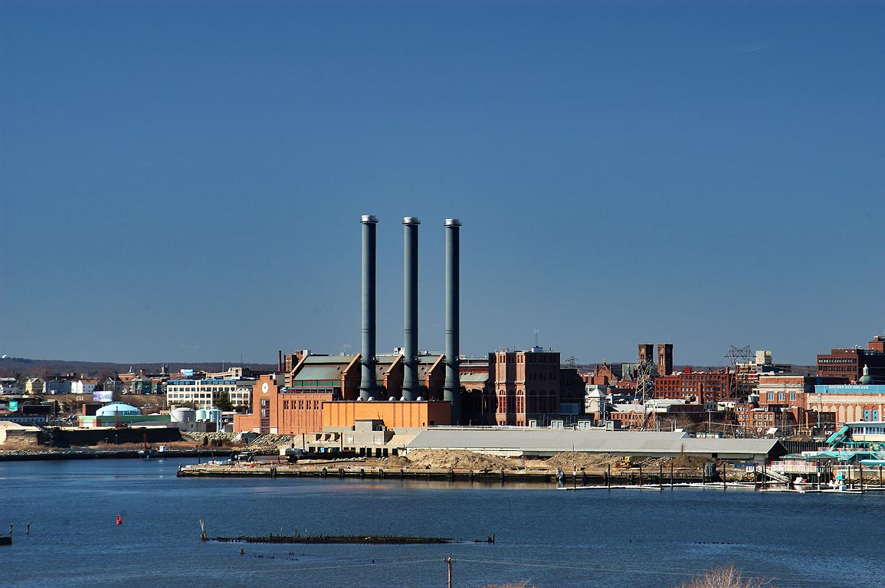
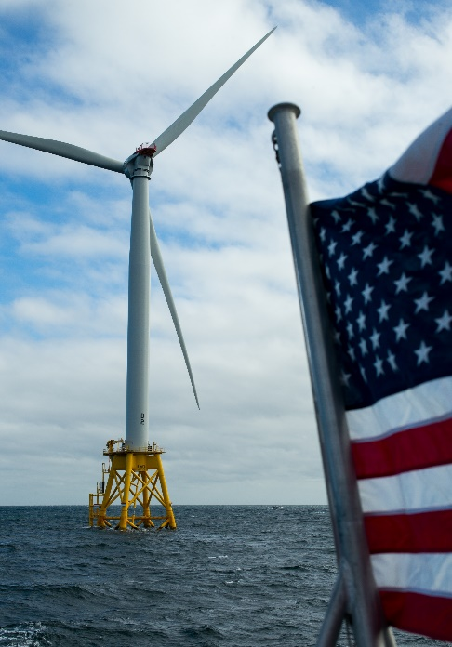

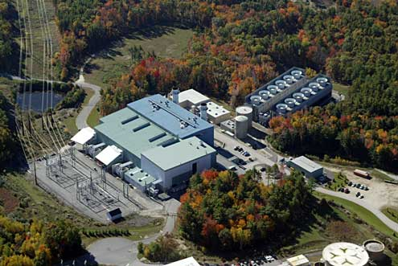

ISO-NE CONE and ORTP Analysis
October 7, 2020
Danielle Powers, Al Ferrer

Slide 2
Overview & Purpose: Agenda
Review of RENEW Offshore Wind Analysis
Review of September Posted Memos
Pay for Performance Update

Slide 3
Offshore Wind Recap

Slide 4
Offshore Wind Position
RENEW has proposed to revise the capital costs for the offshore wind unit downward from the current bottoms up estimate of $5,876/kW to $2,900/kW based on:
Publicly available data on offshore wind capital costs; and
An implied capital cost analysis based on PPA prices proposed in recent offshore wind solicitations of $65/MWh to $74/MWh
Concentric has reviewed the publicly available source data and has several concerns with relying on this data to develop a reasonable proxy for an offshore wind unit capital cost
A review of the data sources provided by RENEW confirmed that the capital costs are often estimated costs based on European installations with no visibility into what is included in these costs
Other data sources provided insufficient information on underlying assumptions (i.e. unit life, interconnection costs, financing structure and costs, etc) from which to form a basis for an ORTP value for an offshore wind unit
The PPA analysis performed by RENEW is an implied market-based capital cost, meaning that the analysis is solving for what the capital cost would have to be to achieve the proposed PPA pricing, which is materially different from a bottoms up analysis
Using auction results as indicators for the real cost of offshore wind development has important limitations that render their use as the basis for an assumed capital cost inappropriate
Concentric and Mott MacDonald do not believe it is physically possible to build an 800MW offshore wind farm for $2,900/kW in the location cited, and in New England generally, at this time.

Slide 5
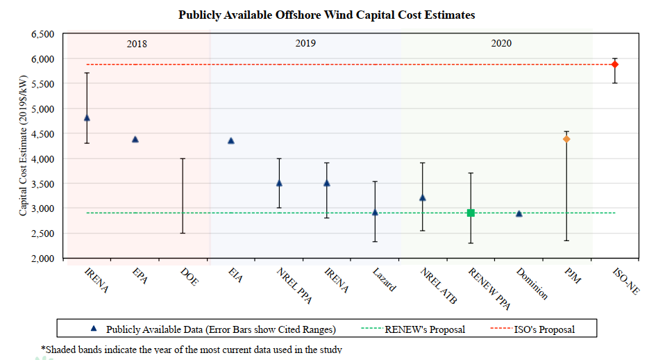
RENEW Presentation – September 2020 MC
RENEW Analysis
RENEW cited several publicly available documents containing various installation costs for offshore wind facilities
RENEW recommends the ORTP be based upon its own PPA analysis of one current executed offshore wind contracts
Source: RENEW Presentation, September 8-10, 2020, Slide 7

Slide 6
Renew Presentation – September 2020 MC
Subsequent slides will discuss each data source in more detail
Without careful review of the underlying data and assumptions in each study, this data comparison can be flawed or misleading, and is insufficient to rely on for an ORTP calculation
Data relies on world averages, mainly reflecting European & Chinese installations
Data does not consider New England location
Figure compares CEA/MM cost estimate to other overnight costs
Insufficient detail on costs included in overnight costs
Inclusion of interconnection costs varies or is unclear
Length of interconnection to shore is unclear or not included
Inclusion of system upgrade costs varies or is unclear

Slide 7
Review of RENEW Data Sources
IRENA: Renewable Power Generation Costs in 2018
IRENA’s report is not specific to the cost of constructing offshore wind in the US. In fact, IRENA’s report suggests that its data on the cost of offshore wind was derived “almost exclusively” from installations in Europe and China (IRENA’s report, at 23)
RENEW’s quoted values of $4,300/kW to $5,700 / kW was derived from European projects, with some of these projects “better categorized as demonstration projects” (IRENA report at 24)
The IRENA report notes that there is “wide variation” in the cost of offshore wind by country (IRENA’s report, at 24).
IRENA: Renewable Power Generation Costs in 2019
Just like the 2018 report, this 2019 report is not specific to the cost of constructing offshore wind in the US. Again, IRENA notes that the cost of offshore wind varies substantially by country:
“The yearly volatility in total installed costs is due to site-specific nature of offshore wind projects and the differences in market maturity and the scale of local or regional supply chain. As deployment in each year is distributed slightly differently across markets this can drive yearly volatility.”
“But there are drivers for differences in total installed costs by country. The most notable is who is responsible for the wind farm-to-shore transmission assets. In some countries the transmission assets are owned by the national or regional transmission network, in some cases they are owned by the wind farm developer. Looking at the total installed cost trends by country is therefore important to understand how cost structures are evolving."(IRENA’s Report, at 80)

Slide 8
Review of RENEW Data Sources (cont’d)
EPA: IPM Platform 2018 Reference Case
EPA’s report suggests that the capital cost of a 600 MW offshore wind facility, in 2016 dollars, is $4,529 / kW if the facility is installed in 2021, $4,169 in 2016 dollars if the facility is installed in 2023, and $4,122 if the facility is installed in 2025 (EPA Report, at 4-28 to 4-29). RENEW’s quoted value of $4,375 / kW appears to reflect the 2025 value of $4,122 / kW, escalated by 3 years of 2% inflation
EPA’s report indicates that an upward adjustment of 6.5% to 8.1% is required to reflect the location in ISO-New England. (EPA Report, at 4-26), bringing the $4,122/kW value to $4,390/kW
EPA’s report also includes meaningful “Short-Term Capital Cost Adders”
This adder is intended to reflect the concept that, if more than a certain amount of a resource is added in any one year, capital costs increase as projects have to compete for scarce labor and materials (EPA Report, at 4-21 to 4-22)
For offshore wind, these adders are quite material, and have relatively low thresholds. For example, in 2025 (i.e., the year RENEW used in its analysis), there is an adder of $1,893 / kW if more than 1,150 MW of capacity is added (EPA Report, at 4-25)
The inclusion of these two adders moves RENEW’s $4,122/kW value to $6,283/kW

Slide 9
Review of RENEW Data Sources (cont’d)
DOE: 2018 Offshore Wind Technologies Market Report
This analysis is not specific to projects located in the United States. The DOE notes that the low end of the range implied by its 2018 figures is set by a project located in China, and the high end of the range is set by a project located in the UK. (DOE report, at 59)
The DOE adds several disclaimers to its data, stating:
“These CapEx data have some uncertainty for various reasons: 1) the CapEx data are normally self-reported by developers and difficult to verify independently, 2) there is limited transparency into the financial impact of cost overruns, and 3) it is often unclear whether the reported CapEx fully captures the total cost of installing the project and connecting it to the grid” (DOE Report, at 60)
There is a footnote attached to this statement, which reads: “For example, it is unclear if the announced capital expenditure values include soft costs, such as construction financing, insurance, or fees.” (DOE Report, at 60)
EIA: AEO2020 Cost of New Generation Technologies
EIA reports a generic “base overnight cost” for offshore wind of $4,356/kW, which is the value reported by RENEW (EIA Report, at 2)
Just one page after the page cited by RENEW, EIA reports an overnight capital cost by region. For offshore wind built in ISO-New England, the EIA estimates an overnight capital cost of $5,446/kW (EIA Report, at 3)
This implies a $1,090/kW locational adder to generic overnight costs

Slide 10
Review of RENEW Data Sources (cont’d)
NREL: Vineyard Wind PPA Analysis
NREL’s capital cost estimate of $3,500/kW was derived from European projects, not anything specific to US plants. Specifically, NREL states:
“The capital expenditures (CapEx) of $3,500/kilowatt (kW) was sourced from Bloomberg New Energy Finance (2018) for the prevailing average CapEx for offshore wind projects in Europe.” (NREL Report, at 6)
The Bloomberg article cited by NREL specifically notes that US projects will be more expensive than European ones:
“The U.S. is a latecomer to the market, and early projects may cost more than those in Europe, in large part because developers will need to import components for the massive offshore structures, which can be as big as 600 feet (183 meters)”
NREL also highlights several limitations to its analysis
“The assumptions made herein about the PPA contract pricing have not been validated extensively and reflect a first-order deterministic scenario that does not capture the inherent uncertainty of many of the parameters considered”(NREL Report, at 11)
Specific limitations include, but not limited to:
Uncertainty associated with the assumed CapEx of the project (which was estimated from global averages but was not explicitly known to the authors)
Strategic bidding behavior (e.g., to gain an advantage as a first mover/market entrant) are not considered in this study but might have impacted the Vineyard Wind LLC/EDC PPA price

Slide 11
Review of RENEW Data Sources (cont’d)
Lazard: 2019 Levelized Cost of Energy
There is extremely limited information on how these cost estimates were derived
It is unclear what region the cost estimates relate to, whether the analysis assumes floating or fixed facilities
Cost estimates do not include network upgrades, transmission, congestion, permitting, environmental costs
Lazard notes that these costs “could have a potentially significant effect on the results contained herein, but have not been examined in the scope of this current analysis” (Lazard at 1)
NREL: 2020 Annual Technology Baseline
These cost estimates appear to reflect a total overnight cost, plus the cost of grid interconnection, grossed up 7.5% for a “construction finance factor”.
It’s not clear what region of the US these cost estimates relate to
Dominion IRP
Dominion’s IRP indicates that these values represent “overnight installed cost”
RENEW indicates that Dominion’s estimate reflects the costs of three projects, each 852 MW. However, those three projects are all located in Virginia, not New England
PJM: Recalculation of the Default MOPR Floor Offer Prices
PJM uses an estimated cost of $4,375/kW and uses several of the same public sources cited by RENEW
This does not account for regional adjustments for the New England location

Slide 12
RENEW PPA Analysis
RENEW calculates an implied capital cost of $2,900/kW based on a Vineyard Wind PPA cost between $65/MWh and $74/MWh
The implied capital cost does not represent an estimated capital cost; rather, it represents a market-based cost with many unknowns and assumptions
New York State’s Empire Wind, has a PPA with a first-year price of $99.08/MWh, escalating at 2% per year
LIPA’s two Deepwater Wind Projects have first-year costs of $160 per MWh and $86 per MWh, respectively, escalating at 2% per year
For comparison, in its most recent report, EIA estimated the real levelized cost of energy for offshore wind facilities beginning service in 2025 between $102.68/MWh and $155.55/MWh, with an average price of $122.25/MWh (2019$)
Also, as noted in the NREL analysis of the Vineyard Wind PPA, adjusting for “expected revenue sources and tax benefits inclusive of those that are exogenous to the PPA” produces “an LROE of $98/MWh ($2018) for the combined facilities (800 MW) of the Vineyard Wind LLC project.” (NREL at 7)
The discrepancy between estimated costs and PPA bids may be due to “winner’s curse”
Auction winners tend to underestimate costs and overestimate benefits
If the true LCOE of the Vineyard Wind project is closer to the higher of the EIA estimates, for example ($160/MWh), the RENEW implied capital cost would MORE THAN DOUBLE
Because none of these projects have been built yet, the reliance on a PPA cost to imply a capital cost is highly speculative and cannot be relied upon

Slide 13
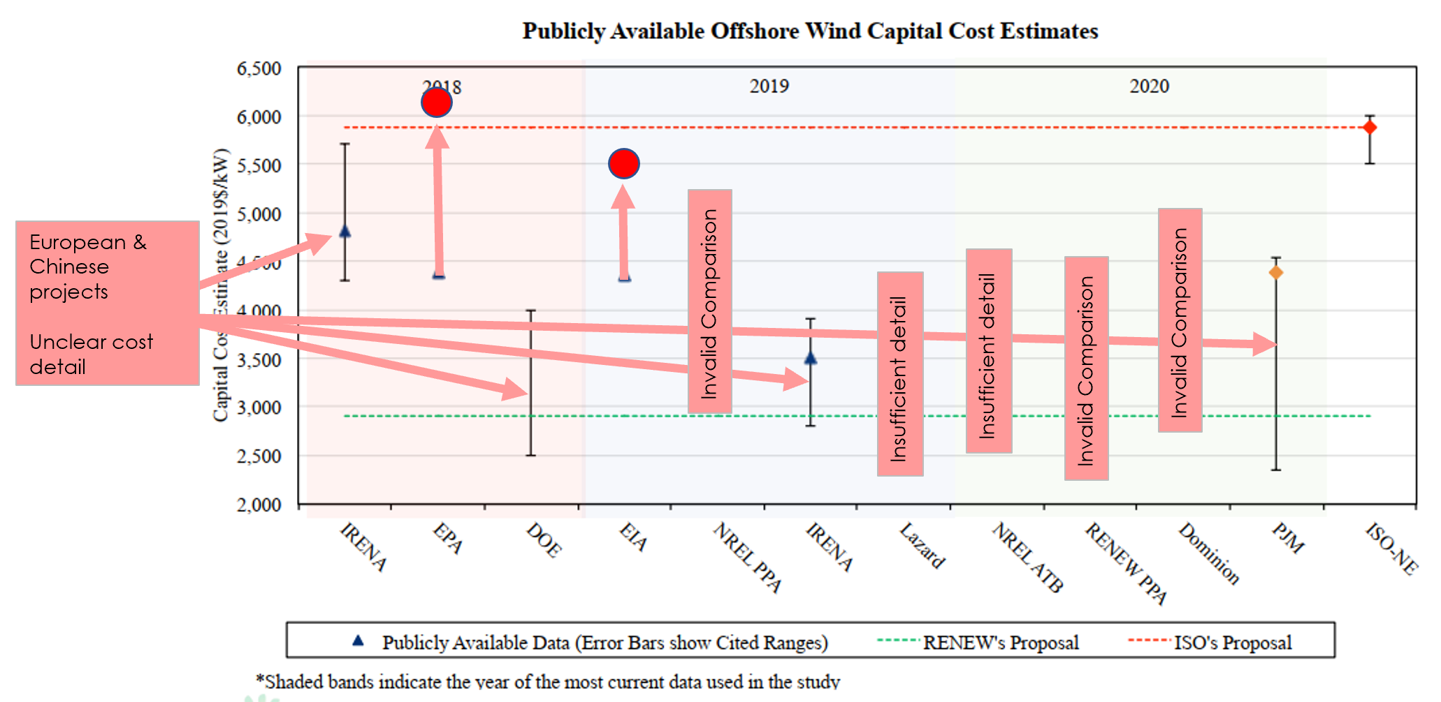
Conclusion
RENEW analysis is inappropriate to rely on for purposes of estimating offshore wind capital costs
Estimated ranges should be revised upward
Most of the data quoted relies on European or Chinese projects
Most of the data quoted provides insufficient detail to determine if comparisons to the CEA/MM estimate are “apples to apples”
NREL analysis that uses a PPA rate to solve for capex freely acknowledges that PPA rates may not fully cover the cost to build and operate a given project
Studies that do provide insight into costs in New England suggest capex in the range of $5,400-6,300/kW
CEA/MM estimate falls squarely in that range

Slide 14
Pay for Performance Update

Slide 15
Pay for Performance
Intermittent resource Availability “A” value updated for expected physical performance during scarcity condition hours calculated using the scarcity hour weights and summer/winter QC values
Expected incremental PFP revenues earned by the intermittent units needs to account for the seasonal variation in the CSO MW that these units receive
Non-intermittent resource availability based on Mott MacDonald generation-specific estimates
PPR rates updates by ISO-NE
Technology | Nameplate MW | Summer Performance MW | Winter Performance MW | Scarcity Type Weighted Performance MW | Scarcity Weighted [A]
Onshore Wind | 82.5 | 19.4 | 39.0 | 21.5 | 26.1%
Offshore Wind | 800.0 | 212.6 | 451.2 | 239.1 | 29.9%
Solar | 20.0 | 10.9 | 0.2 | 9.7 | 48.6%
 | Transient | Summer | Winter | Total
Scarcity Hours | 0.8 | 7.2 | 0.4 | 8.4

Slide 16
Updated CONE and ORTP Values

Slide 17
Draft Net CONE & ORTP Values FRM Sunset & ISO-NE ESI Proposal

Slide 18
Draft Net CONE & ORTP Values – DR/EE FRM Sunset & ISO-NE ESI Proposal

Slide 19
Draft Net CONE & ORTP Values FRM Sunset & NEPOOL ESI Proposal

Slide 20
Draft Net CONE & ORTP Values FRM Sunset & NEPOOL ESI Proposal – EE/DR

Slide 21
Draft Net CONE & ORTP Values With FRM & No ESI

Slide 22
Draft Net CONE & ORTP Values With FRM & No ESI – EE/DR

