Slide 1
November 9-10, 2020 | MARKETS COMMITTEE
Third FERC Order 841 Compliance Filing
Jennifer Wolfson
413.540.4663 | jwolfson@iso-ne.com

Slide 2
Third FERC Order 841 Compliance Filing
WMPP ID:
129
Proposed Effective Date: Q1 2021 and January 1, 2026
The ISO is proposing tariff changes to comply with two of the directives in FERC’s August 4, 2020 Order in the Order 841 proceeding:
One set of changes addresses FERC’s concern that the tariff not create a barrier to entry, and will be effective Q1 2021
The other set of changes addresses FERC’s directive that the tariff include the bidding parameters the ISO will use to account for the state of charge and duration characteristics in the Day-Ahead Energy Market, and will be effective January 1, 2026
In addition, the ISO is proposing clean-up revisions in Appendix C of the tariff
In response to participant feedback, the ISO is proposing additional revisions to three of the definitions presented to the October Markets Committee meeting as part of the day-ahead state of charge changes
The ISO will be seeking a vote on the package of proposed revisions at today’s Markets Committee meeting and at the December 3, 2020 Participants Committee meeting

Slide 3
Overview of additional proposed revisions
The ISO is proposing additional revisions to three definitions; two definitions remain unchanged
The ISO is proposing additional changes to Initial State of Charge, Maximum State of Charge, and Minimum State of Charge
The Round Trip Efficiency and State of Charge definitions remain unchanged:

Slide 4
Additional revisions to Initial State of Charge
Several participants commented that a storage resource’s Initial State of Charge for the start of the next Operating Day cannot be known with certainty at the close of the Day-Ahead Energy Market and there may be little basis to form an expectation
To acknowledge this uncertainty in the tariff, the ISO is proposing the following revision to the definition:

Slide 5
Additional revisions to Maximum and Minimum State of Charge
Order 841 states that Maximum State of Charge and Minimum State of Charge “may be either static values based on manufacturer specifications or dynamic values depending on the operational characteristics of the resource” P 215
Several participants have asked whether the ISO intends to limit Maximum and Minimum State of Charge to the physical value set by manufacturer specs, or whether the values will be dynamic, to reflect operational characteristics
It is not the ISO’s intention that the parameters be limited to manufacturer’s specifications; rather, these parameters can reflect dynamic operational characteristics
To clarify that, the ISO is proposing to additional revisions to the two definitions

Slide 6
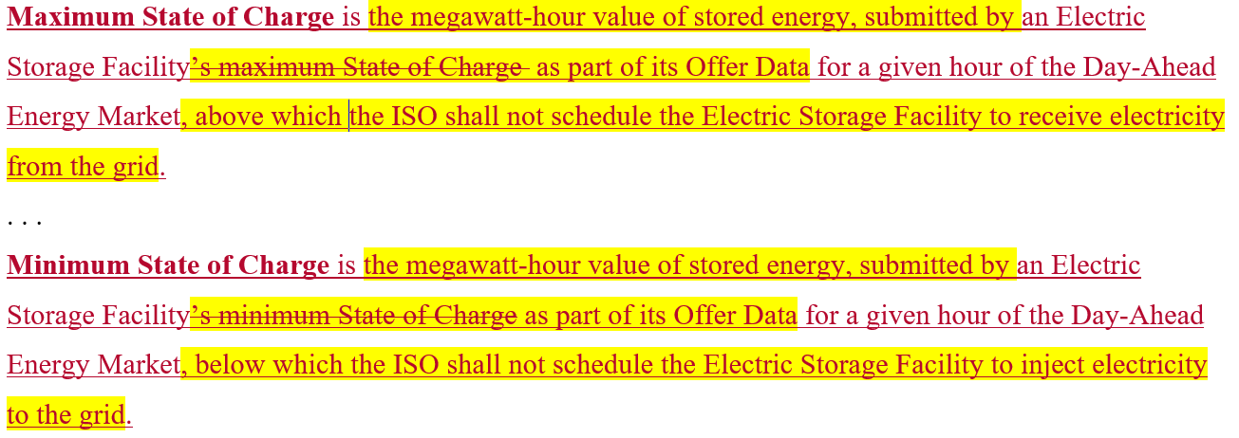
Additional revisions to Maximum and Minimum State of Charge, cont.
The additional proposed revisions are highlighted in yellow:
The ISO may include checks of these parameter values in eMarket to prevent gaming, infeasible dispatch, and/or inefficient pricing outcomes; this determination will be made closer to the January 1, 2026 implementation date

Slide 7
Conclusion
The ISO is proposing tariff changes in compliance with two of the directives in FERC’s August 4, 2020 Order in the Order 841 proceeding
One set of changes addresses FERC’s concern that the tariff not create a barrier to entry, and will be effective Q1 2021
The other set of changes addresses FERC’s directive that the ISO include in its tariff the mechanism by which it will account for State of Charge and Duration Characteristics in the Day-Ahead Energy Market, and will be effective January 1, 2026
In addition, the ISO is proposing clean-up revisions in Appendix C of the Tariff

Slide 8
Stakeholder Schedule
Stakeholder Committee and Date | Scheduled Project Milestone
Markets Committee September 8-10, 2020 | Discussion of proposed tariff revisions
Markets Committee October 6-8, 2020 | Continued discussion of proposed tariff revisions
Markets Committee November 9-10, 2020 | Continued discussion of proposed tariff revisions and vote
Participants Committee December 3, 2020 | Discussion of proposed tariff revisions and vote

Slide 10
Appendix
Summary of Proposed Tariff Revisions

Slide 11
Summary of Proposed Tariff Changes
Section | Change | Reason for Change
Tariff Section I.2.2 | Initial State of Charge is the State of Charge that an Electric Storage Facility offers expects to have at the start of hour one of the Day-Ahead Energy Market. | Day-ahead bidding parameters to allow ISO to comply with FERC’s directive to account for State of Charge and Duration Characteris-tics in the Day-Ahead Energy Market
 | Maximum State of Charge is the megawatt-hour value of stored energy, submitted by an Electric Storage Facility’s maximum State of Charge as part of its Offer Data for a given hour of the Day-Ahead Energy Market, above which the ISO shall not schedule the Electric Storage Facility to receive electricity from the grid.
 | Minimum State of Charge is the megawatt-hour value of stored energy, submitted by an Electric Storage Facility’s minimum State of Charge as part of its Offer Data for a given hour of the Day-Ahead Energy Market, below which the ISO shall not schedule the Electric Storage Facility to inject electricity to the grid.
 | Round-Trip Efficiency is a percentage expressing the megawatt-hours of energy that an Electric Storage Facility injects onto the grid per megawatt-hour of energy it receives from the grid.

Slide 12
Summary of Proposed Tariff Changes
Section | Change | Reason for Change
Tariff Section I.2.2 | State of Charge is the total quantity of megawatt-hours available to be injected by an Electric Storage Facility onto the grid. | Comply with FERC’s directive to account for State of Charge and Duration Characteristics in the Day-Ahead Energy Market
Tariff Section III.1.10.6 | In clearing the Day-Ahead Energy Market, the ISO will respect Electric Storage Facility Initial State of Charge, Round Trip Efficiency, Maximum State of Charge, and Minimum State of Charge account for maximum run time, maximum charge time, state of charge, maximum state of charge, and minimum state of charge through bidding parameters or other means, as required by the Commission in Order No. 841.

Slide 13
Summary of Proposed Tariff Changes
Section | Change | Reason for Change
Tariff Section III.1.10.6(b)(ii) | A storage facility’s charging energy load shall not qualify as, or be billed to, a Storage DARD if that facility’s charging energy is included in another the Host Participant is unwilling or unable to support the registration, metering, and accounting of the storage facility’s load as a separate and distinct Load Asset. A storage facility registered as a DARD will be charged the nodal Locational Marginal Price by the ISO and the Market Participant will not pay twice for the same charging load energy. | Comply with FERC’s directive regarding not creating barrier to entry
Appendix C (Section III.C.6, Steps 3 and 4) | (excluding station service and pumps Storage DARDs) | Clean-up change

