Slide 1
Transmission cost allocation issues for Behind The Meter (BTM) generation
Frank Ettori
(on behalf of the Avangrid, Eversource, National Grid, VELCO, and Versant)
1/12/2021

Slide 2
Introduction
Why are we here?
  TO’s responding to the Internal Market Monitor’s spring 2020 Quarterly Markets Report: Transmission Cost Allocation Issues for Behind-the-Meter Generation (Markets Committee, August 13, 2020)*
Why is it an issue?
  Affects cost allocation for transmission.
  Inconsistent interpretation of tariff language
*IMM Quarterly Markets Report: https://www.iso-ne.com/staticassets/documents/2020/07/2020-spring-quarterly-markets-report.pdf

Slide 3
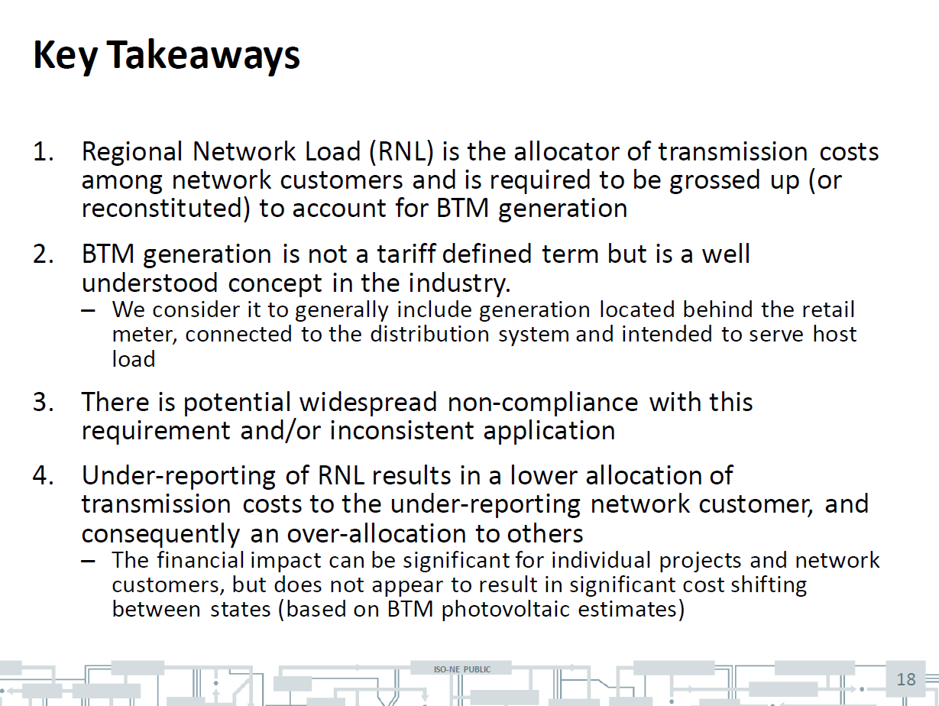
ISO-NE IMM Key concerns

Slide 4
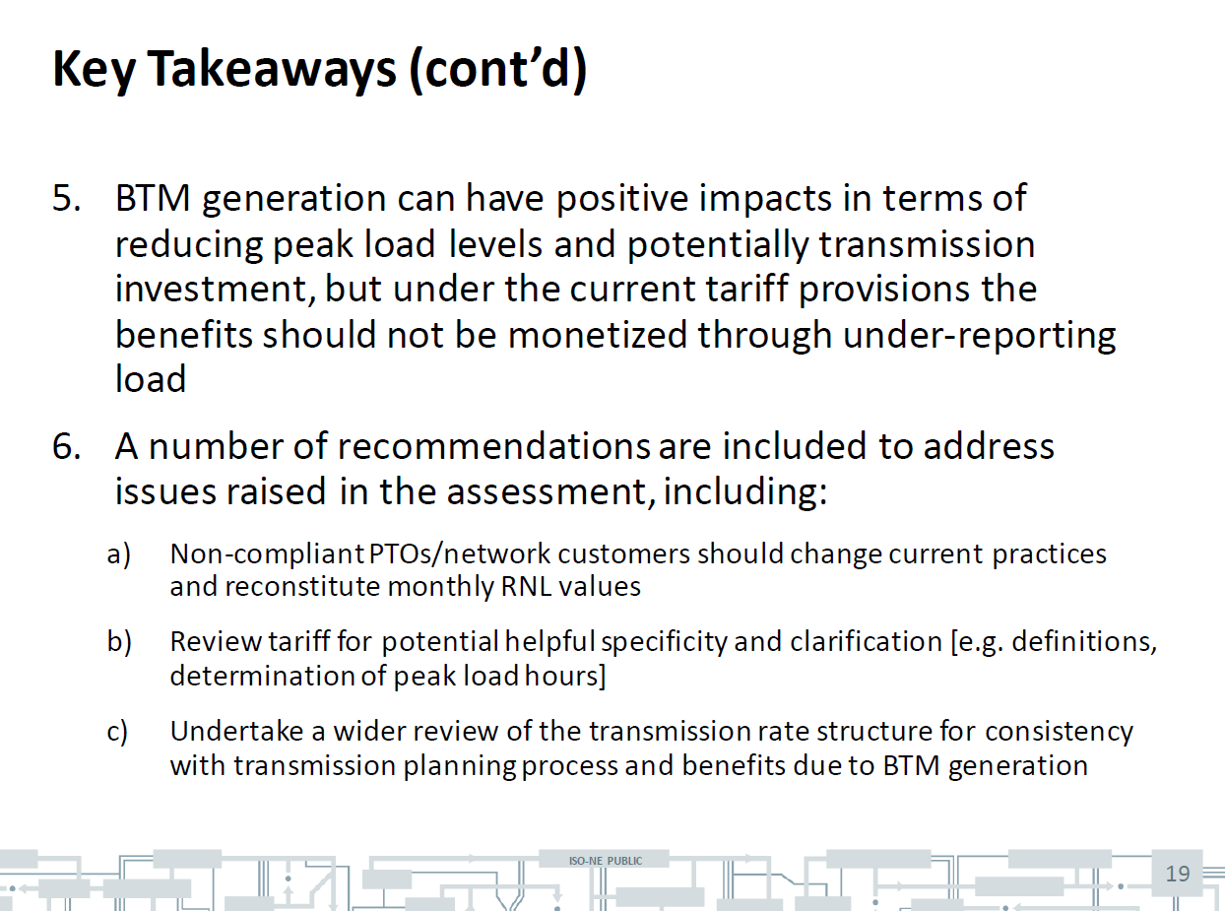
ISO-NE IMM Concerns (cont)

Slide 5
Guiding Principles
Address IMM concern.
Consistent approach for transmission costs.
Minimal investment for settlement, metering, and administrative costs.
Do no harm to New England State policies.

Slide 6
TOs calculate Regional Network Load (RNL) from internal generation and tie lines
RNL = Arithmetic summation of tie lines and generation.
If a generator is included in the RNL calculation, it does not reduce the calculated RNL
If a generator is not included in the RNL calculation, the calculated RNL is lower
Unit | Unit output
U1 | 200 MW
U2 | 500 MW
Net ties | 300 MW
Network load (Ignoring losses) | 1,000 MW
200 MW
100 MW
200 MW
U1: 200 MW
U2: 500 MW

Slide 7
Proposed tariff changes
Section I General Terms and Conditions
New definition of Behind-the-Meter Generation
Behind-the-Meter Generation is, for the purpose of calculating Regional Network Load, 1) an electric generation resource that is not registered as a Generator Asset with ISO-NE or 2) the portion of an electric generation resource that is not reported in the output of the registered Generator Asset associated with the electric generation resource because it serves load located behind the same retail customer meter as the electric generation resource.
Revised definition of RNL
Regional Network Load is the load that a Network Customer designates for Regional Network Service under Part II.B of the OATT. The Network Customer’s Regional Network Load shall include all load designated by the Network Customer (including losses) and shall not be credited or reduced for any behind the meter generation include load offset by Behind-the-Meter Generation. A Network Customer may elect to designate less than its total load as Regional Network Load but may not designate only part of the load at a discrete Point of Delivery. Where a Transmission Customer has elected not to designate a particular load at discrete Points of Delivery as Regional Network Load, the Transmission Customer is responsible for making separate arrangements under Part II.C of the OATT for any Point-To-Point Service that may be necessary for such non-designated load.
Generator Asset is a device (or a collection of devices) that is capable of injecting real power onto the grid that has been registered as a Generator Asset in accordance with the Asset Registration Process.

Slide 8
Examples
Example | ISO-NE Registration | RNL Impact
Rooftop solar array (10 kW) | Not registered | Not included in RNL calculation
Stand-alone distribution-connected PV array (4 MW) | SOG | Included in RNL calculation
Stand-alone distribution-connected PV array (4 MW) | Not registered | Not included in RNL calculation
1 MW distributed generator co-located with 2 MW load | Not registered | Not included in RNL calculation
3 MW distributed generator co-located with 2 MW load | Generation (1 MW) registered as SOG | Net generation included in RNL calculation
530 MW generator with 30 MW online station service load | Generation (500 MW) registered as Generator Asset | Net generation included in RNL calculation
2MW Stand-alone Battery storage | Not Registered | Not Included in RNL
3MW Stand-alone Battery storage | Only Registered as ATRR | Not Included in RNL
3MW Stand-alone Battery storage | Registered as a Generator Asset | Included in RNL calculation
500kW Order 2222 designated resource | Registered as a Generator Asset | Included in RNL calculation
SOG: Settlement Only Generator
ATRR: Alternative Technology Regulation Resource

Slide 9
Proposed Schedule going forward
Nov 17: PTO-AC discussion
Dec 10:
  Introductory discussion at Transmission Committee
Jan:
  Introductory discussion at Markets Committee
  1/19: PTOAC vote
  1/26: Follow-up discussion at TC
Feb:
  Vote at TC
  Follow-up discussions at MC
Mar: Votes at MC
April:
  Vote at NPC
  File at FERC
June: Effective date

Slide 10

Questions/Comments

