Slide 1
Amendment to the ORTP Calculation for
Combined Resources for FCA 16
Presented by
RENEW Northeast
Borrego Solar Systems
ENGIE
EnelX
Advanced Energy Economy
For NEPOOL Markets Committee | February 24, 2021

Slide 2
Presentation Outline
Amendment Goals
Background
Process Concerns
Concerns with Accuracy of ISO’s Combined ORTP Analysis
Proposed Amendment
Including Tariff Red Lines

Slide 3
Amendment Goals
The amendment will clarify existing Tariff language to even more definitively state that in assigning the Offer Review Trigger Price (ORTP) for FCA 16 the Internal Market Monitor (IMM) will, for
Co-located assets of multiple technology types (e.g., PV + battery) registering as a single Forward Capacity Market (FCM) resource:
assign an ORTP equal to the weighted average of the ORTPs applicable to the asset(s) comprising the resource, as prescribed in Sections III.A.21.1.1 and III.A.21.2(c); and for
Co-located assets of multiple technology types registering as separate FCM resources:
assign each FCM resource its own ORTP as applicable solely to the technology of the asset(s) underlying the resource.
For FCA 17 or after, we would support a robust stakeholder process that would afford stakeholders time to:
Review the applicability and appropriateness of the Weighted Average (WA) formula
Review the assumptions used to determine the ORTP for a ”combined” resource type

Slide 4
Background
4

Slide 5
Terminology
“Assets”
Participate in the Energy Market.
Multiple Assets can share a common point of interconnection (POI)
While sharing a POI, these assets may be owned and operated by independent entities, have separate Asset IDs, and may offer, schedule, and settle independently
“Capacity Resources”
Participate in the Forward Capacity Market
Resources must be made up of one or more Assets.
of each other.

Slide 6
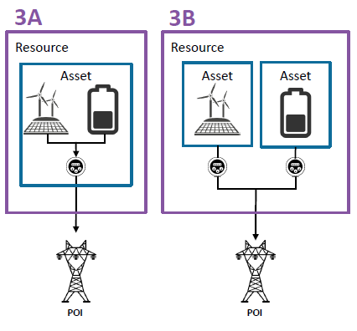
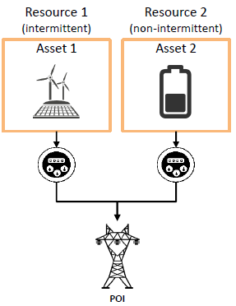
Terminology
“Co-located” – Undefined term that refers to two assets behind the same POI that participate in the FCM separately as two distinct capacity resources
“Hybrid” – Undefined term that refers to one or more assets behind the same POI that participate in the FCM as a single capacity resource
“Combined” – Undefined term used in ISO’s redlines that IMM has stated verbally refers to both hybrid and co-located resources.
ISO’s proposed Tariff redlines include a “Combined Photovoltaic Solar and Energy Storage Device - Lithium Ion Battery” technology type and corresponding ORTP value in both the Generating and Demand Capacity Resource ORTP Tables

Slide 7
Benefits of Co-Location
For assets that are registered entirely independently in both the energy and capacity markets, what are the benefits of sharing a Point of Interconnection?
Sharing a POI generally means reduced interconnection costs (e.g., shared interconnection facilities, may eliminate need to expand substation, etc.)
Shared real estate, permitting, project management, etc. reduces per-unit costs
In some cases, sharing a POI may enable increased access to tax benefits like the ITC
Co-location may be pursued if/when it improves project economics
Would not expect co-location to degrade project economics (would expect projects to proceed independently if that were the case)
ISO’s proposed “combined” ORTP for co-located solar and storage indicates dramatically degraded economics compared to independent projects. This does not make sense conceptually.
Technology | ISO ORTP Values ($/kW-mo)
Solar | ($0.748)
Storage | $2.923
Combined Solar + Storage | $6.964

Slide 8
Benefits of Hybrid Resources
Hybrid resources are made up of multiple technology types registered jointly as a single capacity resource, but may be made up of assets that are registered either jointly or independently in the energy market.
Hybrid resources have all the same benefits of sharing a Point of Interconnection as co-located resources on prior slide
Hybridization may be pursued if/when it improves project economics
Would not expect hybridization to degrade project economics (would expect projects to proceed independently in FCM if that were the case)
ISO’s proposed “combined” ORTP for hybrid solar and storage indicates dramatically degraded economics compared to independent projects. This does not make sense conceptually.
Technology | ISO ORTP Values ($/kW-mo)
Solar | ($0.748)
Storage | $2.923
Combined Solar + Storage | $6.964

Slide 9
Terminology
“Weighted Average Approach” – The methodology currently described in III.A.21.1.1 for calculating the ORTP for resources that are comprised of assets with multiple technology types.
Section III.A.21.1.1. “Where a new resource is composed of assets having different technology types, the resource’s Offer Review Trigger Price will be calculated in accordance with the weighted average formula in Section IIIA.21.2(c).”
Section III.A.21.2(c) “For a new capacity resource composed of assets having different technology types, the Offer Review Trigger Price shall be the weighted average of the Offer Review Trigger Prices of the asset technology types of the assets that comprise the resource, based on the expected capacity contribution from each asset technology type. Sufficient documentation must be included in the resource’s qualification package to permit the Internal Market Monitor to determine the weighted average Offer Review Trigger Price.”
Example:
Technology | NEPOOL ORTP (2025$/kW-yr)
On-Shore Wind | $0.000
Storage | $2.612
Technology (MW of Qualified Capacity) | Calculation | NEPOOL ORTP (2025$/kW-yr)
100 MW On-Shore Wind + 50 MW Storage | ((100*0.000)+(50*2.612))/150 | $0.871

Slide 10
Process Concerns
10

Slide 11
Stakeholders offered amendment to clarify their understanding of the tariff at PC
WA method would apply to hybrid resources
Co-located resources would receive individual ORTPs
Failed with 59.74% in favor
Timeline
IMM Email to Stakeholder: Any combined resource will receive ORTP of the auction starting price
ISO confirmed that they have no additional information to share regarding the IMM”s position and no plan to issue further detail to stakeholders.
Incorporating tax changes, ISO finds combined ORTP to be below starting price
Proposed ORTP for combined resource
Proposed tariff change to modify WA approach
IMM releases memo
SOI Window
Resources must select technology group which determines ORTP
November
December
January
February
March
April
May
June
July
August
September
May
October
Start of ORTP process
No discussion of Wtd Avg (WA) approach
Co-Located met ISO-NE’s criteria to study
Dec Tax law
1st MC Vote
ISO Delays Filing until January
ISO Delays Filing until March
Last Stakeholder Feedback on Co-Located ORTP Model
Pulled amendment
Thought WA still applied
Above starting price
IMM Meeting
Planned filing date
2nd MC Vote
FERC Decision
You are here
Stakeholders Provided Feedback on Co-located Model
AC/DC Coupling
Clean charging for ITC
Unoptimized dispatch
High O&M costs
Stakeholders believed ISO was not planning to follow FERC Approved WA method for combined resource and IMM provided no guidance or explanation why
Time to consider ISO’s proposed Tariff change and resulting ORTP
Stakeholders will not know what ORTP will apply to combined technology
Large difference between WA and ISO’s proposal
More than just the value, how to register the asset

Slide 12
Where We Stand Today
Considering:
ISO’s newly proposed Tariff change to the applicability of the weighted-average ORTP provisions and related ORTP value for a combined solar + battery generating resource
The accelerated timeline in which the committee is being asked to consider this substantive change
The uncertainty this creates for SOI submittals, which will occur prior to a FERC order
The lack of time for the MC to fully vet the assumptions in ISO’s ORTP model
We believe that:
Adopting ISO’s proposed “combined” ORTP value and corresponding Tariff change to the weighted average provision will severely disadvantage combined resources in FCA 16 and beyond
There are several major flaws with the analysis used to calculate the proposed ORTP (outlined in the following section)
Project sponsors will be expected to make financial decisions prior to learning FERC’s position on ISO-NE’s proposal
A thorough stakeholder review should be undertaken by NEPOOL to fully evaluate the implications of ISO’s proposal, a process which would include more than 1 MC meeting before participants are asked to vote
The existing Tariff clearly states how the ORTP is to be calculated for combined resources of all types

Slide 13
Concerns with Accuracy of ISO’s “Combined” ORTP Analysis
*Note all ORTPs in this section are hypothetical and based on rough calculations for illustrative purposes. The sponsors of this amendment do not support any one of these values. To develop a new ORTP, a thorough analysis and stakeholder review should be conducted after it has been decided a “bottoms up” approach is appropriate
13

Slide 14
Overview
At the February 9, 2021 Markets Committee Meeting, in addition to the Tariff change to the weighted average section of the Tariff, ISO proposed an Offer Review Trigger Price for a “Combined Photovoltaic Solar and Energy Storage Device – Lithium Ion Battery” of $9.371/kW-mo in response to the December 2020 Consolidated Appropriation Act which changed the tax eligibility of the combined project (lowered to $6.964 at the Feb 24 meeting)
ISO concurrently proposed an ORTP of $0.000/kW-mo for a stand-alone solar project and $2.923/kW-mo for a stand-alone battery project
ISO calculated this new “combined” ORTP through a “bottoms up” analysis, which they claim is more accurate
A “bottoms up” analysis is only as good as the assumptions used to develop it
The assumptions used in this “bottoms up” analysis do not reflect developer expectations (including the sponsors of this amendment) for combined projects which are expected to reach COD before 2025.
From June through September, NEPOOL stakeholders provided feedback on the co-located resource modeling methodology, including most of the items which are raised on the following slides, which were never addressed by ISO
No amendments were offered in September (when the committee asked for amendments) because there was nothing to change in the ISO’s Tariff proposal
ISO had not proposed to change the weighted average Tariff provision, so it appeared to still apply
ISO had not proposed to add a new combined solar and storage generator technology type to the ORTP table in the Tariff
The impact of the following methodological assumptions are cumulative even though some show their individual ORTP impact

Slide 15
Clean Charging to Capture ITC
For a combined project to take advantage of the solar ITC (26% for FCA 16) the battery must obtain 75% of its charging energy from the solar array during it’s first 5 years of operation
In Aug 2020 stakeholders requested ISO at minimum decouple the battery and solar after year 5
This is the change ISO is now presenting today
Lowered ISO’s ORTP value by $2.407
ISO still assumes the battery obtains 100% of its charging energy from the solar array for its first 5 years
As ISO points out this results in the battery charging during high-priced hours and discharging during lower-priced hours for 5 years (slide 8 of ISO presentation)

Slide 16
Operation and Maintenance Costs
ISO’s O&M Assumptions
Technology | O&M Fixed LTSA (2019$/kW-yr)
Solar | $13.00
Storage | $22.00
Combined | $40.00
ISO assumes O&M costs for a combined project are more than double the O&M costs for stand-alone solar and storage facilities
ISO assumes an additional $22.50/kW-yr simply because the technologies are located behind a common POI
((5,000 kW *$22/kW-yr) + (5,000 kW*$13/kW-yr))/10,000 kW = $17.50/kW-yr
The stand-alone O&M costs are already quite a bit higher than the costs typically carried by new co-located projects
Currently O&M accounts for 74% of ISO’s assumed fixed expenses for combined projects
This assumption has a material impact on the ORTP for Combined Resources
Stakeholders raised this last year, it was not addressed.
O&M Impact on ORTP Value
O&M Fixed LTSA (2019$/kW-yr) | ORTP (2025$/kW-mo)
ISO Proposal: $40 | $6.964
Max of PV/Battery: $22.00 | $4.284
Avg of PV/Battery: $17.50 | $3.614
Typical: $10.00 | $2.499

Slide 17
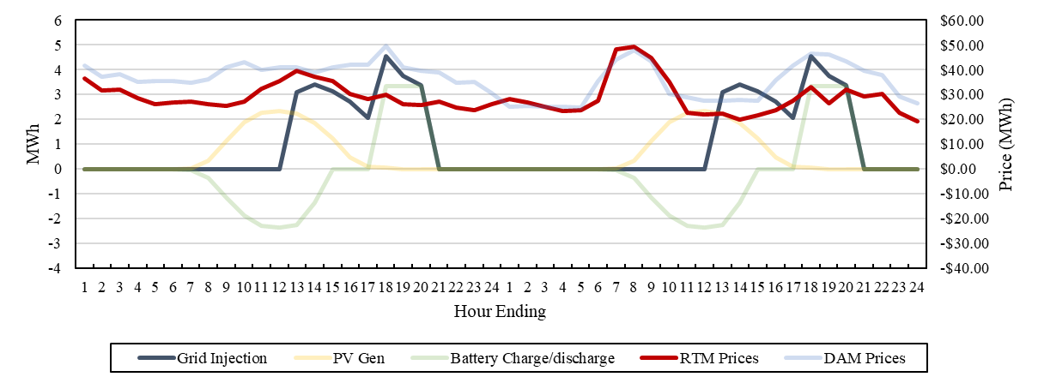
Clean Charging is Not Optimized
ISO’s current clean charging dispatch is an energy arbitrage model that charges the battery with the first 10 MWh of solar energy and discharges the battery in HE 18-20
This strategy is independent of market price signals
NEPOOL supported an optimized battery dispatch strategy for stand-alone storage
A Rational battery storage operator would profit-maximize based on price signals received prior to RT dispatch
Flexible generator is not taking advantage of expected peaks
Fixed Energy Arbitrage schedule reliant on low morning prices and high evening prices (but that pricing pattern doesn’t happen every day)
Market participation the same every month, independent of price, despite flexible generator
Battery does not account for the opportunity cost of providing energy instead of reserves
Battery does not provide reserves in hours it is charged and sits idle (see next slide)

Slide 18
Reserve and Regulation Revenue Inexplicably Missing
Regulation and reserves account for the vast majority of battery revenues in both the ISO and NEPOOL ORTP proposals for a stand alone battery (see figure)
The battery in ISO’s “combined” model inexplicably does not receive revenue for reserves or regulation, only for energy, during the years in which it is clean-charging
ISO training materials indicate that the battery is eligible for these revenues
https://www.iso-ne.com/static-assets/documents/2020/04/20200408-co-located-market-participation.pdf (slides 22, 27)

Slide 19
AC vs. DC Coupling
AC coupling, as ISO assumes, has significant disadvantages
Energy from the solar array and stored in the battery passes through an inverter 3 times, experiencing losses each time
An AC-Coupled system requires additional inverters
DC-Coupled systems capture “clipped” energy when peak solar production exceeds the inverter rating
ISO indicated there were slightly more AC-coupled than DC-coupled projects in FCA 15 qualification
Many current AC-coupled projects are vestiges of solar developers adding batteries to well-developed solar projects
We believe there is a strong trend towards DC-coupling among newer projects
We requested ISO evaluate the ORTP for DC coupled projects and create separate AC- and DC-coupled ORTPs
ISO did not share any DC-coupled analysis with the committee and instead proposes to apply their AC-coupled ORTP to substantially different DC-coupled projects
10 MWh_{Dc}
95% Efficient
95% Efficient
8.57 MWh_{Dc}

Slide 20
NEPOOL’s Economic Life for Solar
The NEPOOL ORTP proposal reflects an assumption of a 30 year economic life for solar generators and 20 years for batteries
The ISO’s proposed ORTP reflects a 20 year economic life for both the solar and battery components of a “combined” project
Even if the battery economic life is only 20 years, the solar portion of the combined project would continue operating (as a pure solar facility) through the end of its 30-year economic life

Slide 21
Proposed Amendment
21

Slide 22
Overall Intent
Maintain existing rules for FCA 16
The FERC approved Tariff already provides a clear method for calculating the ORTP for combined resources that has been used for years
Establish a NEPOOL position
Affirm a shared understanding by NEPOOL stakeholders of the existing Tariff language
If NEPOOL does not establish a position, NEPOOL has no ability to respond to ISO’s proposed Tariff modifications within the jump ball filing
Allow ISO or NEPOOL stakeholders to bring a separate proposal regarding treatment of combined resources at a more appropriate time
ISO’s proposed Tariff changes would have a material impact on the treatment of combined resources and should not be made in the middle of an FCA qualification cycle
The ISO’s proposed Tariff changes are a significant departure from existing procedures and as such deserve a full and thorough stakeholder process in which combined resource sponsors, ISO, and other NEPOOL stakeholder have the opportunity for a full discussion on the most appropriate method for calculating the ORTP(s) for these resources

Slide 23
Intent
Hybrid
Affirm the meaning of the current Tariff language:
Where a new capacity resource consists of more than one underlying technology, the existing weighted average provisions would determine the ORTP for that resource
This applies to both demand and generating capacity resources
The ORTP applicable to each underlying technology is used to calculate the weighted average
The expected contribution of each technology type towards the resource’s qualified capacity determines the weighting
Affirm that this Tariff language applies equally to any resource consisting of more than one technology type
Do not create a different treatment for a single technology type combination (solar + storage), as ISO now proposes.
Do not create a new ORTP value in the Tariff that is less accurate than the existing Tariff
ISO suggests the new “combined” ORTP value should be added because it is more accurate than the weighted average
As discussed previously, there are several significant flaws in the assumptions that make the ISO’s proposed value less accurate and a poor substitute for the weighted average

Slide 24
Summary of Proposed Tariff Changes
Hybrid
Section | Change | Reason for Change
III.A.21.1.1. Offer Review Trigger Prices for the Forward Capacity Auction | Where a new resource is composed of assets having different technology types (including, but not limited to, a photovoltaic solar generator sharing a point of interconnection with an energy storage device participating in the energy market as one or more assets and participating in the capacity market as a single New Capacity Resource) the resource’s Offer Review Trigger Price will be calculated in accordance with the weighted average formula in Section III.A.21.2(c). | Affirm that the application of this Tariff provision applies to all hybrid capacity resources by providing specific example of a new resource composed of assets with different technology types.

Slide 25
Intent
Co-Located
Affirm the meaning of the current Tariff language:
Where a new capacity resource consists of only one underlying technology, the ORTP applicable to that technology type is used
This applies regardless of whether there is another capacity resource sharing the same Point of Interconnection (POI)
This applies to both demand and generating capacity resources
This applies when a new resource shares a POI with another new resource or with an existing resource
Affirm that this applies equally to any resource regardless of technology type
Do not create a different treatment for a single set of technology types that might share a POI (i.e., solar, storage), as ISO now proposes.
Do not create a new ORTP value in the Tariff that is less accurate than the existing Tariff
ISO suggests the new “combined” ORTP value should be added because it is more accurate than using technology-specific ORTPs when multiple resources share a POI
By sharing interconnection facilities among two separate resources costs should decrease, yet ISO’s proposed ORTP specific to solar and storage sharing a POI is, inexplicably, dramatically higher

Slide 26
Summary of Proposed Tariff Changes
Co-Located
Section | Change | Reason for Change
III.A.21.1.1. Offer Review Trigger Prices for the Forward Capacity Auction | Where one or more assets sharing a point of interconnection register as a New Capacity Resource that does not include all of the assets sharing the point of interconnection, the Offer Review Trigger Price for the New Capacity Resource will be assigned according only to the asset or assets comprising the New Capacity Resource. | Clarify that ORTPs are assigned based solely on the asset(s) underlying the resource in question. The point of interconnection refers to the generally understood concept and the intent of this language is to apply to all co-located assets regardless of the process under which they interconnect.

Slide 27
Summary of Proposed Tariff Changes
Hybrid
Co-Located
Section | Change |  | Reason for Change
III.A.21.1.1. Offer Review Trigger Prices for the Forward Capacity Auction | Demand Capacity Resources |  | Strikes the ISO-NE proposed DR combined PV/battery ORTP value as its addition would be inconsistent with the existing tariff language that should be maintained for FCA 16 and calls for: a) a weighted average approach to calculating the ORTP in the case of a hybrid resource consisting of solar+storage, or b) utilizing the ORTP specific to the resource’s underlying technology in the case of a solar or storage resource that shares a POI with another resource of the other technology
 | Technology Type | Offer Review Trigger Price ($/kW-month)
 | Combined Photovoltaic Solar and Energy Storage Device – Lithium Ion Battery | $7.376

Slide 28
THANK YOU!
Questions?
Abigail Krich Krich@BoreasRenewables.com
Alex Worsley Worsley@BoreasRenewables.com
Sarah Bresolin sarah.bresolin@engie.com
Liz Delaney edelaney@borregosolar.com
Michael Macrae Michael.macrea@enel.com
Caitlin Marquis cmarquis@aee.net

