Slide 1
Amendment to NEPOOL ORTP Proposal
To Incorporate Current ITC Values into FCA 16 ORTPs
Presented by
Abigail Krich & Alex Worsley
Boreas Renewables
For NEPOOL Markets Committee | February 24, 2021

Slide 2
About RENEW Northeast
The comments expressed herein represent the views of RENEW and not necessarily those of any particular member.

Slide 3
Impact of December 2020 Tax Law Changes on NEPOOL ORTPs
On Dec 3, 2020 NEPOOL approved a set of FCA 16 ORTP values based on the following Investment Tax Credit (ITC) assumptions:
Offshore wind = 18%
Solar = 10%
Tax law was changed on December 27, 2020, increasing the ITC level these technologies are eligible for as follows (as presented by ISO on Feb 9, 2021):
Offshore wind = 30%
Solar = 26%
The NEPOOL ORTP values, if updated to reflect the current ITC eligibility, would change as follows:
Technology | Dec 3 NEPOOL ORTP with prior ITC ($/kW-mo) | NEPOOL ORTP Updated for Current ITC ($/kW-mo) | NEPOOL Tariff Change due to Current ITC ($/kW-mo) | ISO Tariff Change due to Current ITC ($/kW-mo)
Offshore Wind | ($3.360) | ($9.936) | No Change | No Change
Solar | $1.861 | ($8.171) | $0.000 $1.861 | $0.000 n/a

Slide 4
Proposed Revision to NEPOOL ORTPs - Intention
We believe it is appropriate for NEPOOL’s ORTP values to reflect current tax law
ISO is proposing to do the same with their ORTP proposal
We agree with ISO-NE that offshore wind projects and solar projects participating in FCA 16 would be eligible for 30% and 26% ITC levels, respectively
We propose that NEPOOL revise its ORTP proposal to reflect these current ITC levels
All other inputs underlying the NEPOOL ORTP proposal from Dec 3 remain unchanged
This would result in a reduction in the FCA 16 solar ORTP from $1.861 to $0/kW-mo
A NEPOOL solar ORTP of $0 would be identical to the ISO-proposed ORTP value of $0
This would result in no change to NEPOOL’s offshore wind ORTP value in the Tariff, as that value is already $0 in the NEPOOL proposal

Slide 5
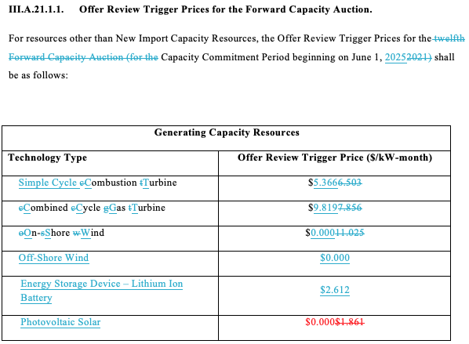
Proposed Revision to NEPOOL ORTPs - Redline

Slide 6
Questions?
Abigail Krich Krich@BoreasRenewables.com
Alex Worsley Worsley@BoreasRenewables.com

