Slide 1
MARCH 2021
March 2021 NEXTT Updates
Operations Analysis & Integration
ISO New England, INC.

Slide 2
Updates made to NEXTT
Customer notification of MW changes during day after checkout
Viewing transaction changes in next
NEXTT XML output showing 3 decimal places
Filtering on the NEXTT hourly details display

Slide 3
Customer notification of mw changes during day after checkout

Slide 4
Customer notification of MW changes
There are instances when ISO-NE must modify the scheduled MW on a transaction during the day-after checkout process
  Since this occurs after-the-fact there is no e-Tag adjustment by the ISO
  Currently, customers may not be aware of this change until settlement occurs
  ISO has created the capability for customers to request notification when these changes occur

Slide 5
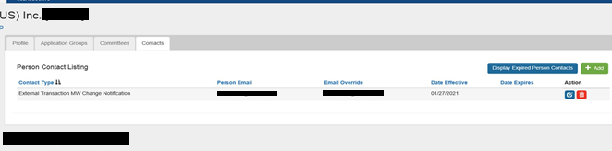
Setting up notification
Customers can add the Contact Type “External Transaction MW Change Notification” to users with NEXTT access in CAMS.
Any user with this Contact Type will receive the email when the scheduled MW is changed on transaction after the operating hour has ended.
To add a new Contact Type in CAMS please refer to the CAMS User Guide on the ISO-NE public website.
Any contact can be added to any user with NEXTT access.
The “email override” can be used to send to an internal distribution list rather than specific people

Slide 6
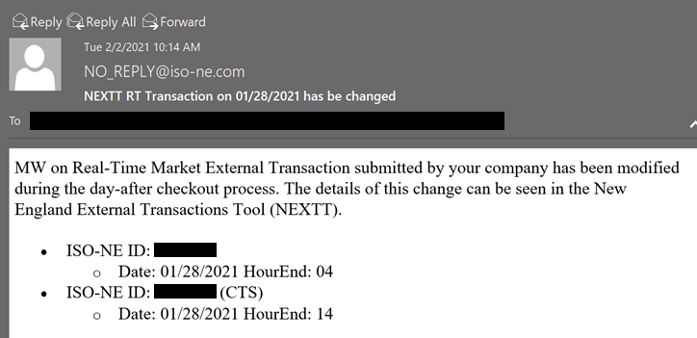
What will the notification look like?
Notification email comes from no_reply@iso-ne.com and includes
  ISO-NE ID of transaction(s)
  Date and time of the modification(s)
    MW information will not be included
Notification is the same for:
  Transactions submitted to NEXTT
  Transactions submitted on the CTS interface in the NYISO JESS
User must open NEXTT to see the details of the change

Slide 7
Viewing transaction changes in nextt

Slide 8
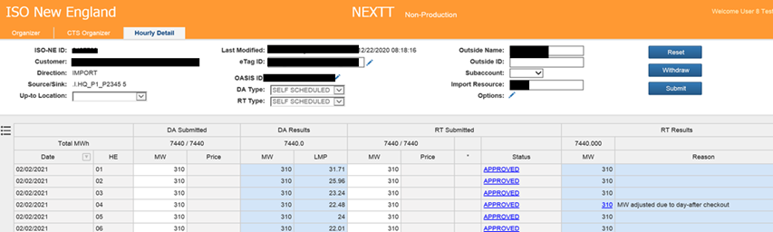
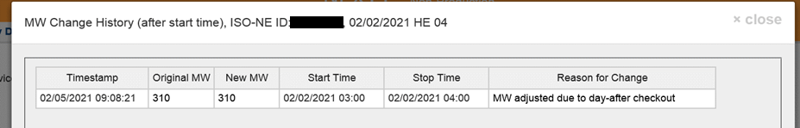
Transaction Hourly Detail Display
Changes made after the transaction has start flowing can be viewed in NEXTT
The MW value is a link that opens MW change history for that hour

Slide 9
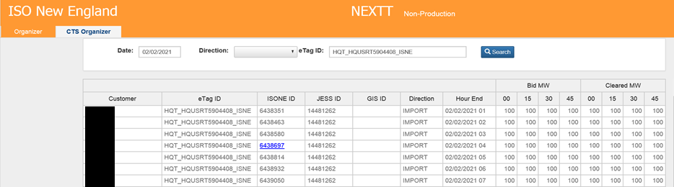
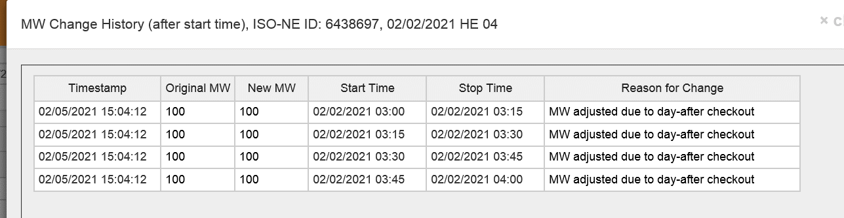
CTS Organizer Display
On the CTS Organizer the user may select the transaction ID to view the history of MW changes for transactions changed during the Day After checkout

Slide 10
NEXTT XML output showing 3 decimal places

Slide 11
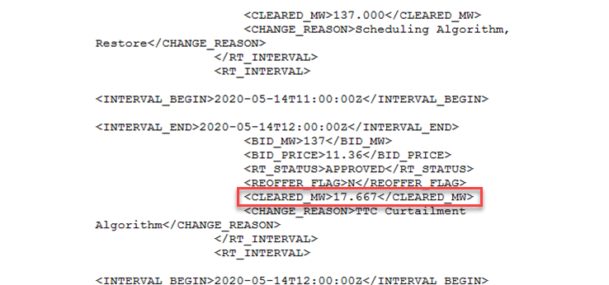
NEXTT XML output showing 3 decimal places
XML response to transaction request was rounding the hourly RT scheduled MW to a whole number
This update will provide RT schedule MW data out to 3 decimals, matching the value in the GUI

Slide 12
Filtering on the nextT hourly details display

Slide 13
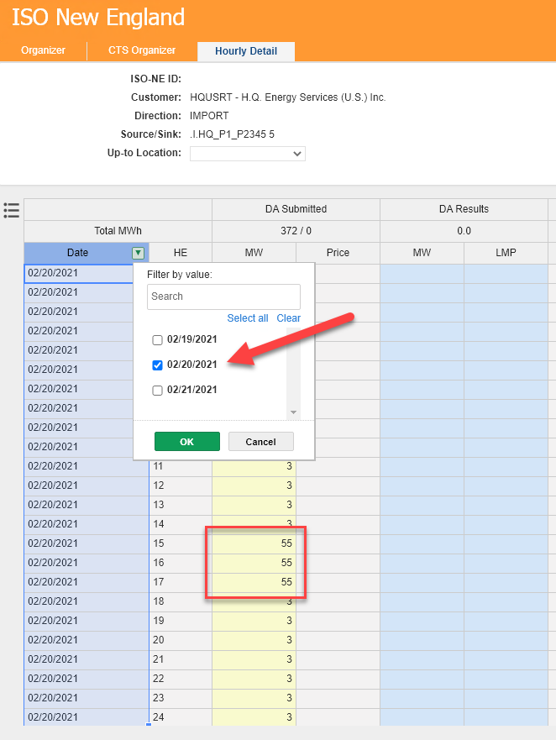
Filtering Date on Transaction
Initial NEXTT release prevented editing when date filter was applied
This release removes that restriction
All MW and Price fields can now be edited, even when a date filter is applied
Can edit boxes in filtered mode

Slide 14
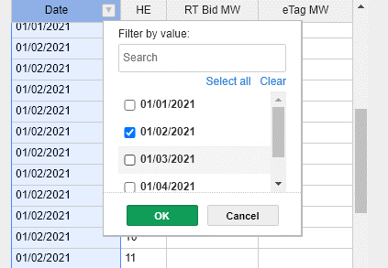
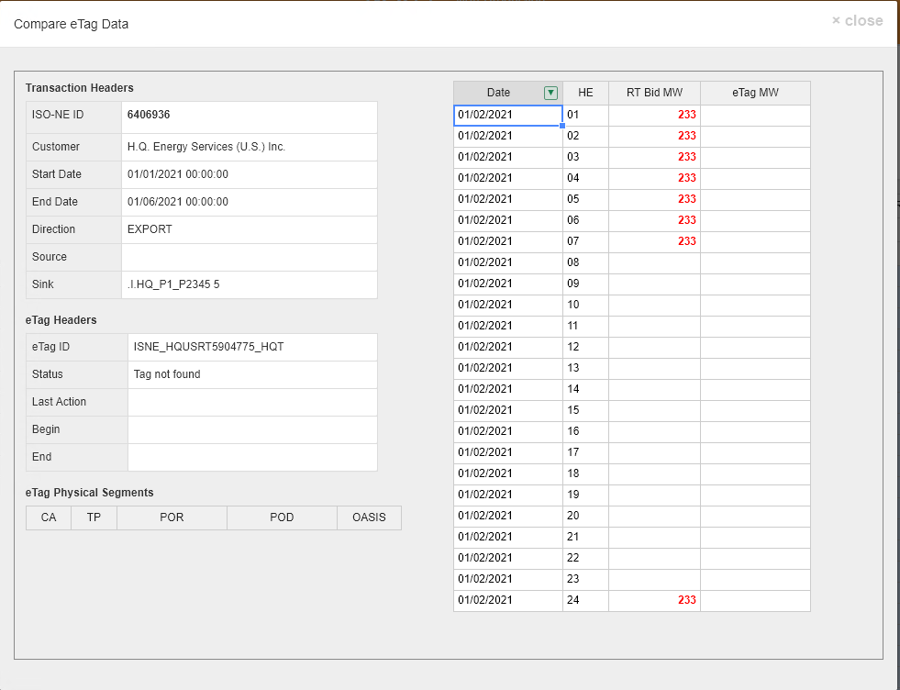
Filtering Date on Transaction
The Compare displays can also now be filtered by date

Slide 15
Next Steps
These changes are in effect at the time of this presentation
The NEXTT User Guide has been updated to reflect these changes

