Slide 1
December 7, 2021 | Nepool Markets Committee
Elimination of the Minimum Offer Price Rule & Buyer Side Mitigation
IMM Thoughts on Market Implications
Dave Naughton & Mike Redlinger
Internal Market Monitor

Slide 2
Importance of Price Formation in the FCM
FCM is designed to coordinate efficient entry and exit to meet the ISO’s resource adequacy standard over the long run
Provides a revenue stream to recover avoidable costs not recovered in the E&AS markets
Together, these markets play a central role in providing efficient price signals for various products and in coordinating entry and exit
In the FCM context:
when the region has insufficient capacity, prices should rise to attract new entry
in times of excess capacity, prices should fall to reflect that new entry is not needed and to induce higher-cost resources to exit

Slide 3
Role of Market Power Mitigation in Price Formation
Mitigation rules are designed to ensure FCA prices are based on competitively-priced offers by existing and new resources
Process screens for offers that deviate from benchmark prices (e.g. DDBT, ORTP) and that may adversely influence auction outcomes
Inadequate mitigation rules may undermine the efficiency of the FCM in performing its function, and ability to produce just and reasonable rates
MOPR has been effective at mitigating the impact of “below cost” offers on auction outcomes
In recent years, primary driver of below cost offers has been “out of market”* revenues, rather than an observable attempt to profitably exercise buyer-side market power
*Note that the terms “out-of-market” and “subsidies” are used interchangeably throughout this presentation and are intended to have the same meaning.

Slide 4
MOPR and State Sponsored Policy Resources
Disallowing out-of-market revenues through the application of MOPR makes it less likely that sponsored resources will clear in the FCA
but limits market distortions, particularly protecting price formation and signals
IMM recognizes the potential barriers this creates to the states achieving their decarbonization goals and can result in an “over-procurement” or “double-build” problem
excess costs to rate-payers due to over-procurement is also not an efficient outcome
with current clean energy targets this problem is becoming pressing
Market design efforts to address this tension between price formation and states’ desired generation mix have had limited results
renewable technology resource exemption and substitution auction
We support the continued efforts to evaluate long-term market mechanisms, particularly Net Carbon Pricing
provides transparent investment signal for clean energy
reduces the “missing money” of clean and less-carbon intensive technologies and could work well with the current broad MOPR

Slide 5
Illustrative Impact of MOPR Elimination [simple]

Slide 6
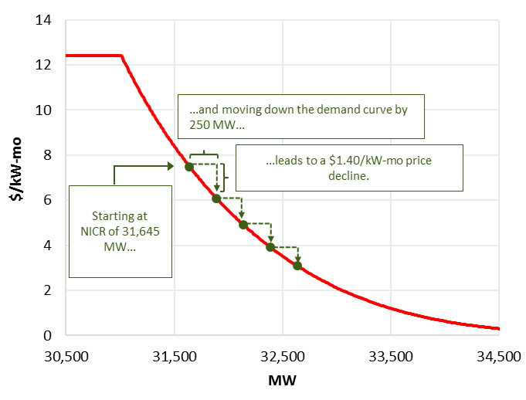
Illustrative Impact of MOPR Elimination [walking down the FCA demand curve]
Sponsored policy resources clearing the auction leads to essentially walking down the FCA demand curve
Magnitude of the price impact depends on steepness of demand curve and other factors

Slide 7
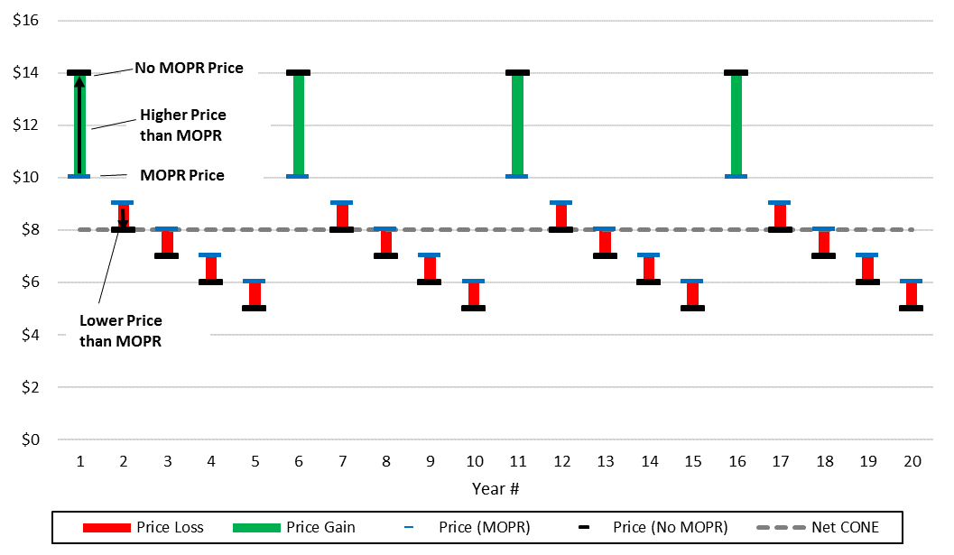
Market Dynamics: high prices required to compensate for years with suppressed prices
Net CONE is the long-run equilibrium price in both a “MOPR” and “No-MOPR” scenario
In some years, “No MOPR” will result in lower prices [“Price Loss”], particularly when no new entry is needed
To compensate for lower prices, investors will need to expect high-priced years when new merchant capacity is needed
1
3
2
1
3
2

Slide 8
The path to market equilibrium: NICR in the context of Sponsored Policy Resources
Starting at FCA 15's cleared resources of 34,621 MW...
...adding ≈6 GW of new subsidized entry by 2030 (based on Potomac model inputs)...
...means almost 9 GW needs to exit...
...to be at NICR of 32,400 (ISO forecast of NICR in 2030).

Slide 9
Market Performance Risks with the Elimination of MOPR
MOPR elimination will allow (subsidized) sponsored policy resources to offer at a lower cost than they otherwise would absent the subsidy, in many cases down to zero dollars
Sponsored policy resources are more likely to clear irrespective of FCA prices (during periods of low prices and further dampening prices)
Resulting price suppression and volatility impacts the investment environment for new merchant development and investment in existing resources
Investors may react in various ways; e.g. require higher return on investment (EMM), shorter pay-back period, long-term contract
IMM concern that the impact creates a real risk that the FCM may not provide efficient entry and exit price signals
Existing resources may retire if unwilling to withstand periods of suppressed prices
Future initiatives such as Resource Capacity Accreditation and Day-Ahead Ancillary Services Improvements may help mitigate some of the MOPR elimination concern, but do not address the core price formation concern

Slide 10
IMM overview and thoughts on the proposed Buyer-Side Market Power Mitigation rules
Objective of mitigation rules should be to ensure reasonable price formation in the FCM. In this context, buyer-side mitigation (BSM) rules should mitigate:
Non sponsored policy resources offering below cost with a net material benefiting load position
including any potential subsidized resource not directly aligned with decarbonization goals (fossil fuel)
The BSM proposal*:
Targets below-cost offers that may impact price and financially benefit a related load position
Applies to non sponsored policy & non EE resources above 5 MW with a load interest
In those instances, the price offer is subject to a Conduct and Impact assessment by IMM
Project Sponsor has the option to demonstrate that there is no incentive (i.e. no net financial benefit) to exercise buyer-side market power
Net Benefit = $\left[Load Position Benefit\right]− \left[New Resource Net Cost\right]$
The ISO anticipates that Project Sponsor would provide data on relevant supply and load positions of related entities to the new resource, along with an analysis demonstrating no net benefit. However, no requirement or specific formula or approach is prescribed
The IMM will consider this additional information in its overall assessment along with its Conduct and Impact review
*Review of finalized Tariff redlines required to complete this assessment

Slide 11
Towards a Narrow Form of Buyer-Side Mitigation (BSM)
The ISO’s BSM proposal is a step forward in allowing Sponsored Policy Resources the opportunity to participate in the FCA while providing a check on the exercise of market power by non-policy resources that have materially net benefiting load
“BSM” appears neither in current Tariff nor the original Settlement Order that gave rise to the FCM
Replacing MOPR (also not part of original FCM design) with a new design that results in just and reasonable capacity prices and is not arbitrary and unduly discriminatory is the challenge — both at the FERC level and likely upon judicial review
From FCM inception IMM’s role has been to exclude offers that do not represent actual costs to ensure competitive outcomes so that prices over the long run will approximate the competitive cost of new entry (CONE)
ISO’s proposal will exempt certain categories of new supply from IMM review/mitigation: Sponsored Policy Resources, 5MW and under capacity, passive demand (energy efficiency), and projects whose Project Sponsors self-certify no load interest.
Any remaining new capacity will be subject to review and possible mitigation unless the Project Sponsor provides evidence to the IMM’s satisfaction that it “unlikely to realize a material, net financial benefit from any reduction in [FCA] clearing prices resulting from entry of the New Capacity Resource in the [FCM].” Redline Section III.A.21.2.3

Slide 12
IMM Observations and Concerns with Proposal Include:
The IMM has concerns about the incentive/benefitting positions approach of the BSM proposal
BSM proposal is like a narrow application of Anti-Manipulation Rule to non-policy new capacity resources that submit below-market offers with potentially benefitting load positions
focuses on uneconomic conduct that impacts prices in FERC jurisdictional market for the benefit of a “net” or “leveraged” position
But the exercise of market power can take many forms and the IMM is focused on the impact on price formation from below cost offers regardless of whether to benefit a load position
Mitigation needs to address market power in whatever form when it would impair competitive market outcomes
The IMM is concerned with the “lack of incentive” aspect of the proposal
The Project Sponsor is able to decide what and how much information to provide to the IMM to demonstrate that it is unlikely to realize a material net financial benefit and not required to identify its potentially benefiting load positions
This limits the IMM’s ability to evaluate and determine whether the declaration of no material net benefit is accurate and hence the lack of mitigation warranted – also, what is “material” and how determined?
Notably different from current Appendix A requirements that require participant to provide “all” relevant information from which the IMM can make an independent determination. E.g., III.A.21.2(b)(v)

