Slide 1
JUNE 7-8, 2022 | Westborough, MA
Resource Capacity Accreditation in the Forward Capacity Market
Overview of Key Concepts in Capacity Accreditation
Steven Otto
ECONOMIST
sotto@iso-ne.com
413-540-4738

Slide 2
Resource Capacity Accreditation in the Forward Capacity Market
WMPP ID:
157
Proposed Effective Date: FCA 19
The Resource Capacity Accreditation (RCA) project proposes improvements to ISO-NE’s accreditation processes in the Forward Capacity Market (FCM) to further support a reliable, clean-energy transition by implementing methodologies that will more appropriately accredit resource contributions to resource adequacy as the resource mix transforms
The ISO has made a commitment to FERC to file proposed improvements in time for FCA 19
This presentation provides an educational foundation for future discussion on capacity accreditation
  To this end, it covers key concepts in the accreditation space, but does not cover any conceptual design components or proposals
  Numerical examples included do not reflect estimates of the impacts of potential reforms but are merely stylized examples

Slide 3
Resource Capacity Accreditation in the Forward Capacity Market
WMPP ID:
157
Proposed Effective Date: FCA 19
Today’s discussion will focus on:
  Conceptual overview of purpose of capacity accreditation (slides 5-9)
  Discuss different accreditation methods (slides 10-14)
  Discuss average and marginal approaches to accreditation at a conceptual level (slides 15-23)
  Define a common nomenclature for discussions (slides 24-25)
  Discuss benefits and challenges of average and marginal approaches (slides 26-27)
  Introduce FCM design objectives and opportunities for improvement (slides 28-32)
  Overview of stakeholder schedule (slides 36-40)

Slide 4
Prior Outreach and Background: Technical Sessions
On August 20, 2021, the ISO presented technical background and general concepts behind different resource capacity accreditation methodologies
A subsequent technical session was held on November 22, 2021, where stakeholders presented their experiences and insights on capacity accreditation in other RTOs
These technical sessions covered foundational concepts in capacity accreditation, including:
  Heuristic, ELCC, and MRI approaches to accreditation
  Differences between “average” and “marginal” approaches to accreditation

Slide 5
Review of key concepts in capacity accreditation

Slide 6
Resource Adequacy Assessment
Generally speaking, a resource adequacy assessment process consists of:
  Quantifying the contributions of resources (i.e., capacity) to meet,
  A specific target for a reliability metric (“loss of load”), for a specific (future) time period or planning horizon, using
  A specified quantitative methodology
In practice, this requires the use of simulation models and considerable data on many inputs
Today’s discussion will focus on the first piece of this process: quantifying the contributions of resources to resource adequacy

Slide 7
Capacity Accreditation
Capacity accreditation processes quantify resources’ reliability contributions to resource adequacy
Accreditation processes use each resource’s physical characteristics (e.g., their nameplate capability, technology, location, etc.) to determine an accreditation value, which is the maximum amount of capacity that the owner can sell in a forward reliability market
  Because of differences in contributions to resource adequacy, some resources will need more MWs of nameplate capacity than others to have a similar quantity of accredited capacity
  E.g., an intermittent resource with 100 MW of nameplate capacity may have 20 MW of accredited capacity while a 25 MW thermal resource may have the same 20 MW of accredited capacity

Slide 8
Purpose of Capacity Accreditation
Capacity accreditation allows resources with disparate features that may have different reliability contributions toward resource adequacy per nameplate MW (e.g., solar vs. nuclear resources) to sell the same uniform product: accredited capacity
The accreditation process should yield accredited capacity that is substitutable across resources
Substitutability implies that small changes in the accredited capacity of different resources have approximately the same impact on resource adequacy

Slide 9
Substitutability
When comparing resources to determine who should clear the next increment of accredited capacity, substitutability allows for the direct comparison of different resources’ costs ($/kW-month), even when the resources have significantly different attributes/characteristics
If accredited capacity is not substitutable, costs cannot be easily compared to determine which resources should be procured to best meet resource adequacy requirements at lowest cost because the resources will provide different contributions per unit of accredited capacity
The ability to directly compare costs allows a more optimal resource mix to be achieved

Slide 10
Approaches to Accreditation

Slide 11
Different Methodologies to Accredit Capacity
Heuristics. Heuristic approaches employ practical rules to determine accredited capacity
  Some of the current accreditation methods in New England are based on heuristics
  E.g., the accredited capacity of an intermittent resource is based on historical average output in a predetermined set of hours
Installed Capacity (ICAP). Represents physical generating capacity adjusted for ambient weather conditions
Unforced Capacity (UCAP). Similar to the ICAP approach, but also incorporates resources’ expected forced outage rates (EFORd)
  E.g., a resource with 100 MW of installed capacity and an EFORd of 10% would have a UCAP value = 90 MW

Slide 12
Different Methodologies to Accredit Capacity, cont.
Effective Load Carrying Capability (ELCC). A resource’s ELCC value measures the equivalent amount of additional load the system could serve (“carry”) with the resource (versus without it), while meeting the same target number of load shed events
  Alternatively, ELCC is often measured as the amount of ‘perfect capacity’ needed to serve load without the (entire) resource under evaluation while meeting the same target number of load shed events
Marginal Reliability Impact (MRI). A resource’s MRI value measures the incremental impact of its ‘last’ MW on system reliability
  Similar to the MRI concept that underpins the capacity demand curves
Note there are numerical examples that demonstrate ELCC and MRI approaches in Appendix B. Appendix A also includes additional reference material that considers ELCC and MRI approaches in greater detail

Slide 13
ISO-NE’s Current Approach to Accreditation
No two ISOs/RTOs have identical accreditation processes
ISO-NE currently uses a mix of an installed capacity (ICAP) approach and heuristics to generate resources’ accreditation values, which we call their qualified capacity (QC) values
  Non-intermittent generation resources are accredited based on the resource’s average output over a defined audit duration (median of the yearly average over five years)
  Intermittent generation resources are accredited based on their median output during predetermined “reliability” hours (average over five years)
  Import capacity resources are accredited based on documentation that demonstrates the capability and commitment of the resources backing the Imports
  Active demand resources are accredited in a similar manner to non-intermittent generation resources
  Passive demand response resources are accredited based on documentation supporting requested demand reduction values and consider the amount of capacity cleared and permanently removed in previous FCAs and expiring measures for EE resources

Slide 14
Accreditation Approaches in Other Regions
NYISO is transitioning to a marginal method they refer to as “Marginal Reliability Improvement”
PJM utilizes a UCAP construct for conventional resources and an average ELCC for energy limited or intermittent resources
MISO utilizes a UCAP construct for most resource types and an average ELCC approach for wind resources
More details on the accreditation approaches in the other regions can be found in Appendix A and were discussed during the November, 2021 technical session

Slide 15
Conceptual Discussion of Average vs. marginal approaches

Slide 16
Average vs. Marginal Approaches
Speaking broadly, ELCC approaches can be described as either marginal or average, while the MRI approach is a marginal approach
At a high level, marginal approaches set a resource’s accredited capacity based on the marginal reliability impact of an incremental change in its size
Average approaches set a resource’s accredited capacity based on the average reliability impact of each resource’s respective class
These approaches and their differences have been discussed in PJM, NYISO, and with FERC in recent stakeholder and regulatory proceedings (see Appendix A material)
The next few slides include graphical demonstrations of marginal and average approaches to accreditation, including how the two approaches generally determine capacity accreditation, and how (and under what circumstances) these approaches can produce different outcomes

Slide 17
Loss of Load Expectation and Expected Unserved Energy
Expected Unserved Energy (EUE) is a reliability metric that measures the total amount of load shed expected in a given year, measured in MWh/year
Loss of Load Expectation (LOLE) is a reliability metric that measures the number of load shed events that the region expects to observe in a given year, measured in days/year
NPCC uses the LOLE concept in their one-day-in-ten standard and the ISO uses LOLE to calculate it’s Installed Capacity Requirement (ICR)
The ISO uses the EUE concept in developing its demand curves for use in the Forward Capacity Market because it accounts for the severity of load shed events
  For example, the LOLE concept does not distinguish between a day with 10 MWh of load shed and a day with 500 MWh of load shed. This distinction is captured by the EUE concept
In concept, both average and marginal approaches could be applied with respect to EUE or LOLE. For today, we will use EUE as it is the ISO’s market metric used to calculate capacity demand curves

Slide 18
Graphical Demonstration of Marginal Approach
This figure shows the marginal reliability contribution of a resource class at different penetrations of that class
Illustrates EUE as the relevant reliability measure, where the marginal reliability contribution is the MWh decrease in EUE given a 1 MW increase in the class’ penetration
  The units for marginal reliability contribution is MWh/MW/year, or hours/year, as with the capacity demand curves
Continued on the next slide

Slide 19
Graphical Demonstration of Marginal Approach, cont.
Suppose there are 999 MWs of the resource class in the mix and the region is considering the addition of a 1 MW resource in the class, represented by the blue dot
Continued on the next slide

Slide 20
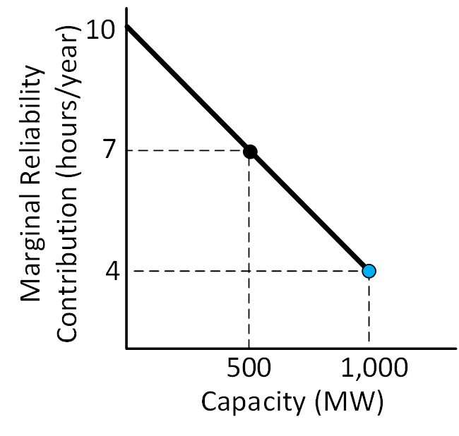
Graphical Demonstration of Marginal Approach, cont.
The marginal reliability contribution of the potential new resource is the height of the marginal reliability contribution line at the class’ penetration, assuming the new resource is built
Conceptually, marginal approaches accredit all resources using this marginal reliability contribution
  E.g., the resource represented by the blue dot would be accredited based on the 4 hours/year value

Slide 21
Graphical Demonstration of Average Approach
The shaded area under the marginal reliability contribution curve up to and including the blue dot represents the total reliability contribution of the class, assuming the new resource is built
  This area is measured in MWh of decreased EUE, and equals 7,000 MWh
Continued on the next slide

Slide 22
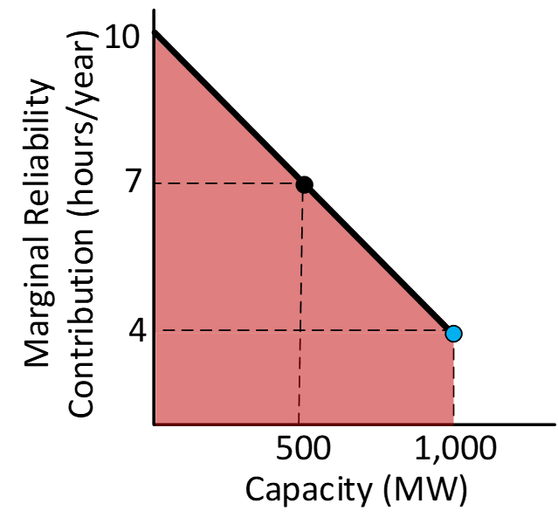
Graphical Demonstration of Average Approach
Conceptually, average approaches accredit resources using their share of their class’ total contribution to reliability
  E.g., under an average approach, the 1 MW blue dot resource would be accredited based on their share (1 MW/1,000 MW) of the class’ total reliability contribution, in this case 7 hours/year
Continued on the next slide

Slide 23
Average vs. Marginal Takeaways
Marginal approaches accredit all resources based on their marginal contribution to reliability
Average approaches accredit resources based on their share of their class’ total contribution to system reliability
Marginal approaches generally lead to accreditation values that are less than or equal to average approach’s accreditation values because many resources have declining contributions to reliability as their class’ penetration increases
Note if the marginal reliability contribution of a class is constant (e.g. the marginal reliability contribution line is horizontal), the average and marginal approaches should yield the same accreditation value

Slide 24
Nomenclature
When discussing these concepts and approaches going forward, a commonly understood nomenclature is helpful:
Accredited capacity – measures a resource’s estimated reliability contribution and is used to determine the maximum amount of capacity a resource can sell in a forward reliability/capacity market
Qualified capacity – ISO-NE’s current approach to accrediting resources using a combination of ICAP and heuristic approaches
Substitutability – resources are substitutable if changes in the accredited capacity of different resources have approximately the same impact on resource adequacy
Marginal approach – accredits resources based on their marginal contribution to reliability
Continued on the next slide

Slide 25
Nomenclature, cont.
Average approach – accredits resources based on their share of their class’ total contribution to system reliability
Class average ELCC approach – an average approach that examines the impact on a given reliability metric of the addition or removal of an entire class
Marginal ELCC approach – a marginal version of the average ELCC approach that examines the impact on a given reliability metric of the addition or removal of a small increment of a given resource
MRI approach – a marginal approach that accredits resources based on the impact an incremental increase in a resource’s capacity has on resource adequacy

Slide 26
Average and Marginal Approaches
Benefits and Challenges
Framework | Methodology | Benefits (Highlights) | Challenges (Highlights)
Average | Accredits resources based on their share of their class’ total reliability contribution | Accreditation values will likely be more stable over time compared to a marginal approach | Incremental resources may be over-valued in reliability contribution (suboptimal entry/exit signals) Diversity benefits (solar vs storage vs wind interactions) have to be allocated to resources
Marginal | Accredits resources based on their marginal contributions to reliability | Sends accurate entry and exit signals to market participants Interactions between resource types are easily incorporated into accreditation values Provides the same compensation to resources that provide the same service | May be challenging to accurately calculate the marginal impact of a small change in accredited capacity Accreditation values may shift more over time compared to an average approach
The ISO finds the benefits of a marginal approach compelling, and at this time is leaning towards this approach

Slide 27
Continued Discussion on Average and Marginal Approaches in July
Please submit additional clarifying questions on these approaches to the MC Secretary (dcakert@iso-ne.com) by June 24 to help with preparation for upcoming meetings
The ISO will endeavor to address these questions throughout the year-long RCA stakeholder process

Slide 28
Opportunities for improvements to current resource capacity accreditation process

Slide 29
Forward Capacity Market Design Objectives
Design Objective 1: To ensure the system has sufficient resources to meet the region’s one-day-in-ten reliability requirement, where “sufficient” is defined as having enough resources that can perform as expected in the right locations
Design Objective 2: To ensure that Design Objective 1 is achieved in a cost-effective manner
Design Objectives 1 and 2 are the ISO’s current objectives for the FCM and the ISO is not proposing changes to these objectives as part of the RCA reforms

Slide 30
Opportunities for Improvement
The region is moving swiftly toward a decarbonized grid. There are opportunities to implement improvements now to better facilitate reliability and market efficiency in the future
In other words, our current resource adequacy assessment and accreditation processes could be improved to better ensure that the FCM continues to meet Design Objectives 1 and 2 as the resource mix evolves

Slide 31
Opportunity 1: Improved Accuracy in Accreditation
Opportunity 1: Current capacity accreditation framework can be improved to reflect different resource contributions toward resource adequacy. These adjustments will better yield accredited capacity that is substitutable between resources, which is beneficial as unique resource types enter the market
For example, under current rules, an increase in the accredited capacity of a fossil resource may not have the same impact on EUE as a similarly sized increase in the accredited capacity of a solar resource

Slide 32
Opportunity 2: Improved Accuracy in Resource Adequacy Assessment Modeling
Opportunity 2: Current resource adequacy assessment process can be improved to better reflect resources’ expected performance and reliability contributions as the resource mix changes
Intermittent resources are currently modeled as “perfect capacity” resources at their seasonal qualified capacity, meaning that they are assumed to be available to provide a constant quantity of energy in all hours
  Intermittent resources can perform better than this level in some hours and worse in others, in practice
Fuel limitations for gas-only resources in the winter are not reflected
Energy limitations for pumped storage hydro resources are not reflected

Slide 33
Conclusion

Slide 34
Outline of Project Scope
The ISO intends to revise its approach to capacity accreditation to use probabilistic resource adequacy assessment modeling processes
  ISO will present thoughts its proposed approach in the next few meetings
Improve Resource Adequacy (RA) Assessment processes
  ISO will present additional details on improvements to the RA Assessment processes in the coming months

Slide 35
Key Takeaways
Capacity accreditation qualifies resources’ contributions to reliability and is used to set the maximum quantity they can sell in forward reliability/capacity markets
Accredited capacity is substitutable if an incremental decrease in one resource can be offset by an incremental increase in another resource without changing system reliability
There are broadly two approaches to capacity accreditation using stochastic modeling: average and marginal approaches
  Average approaches accredit resources based on their share of their class’ total contribution to reliability
  Marginal approaches accredit resources based on their marginal reliability contribution
The ISO is currently planning to employ a MRI approach
Please send questions and comments on average and marginal approaches to the MC Secretary (dcakert@iso-ne.com) by June 24

Slide 36
Stakeholder schedule

Slide 37
Stakeholder Process - Overview
There are several broad phases laid out for this proposal in the stakeholder process:
  Background, Conceptual Design, & Education: June 2022 – October 2022
  Detailed Design: November 2022 – January 2023
  Finalize Design & Review Tariff Language: February 2023 – April 2023
  Voting: May 2023 (Technical Committees) and June 2023 (Participants Committee)
Through at least the conceptual design phase, the content will primarily be delivered during the MC with the RC jointly invited to discuss the RCA proposal
  As needed, additional joint MC/RC meetings would be held during the regularly scheduled RC to continue discussions of material that were not completed during the regular joint MC/RC meeting
Starting likely with the detailed design phase, the MC and RC will meet separately and discuss distinct content under their committee’s purview
  The MC and RC are each invited to continue to participate in each other’s ongoing discussions and review on the RCA proposal
At the next meeting in July, discussions will continue on average vs. marginal and the conceptual design will be introduced

Slide 38
Stakeholder Schedule – Conceptual Design Phase
JUNE 2022 |  |  |  |  |  |  |  | Joint Markets and Reliability Committees MC Meeting Dates: June 7-8, 2022 (with joint RC during RCA components) Posting Materials Beginning: June 1, 2022 Topics: Review background and discuss opportunities for adjusting the way resources are accredited in the FCM to support a reliable, clean-energy transition
S | M | T | W | T | F | S
 |  |  | 1 | 2 | 3 | 4
5 | 6 | 7 | 8 | 9 | 10 | 11
12 | 13 | 14 | 15 | 16 | 17 | 18
19 | 20 | 21 | 22 | 23 | 24 | 25
26 | 27 | 28 | 29 | 30
JULY 2022 |  |  |  |  |  |  |  | Joint Markets and Reliability Committees MC Meeting Dates: July 12-14, 2022 (with joint RC during RCA components) Posting Materials Beginning: July 6, 2022 Topics: Discussion of ISO's design objectives and conceptual design. Stakeholders should submit additional clarifying questions on average and marginal approaches to the MC Secretary by June 24, 2022
S | M | T | W | T | F | S
 |  |  |  |  | 1 | 2
3 | 4 | 5 | 6 | 7 | 8 | 9
10 | 11 | 12 | 13 | 14 | 15 | 16
17 | 18 | 19 | 20 | 21 | 22 | 23
24 | 25 | 26 | 27 | 28 | 29 | 30
31
AUGUST 2022 |  |  |  |  |  |  |  | Joint Markets and Reliability Committees MC Meeting Dates: August 9-10, 2022 (with joint RC during RCA components) Posting Materials Beginning: August 3, 2022 Topics: Continue discussion of ISO's design objectives, and conceptual design Additional Joint Markets and Reliability Committees RC Meeting Dates: August 16-17, 2022 (with joint MC during RCA components) Posting Materials Beginning: August 10, 2022 Topics: As needed, continue discussion of ISO materials from August 9-10 Joint MC/RC meeting on ISO's design objectives, and conceptual design
S | M | T | W | T | F | S
 | 1 | 2 | 3 | 4 | 5 | 6
7 | 8 | 9 | 10 | 11 | 12 | 13
14 | 15 | 16 | 17 | 18 | 19 | 20
21 | 22 | 23 | 24 | 25 | 26 | 27
28 | 29 | 30 | 31

Slide 39
Stakeholder Schedule – Conceptual Design Phase, cont.
SEPTEMBER 2022 |  |  |  |  |  |  |  | Joint Markets and Reliability Committees MC Meeting Dates: September 13-14, 2022 (with joint RC during RCA components) Posting Materials Beginning: September 7, 2022 Topics: Continue discussion of conceptual design and review proposed impact assessment approach Additional Joint Markets and Reliability Committees RC Meeting Date: September 20, 2022 (with joint MC during RCA components) Posting Materials Beginning: September 14, 2022 Topics: As needed, continue discussion of ISO materials from September 13-14 Joint MC/RC on ISO's conceptual design and proposed impact assessment approach
S | M | T | W | T | F | S
 |  |  |  | 1 | 2 | 3
4 | 5 | 6 | 7 | 8 | 9 | 10
11 | 12 | 13 | 14 | 15 | 16 | 17
18 | 19 | 20 | 21 | 22 | 23 | 24
25 | 26 | 27 | 28 | 29 | 30
OCTOBER 2022 |  |  |  |  |  |  |  | Joint Markets and Reliability Committees MC Meeting Dates: October 12-13, 2022 (with joint RC during RCA components) Posting Materials Beginning: October 5, 2022 Topics: Continue discussion of conceptual design and proposed impact assessment scope and scenarios Additional Joint Markets and Reliability Committees RC Meeting Date: October 18, 2022 (with joint MC during RCA components) Posting Materials Beginning: October 12, 2022 Topics: As needed, continue discussion of ISO materials from October 12-13 Joint MC/RC on ISO's conceptual design and proposed impact assessment scope and scenarios
S | M | T | W | T | F | S
 |  |  |  |  |  | 1
2 | 3 | 4 | 5 | 6 | 7 | 8
9 | 10 | 11 | 12 | 13 | 14 | 15
16 | 17 | 18 | 19 | 20 | 21 | 22
23 | 24 | 25 | 26 | 27 | 28 | 29
30 | 31

Slide 40
Stakeholder Schedule – Detailed Design Phase
NOVEMBER 2022 |  |  |  |  |  |  |  | Markets Committee MC Meeting Dates: November 8-9, 2022 (RC invited to participate in RCA discussions) Posting Materials Beginning: November 2, 2022 Topic: Review detailed design and finalize impact assessment scenarios Reliability Committee RC Meeting Date: November 16, 2022 (MC invited to participate in RCA discussions) Posting Materials Beginning: November 9, 2022 Topic: Review detailed design
S | M | T | W | T | F | S
 |  | 1 | 2 | 3 | 4 | 5
6 | 7 | 8 | 9 | 10 | 11 | 12
13 | 14 | 15 | 16 | 17 | 18 | 19
20 | 21 | 22 | 23 | 24 | 25 | 26
27 | 28 | 29 | 30
DECEMBER 2022 |  |  |  |  |  |  |  | Markets Committee MC Meeting Dates: December 6-8, 2022 (RC invited to participate in RCA discussions) Posting Materials Beginning: November 30, 2022 Topic: Continue review of detailed design Reliability Committee RC Meeting Date: December 14, 2022 (MC invited to participate in RCA discussions) Posting Materials Beginning: December 8, 2022 Topic: Continue review of detailed design
S | M | T | W | T | F | S
 |  |  |  | 1 | 2 | 3
4 | 5 | 6 | 7 | 8 | 9 | 10
11 | 12 | 13 | 14 | 15 | 16 | 17
18 | 19 | 20 | 21 | 22 | 23 | 24
25 | 26 | 27 | 28 | 29 | 30 | 31
JANUARY 2023 |  |  |  |  |  |  |  | Markets Committee MC Meeting Dates: January, 2023 (RC invited to participate in RCA discussions) Posting Materials Beginning: January, 2023 Topic: Continue review of detailed design. Review initial Impact Assessment results. Stakeholders interested in proposing conceptual amendments should contact the MC secretary for time on the agenda Reliability Committee RC Meeting Date: January, 2023 (MC invited to participate in RCA discussions) Posting Materials Beginning: January, 2023 Topic: Continue review of detailed design. Stakeholders interested in proposing conceptual amendments should contact the RC secretary for time on the agenda
S | M | T | W | T | F | S
1 | 2 | 3 | 4 | 5 | 6 | 7
8 | 9 | 10 | 11 | 12 | 13 | 14
15 | 16 | 17 | 18 | 19 | 20 | 21
22 | 23 | 24 | 25 | 26 | 27 | 28
29 | 30 | 31
Note: Detailed information will be shared once the dates for the 2023 NEPOOL calendar are established

Slide 42
Appendix A
Accreditation in other Regions and Reference Materials

Slide 43
PJM’s Approach to Capacity Accreditation
PJM’s capacity market is referred to as the Reliability Pricing Model
Their auction utilizes a UCAP construct to accredit all resources
  UCAP for conventional resources is their installed capacity less unit-specific EFORd
  UCAP for energy limited or intermittent resources is now an average ELCC value
PJM recently transitioned to an average ELCC construct for a variety of resource types, including onshore wind, offshore wind, 2-hour storage duration resources, 4-hour storage duration resources, etc.
PJM’s average ELCC approach applies to specific classes
Some resources have complimentary characteristics, where the total contribution to resource adequacy of the classes together is more than their individual contributions combined. This dynamic is called “diversity benefits” and PJM has a method to allocate those benefits across resources

Slide 44
NYISO’s Approach to Capacity Accreditation
Historically, NYISO has employed a UCAP accreditation framework to value capacity from various resource types
NYISO is transitioning to a marginal method they refer to as “Marginal Reliability Improvement”
  Like PJM, NYISO’s framework uses a class-based approach, although NYISO’s method will apply resource specific adjustments
NYISO is working with its stakeholders on further design details for its Marginal Reliability Improvement approach

Slide 45
MISO’s Approach to Capacity Accreditation
MISO administers its resource adequacy requirements through an annual capacity auction, using a UCAP construct to accredit all capacity
  UCAP for energy limited or intermittent resources is:
    Average ELCC for wind resources
    Expected output during peak gross demand for other resource types
MISO has recently been pursuing a seasonal construct for capacity, and has indicated it will likely employ average ELCC as solar/storage on their system grows

Slide 46
Accreditation in Other Regions without Reliability Markets
In California, resource adequacy requirements are directed by the CPUC and implemented by CAISO on a monthly basis bilaterally between entities
  Average ELCC is used to express the planning reserve margin, while marginal ELCC guides procurement
SPP establishes resource adequacy requirements through a biennial Loss of Load Expectation (LOLE) study for participants. Requirements are met through bilateral agreements
  Resource accreditation is generally ICAP for “conventional” resources and expected output at peak times for other resource classes
ERCOT does not maintain a resource adequacy construct through a capacity market

Slide 47
Reference Materials
This appendix contains pertinent materials on capacity accreditation. This appendix should not be considered an exhaustive list of all material the ISO has consulted.
Potomac Economics, “NYISO Capacity Accreditation: Conceptual Framework and Design Principles”
Potomac Economics, “Highlights from the 2020 State of the Market Report for NYISO Markets: Capacity Market Issues”
NYISO, “Capacity Accreditation” August 30 2021
FERC Order on NYISO Capacity Accreditation Changes
Potomac Economics, “2020 Assessment of the ISO New England Electricity Markets”

Slide 48
Reference Materials, cont.
PJM, “How Effective Load Carrying Capability (“ELCC”) Accreditation Works”
Monitoring Analytics “ELCC – IMM Proposal” for PJM
E3, “Practical Considerations for Application of Effective Load Carrying Capability”
FERC Order on PJM Capacity Accreditation Changes
E3, “Capacity and Reliability Planning in the Era of Decarbonization”
ISO-NE, First Technical Session on August 20, 2021
ISO-NE, Second Technical Session on November 22, 2021
FERC Technical Conference on RA, March 23, 2021
Astrape Consulting, Accrediting Resource Adequacy Value to Thermal Generation

Slide 49
Appendix B
Additional Details on Accreditation Methods

Slide 50
Illustrating the ‘effective load’ approach to calculate average ELCC values
Begin with a base case reflecting the expected resource mix, excluding the resource class being examined
  Decrease load so that LOLE = 0.1 days per year
Add the resource class to the base case; the total nameplate capability along with its stochastic output profiles (e.g., add 1000 MW of wind resources)
  Because the system now has more supply, the LOLE will be less than 0.1 (better)
  Note that this change in LOLE is an estimate of the total contribution to reliability of the class, analogous to the area under the marginal reliability contributions curve
Add load to the system (step 2) until LOLE returns to 0.1
  Assume 300 MW of load was added to bring the system back to LOLE = 0.1
The average ELCC accreditation value of the 1000 nameplate MW resource class is the ratio of the load added, relative to the total nameplate quantity of the resource class added
  In this example, the total average ELCC accreditation value for all wind resources in the class would be (300 MW/1000 MW)*1000 MW = 300 MW

Slide 51
Illustrating the ‘perfect capacity’ method to calculate ELCC values with an average approach
Begin with a base case reflecting the expected system resource mix, including the nameplate capability of the resource class being examined along with its stochastic output profiles (e.g., 1000 MW of wind resources)
  Increase load so that LOLE = 0.1 days per year
Remove the resource class from the base case (i.e., remove the 1000 MW of wind resources)
  Because the system now has less supply, the LOLE will be above 0.1 (worse)
  Note that this change in LOLE is an estimate of the total contribution to reliability of the class, analogous to the area under the marginal reliability contributions curve
Add ‘perfect capacity’ to the system (step 2) until LOLE returns to 0.1
  Assume 250 MW of perfect capacity was needed to bring the system back to LOLE = 0.1
The average ELCC accreditation value of the 1000 nameplate MW resource class is the ratio of the perfect capacity added, relative to the total nameplate quantity of the resource class removed
  In this example, the total average ELCC accreditation value for all the wind resources in the class would be (250 MW/1000 MW) * 1000 MW = 250 MW

Slide 52
Marginal ELCC
Marginal ELCC approaches are conceptually similar to average ELCC approaches, but instead of removing or adding entire resource classes to the resource mix, the approach examines how incremental changes in a resource or its class impact reliability
Focus remains on measuring how much additional load could be carried (or perfect capacity added) while holding the given reliability metric constant

Slide 53
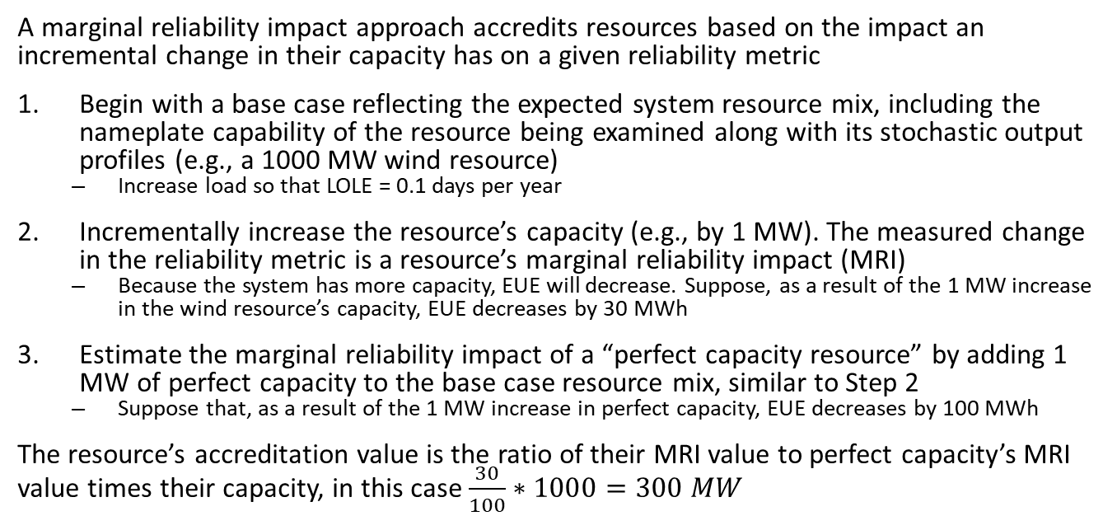
Marginal Reliability Impact Approach
A marginal reliability impact approach accredits resources based on the impact an incremental change in their capacity has on a given reliability metric
Begin with a base case reflecting the expected system resource mix, including the nameplate capability of the resource being examined along with its stochastic output profiles (e.g., a 1000 MW wind resource)
  Increase load so that LOLE = 0.1 days per year
Incrementally increase the resource’s capacity (e.g., by 1 MW). The measured change in the reliability metric is a resource’s marginal reliability impact (MRI)
  Because the system has more capacity, EUE will decrease. Suppose, as a result of the 1 MW increase in the wind resource’s capacity, EUE decreases by 30 MWh
Estimate the marginal reliability impact of a “perfect capacity resource” by adding 1 MW of perfect capacity to the base case resource mix, similar to Step 2
  Suppose that, as a result of the 1 MW increase in perfect capacity, EUE decreases by 100 MWh
The resource’s accreditation value is the ratio of their MRI value to perfect capacity’s MRI value times their capacity, in this case $\frac{30}{100}∗1000=300 MW$

