Slide 1
July 19, 2022 | NEPOOL Reliability Committee | Doubletree Hotel, Westborough, ma
Operational Impact of Extreme Weather Events
Energy Security Study Performed in Collaboration with EPRI
Stephen George
Director, operational performance, training & integration
Aidan Tuohy
EPRI – Program manager

Slide 2
Operational Impact of Extreme Weather Events – Energy Security Study
ISO is working with EPRI to conduct a probabilistic energy security study for the New England region in the operational time frame under extreme weather events
Why: Improve the ISO’s and stakeholders’ understanding of operational risks under future weather extremes
Enhance understanding of potential consequences of extreme weather and prompt a regional discussion about how best to prepare for them
How: Understand stressors and the related failure mechanisms during extreme weather events and then perform risk analysis across multiple scenarios
Establish a framework for analysis of risk under extreme weather events
The framework should prove useful even if climate projections change in the future
There are three major steps to this effort. This presentation will be a brief update on recent progress and will focus on a continued review of Step 2 activities.
Step 1: Weather Modeling (performed by EPRI)
Step 2: Risk Model Development and Scenario Generation (performed by EPRI)
Step 3: Energy Security Assessments (performed by the ISO)

Slide 3
Step 1: Weather Modeling (Review)
The objectives of this step are to identify weather events of interest using statistical analysis and to develop hourly profiles of weather variables for the periods of study in the future
This analysis includes the acquisition and interpretation of locationally-specific climate data
This data is used to characterize trends, including uncertainty, in the mean and extremes for different climate variables of interest
As part of Step 1, EPRI performed a historical weather review of the New England region which was intended to provide context to ISO and stakeholders related to historical extremes and trends; EPRI also analyzed global climate model projections, results of which were shared at the May RC meeting
Final deliverables for this task also include hourly profiles of weather variables which will be used to generate renewable generation availability and load profiles as part of Step 2 (see next slide)

Slide 4
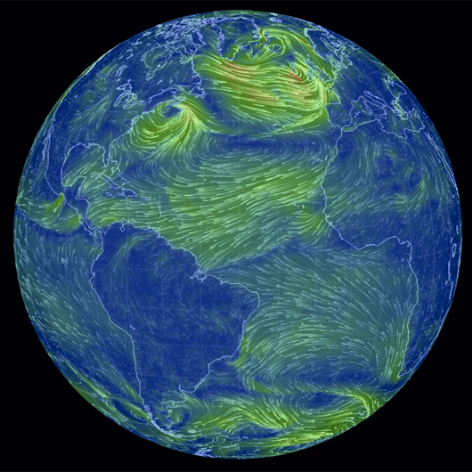
Step 1: Development of Hourly Weather Variable Profiles - A Key Input to Step 2
Scenarios For Study Will Include These Elements
Weather Modeling
Weather Events
Non-Weather Variables
Random Events
Goal: Develop a set of hourly weather profiles that are representative of the target year(s) climate
Represent future climate with a set of climate model output data sets representing alternative pathways
Use historical profiles to inform bias correction and downscaling of climate model to hourly resolution
Develop hourly profiles of weather variables for the periods of study in the future; hourly profiles of weather variables will be used to generate renewable generation availability and load profiles for use in Step 2
710
Hourly weather year profiles per target study year; 710 versions of 2027 and 2032 weather
71 Historical years normalized & mapped to
=
x 5 Climate models representing
x 2 Emissions concentration scenarios
Source: https://gcaptain.com/earth-weather-visualized/

Slide 5
Step 2: Risk Model Development and Scenario Generation
The objective of this step is to identify events of interest and develop the inputs to the 21-day energy assessment in Step 3
Key activities in this step include:
Development of macro assumptions about future energy mix, demand composition, and other high-level factors
Development of risk models which will facilitate understanding of the vulnerabilities of the future energy mix to weather drivers
Development of scenario engine tool which will be used to develop multiple scenarios for further analysis
This section of the presentation will include a review of the risk model and introduce aspects of the scenario generation methodology, both of which are currently under development by EPRI
Portions of the Risk Model discussion are intended as a review of previously presented materials (see slides 8-14)

Slide 6
Step 2: A Review of Common Approaches to Climate Vulnerability & Resilience Assessment
Conventional assessment approach
Hazards: define classes of weather events (e.g. hurricane, heatwave)
Exposure: identify assets / components that are affected by the hazard (e.g. power plants)
Vulnerability: assess the extent to which exposed assets are compromised by the hazard (e.g. low wind speed impact on wind generation)
Hazard Identification
Exposure Assessment
Vulnerability Assessment
Climate Characterization
6

Slide 7
Step 2: Enhanced Approach to Identify Hazards Based on Asset Exposure, EPRI’s Approach
Enhanced assessment approach
Hazard identification based on bottom-up screening model of exposure of assets to new climate
Dynamic, repeatable, data-driven approach to define and characterize hazardous considerations
Requires development of high-level relationships between asset availability and weather conditions; these relationships are established in Risk Modeling activities as part of Step 2
Climate Characterization
Exposure Assessment
Vulnerability Assessment
Hazard Identification
7

Slide 8
Step 2: Risk Model
Scenarios For Study Will Include These Elements
Weather Modeling
Weather Events
Non-Weather Variables
Random Events
Goal: Identify discrete (extreme) weather events that may be stressful to system operations; begin to define scenarios for study
As part of risk modeling, simplified relationships between resource availability and weather conditions are defined (see example on next slide)
Screen weather data set to identify set of stressful (extreme) weather events
Transform hourly profiles of weather variables into hourly demand and renewable generation availability
Reduce set of weather events for further study
Source: https://gcaptain.com/earth-weather-visualized/

Slide 9
Step 2: Risk Model, cont. Define relationships between availability and weather conditions
Identify typical weather-related operating range limits by resource type (examples below)
Wind requires wind speed between 4-25 m/s
PV needs irradiance above 300 W/m²
CT needs to ambient temperatures to be above 0F and below 120F
Estimate de-ratings outside normal operating range (examples below)
Wind speed < 4 m/s = 100% derate
PV irradiance < 300 W/m² = 100% derate
Ambient temperatures > 95F = 5% derate

Slide 10
Step 2: Risk Model, cont. Modelling Considers Direct & Indirect Impacts
The mechanism by which weather influences the availability of a generator or demand may be classified into two groups:
Direct Impacts: represent the dependence between asset performance on the weather conditions at a particular location at a given time
Example: Wind output is a function of wind speed at the site
Indirect Impacts: represent the dependence between asset performance and conditions arising subsequent to a given weather condition near the asset
Example: Gas plant fuel supply is a function of heating demand that is a function of weather
Both direct and indirect impacts are considered in the risk model

Slide 11
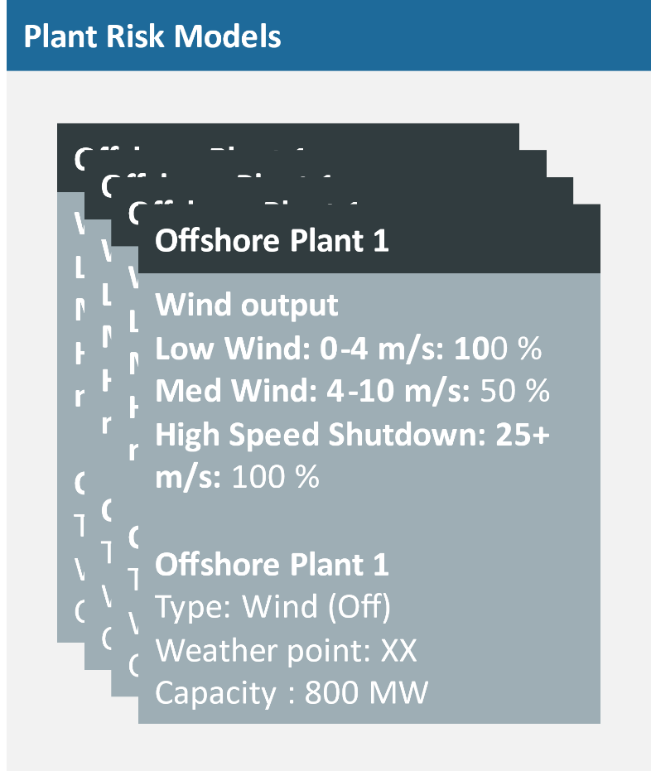
Step 2: Risk Model, cont. Screen weather data set to identify set of stressful (extreme) weather events
Weather Year: 2005, Model 4, SSP3
Temperature
Wind Speed
Irradiance
3 Day Avg. HDD
Unavailable Supply Estimate
Each resource-specific risk model is evaluated at each interval in the weather data provided and the unavailable capacity is estimated
Unavailable capacity is aggregated across all resource types in each interval

Slide 12
Step 2: Risk Model, cont. Screen weather data set to identify set of stressful (extreme) weather events
Weather Year: 2005, Model 4, SSP3
Hourly demand profiles already available as part of pre-processing in earlier Step 2 activities
Exceptional demand represents demand above a fixed threshold
Example: demand above 23 GW
Temperature
Wind Speed
Irradiance
3 Day Avg. HDD
Unavailable Supply
Exceptional Demand
*Graphs supplied above are for illustrative purposes

Slide 13
Step 2: Risk Model, cont. Screen weather data set to identify set of stressful (extreme) weather events
Weather Year: 2005, Model 4, SSP3
Unavailable supply and exceptional demand aggregated
Total system risk measure derived
Unavailable Supply
+
Exceptional Demand
Exceptional Demand
+ Unavailable Supply
*Graphs supplied above are for illustrative purposes

Slide 14
Step 2: Risk Model, cont. Identifying Events of Interest and Reducing for Further Study
Weather Year: 2005, Model 4, SSP3
Sliding windows applied in order to define events
21 days long
New window every 1-3 days
As an example, retention of top 5% risk events as eligible set of events for scenarios
Scenario reduction techniques will be applied to ensure diversity of tail risk events are examined and establish likelihoods of occurrence
A set of extreme weather events (initial set of scenarios) to study will be determined at this point
Risk (MW)
*Graph supplied above is for illustrative purposes

Slide 15
Step 2: Scenario Generation, cont.
Scenarios For Study Will Include These Elements
Weather Modeling
Weather Events
Non-Weather Variables
Random Events
Goal: Include in scenarios any non-weather variables that may occur during the event and may influence resource (or energy) availability
Identify variables of interest that can be categorized (i.e. high/med/ low)
Examples include fuel availability, imports, and hydro availability
Determine appropriate values and likelihoods for each variable of interest category (i.e. branch)
Develop scenario tree for each event, creating alternative scenarios for each event that capture additional variables
Source: https://gcaptain.com/earth-weather-visualized/

Slide 16
Step 2: Scenario Generation, cont.
Scenarios For Study Will Include These Elements
Weather Modeling
Weather Events
Non-Weather Variables
Random Events
Goal: For each scenario, create multiple realizations of uncertain (random) events such as forced outages and maintenance
Forced Outages: Implement correlated outage model for resource outages – temperature, ageing
Maintenance: apply maintenance profiles for each resource
Each scenario will include multiple forced outage and maintenance profiles; these scenarios become an input to Step 3
Source: https://gcaptain.com/earth-weather-visualized/

Slide 17
Step 3: Energy Security Assessments
The ISO will use its enhanced 21-day Energy Assessment tool to assess operational impacts by studying scenarios generated in Step 2
By limiting the analysis to 21 days, and furthermore, by applying the scenarios developed in the prior step, the ISO expects to quantify the operational impact of extreme weather events using probabilistic risk metrics, thereby reducing the use of engineering judgement

Slide 18
Summary
Enhancement of energy assessment techniques are necessary to better understand the risks associated with an evolving grid, especially during periods of extreme weather
Step 2’s risk model development and scenario generation methodology are currently underway and are expected to continue for several months

Slide 19
Preliminary Stakeholder Schedule *Schedule is subject to change based on modeling progress
Stakeholder Committee and Date | Scheduled Project Milestone
Reliability Committee February 15, 2022 | Initial presentation
Reliability Committee March 15, 2022 | Summary of EPRI’s historical weather analysis deliverables and discussion of macro assumptions
Reliability Committee May 17, 2022 | Share results of Step 1 (Extreme Weather Modeling) report. Review and discuss Step 2 (Risk Model Development and Scenario Generation) activities
Reliability Committee July 19, 2022 | Review progress on Step 2 activities
Reliability Committee September 20, 2022 | Continue to gather feedback with respect to Step 2 activities
Reliability Committee November 16, 2022 | Share results of Step 2 report and gather feedback on high risk scenarios
Reliability Committee January, 2023 | Discuss preliminary results of Step 3 (Energy Security Assessments)
Reliability Committee February, 2023 | Continued discussion of Step 3 results

Slide 21
appendix
Example of Technology-Specific Risk Model

Slide 22
Step 2: Risk Model, Technology-Specific Mapping of Weather-Related Risks (an example)
*Note this is a draft for discussion of only one of the technology types. Risk Model development for all technology types is work in progress.

