Slide 1
July 19, 2022 | NEPOOL Reliability Committee | Doubletree Hotel, Westborough, ma
GridEx VI
Summary of Exercise and Lessons Learned
Jonathan Gravelin
Manager, control room operations

Slide 2
GridEx VI - Overview
Exercise Summary
Objectives
Participants
Exercise Adaptations
Simulated Generation Events
Simulated Transmission Events
System Loads
Customer Outages
Strengths
Primary Areas for Improvement
Action Items

Slide 3
GridEx VI – Exercise Summary
GridEx VI was designed to provide the electricity industry, government agencies, and other relevant organizations the opportunity to exercise emergency response and recovery plans in response to simulated cyber and physical security attacks and other contingencies affecting North America’s electricity system
The goal of GridEx VI was to exercise the resilience of the North American electricity system in the face of a coordinated attack from a state sponsored adversary

Slide 4
GridEx VI – Exercise Summary
GridEx Exercise was conducted on November 16-17, 2021
The scenario was primarily driven by a hypothetical adversarial organization with knowledge and understanding of the Bulk Electric, Natural Gas, and Transportation Systems
Initiated simulated impactful cyber and physical attacks on key locations of transmission infrastructure
Leveraged social media to target key employees, critical facilities, and generate uncertainty and unrest
Inflicted potentially crippling effects to energy supply throughout the region
Nor’easter weather was included in the scenario development
Designed to produce photo-voltaic forecast deviations resulting in higher actual loads as well as influence events that result in infrastructure damage

Slide 5
GridEx VI – Objectives
The GridEx scenario allowed planners to:
Exercise crisis response and recovery
Evaluate plans, processes, and procedures in a controlled simulated environment
Exercise communication flow-paths
Test organizational continuity
Identify lessons learned and corrective actions
Directly engage senior leadership

Slide 6
GridEx VI – Participants
GridEx VI was conducted with 293 organizations participating
This was a reduction of 45% from GridEx V due to COVID-19
Pandemic conditions impacted the entire life cycle of the exercise
Early on in the planning process preparations were considered for the potential of a full remote exercise with no on-site participants or observers
COVID work posture encouraged use of remote-work technology and the exercise of communication and coordination processes that may not have been incorporated if not for these challenges

Slide 7
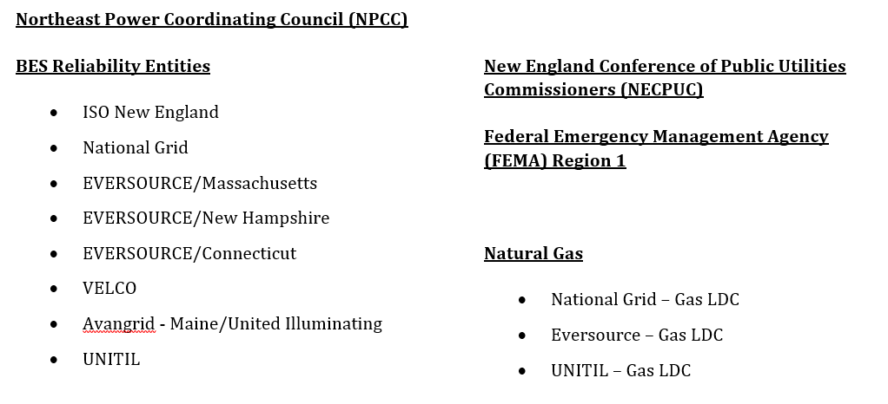
GridEx VI – Participants
The following entities from New England participated in the exercise:

Slide 8
GridEx VI – Exercise Adaptations
3 main adaptations from previous GridEx events:
Participant Locations
Players and planners not co-located at a central location
On-site
Remote
Hybrid – departments operating in both
Simulated Inject Delivery Method
Not all players received injects
Pre-determined point of inject
ex. SCADA or Phone Communication to a specified group or individual
Pre-determined or scripted data or message by a responsible individual
Ensured accountability for delivery of intended information
Incorporation of future/simulated facilities
Simulations included future Offshore Wind facilities

Slide 9
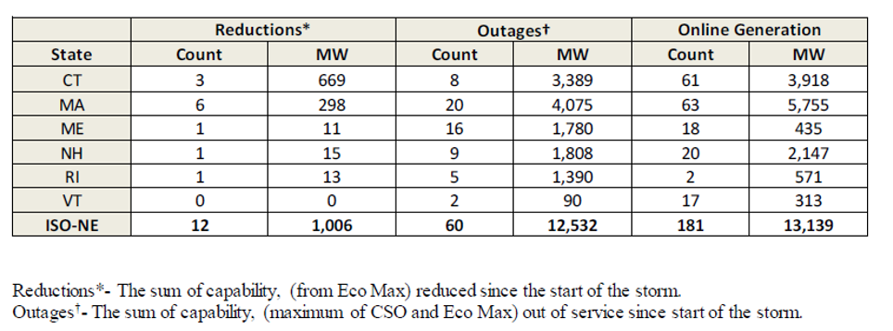
GridEx VI – Generation Events
Over 12,000 MW of generation loss attributable to
Cyber attacks
Physical attacks on transmission facilities
Physical attacks on natural gas pipelines and infrastructure
Generation losses and remaining online generation:

Slide 10
GridEx VI – Transmission Events
Multiple transmission events due to weather and physical attacks resulting in loss of import capability and generating supply
Transmission Outage Details:
Transmission Outage Details by Voltage
Voltage | Number of Trips | Remaining OOS
115 kV | 37 | 10
230 kV | 0 | 0
345 kV | 9 | 8
Other | 0 | 0

Slide 11
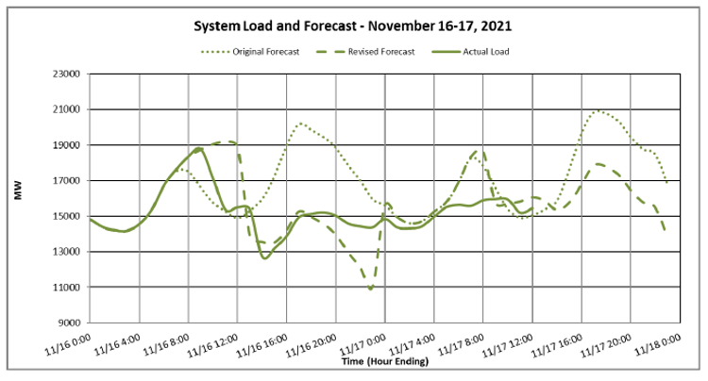
GridEx VI – System Loads
The difference between the original forecast and actual load is the approximate load that was lost due to inject events or manual load shedding to secure the Bulk Electric System under OP-7

Slide 12
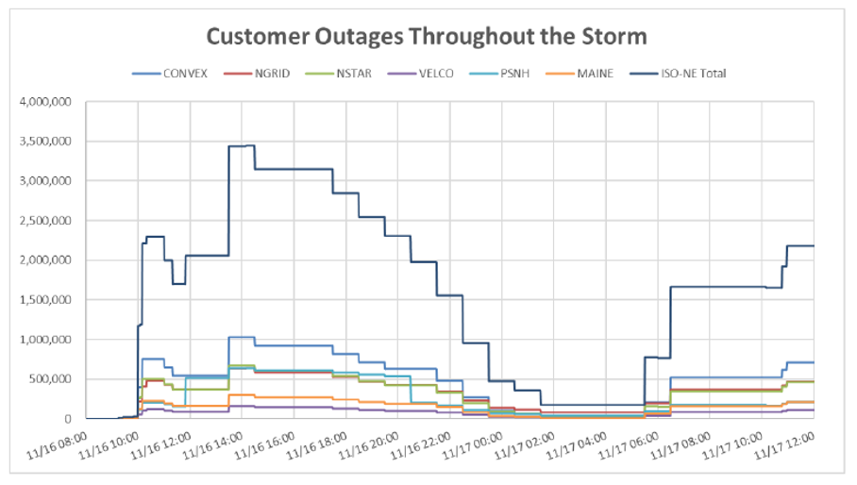
GridEx VI – Customer Outages
Estimated customer outages over time due to inject events and manual load shedding to secure the Bulk Electric System under OP-7

Slide 13
GridEx VI – Strengths
Exercise Crisis Response and Recovery
Strength 1: The GridEx exercise proved that the use of video conferencing and available communication paths were effective in responding to emergency events by groups and teams who were not co-located. Instead of performing the exercise from centralized locations, departments were located at separate locations, or even remotely. Communications were effectively maintained using technology and methods introduced because of the pandemic.
Strength 2: Electronic emergency notification systems allowed rapid and effective communications with a large number of government OP-4 contacts throughout the emergency.
Strength 3: Real-time coordination between the Security, Human Resources, External Affairs and Corporate Communications teams proved essential when actors confronted New England facilities or regional employees in an aggressive manner.

Slide 14
GridEx VI – Strengths
Evaluate Plans, Processes, and Procedures in a Controlled Simulated Environment
Strength 1: Load shed orders were effectively initiated and carried out system-wide, using process improvements from previous exercise recommendations. Communications were clear and concise, delivering instructions to initiate multiple load shed events without confusion.
Strength 2: The 21-day Energy Analysis was produced multiple times throughout the exercise as rapidly changing conditions were presented to the analyst. The tool provided charts and summary analysis that could be easily understood by senior staff. This analysis delivered valuable inputs to their decisions surrounding fuel and energy security during the exercise.
Strength 3: Despite severe adverse conditions, System Operators at the ISO and LCCs as well as local utilities were able to operate the system within all reliability criteria with zero Disturbance Control Standard (DCS), Interconnection Reliability Operating Limit (IROL) and System Operating Limit (SOL) violations recorded during the event.

Slide 15
GridEx VI – Strengths
Exercise Communication Flow-paths
Strength 1: Communications between Security Operations Center (SOC) personnel and Control Room staffs has developed and matured since early exercises. A level of awareness and understanding has been achieved, that provides effective collaboration between cyber security and operational entities.
Strength 2: Emergency Reporting by ISO-NE support staff remains an effective tool for communicating system conditions and event history during system events. This GridEx exercise demonstrated that emergency reporting provided valuable data and information in a consolidated format for timely decision-making.

Slide 16
GridEx VI – Strengths
Test Organizational Continuity
Strength 1: Dispersed and remote participation from players demonstrated the effectiveness of procedures and processes during emergency response situations. The organizations exemplified their resilience, utilizing many of the tools and technologies implemented to manage business continuity during the pandemic.
Strength 2: Emergency Operations Centers (EOC) were activated as a result of injects in this exercise. The EOCs facilitated the emergency response contact with external first responder organizations. The process utilized the electronic emergency notification system to activate EOC, coordinate executive briefing calls, and to simulate OP-4 calls by External Affairs groups.

Slide 17
GridEx VI – Strengths
Directly Engage Senior Leadership
Strength 1: Operations Emergency Preparedness conference call procedures are highly effective for initiating collaborative and effective communications during emergency situations. These procedures and the participants are clearly defined and documented, and the process incorporates periodic testing for familiarity.
Strength 2: Senior Executive leadership welcome opportunities to actively participate in feedback sessions, such as the Executive Debrief “Hotwash.” Collaboration in discussions like this have led to many impactful ideas and recommendations and are of critical importance in these types of exercises.

Slide 18
GridEx VI – Primary Areas for Improvement
Energy Emergencies: Developing and improving the region’s response to Energy Emergencies has been a high priority, primarily due to the heavy dependence on natural gas and limited availability of other fuel types. A goal of this exercise was to incorporate significant disruptions of natural gas supply for a prolonged period of time, driving the system into an extended deep load shed situation. This simulation was successful and brought to light a few areas that could benefit from some exploration and analysis:
ISO-NE utilizes tools and processes that were developed to forecast and analyze expected energy deficiencies for a 21-day period. These tools are constantly being improved and the exercise provided insight into ways to continue to make them more flexible
The use of load management for energy conservation, evaluation of feeder rotation, energy storage facilities, and the actual impact of current emergency actions are being assessed for future strategic management opportunities.
A regional Load Shed Tabletop exercise has been proposed to explore and analyze these areas in detail

Slide 19
GridEx VI – Primary Areas for Improvement
Communications
While GridEx VI proved that ISO and the regional entities incorporate effective communications processes, it helped identify improvement in emergency coordination that will continue to develop these capabilities
Through the evolution of the GridEx exercise, entities have developed processes to rapidly and effectively initiate communications within operations management and executive groups. This exercise seeks to broaden the use of similar techniques to reach out to additional groups, such as IT, cyber security, and generation cyber security representation.
Groups should continue their efforts under the concept of a “Unified Message” for coordinating requests to government entities, as well as for communicating system conditions during times of load shed when the need for energy conservation is paramount

Slide 20
GridEx VI – Primary Areas for Improvement
Renewable Resources
As all areas experience deeper penetration of Renewable Resource types, the need for greater understanding of them becomes increasingly evident. GridEx VI included future large offshore wind facilities in an effort to explore their impact.
Using the knowledge and experience gained from the collaboration on the modeling, operation, and response to events in the exercise, the ISO has identified areas for further operational and technical exploration, in order to understand how these resources function, how to manage and operate with them, and how to develop tools that are effective in these efforts
The recommendations suggest a task-force type approach to collaborate and gather information and knowledge across impacted parties

Slide 21
GridEx VI – Final NERC Report and Action Items
NERC Lessons Learned Report published April 2022 is available for download for those interested in learning more about the overall impact and lessons learned from this exercise
ISO-NE will implement the lessons learned identified in accordance with its internal processes and procedures

