Slide 1
NEPOOL Markets committee | December 6-8, 2022 | Westborough, MA
Day-Ahead Ancillary Services Initiative (DASI)
Procure and price services required for a reliable operating plan in the Day-Ahead Energy Market
Ben Ewing
Andrew Withers
Principal AnalysT
Economist

Slide 2
Day-Ahead Ancillary Services Initiative
WMPP ID:
162
Proposed Effective Date: Q4 2024/Q1 2025
With DASI, the ISO seeks to procure and price the ancillary service capabilities needed to meet real-time energy demand and deliver a reliable, next-day operating plan with an evolving generation fleet
With DASI, these reliability requirements will be satisfied within the clearing of the day-ahead market (DAM)
Today’s discussion addresses several components:
Strike price adder FAQ
Day-Ahead Ancillary Services (DA A/S) offer format
DA A/S offer formulation

Slide 3
Strike Price Adder
In this module we’ll discuss:
Analysis requested by participants related to a strike price adder
Initial indicative results
ISOs plans for further analysis

Slide 4
Review: the value of the strike price impacts DA A/S seller’s incentives
As the value of the strike price (K) increases above a DA A/S seller’s real-time marginal cost (MC) of energy, its incentive to be able to operate in real-time declines
Generally, setting K at the expected real-time locational marginal price (RT LMP) will suffice to achieve efficient incentives
Recall Resource A from last month’s examples, which could choose to take a costly action that would impact its ability to operate in real-time
If the resource is needed and can operate, RT LMP = $80/MWh
If the resource is needed and cannot operate, RT LMP = $180/MWh
Setting K at or below the expected RT LMP causes the resource to fully internalize the cost of potential nonperformance in real-time
See November MC presentation, slides 49-53

Slide 5
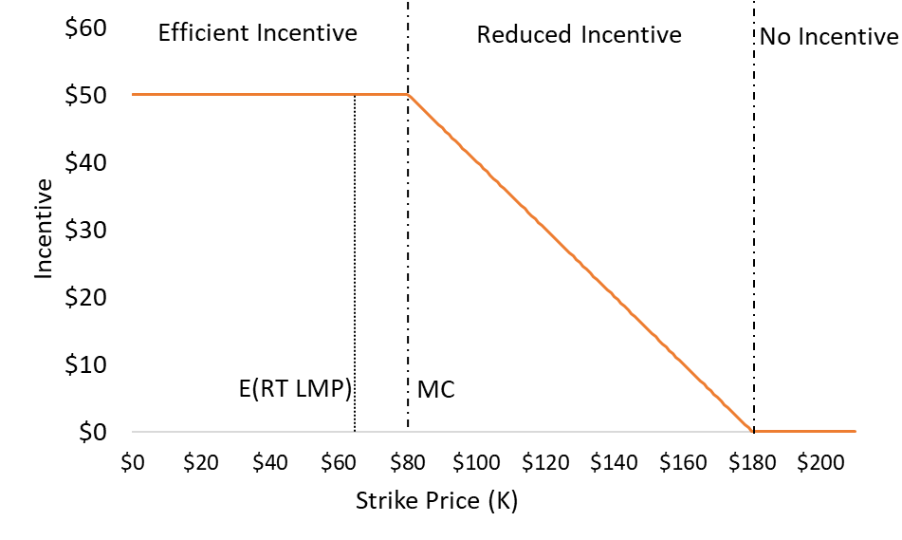
Review: the value of the strike price impacts DA A/S seller’s incentives (cont’d)
Figure previously presented at November 2022 MC, slide 53

Slide 6
FAQ: Could the strike price be increased above expected RT LMP without loss of efficiency?
Is there some value by which K could be increased while maintaining a sensible balance between:
Maintaining efficient incentives for DA A/S sellers (as occurs with the currently proposed strike price), and
Limiting costs due to risks associated with selling the option, rather than the increased incentives to be able to perform
ISO perspective: This is an empirical question, and we are undertaking analysis to inform it
It depends on the extent to which an adder would place the value of the strike price above DA A/S sellers’ marginal cost of energy (in terms of both frequency and magnitude)
On the next slide, we illustrate this graphically for a single hour

Slide 7
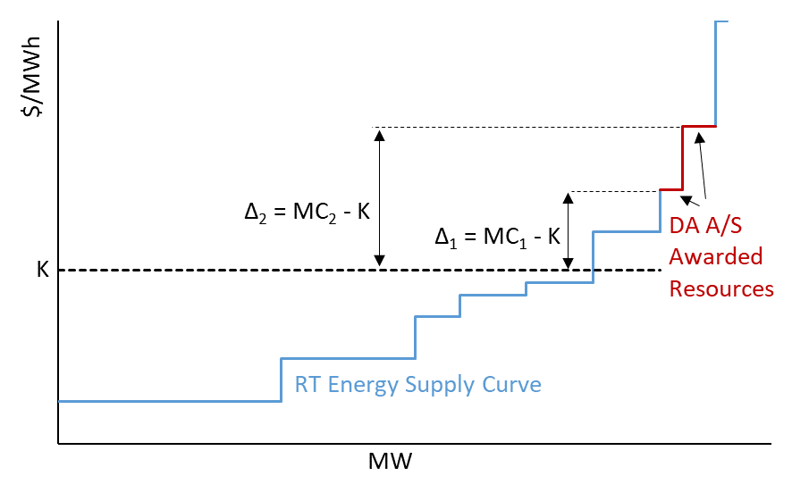
Conceptual Illustration of Strike Price Adder considerations
With a strike price adder of (up to) Δ₁ , efficient incentives are preserved for both sellers of DA A/S
With a strike price adder greater than Δ₁, incentives begin to decline for the first seller of DA A/S
With a strike price adder greater than Δ₂, incentives begin to decline for the second seller of DA A/S

Slide 8
Preliminary Analysis and Indicative Results
We simulated two hours, each with different operating conditions, to study the deltas (MC – K) of DA A/S sellers discussed on the prior slide
Low load, low DA LMP hour: March 27, 2019, hour ending 13
High load, high DA LMP hour: June 29, 2021, hour ending 17
On the next slide, we show the distribution of these deltas across all resources that clear DA A/S
Key takeaway: the magnitude of a strike price adder that maintains efficient incentives for sellers of DA A/S can be variable
In the low load hour, more than half of DA A/S sellers have a delta of less than $10/MWh
In the high load hour, nearly 90% of DA A/S sellers have a delta greater than $10/MWh, with most deltas in the $100-$200/MWh range

Slide 9
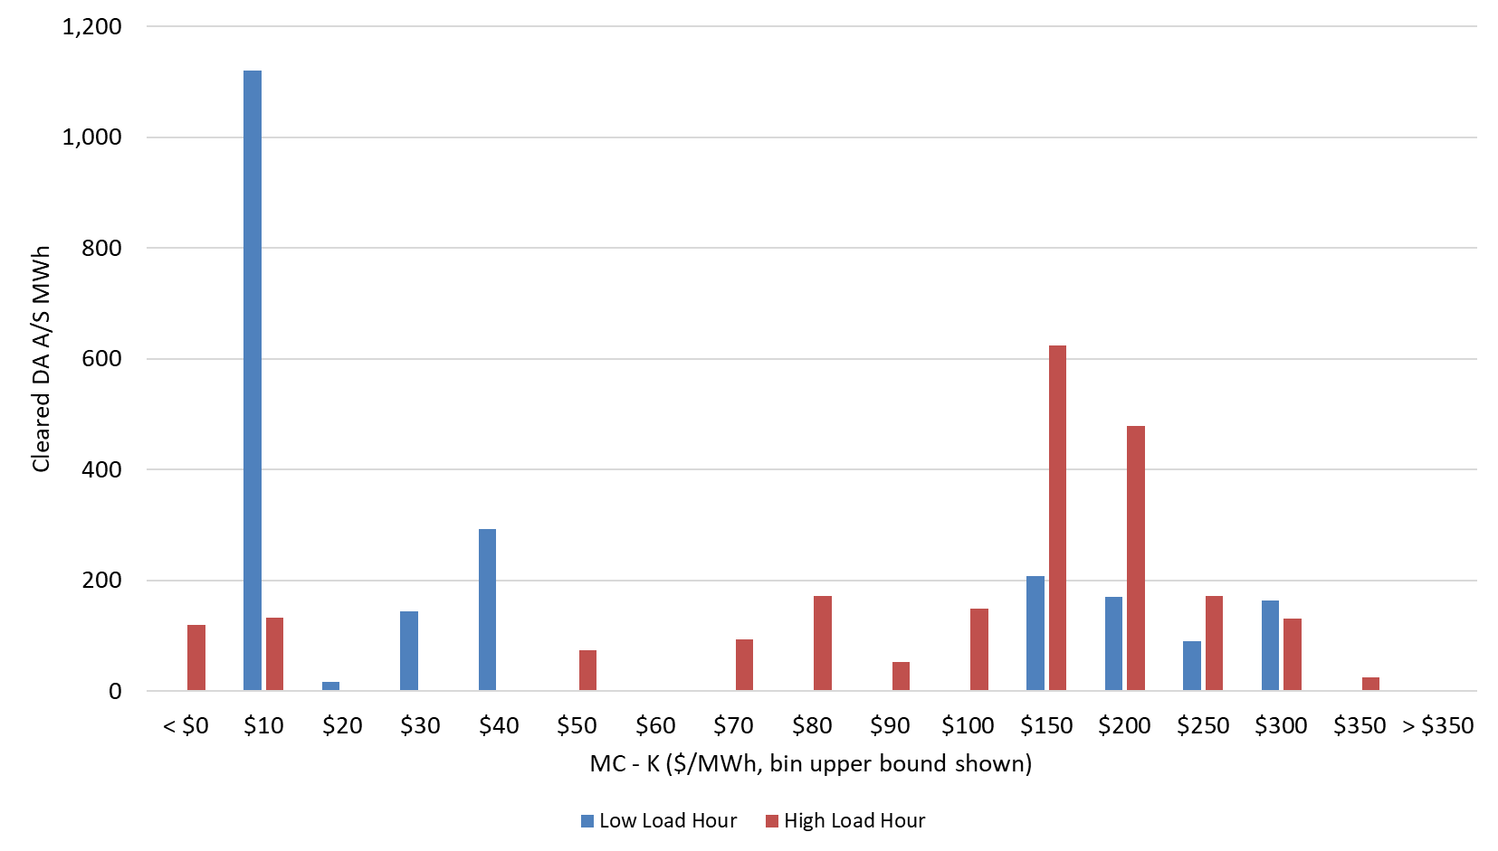
Distribution of [MC - K] Deltas
In the low load hour, for example, ~1,100 MWh of resources that cleared DA A/S awards have RT marginal costs that are between $0/MWh and $10/MWh greater than the strike price

Slide 10
Strike Price Adder Next Steps
The ISO anticipates conducting a similar analysis, across all hours for the Impact Analysis study period (2019-2021), once a full set of indicative results is complete
These results will help inform the impacts of a strike price adder on the efficacy of DASI
This analysis may also inform if some strike price adder frameworks appear more effective in allowing DASI to address misaligned incentives than others
Methodology, results, and ISOs position on some form of a strike price adder will be shared in coming meetings (Q1 2023)
Feedback on the types of results that stakeholders find most useful to assess potential strike price adders is welcome

Slide 11
DA A/S Offer Format Updates

Slide 12
Sellers of DA A/S will submit new A/S offer parameters with their DA energy supply offer
DA A/S Offer Prices: an hourly, product-specific $/MWh value representing the minimum price a resource is willing to accept a DA A/S award for that product
Product-specific offer prices are a participant-requested enhancement from the “single offer price” format proposed with Energy Security Improvements (ESI)
A participant may submit a different price for each DA A/S product to reflect different costs it may incur to provide each service (example next slide)
DA A/S Offer Quantity: a single hourly MWh quantity representing the maximum DA A/S award a participant is willing to accept, across all products
This offered DA A/S quantity, if cleared, will be optimally allocated to specific DA A/S products by the DA Market Clearing Engine (MCE), subject to the resource’s physical capabilities
If the offered DA A/S quantity exceeds what the resource can deliver (e.g., because of its DA energy award), DA A/S award is limited by its physical capability conditional on its DA energy award
Resources submitting DA A/S offers must also have energy supply offers
DA MCE will determine opportunity costs of providing DA energy rather than DA A/S, or vice versa

Slide 13
Illustration: A DA A/S ‘offer block’ can be submitted in each hour
Hour | DA A/S Quantity (MWh) | DA TMSR Offer ($/MWh) | DA TMNSR Offer ($/MWh) | DA TMOR Offer ($/MWh) | EIR Offer ($/MWh)
1 | 100 | $5.25 | $5.25 | $3.50 | $2.75
2 | 100 | $6 | $6 | $4 | $3
The values in this table are for illustration purposes only
Offer prices do not have to vary by product, or have descending values as shown here
Offer prices can be the same for each product
ISO has considered enabling multiple offer blocks per hour, but this poses significant technical challenges
Multiple offer blocks in a single hour would make the DAM optimization problem non-convex, making it difficult (potentially impossible) to arrive at the optimal solution

Slide 14
Maximum Daily Award Limit (MDAL)
MDAL is an optional new offer parameter
This is a participant-requested enhancement
MDAL represents the maximum MWh quantity of Energy + DA A/S awards a resource can clear across the 24-hour DAM horizon
Sum (Energy + TMSR + TMNSR + TMOR + EIR) ≤ MDAL
If no MDAL is submitted, this limitation will not be applied
MDAL provides an additional means for DA A/S sellers to limit their total cleared quantities each day, and thereby their financial exposure
It is analogous to the existing Maximum Daily Energy offer parameter in the DAM
MDAL is in addition to, and not a replacement of, the Maximum Daily Energy parameter

Slide 15
DA A/S Offer Formulation
Competitive DA A/S offer foundations, components and examples

Slide 16
ISO is providing information on and estimates of resources’ competitive offer formulations
Stakeholders have expressed interest in how resources may formulate competitive DA A/S offer prices
ISO is using the competitive offer framework discussed next to construct resource-specific (hourly) offer estimates
These are inputs for the DASI Impact Analysis and market power evaluations
ISO is also planning to use this competitive offer framework as the basis for calculating resource-specific reference levels under its DA mitigation enhancements with DASI
Mitigation approach will be discussed in a separate presentation today
Today’s presentation provides a high level overview of this methodology
Detailed analysis and further examples are available in the ISO’s memo “Competitive Offer Price Formulations for Day-Ahead Ancillary Services as Options” posted for today’s meeting

Slide 17
Several distinct components factor into a competitive DA A/S offer price
Expected components of a competitive DA A/S offer:
Expected DA A/S closeout charge – All resources would incorporate
Avoidable fuel-related costs – Some resources would incorporate
A risk premium – Some resources (likely not all) would incorporate
The first two components are costs a resource incurs because it clears DA A/S (avoidable costs)
Risk premiums may be positive for some resources, but may be zero for others
A DA A/S positon can ‘de-risk’ energy and ancillary service (E&AS) market participation for some resources (See ISO’s November MC presentation, slides 63-65)
Further discussion of each of these offer components in upcoming slides

Slide 18
A useful conceptual organization will facilitate offer formulation analysis
For simplicity, think of each resource in one of two categories based on whether or not it would (conceptually) incur any avoidable fuel costs as a result of (i.e., after) clearing DA A/S
Category 1 resources: competitive offers have only two components, the expected DA A/S closeout charge and risk premium components – no fuel-related offer component
For this category, its fuel costs (if any) are sunk costs before the DA market
Category 2 resources: competitive offers have all three components, the expected DA A/S closeout charge, a fuel-cost component, and a risk premium
For this category, its fuel costs are not sunk (thus are avoidable) before the DA market
A few examples (next) will clarify how this affects different resource types’ offers

Slide 19
Example: An oil-fired generator that procures fuel in advance of the DA market
Assume: The resource acquires fuel oil before it makes its DAM offer (i.e., the fuel acquisition cost is sunk)
The example illustrates:
The calculation of an expected DA A/S closeout charge; and
Why its competitive offer would not include a fuel-related component
For those two components, avoided cost logic has different implications:
It “avoids” the DA A/S closeout charge by not clearing DA A/S
It does not avoid the (sunk) cost of its fuel by not clearing DA A/S
We ignore the risk premium component for now (addressed in next module)

Slide 20
Example: oil-fired generator (cont’d)
The Appendix provides fully-worked example assumptions and calculations
This is Example 2 from the ISO memo posted for today’s session
The competitive DA A/S offer price makes the oil resource just willing, in expectation, to sell one MWh of DA A/S rather than selling energy in RT only
Mechanically, we solve for the DA A/S clearing price that sets its expected net revenues from selling DA A/S equal to its expected net revenues from selling energy in RT only
In this example, the competitive DA A/S offer is equal to the expected DA A/S closeout charge, which is $22/MWh
In this example, the resource’s RT energy revenue and RT marginal cost (when in merit in RT) does not change its DA A/S offer price
Its RT energy net revenue (total net revenue it receives from selling energy in RT when in merit) is the same whether it clears DA A/S or not
In later examples without sunk costs, this will not be the case

Slide 21
A reality check: Expected closeout calculations in practice
In simple numerical examples, expected closeout costs use a limited number of assumed probabilities
In practice, we anticipate market participants would use (possibly sophisticated) models to estimate the likelihood that the (next day’s) RT LMP each hour will take various possible values above K
The ISO’s strike price estimation algorithm provides one such model, and will be publicly available to stakeholders
ISO plans to discuss this model at the January MC meeting
The Impact Analysis will use it to compute hourly expected close-out costs
Other statistical methods are possible to estimate closeout costs; participants have incentives to create more accurate models to improve their offer price calculations

Slide 22
New example: A natural gas-fired generator
This example illustrates that, in addition to the expected DA A/S closeout, resources may incur avoidable fuel-related costs when selling DA A/S
Fuel-related costs have more components to consider than simply the DA price of gas:
If it procures gas DA, and is not in merit in RT, it may incur a net loss on the unused gas
If it procures gas DA, and is in merit in RT, its net revenue depends on the DA gas price
It also matters what happens if it does not clear for DA A/S:
If it does not procure gas DA, and is in merit in RT, its RT net revenue may be lower
For instance, the cost of gas procured intra-day may be higher than DA gas
There is a simple, natural logic for how these fuel-related considerations ‘fold’ together into a DA A/S offer (next)

Slide 23
Gas-fired generator example assumptions: timing and avoidable costs
Assume: If the gas resource clears DA A/S, it then schedules gas day-ahead (e.g., timely nomination)
In real-time, if the resource is not in merit, its unused fuel has lower value than the cost paid DA
E.g., assume generator sells its unused gas intraday at a net loss
If the gas resource does not sell DA A/S, it does not schedule gas day-ahead
If in-merit in RT: buys gas intraday (at a possibly higher intraday price) and generates electricity
If not in-merit in RT: no RT revenue, no fuel costs

Slide 24
Gas-fired generator example: fuel-related cost components of its DA A/S offer
The Appendix provides the fully-worked example numerical assumptions and calculations
This is Example 3 from the ISO memo for today’s session
Here are the key points for its fuel-related cost components, in two parts:
(i) Expected net loss on unused fuel: $5.33/MWh, in this example:
This loss occurs when it clears DA A/S, buys DA gas, is out of merit in RT for energy, and must unload (sell at a loss) its unused gas
The resource would add this expected cost to its DA A/S offer price, because it would avoid this cost if it did not sell DA A/S (i.e., would not buy DA gas to cover its position) (continued next slide)

Slide 25
Gas-fired generator example: fuel-related cost components of its DA A/S offer (cont’d)
(ii) Difference in RT net revenue when it sells DA A/S, versus not: $3.66/MWh in this example
This occurs when it is in-merit in RT
It arises (primarily) because when the resource is in merit for energy in RT, its expected cost to acquire intraday gas is higher than DA gas
Note this component (ii) is a cost saving from clearing DA A/S and acquiring DA gas, rather than waiting and buying more expensive intraday gas
The resource reduces its DA A/S offer price by this expected cost savings, when it arises (as occurs in this numerical example)
Note: If the expected cost saving from acquiring DA gas outweighs the expected net loss on unused fuel in (i), then the avoidable cost of DA fuel procurement would be $0
It would be worthwhile to buy gas DA even without a DA A/S position

Slide 26
Gas-fired generator example: Putting the pieces together for its DA A/S offer
Expected close-out cost: $22/MWh, in this example (same as in earlier oil-unit example)
Fuel-related costs: (i) $5.33/MWh expected loss when not in merit in RT, minus (ii) $3.66/MWh expected higher net energy revenue when in merit in RT = $1.67 / MWh total fuel-related component
Risk premium is not included for now (next module)
The gas-generator’s competitive DA A/S offer price (excluding risk premium) is therefore:
Offer = $22 + $1.67 = $23.67 / MWh
Interpretation: If the DA A/S clearing price is $23.67/MWh, the generator in this example would expect to (just) cover all its avoidable (closeout and fuel-related) costs resulting from its DA A/S obligation
A competitive DA A/S market would drive its offer down to this minimum-selling price, below which it would not be willing to offer DA A/S (ignoring a risk premium)

Slide 27
Examples Summary
For Category 1 resources: Their (avoidable) cost of selling DA A/S is (just) the expected DA A/S closeout charge.
E.g.: The oil unit example, where fuel-related costs are sunk
For Category 2 resources: Their (avoidable) cost of selling DA A/S involves various fuel-related cost components, such as:
Net losses on unused fuel acquired after clearing DA, when not in merit for energy in RT, and
Differences in RT net energy revenue (RT revenue less fuel costs), when in merit for energy in RT, if it clears for DA A/S or not
All else equal: We tend to expect that resources with fuel-related offer cost components (e.g., the gas-fired unit in this example) would tend to have higher DA A/S offer prices than resources with either only sunk costs of fuel (e.g., the oil-fired unit in this example), or no costs of fuel

Slide 28
A reality check: Further considerations on fuel-related cost components
Other technologies. Non-gas resources may have conceptually similar avoidable DA costs of acquiring “input energy” to cover a DA A/S obligation, and would have similar DA A/S offer cost components
Example: Storage resources that charge/pump (additional) energy into storage after clearing DA A/S, in order to cover their A/S position
Other assumptions. Under different assumptions, the only avoidable cost of selling DA A/S for a natural gas resource might be the expected DA A/S closeout charge
This could occur if the availability and expected cost of gas (whether buying or selling) in RT is the same as DA; in such cases, there may be no higher fuel-related costs with DA A/S to ‘avoid’
In practice, these fuel-related cost components may vary seasonally and across resources (depending how they manage unused fuel, likelihood of being in-merit for energy the next day, and so on)

Slide 29
Illustrative numerical calculations of real resources’ offer prices
The next two figures show preliminary estimates of resources’ DA A/S offer prices, calculated for two specific (illustrative) hours
Winter hour: December 14, 2021, hour ending (HE) 17
Late spring hour: June 17, 2021, hour ending 12
The figures show histograms of estimated DA A/S offer price values for all resources
These figures account for both (closeout and fuel-related) cost components described above, but exclude risk premiums (more about which next module)
Resource technology types are color coded

Slide 30
Competitive “higher cost day” DA A/S cost estimates: Dec 14, 2021, HE 17 (excluding risk premiums)

Slide 31
Competitive “lower cost day” DA A/S cost estimates: June 17, 2021, HE 12 (excluding risk premiums)
Revision 1: - Updated figure to reflect correct data

Slide 32
Competitive cost indicative figures: Summary points
Gas-fired resources tend to have higher offer prices than other resource types in the higher-cost day figure
Due to positive avoidable fuel-related cost components in offers
Offer prices, for all resources, are more tightly clustered (lower overall dispersion) in the lower-cost day figure
No avoidable fuel costs for gas resources this hour
The expected DA A/S closeout charge forms a “lower bound” for competitive offers in both hours
The expected DA A/S closeout charge is an avoidable cost of selling DA A/S for all resources
Lower load forecast, lower gas prices, etc., mean the expected DA A/S closeout charge is lower in the June hour than in the December hour

Slide 33
Competitive offer calculations: next steps
The ISO plans to share more information on competitive DA A/S cost estimates during the Impact Analysis discussion, slated to begin in March 2023
We are completing calculations of estimated DA A/S offer prices for the full Impact Analysis study period (three years)
Additionally, will share more information on risk premiums and “total” competitive offer prices including risk premiums (more about which next)

Slide 34
Risk premiums in DA A/S offers
Logic, methodology, illustrative results, and next steps

Slide 35
Risk premiums in DA A/S offers: Context
The net revenues associated with selling DA A/S are uncertain. To account for this uncertainty, we expect sellers may want to include a risk premium in their resources’ competitive DA A/S offers
We develop a methodology and estimate these values to derive competitive D/A offer estimates that account for risk
ISO will use these in the Impact Analysis simulation studies and market power evaluations
However, as we’ll cover in the discussion of mitigation (later today), this methodology is not used to calculate reference levels (risk will be accounted for via conduct test thresholds)

Slide 36
Risk premiums in DA A/S offers: Conceptual framework
When a resource sells DA A/S, it faces a DA A/S closeout charge (second settlement), equal to RT LMP – K, whenever the RT LMP is greater than the strike price
This is what leads DA A/S sellers to internalize their (potential) replacement cost of RT energy, creating the efficiency gains of the proposed DA A/S settlement design
See ISO’s November MC presentation, slides 15-44
Because the DA A/S closeout charge depends on the RT LMP, uncertainty over the RT LMP is a primary driver of the risk of selling DA A/S
A resource’s ‘gap’ between its marginal energy cost and the strike price, and the possibility of a forced outage, can also impact a resource’s risk of loss from selling DA A/S
See ISO’s November MC presentation, slides 62 & 66

Slide 37
Risk premiums in DA A/S offers: Conceptual framework (cont’d)
Uncertainty over the RT LMP is also a primary driver of the risk of selling DA energy
All else equal, generally the risk associated with selling DA A/S is less than the risk of selling DA energy
There is more at risk if a resource ‘buys out’ at the full RT LMP (selling DA energy) than if it ‘buys out’ at a lower cost of max{RT LMP – K ,0}
This concept is illustrated in the examples in Section 2.3 of the ISO memo posted for today’s session
This observation, and relationships between the relative risk of settling DA A/S versus DA energy, are leveraged to estimate risk premiums for DA A/S offers

Slide 38
A risk-adjusted return methodology
We account for the risk associated with selling DA A/S by estimating a risk premium that is added to the competitive (avoidable) costs of selling DA A/S
The process for estimating risk premiums is performed at the individual resource level, as follows:
First, we estimate how the resource would have offered for DA energy if it were risk neutral
We then calculate the percentage difference between its observed historical energy offer and its estimated risk neutral energy offer
This estimates its implied risk premium in its DA energy offer
We then assume that the resource would similarly increase its DA A/S offer price above its DA A/S expected costs (as discussed in the previous module) by this same percentage

Slide 39
A risk-adjusted return methodology (cont’d)
Consider the following example to help make these concepts clear:
A resource submits an energy offer equal to $55/MWh
Assume we estimate that, if this same resource were risk neutral, it would have offered $50/MWh
The percentage difference between the observed historical energy offer and the estimated risk neutral energy offer is ($55 - $50)/$50 = 10%
Assume next we calculate a risk neutral, expected-cost DA A/S offer (using the prior module’s methods) for this resource of $10/MWh
We would then estimate this resource’s DA A/S offer would have:
A risk premium of $1 ($10 expected DA A/S costs × 10% risk rate), and
A total competitive DA A/S offer price of $10 + $1 risk premium = $11/MWh
The examples in Section 2.3 of the accompanying memo further explain the logic, rationales, and assumptions under which this is a reasonable methodology for DA A/S
We touch on these examples in upcoming slides

Slide 40
Example: Comparing the risk of selling DA A/S to the risk of selling DA energy
Examples 4 and 7 in the accompanying memo illustrate a conceptually simple framework for estimating the risk of selling either A/S or energy in DA
These examples use the same framework as the oil and natural gas examples, with additional assumptions about DA clearing prices to allow for the calculation of the risk premium component
Risk is measured in terms of expected net revenues and variance of these net revenues (measured in std. deviations)
This gives a measure of “risk adjusted return.” Adjusting expected returns for risk is standard practice, in various forms
As the risks of an investment position increase, investors require greater expected returns

Slide 41
Example: Comparing the risk of selling DA A/S to the risk of selling DA energy (cont’d)
Examples 4 and 7 illustrate a case where the “risk adjusted return” for DA A/S is slightly higher than for energy
At the assumed clearing prices for DA energy and DA A/S, the expected net revenues from selling DA energy and DA A/S are equal
However, the standard deviation (i.e., uncertainty) of net revenues is lower when the resource sells DA A/S than when it sells DA energy
For these reasons, we would expect the resource modeled in these examples to include a higher risk premium in its competitive DA energy offer than in its competitive DA A/S offer
In such cases, the methodology by which we estimate risk premiums will not underestimate risk premiums for competitive DA A/S offers

Slide 42
New examples: Forced outage and the risk of DA A/S
Stakeholders have expressed interest in how the possibility of a forced outage may impact the risk of selling DA A/S
Examples 6 and 9 in the accompanying memo illustrate how the possibility of a forced outage increases the risk of selling DA A/S, relative to a “perfect performer”
These examples also illustrate that the possibility of forced outage increases the risk of selling energy DA
The examples conclude by showing that the risk of selling DA A/S is still similar to, but less than, the risk of selling energy DA
Practical Implications:
Resource’s existing DA energy offers are assumed include a (possibly small) risk component to account for the possibility of forced outage
The methodology we use to estimate risk premiums for DA A/S leverages these DA energy offer risk premiums, and therefore accounts for the possibility of forced outage

Slide 43
Illustrative numerical calculations of resources’ risk premiums
The next two figures show preliminary estimates of resources’ DA A/S risk premiums, calculated for same hours as before (December 14, 2021, HE 17 and June 17, 2021, HE 12)
The figures show histograms of estimated DA A/S risk premiums for all resources
Resource technology types are color coded

Slide 44
DA A/S risk premium component estimates for “higher cost day”: Dec 14, 2021, HE 17
Revision 1:
- Added missing text box (bottom right of figure)
Risk premiums greater than $40/MWh omitted

Slide 45
DA A/S risk premium component estimates for “lower cost day”: June 17, 2021, HE 12
Revision 1:
- Added missing text box (bottom right of figure)
Risk premiums greater than $20/MWh omitted

Slide 46
Illustrative risk premium figures: Summary points
Methodology captures that the risk of selling DA A/S is higher when the system is tighter
We observe significant variation in the risk premium estimates across resources in the fleet
This reflects the historical risk premiums we estimate (i.e., “embedded” in) each resource’s observed DA energy offers
Given the ample supply of A/S capability in the system relative to A/S requirements, the resources with larger risk premiums appear unlikely to clear DA A/S
Impact Analysis simulations should be able to inform this more completely

Slide 47
Competitive DA A/S offers
Combining competitive costs with risk premium estimates

Slide 48
Recap: components of a competitive DA A/S offer
Competitive costs: DA A/S offer cost components resources could avoid by not selling DA A/S
Expected DA A/S closeout charge (all resources)
Fuel-related costs (some resources)
Note: Both components included in reference prices used for mitigation
Risk premiums:
Some resources will include a positive risk premium (DA A/S may de-risk E&AS market participation for other resources)
We estimate risk premiums using historical energy offers (prior module)
Note: ISO will not directly estimate risk premiums as part of the DA A/S mitigation process; conduct test thresholds account for risk premiums (more on this in the mitigation presentation today)

Slide 49
Combining competitive costs and risk premium to arrive at competitive DA A/S offer
The figures illustrate the total estimated DA A/S offer prices for the resources shown previously, for the same two illustrative hours
The next slides’ figures present the total competitive DA A/S offer prices estimates for the same two hours illustrated previously
December 14, 2021, HE 17, and June 17, 2021, HE 12
The total DA A/S offer is the competitive cost component, plus the resource’s estimated risk premium

Slide 50
Competitive DA A/S offer prices for “higher cost day”: December 14, 2021, HE 17
Revision 1:
- Added missing text box (bottom right of figure)
Offers greater than $40/MWh omitted

Slide 51
Competitive DA A/S offer prices for “lower cost day”: June 17, 2021, HE 12
Revision 1:
- Added missing text box (bottom right of figure)
Offers greater than $20/MWh omitted

Slide 52
Competitive Offer Figures Summary
Estimated A/S offer prices are higher on Dec 14 than on Jun 12
Higher DA A/S closeout charge, and higher gas components on Dec 14
This reflects the higher loads and higher fuel prices on Dec 14
Gas resources’ DA A/S offers are more varied on higher-cost Dec 14 day; more tightly clustered when there is no fuel-cost component, on June 12
We observe significant variation in offer price estimates across resources in the fleet
Reflects differing risk premiums, fuel-related cost components, and factors determining each that vary by resource
Note the ample supply of A/S capability and total offered MWh, relative to A/S requirements
Implies many resources, with higher total offer prices, are unlikely to clear DA A/S
Supports modeling assumption that competition should drive offer prices down to levels consistent with what resources are (just) willing to accept for a DA A/S position
On both days, the vast majority of A/S offers are less than the strike price

Slide 53
Conclusion

Slide 54
Key Takeaways
The ISO is undertaking analysis to inform discussions of a strike price adder, and will return with more information in early 2023
Competitive offers for DA A/S have three components
Expected DA A/S closeout charge
Avoidable fuel-related costs
Risk premium
The ISO is estimating competitive DA A/S offers for use in the Impact Analysis and market power evaluations
ISO plans to use the competitive offer framework to set reference prices in DA A/S mitigation (i.e., to estimate avoidable costs) and to account for risk premiums in mitigation conduct tests

Slide 55
Stakeholder schedule

Slide 56
Stakeholder Schedule
Stakeholder Committee and Date | Scheduled Project Milestone
Markets Committee - October 12-13, 2022 | Overview and initial proposed design discussion
Markets Committee - November 8-10, 2022 | Continue design discussions
Markets Committee - December 6-8, 2022 | Continue design discussions
Markets Committee - January 10-11, 2023 | Continue design discussions
Markets Committee - February 7-8, 2023 | Continue design discussions
Markets Committee - March 7-8, 2023 | Continue design discussions and review initial impact analysis results
Markets Committee - April 11-12, 2023 | Continue design discussions and continue review of impact analysis results
Markets Committee - May 9-10, 2023 | Present draft of the ISO’s proposal and initial Tariff redlines; Continue review of impact analysis results; Discussion of any potential amendments to the ISO proposal*
*Members should provide their materials in advance so that they can be distributed by the posting date for the relevant MC meeting and should work with NEPOOL Counsel in the drafting of any desired Tariff changes or amendments to the ISO proposal

Slide 57
Stakeholder Schedule
Stakeholder Committee and Date | Scheduled Project Milestone
Markets Committee - June 6-7, 2023 | Present any design refinements to the ISO’s proposal and review Tariff redlines focusing on revisions since the prior meeting; Continue review of impact analysis results; Discussion of any potential amendments to the ISO proposal including Tariff language*
Markets Committee - July 11-12, 2023 | Discuss any remaining design refinements to the ISO’s proposal and continue review of Tariff redlines focusing on what is new; Continued discussion of any potential amendments*
Markets Committee - August 8-10, 2023 | Vote on DASI proposal and any proposed stakeholder amendments
Participants Committee - September 7, 2023 | Vote on DASI proposal and any proposed stakeholder amendments
*Members should provide their materials in advance so that they can be distributed by the posting date for the relevant MC meeting and should work with NEPOOL Counsel in the drafting of any desired Tariff changes or amendments to the ISO proposal

Slide 58
Ben Ewing
(413) 535-4361 | Bewing@iso-ne.com
Andrew Withers
(413) 540-4797 | jwithers@iso-ne.com

Slide 59
Appendix

Slide 60
Oil-fired generator, expected net revenues from selling DA A/S

Slide 61
Oil-fired generator, expected net revenues from selling energy in RT only

Slide 62
Gas generator, expected net revenues from selling DA A/S

Slide 63
Gas generator, expected net revenues from selling energy in RT only

Slide 64
Risk premium methodology
We estimate risk premiums in competitive offers by first estimating how a resource would offer for energy if it were risk neutral
When a resource sells energy in DA market, its net revenue is $DA LMP−RT LMP+RT Energy Credits−RT Energy Costs$
If resource is risk neutral, it is willing to sell DA energy as long as it breaks even (expected net revenue equals to zero): $Risk Neutral DA Offer=E[RT LMP]−E[RT Energy Credit]+E[RT Energy Cost]$
We obtain hourly expected RT LMP estimates using the ISO’s (strike) price model for RT LMP’s
We estimate RT energy credits and RT energy costs with historical data on RT LMPs, resource specific heat rates, and fuel price data

Slide 65
Risk premium methodology
The estimated risk premium is the percentage difference between estimated risk neutral offer and observed historical energy offer
If historically observed energy offer is $55, and estimated risk neutral offer is $50, then estimated risk premium is ($55 - $50)/$50 = 10%
Note that if observed energy offer is less than risk neutral estimate, we assume risk premium is zero.
Suppose observed energy offer is $45, and estimated risk neutral offer is $50. Instead of using the estimated risk premium of ($45 - $50)/$50 = -10%, we assume the risk premium is zero.
This ensures that we do not assume resources will offer below the competitive costs derived in the first module

Slide 66
Example: expected net revenue and standard deviation of selling energy DA

Slide 67
Example: expected net revenues and standard deviation of selling DA A/S

Slide 68
Example: impact of forced outage on risk of selling energy DA

Slide 69
Example: impact of forced outage on risk of selling DA A/S

