Slide 1
NEPOOL Markets committee | January 10-12, 2023 | Westborough, MA
Day-Ahead Ancillary Services Initiative (DASI)
Procure and price services required for a reliable operating plan in the Day-Ahead Energy Market
Ben Ewing
Zeky Murra Anton
Principal AnalysT
Economist

Slide 2
Day-Ahead Ancillary Services Initiative
WMPP ID:
162
Proposed Effective Date: Q4 2024/Q1 2025
With DASI, the ISO seeks to procure and price the ancillary service capabilities needed to meet real-time energy demand and deliver a reliable, next-day operating plan with an evolving generation fleet
With DASI, these reliability requirements will be satisfied within the clearing of the day-ahead market (DAM)
Today’s discussion addresses several components:
Review clearing and pricing considerations in a co-optimized DAM
Review the ISO’s methodology and RT LMP forecasting model used to set the strike price and compute expected closeouts

Slide 3
Review: Reliability standards and DASI

Slide 4
Review: Day-Ahead Reliability Standards
The ISO must produce a day-ahead operating plan that satisfies key reliability standards
Operating reserve. The ISO must have sufficient 10- and 30-minute response capability to ensure the ability to recover from the loss of the largest contingency
NERC BAL-002-3, Requirement R.2
NPCC Directory #5
Load Forecast. The ISO must ensure sufficient supply capability to satisfy the load forecast
NERC-TOP-002-4
ISO has provided a detailed memo on the associated NERC and NPCC standards, and the current practices for satisfying these standards:
Reliability Standards Supporting Day-Ahead Ancillary Services Requirements – Revised Edition

Slide 5
Review: DASI satisfies these DA reliability standards within the market
With DASI, the ISO is procuring, within the co-optimized DA market, the capabilities required to meet these key reliability standards in the DA timeframe
New DA A/S constraints will be applied in market clearing
New DA A/S products will be procured, and transparently priced
DA A/S awards provide sellers
Information: sellers will know the ISO is counting on their resources’ fast-start and ramp-up capabilities
Compensation: sellers receive payment for providing these key reliability services
Settlement obligation: sellers have efficient incentives to ensure the ability to operate in real-time

Slide 6
Review: DASI constraints and products to meet key reliability standards
Load Forecast
New system-level DAM constraint: Forecast Energy Requirement (FER)
New system-level DAM product: Energy Imbalance Reserve (EIR)
Operating Reserve
New system-level DA constraints:
TMSR requirement, Total 10-minute requirement, Total 30-minute requirement
New suite of system-level products: Flexible Response Services (FRS)
Day-Ahead Ten-Minute Spinning Reserve (DA TMSR)
Day-Ahead Ten-Minute Non-Spinning Reserve (DA TMNSR)
Day-Ahead Thirty-Minute Operating Reserve (DA TMOR)

Slide 7
Refresher: FER and EIR
In this module, we’ll discuss:
the energy gap, and how it is addressed today and with DASI
the formulation of the FER constraint, and the new EIR product
FER supply and demand

Slide 8
Today, an ‘energy gap’ may exist after the DAM clears
Energy gap occurs when Load Forecast > DA cleared physical energy supply
Today, the ISO’s load forecast is not a direct input to the DAM
Today, the energy gap is addressed by the Reserve Adequacy Analysis (RAA) process, outside of the DAM
If energy gap is observed, the RAA can:
Rely upon uncleared fast-start resources, and DA-cleared non-fast start resources’ “headroom” range above DA energy awards (common)
Commit additional resources, or extend run times of DA cleared resources (uncommon)
RAA results are not financially binding
Resources receive no compensation or settlement obligation associated with being relied upon to operate above their DA energy award in RAA

Slide 9
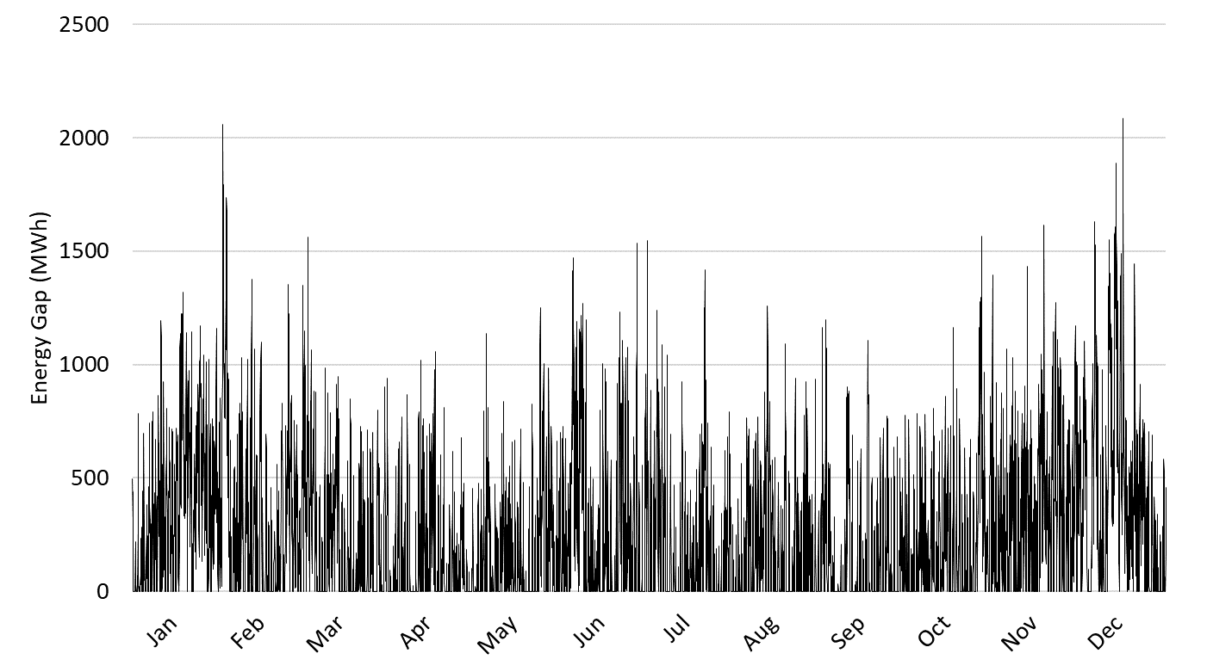
Historical Energy Gap - 2021
Energy gap is 0 MWh in 38% of hours, and greater than 0 MWh in 62% of hours
Average energy gap = 253 MWh
Maximum energy gap = 2,084 MWh

Slide 10
DASI closes the energy gap within the DAM
Recall: NERC reliability standard requires a DA operating plan capable of satisfying the day-ahead load forecast (LF)
To satisfy this reliability standard within the DAM, we introduce a new constraint and a new product to the DAM’s commitment, pricing and dispatch processes
Forecast Energy Requirement (FER) constraint ensures sufficient physical supply to meet DA LF
Energy Imbalance Reserve (EIR) is a new DA A/S product that can contribute to satisfying the FER, if necessary, to close the energy gap

Slide 11
Forecast Energy Requirement – a second DA demand constraint
To bring the Load Forecast into the DAM, the FER constraint (a second demand constraint) will be applied
With DASI, two demand constraints will be applied in the clearing of the DAM:
DA Energy Balance: exists today, considers bid-in demand
FER: new, considers Load Forecast
FER formulation: Gen + Imp + EIR >= LF + Exp
Gen = cleared DA energy from physical supply resources (generators, DRRs)
Imp = cleared DA imports
EIR = new DA A/S product
LF = DA Load Forecast
Exp = cleared DA Exports
Important: both cleared physical energy supply and cleared EIR quantities contribute to satisfying the FER

Slide 12
EIR is a new product introduced with DASI
EIR has a 60-minute ramping horizon, similar to DA energy
EIR can only be cleared on physical supply resources internal to the New England control area
It cannot be provided by INCs or Imports
EIR can be provided by DAM-committed supply resources, or offline resources with fast-start capability

Slide 13
EIR simple numerical examples
Cleared DA Energy and EIR jointly satisfy the load forecast when the FER is applied
EIR may, or may not, be needed, depending on the amount of DA Energy cleared on physical supply resources
Assume LF = 20 GWh. The following cleared quantities satisfy the FER:
Cleared Physical Energy (GWh) | Cleared EIR (GWh) |  | Load Forecast (GWh)
18 | 2 | >= | 20
19 | 1 | >= | 20
21 | 0 | >= | 20

Slide 14
Ample capability is available to the DAM to close the energy gap via the FER
The DAM has access to all offered physical capability on the system to satisfy the FER
Committed physical supply may be cleared for additional energy, or for EIR
Uncommitted fast start (FS) units may be cleared for energy or for EIR
Uncommitted physical supply may be committed in order to provide energy and EIR
The supply available to the DAM exceeds the magnitude of the largest observed energy gap

Slide 15
Key Takeaways – FER/EIR Refresher
The DA energy gap is a common occurrence
Today, the energy gap is addressed after the DAM in the RAA
With DASI, the energy gap will be addressed within the DAM
The FER will procure and price the services needed to close the energy gap
Both energy and EIR can satisfy the FER
Ample supply capability is available to the FER for use in addressing the energy gap

Slide 16
Refresher: FER/EIR clearing and pricing fundamentals

Slide 17
Clearing and Pricing with Two Demand Constraints Overview
Application of a second demand constraint (the FER) in the DAM’s clearing and pricing process will change cleared energy quantities and prices
Quantities: DA energy awards (exists today), EIR awards (new)
Prices: DA LMP (exists today), FER Price (FERP, new)
In this section, we’ll review the key takeaways associated with clearing and pricing with the FER/EIR
These details were covered in detail during Energy Security Improvements (ESI) discussions, and are unchanged*
Detailed conceptual examples and numerical examples are reflected in the Appendix
*see ESI White Paper section 6.2

Slide 18
Clearing and Pricing with One Demand Constraint Refresher
Today’s energy balance constraint reflects one demand curve (bid-in energy demand) and one supply curve (offered energy supply)
Today’s DAM clears where supply and demand intersect:
Price: DA LMP = Marginal Cost (MC) of DA energy supply
Important: These dynamics will change with the addition of the FER!

Slide 19
Two Demand Constraints – Quantity Implications
When an energy gap exists, the FER will address it through procurement of the efficient combination of the following products:
EIR
Additional DA energy supply from physical supply resources (which clears against bid-in energy demand, via the energy balance constraint)
Key point: When an energy gap exists, we expect more physical DA energy supply (and, consequently, more DA energy demand) to clear than under current market rules
It may be more cost effective to clear additional energy supply (against bid-in energy demand) than to clear EIR
Cleared energy quantities no longer occur at the point where offered energy supply intersects bid-in energy demand
See Appendix for conceptual discussion and clearing example

Slide 20
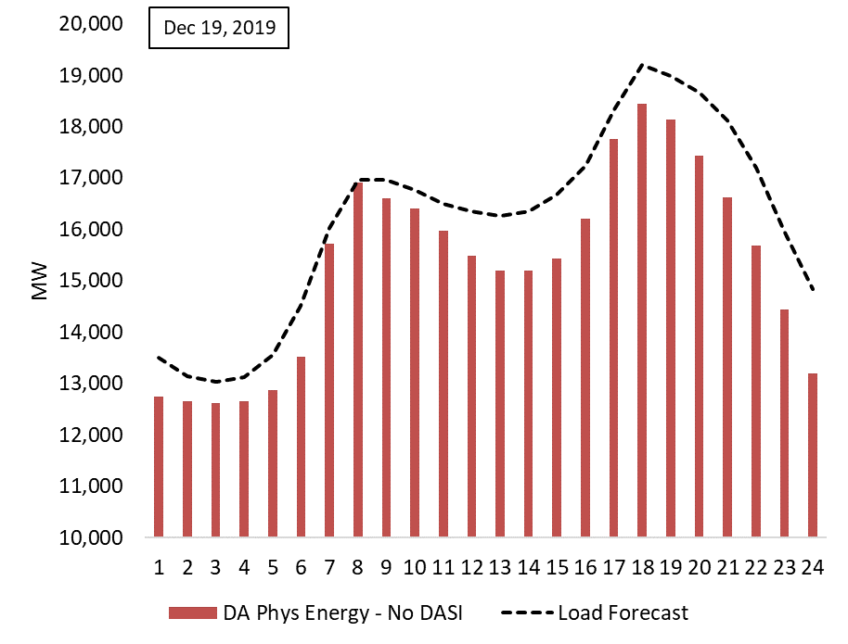
Example – Historical Day with Persistent Energy Gap
The load forecast exceeded DA cleared physical supply in most hours

Slide 21
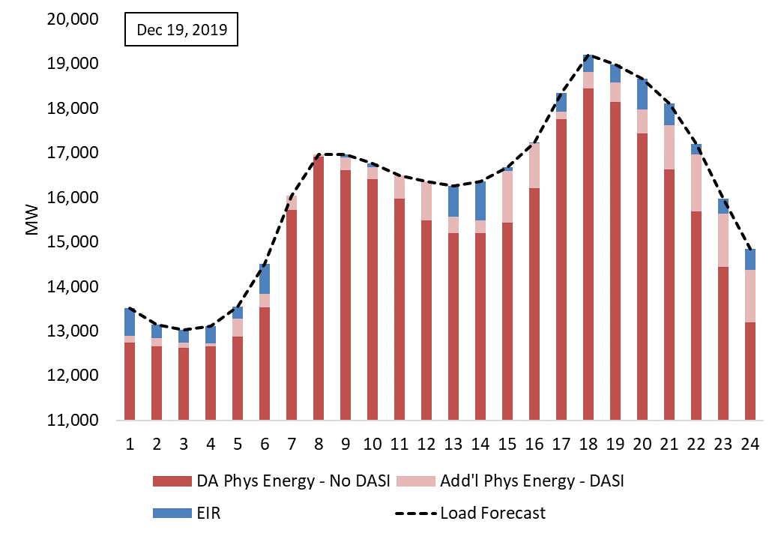
Example – FER Closes Energy Gap with Additional Physical DA Energy and EIR
Observation: the quantity of additional energy procured often exceeds the quantity of EIR procured
The results above were produced by simulating the co-optimized DAM with ISO-modeled DA A/S offers

Slide 22
Two Demand Constraints – Pricing Implications
Clearing prices reflect the incremental cost that would be incurred to satisfy one additional MWh of demand
DA LMP = incremental cost of meeting another MWh of (bid-in) energy demand
FERP = incremental cost of meeting another MWh of the Forecast Energy Requirement
Pricing interaction: clearing an additional MWh of physical energy supply means one less MWh of EIR is required
DA LMP can reflect both the marginal cost of one more MWh energy, and the marginal savings of one less MWh of EIR
With two demand constraints, the marginal cost of energy supply is reflected by the combination of DA LMP and FERP
See Appendix for
conceptual discussion
Numerical clearing example (Examples 1 & 2)

Slide 23
DAM with FER/EIR – Who gets paid/charged these prices?
The participation payment principle: Offers cleared to help satisfy a constraint must be paid the shadow price of that constraint
Conceptually, a MWh of cleared energy or A/S is compensated for the value (system savings) it provides by avoiding the purchase of a more costly MWh at the margin
Certain DA awards can satisfy more than one constraint
Following this principle, DA cleared supply offers will be paid (and DA cleared demand bids will be charged) as follows:
*FERP charges will be allocated to RT load obligation and DA cleared exports, on a beneficiary pays principle
(further discussion at future MC meeting)

Slide 24
DAM with FER/EIR – Equilibrium Behavior and Price Convergence
In the Appendix numerical examples, we see that DA LMP can be lower with the FER applied
This is conditional on all energy supply offers and demand bids remaining unchanged with the FER/EIR (see Appendix Examples 2 & 5)
Expectation: buyers will respond, with load increasing the amount of energy procured DA
Result: increase in DA LMP, bringing it in line with expected RT LMP (see Appendix Example 6)
Expectation: cleared EIR will be smaller than the historical energy gap as load responds
As load increases the amount of energy it buys DA, additional physical energy supply will be procured, reducing the amount of cleared EIR

Slide 25
Key Takeaways – FER/EIR Clearing and Pricing
Day-ahead clearing and pricing dynamics change when the FER is applied
Cleared energy from physical suppliers and cleared EIR jointly satisfy the FER
Additional physical energy supply, as well as EIR, will be cleared to satisfy the load forecast when an energy gap exists
DA LMP will be dependent on the marginal cost of energy supply and the marginal cost of satisfying the FER
Cleared physical energy supply will be paid both the DA LMP and the FERP

Slide 26
Refresher: DA Flexible Response Services

Slide 27
DA A/S Products: Flexible Response Services (FRS)
Suite of three DA A/S products that have a similar purpose as real-time operating reserve
Purpose: prepare the system to be able to successfully respond to sudden, unanticipated losses of supply, or increases in demand, during the operating day
see reliability standards memo for further details
DA TMSR – ten-minute response capability on committed (synchronized) resources
DA TMNSR – ten-minute response capability on uncommitted FS resources
DA TMOR – thirty-minute response capability on committed resource or uncommitted FS resources

Slide 28
FRS Constraints and Demand Quantities
New FRS constraints will be enforced in each hour of the DA clearing and pricing process
Demand quantities for each constraint will be calculated within the DAM, consistent with ISO, NERC, and NPCC standards
*Non-performance factor is currently set to 120%, and is reviewed quarterly
** TMSR % can range from 25% to 100%; currently, it is generally set at 25%
*** Replacement reserve MW represent the ‘second step’ of the two-step Total 30-minute reserve demand curve,
and is set to 160 MW or 180 MW seasonally

Slide 29
FRS Demand Quantity – Historical Values
Statistics on FRS demand quantities for 2019-2021 are shown in the table below

Slide 30
FRS awards ‘cascade down’ to satisfy Demand Quantities
Faster-ramping reserve awards ‘cascade down’ to satisfy less restrictive demand quantities
This cascading is identical to that in effect for RT reserves today

Slide 31
FRS prices ‘cascade up’, following the participation payment principle
FRS clearing prices ‘cascade up’ from slowest-ramping products to fastest-ramping products
Product clearing price is equal to the sum of all shadow prices (SPs) of the constraints to which that product contributes (just as real-time reserve pricing works today)
This satisfies the participation payment principle

Slide 32
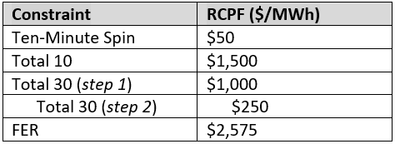
Reserve Constraint Penalty Factors (RCPFs)
FRS constraint RCPFs correspond with those that exist in real-time today
FER constraint RCPF is proposed to be 101% of the sum of FRS RCPFs
The intent is to ensure that satisfying the FER is prioritized above satisfying FRS requirements

Slide 33
Key Takeaways – FRS Clearing and Pricing
FRS products satisfy day-ahead reliability standards related to contingency response
Many similarities exist between FRS and real-time operating reserves
Demand quantities are established in the same manner
Cleared quantities ‘cascade down’, with faster-ramping products satisfying less restrictive demand quantities
Clearing prices ‘cascade up’, satisfying the participation payment principle
RCPFs are the same

Slide 34
Key pricing considerations with a co-optimized DAM

Slide 35
Clearing price considerations – opportunity costs
In a co-optimized DAM, clearing prices may reflect two components
The supply offer of the marginal resource
Inter-product opportunity costs
Inter-product opportunity costs occur when a resource is cleared to provide one product, but would receive greater profit by providing a different product
In the Appendix, we illustrate how inter-product opportunity costs can be reflected in:
DA LMP (see Example 3) – resource incurs opportunity cost by providing energy, rather than FRS
FRS clearing price (see Example 4) – resource incurs opportunity cost by providing FRS, rather than energy
FER price (see Examples 5 & 6) – resource incurs opportunity cost by providing energy, rather than FRS

Slide 36
FRS and FER are tightly-coupled, interdependent design elements
With DA FRS alone (and no FER), due to energy vs. A/S inter-product opportunity costs:
DA LMPs would generally be higher than expected RT LMPs
That would adversely decrease load’s incentive to participate in the DAM, making the DAM’s energy gap worse (see Appendix Example 3)
With both FRS and the FER, demand has a strong incentive to clear in the DAM
This will tend to drive the cleared EIR quantity toward zero, and will tend to converge DA and RT LMPs (see Appendix Examples 5 & 6)
Co-optimizing the FER and FRS simultaneously ensures that the inter-product opportunity costs are compensated, without suppliers needing to ‘price’ them into A/S or energy offer prices

Slide 37
PROPOSED RT LMP Forecasting Model
In this module, we will
Describe the ISO’s proposed RT LMP forecasting model
Show that the proposed model performs well for its intended purposes

Slide 38
Additional Statistical Model Materials Available
This module provides a brief summary of the proposed real-time price forecasting model, developed to support DASI
A technical memorandum posted for today, Day-Ahead Ancillary Services – Statistical Model for Real-Time Energy Prices, provides further modeling information covering:
Statistical price forecasting model’s objectives
Modeling approach: Key ideas and simple numerical examples
Practicalities: Data, training, and testing
Performance results for expected real-time prices, confidence intervals, and expected closeout cost
Mathematical formulations and algorithm details (in Appendices)

Slide 39
Administering the DA A/S market requires estimates of the expected RT Hub LMP and its distribution
The call option strike price should depend (in significant part) on the expected RT Hub LMP
See ISO’s November MC presentation, slides 45-56.
Note: ISO continues to evaluate a possible “strike price adder” (future MC session)
The expected call option closeouts depend on the distribution of possible RT Hub LMPs
They are an input to calculate reference prices in the proposed DA A/S mitigation design
They are also used to construct DA A/S offer prices for the Impact Analysis simulations (future MC session)
Stage 1:
Set the Strike Price
Stage 2:
DAM energy and DA A/S offers and awards
Stage 3:
RT Market, realizing the LMP
Stage 4:
Settlement calculation
For the remaining slides in this module, the term ‘RT LMP’ refers to the RT Hub LMP

Slide 40
RT LMP Forecasting Model Needs to be Flexible
Both the expected RT LMP, and the uncertainty over it, can vary widely by hour and day-to-day
To account for this, the ISO’s model incorporates key predictive data on:
Fuel prices
Forecast system loads
Forecast weather information
For each hour of the next operating day, this information, and the statistical modeling technique we propose, predicts:
The next-day expected RT LMP
A full probability distribution of possible RT LMP outcomes
For more discussion and figures, see Sec. 5.1 of the technical memo for today

Slide 41
A Gaussian Mixture Statistical Forecasting Model Performs Well for These Purposes
The proposed statistical modeling technique accounts for data that is observable before DA A/S offers are due (details in the memo)
Day-ahead market load forecast, 24-hour lagged LMP, gas price, No. 6 fuel price, and a number of standard forecast weather measures
Extensive testing showed that additional variables would not meaningfully improve the forecast model
All model input information is publicly available (from commercial vendors)
A Gaussian Mixture Model (GMM) will allow us to account for structural characteristics observed in the historical RT LMP
GMM is a sophisticated statistical model useful for forecasting (asymmetric) probability distributions and their dynamics (by hour)
Provides more flexibility and leverages available data better than widely-used alternatives (more on which shortly)

Slide 42
Gaussian Mixture Models (GMM)
We illustrate how the GMM works through an example
The detail of the example is in section 2 of today’s memorandum
Suppose that we have a (simulated) dataset consisting of hourly RT LMP data, represented in the following histogram

Slide 43
Challenges Modelling Electricity Price Data: Example
Widely-used statistical methods try to find one distribution that best fits the data
One example is the “bell-shape” or normal distribution
In electricity price data, this approach commonly leads to poor fit
Underestimates the frequency of the most common RT LMP values
Mis-estimates the frequency of not-so-frequent RT LMP values and the “fat right tail” of electricity price data

Slide 44
Gaussian Mixture Models (GMM)
The Gaussian Mixture Model is able to overcome these issues
The GMM technique approximates the data with (dynamic) combinations of multiple distributions, depending on the hour
This significantly better matches the frequency of each RT LMP

Slide 45
Gaussian Mixture Models (GMM)
In practice, the GMM uses the historical data, identifies the best mean and variance for each distribution, and the optimal weight that each distribution should have, for each hour of the data
Gaussian Mixture Model = Optimal Dynamic Mix of Different Gaussian Distributions

Slide 46
GMM Development and Testing
We recommend a 3-distribution approximating mixture model, based on extensive testing
Each distribution’s shape, scale, and position depend on the input data
We trained and tested the proposed model with historical hourly LMPs and observable data from 2012 through 2021
Training Period: 61,389 hours from Jan 2012 through Dec 2018
Testing Period: 26,304 hours from Jan 2019 through Dec 2021
To evaluate performance during the testing period:
The next-day hourly RT LMPs were forecasted ‘one day at a time’, sequentially, using the trained model (as would occur in production), and compared with the actual hourly RT LMPs

Slide 47
Comparative Performance of the Proposed GMM
We first assessed the performance of the GMM at predicting the RT LMP
Benchmarked against a leading commercial price forecasting service vendor’s forecasts
Also compared for reference to the DA LMP, which is determined several hours later (after the DA market is cleared)
The expected RT LMP predicted by the GMM is strongly correlated with the observed RT LMP, and the forecasting errors are slightly smaller than the alternative’s
For more information, consult Table 4 and section 5.2 of today’s memo
Forecast | Correlation Coefficient | Mean Absolute Error | Root Mean Square Error
ISO’s GMM real-time price forecast | .75 | $9.27/MWh | $15.77/MWh
Commercial vendor real-time price forecast | .71 | $9.74/MWh | $16.65/MWh
For Reference Purposes:
DA LMP | .83 | $7.48/MWh | $13.26/MWh

Slide 48
Comparative Performance of the Proposed GMM
Both the commercial alternative and the DA LMP forecast the RT LMP, but not its distribution
As such, they are not viable alternatives to be used to estimate the expected closeouts
We cannot compare distributional properties across alternatives
Additional testing (Appendix A7.1 of the memo) shows that all three models have qualitatively similar forecasting errors
No evidence found that the model will materially mis-estimate the expected RT LMP when the other two models would not

Slide 49
Distributional Performance of the Proposed GMM
Coverage probability accuracy. The frequency the RT LMP falls within the model’s hourly predicted confidence intervals
Measured during the testing period, on ‘one day-before’ forecasts
An accurate model should produce coverage probabilities equal to the significance level of the confidence interval
The trained GMM performs well estimating next-day confidence intervals for each hour’s RT LMP
The GMM coverage probabilities are close to the intervals’ confidence level
For more information, consult Table 5 and section 5.3 of today’s memo
Year | 50% Confidence Interval | 80% Confidence Interval | 90% Confidence Interval
2019 | 51% | 84% | 94%
2020 | 53% | 86% | 94%
2021 | 46% | 78% | 89%
2019-2021 | 50% | 83% | 92%

Slide 50
Proposed GMM’s Performance Calculating Expected Closeouts
The DA A/S market does not operate yet, so there is no historical closeout data to test the model
Using the model’s forecasted expected RT LMP we calculated what the “realized” closeout would have been for each hour of the testing period years
We compared such estimate of the realized closeout with the expected closeout produced by the model
The model was $0.04 per MWh from the estimate of the realized expected closeout:
Average Estimate of the realized closeout = $5.52 /MWh
Expected closeout = $5.56 /MWh
Additional measures on expected closeout cost accuracy are provided in Table 6 in Section 5.4 of today’s memo

Slide 51
Key Takeaways
Based on extensive testing, we expect the proposed model will be satisfactory for its intended purposes in administering the co-optimized Day-Ahead Market
It will be used to determine (prior to any “adder”) the energy call option strike price, and to calculate expected closeout costs (a component of DA A/S mitigation reference prices)
The proposed GMM model will be flexible and dynamic, to make forecasts that vary hourly and reflect system conditions forecast for the next day
The model’s technical formulation is provided in the ISO’s memorandum for today, and the input data is publicly available (from commercial vendors)
The GMM model performs slightly superior to available commercial vendor’s forecasts of the expected RT LMP
Strong predictive power over the RT LMP, with similar forecasting errors

Slide 52
Conclusion

Slide 53
Key Takeaways
DASI satisfies day-ahead reliability standards within the clearing and pricing of the DAM
FRS ensures operating reserve needs are satisfied, and that the cost of satisfying them is transparently priced
FER closes the energy gap and satisfies the load forecast by clearing additional physical DA energy supply and EIR
Works in conjunction with FRS constraints to maintain load’s incentive to participate in the DAM
The DA A/S design requires a reliable RT LMP forecasting model to set the strike price and compute the expected closeouts
The proposed GMM model performs similarly to alternatives in forecasting the expected RT LMP
It also accurately estimates the RT LMP distribution needed to compute the expected closeouts

Slide 54
Stakeholder schedule

Slide 55
Stakeholder Schedule
Stakeholder Committee and Date | Scheduled Project Milestone
Markets Committee - October 12-13, 2022 | Overview and initial proposed design discussion
Markets Committee - November 8-10, 2022 | Continue design discussions
Markets Committee - December 6-8, 2022 | Continue design discussions
Markets Committee - January 10-12, 2023 | Continue design discussions
Markets Committee - February 7-9, 2023 | Continue design discussions
Markets Committee - March 7-9, 2023 | Continue design discussions and review initial impact analysis results
Markets Committee - April 11-12, 2023 | Continue design discussions and continue review of impact analysis results
Markets Committee - May 9-10, 2023 | Present draft of the ISO’s proposal and initial Tariff redlines; Continue review of impact analysis results; Discussion of any potential amendments to the ISO proposal*
*Members should provide their materials in advance so that they can be distributed by the posting date for the relevant MC meeting and should work with NEPOOL Counsel in the drafting of any desired Tariff changes or amendments to the ISO proposal

Slide 56
Stakeholder Schedule
Stakeholder Committee and Date | Scheduled Project Milestone
Markets Committee - June 6-7, 2023 | Present any design refinements to the ISO’s proposal and review Tariff redlines focusing on revisions since the prior meeting; Continue review of impact analysis results; Discussion of any potential amendments to the ISO proposal including Tariff language*
Markets Committee - July 11-12, 2023 | Discuss any remaining design refinements to the ISO’s proposal and continue review of Tariff redlines focusing on what is new; Continued discussion of any potential amendments*
Markets Committee - August 8-10, 2023 | Vote on DASI proposal and any proposed stakeholder amendments
Participants Committee - September 7, 2023 | Vote on DASI proposal and any proposed stakeholder amendments
*Members should provide their materials in advance so that they can be distributed by the posting date for the relevant MC meeting and should work with NEPOOL Counsel in the drafting of any desired Tariff changes or amendments to the ISO proposal

Slide 57
Ben Ewing
(413) 535-4361 | Bewing@iso-ne.com
Zeky Murra Anton
(413) 540-4448 | zmurraanton@iso-ne.com

Slide 58
Appendix

Slide 59
Appendix 1: Conceptual Logic of DAM clearing with FER/EIR

Slide 60
Market Clearing fundamentals with FER and Bid-In Energy Demand
Efficient market clearing occurs when
Marginal Benefit of serving demand = Marginal Cost of serving demand
We’ll examine how this condition holds under the current DAM clearing, as well as with the FER applied

Slide 61
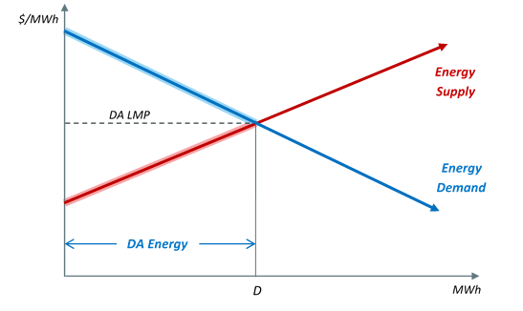
Today’s DAM: One demand constraint
Conceptually, today’s DAM clears at the point where offered supply meets bid-in demand
The blue demand curve here is comprised of participant’s demand bids
DA LMP reflects the price at which:
Marginal Cost of Suppliers = Marginal Benefit of Consumers

Slide 62
DAM with FER/EIR
Two demand constraints will be applied in the clearing of the DAM
Bid-in Demand – exists today
FER – new, considers Load Forecast
Two supply curves will be considered when satisfying these two demands
Energy supply offers – exists today
EIR offers – new
Two clearing prices will result
DA LMP – exists today
FER Price (FERP) – new
We’ll walk through these concepts graphically over the next several slides

Slide 63
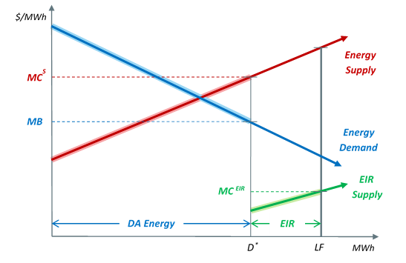
DAM with FER/EIR – Cleared Quantities
First, examine cleared quantities with two supply and two demand curves in the DAM
(terms defined on the next slide)

Slide 64
DAM with FER/EIR – Cleared Quantities (cont’d)
On the prior slide,
D* represents the cleared DA Energy quantity
EIR is cleared, beyond D*, to satisfy the load forecast (LF)
For convenience, the EIR supply curve is drawn starting at D*
MC^{S} is the marginal cost of cleared energy supply
MC^{EIR} is the marginal cost of cleared EIR
MB is the marginal benefit of serving energy demand

Slide 65
DAM with FER/EIR – Cleared Quantities discussion
Cleared Physical Energy + EIR = Load Forecast
More energy is cleared with the FER applied than in the current DAM
D* > D
Note: The DAM no longer clears where energy supply and bid-in energy demand intersect
The marginal cost of energy supply (MC^{S}) exceeds the marginal benefit of demand (MB)
next slide: How are marginal costs and marginal benefits aligned?

Slide 66
DAM with FER/EIR – Aligning marginal costs and marginal benefits
With two supply curves (energy and EIR), we have two marginal costs to consider
With the FER in place, clearing an additional MWh of energy, at the margin, incurs both a cost and a savings
Cost of one more MWh of energy
Savings of one less MWh of EIR
MB of serving energy demand = MC of serving energy demand
MC of serving energy demand = MC^{S} - MC^{EIR}
MB = MC^{S} - MC^{EIR}

Slide 67
DAM with FER/EIR – Aligning marginal costs and marginal benefits (cont’d)
With two supply and demand curves, efficient market clearing does not necessarily occur where supply and demand for energy alone intersect
Clearing must account for the fact that clearing one more MWh of energy means we need one less MWh of EIR
This occurs whenever LF is ‘to the right’ of the intersection of energy supply and demand
Under this condition, more energy will be cleared than in today’s energy-only DAM (D* > D)

Slide 68
DAM with FER/EIR – Pricing
As always, clearing prices reflect the incremental cost that would be incurred to satisfy one additional MWh of demand
Bid-in Energy: clearing one more MWh of energy supply means one less MWh of EIR is needed
DA LMP = MC^{S} - MC^{EIR}
Load Forecast: an additional MWh of EIR can satisfy an incremental MWh of Load Forecast
FER Price = MC^{EIR}
We’ll look at this pricing in the context of our clearing illustration

Slide 69
DAM with FER/EIR – Pricing

Slide 70
DAM with FER/EIR – Pricing Discussion
DA LMP is the correct price for cleared DA demand
All cleared DA demand is willing to pay, at most, DA LMP
But, the DA LMP is lower than the MC of energy supply!
This is accounted for via the FER Price (FERP)
When EIR is cleared, the MC of energy supply will exceed DA LMP by (precisely) the FERP
MC^{S} = DA LMP + FERP
With the FER applied, the DAM separates the marginal cost of energy supply into two distinct price signals
The MC of serving DA energy demand (DA LMP)
The MC of satisfying the Load Forecast (FERP)

Slide 71
Appendix 2: Numerical clearing and pricing examples

Slide 72
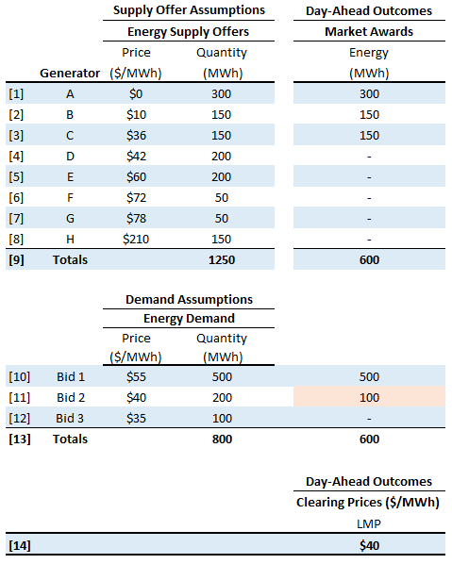
Example 1 - Clearing and pricing - today’s energy-only DAM
DA LMP = $40/MWH
Set by Demand Bid 2

Slide 73
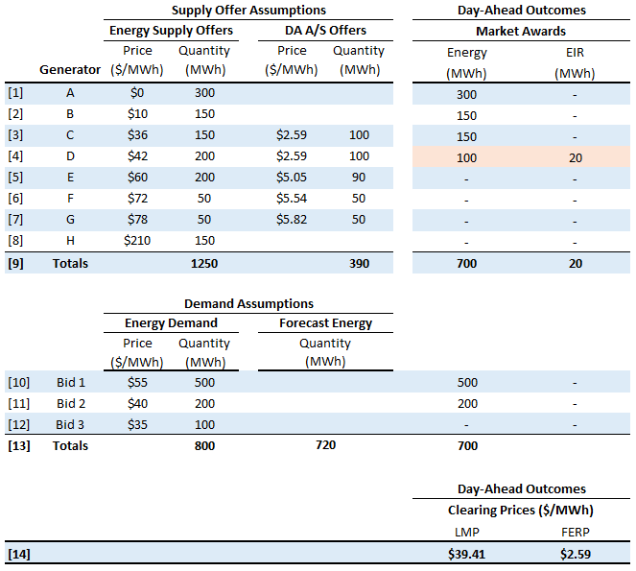
Example 2 - Clearing and Pricing - Energy balance & FER only

Slide 74
Example 2 - Clearing and Pricing - Energy balance & FER only (cont’d)
Now, the DAM takes into consideration the load forecast of 720 MWh, via the FER
FER is satisfied with additional cleared energy, as well as EIR
Resource D now clears for energy and EIR, and is marginal for both
Note: in order to clear energy on Resource D, additional demand from Bid 2 is also cleared
FERP = $2.59/MWh
An additional MWh of load forecast would be satisfied by procuring an additional MWh of EIR from Resource D at a cost of $2.59/MWh
continued next slide

Slide 75
Example 2 - Clearing and Pricing - Energy balance & FER only (cont’d)
DA LMP: an additional MWh of bid-in demand would be satisfied as follows:
Marginal Cost of Energy Supply (Resource D) = DA LMP + FERP = $39.41 + $2.59 = $42

Slide 76
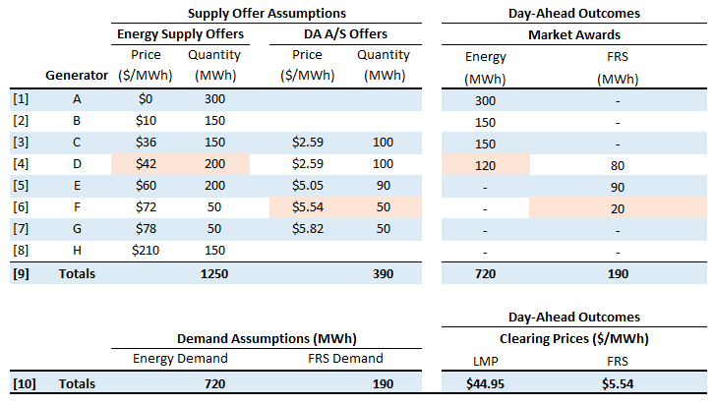
Example 3 - Energy balance and FRS – Opportunity Costs in DA LMP

Slide 77
Example 3 - Energy balance and FRS– Opportunity Costs in DA LMP (cont’d)
In a co-optimized DAM, inter-product opportunity costs can be reflected within the DA LMP
Here Gen D is marginal for energy, but incurs an opportunity cost as a result of selling energy and not FRS
Opportunity cost = FRS Clearing Price ($5.54) – Gen D FRS Offer ($2.59) = $2.95/MWh
This opportunity cost is ‘naturally’ reflected in the DA LMP, making Gen D indifferent between providing energy and FRS
continued next slide

Slide 78
Example 3 - Energy balance and FRS – Opportunity Costs in DA LMP (cont’d)
We can see how this opportunity cost is incorporated into the DA LMP by calculating the incremental cost that would be incurred to satisfy an additional MWh of bid-in demand

Slide 79
Example 3 - Energy balance and FRS – Opportunity Costs in DA LMP (cont’d)
Key observation: With the opportunity cost of providing energy, rather than FRS, incorporated into the DA LMP, the DA LMP is higher
DA LMP = $44.95
Expected RT LMP = $42
With FRS alone, this dynamic would provide a disincentive for load to participate in the DAM
Load would instead prefer to consume in real-time only, at lower cost
We’ll see that this is resolved when we jointly apply the FER and FRS constraints
see Example 5

Slide 80
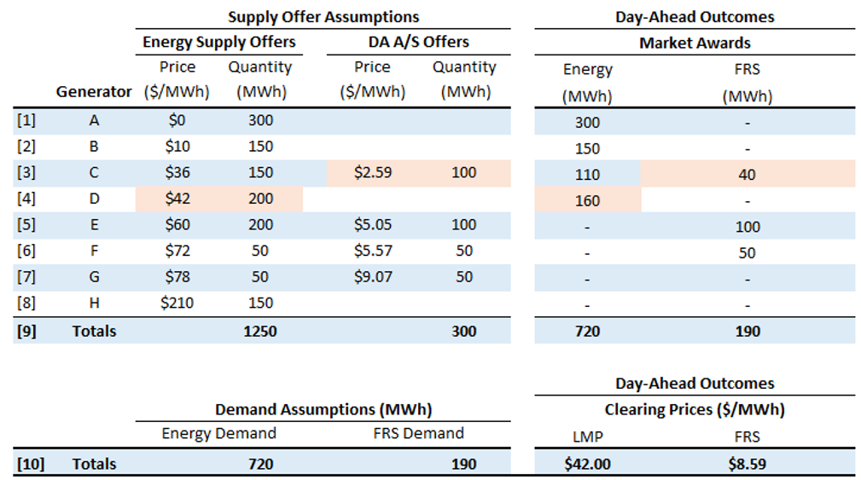
Example 4 - Energy balance and FRS – Opportunity cost in the FRS clearing price
Key change from prior example: here, Gen D is not offering to supply DA A/S

Slide 81
Example 4 - Energy balance and FRS – Opportunity cost in the FRS clearing price (cont’d)
In a co-optimized DAM, inter-product opportunity costs can be reflected within the FRS clearing price
Here Gen D is marginal for energy and sets DA LMP at its MC of $42/MWh
The most cost effective way of satisfying the FRS requirement requires ‘holding down’ Gen C to provide FRS instead of energy
This is analogous to the ‘re-dispatch’ for reserves that may occur in real-time today
As a result, Gen C incurs an opportunity cost associated with selling reserves and not energy
This opportunity cost is ‘naturally’ reflected in the FRS clearing price, making Gen C indifferent between providing energy and FRS

Slide 82
Example 4 - Energy balance and FRS – Opportunity cost in the FRS clearing price (cont’d)
We can see how this opportunity cost is incorporated into the FRS clearing price by calculating the incremental cost that would be incurred to satisfy an additional MWh of FRS demand

Slide 83
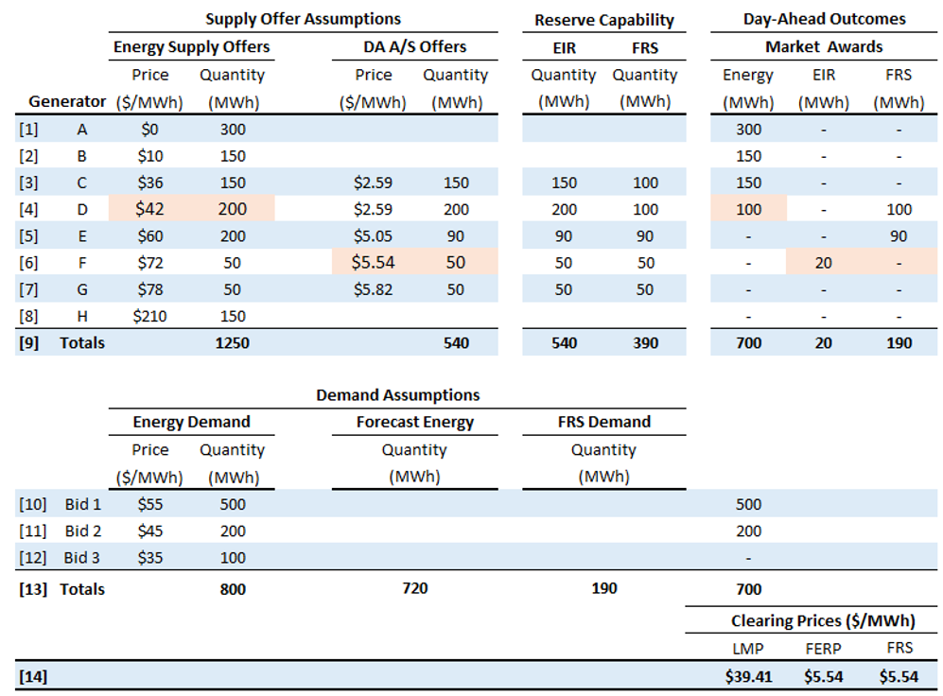
Example 5 - Energy balance, FER, and FRS – Opportunity costs in FERP
Same setup as the ‘Energy Balance and FER’ Example 2, and add the FRS constraint

Slide 84
Example 5 - Energy balance, FER, and FRS – Opportunity costs in FERP (cont’d)
Here, we see that inter-product opportunity costs can be reflected within the FERP
Just as in Example 3, Gen D is marginal for energy, but could sell FRS more profitably
As a result, it incurs an opportunity cost
Its total compensation for energy must be equal to its marginal cost plus this opportunity cost (recall, $44.95/MWh)
With the FER now applied, this opportunity cost is ‘naturally’ reflected in the FERP
Gen D will be paid DA LMP + FERP = $39.41 + $5.54 = $44.95/MWh

Slide 85
Example 5 - Energy balance, FER, and FRS – Opportunity costs in FERP (cont’d)
DA LMP pricing logic is illustrated in the following table
FERP and FRS prices are both $5.54/MWh
An additional MWh of load forecast or an additional MWh of FRS demand would be satisfied by procuring an additional MWh of DA A/S from Gen F at a cost of $5.54/MWh

Slide 86
Example 5 - Energy balance, FER, and FRS – Opportunity costs in FERP (cont’d)
Key Observation: with the FER and FRS constraints applied jointly, the incentive for load to participate in the DAM is strengthened, as FERP internalizes suppliers opportunity costs
DA LMP is now $39.41/MWh
Contrast this with FRS-only Example 3, in which DA LMP was $44.95/MWh
Load will now prefer to clear in the DAM
This will lead to DA-RT price convergence (next)

Slide 87
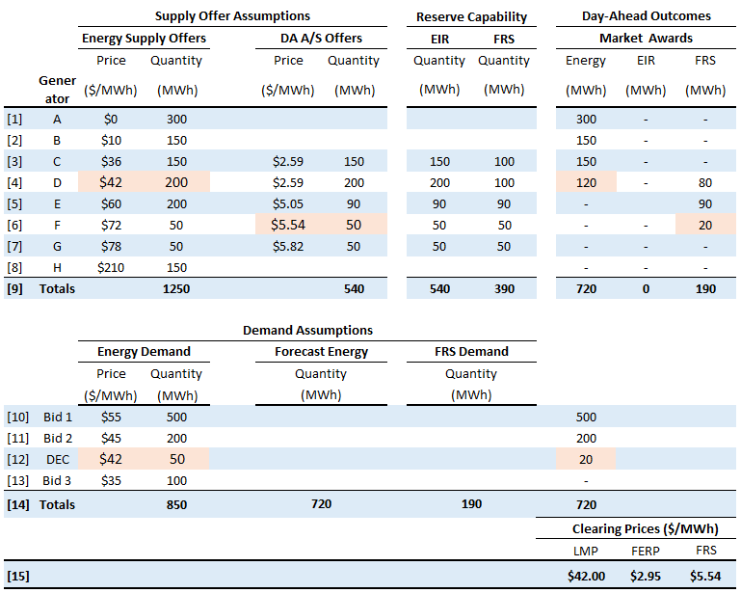
Example 6 – Energy balance, FER, and FRS – Price Convergence
Key change from Example 5: the addition of an additional demand bid (DEC),
priced at the expected real-time LMP of $42/MWh (think: $41.9999/MWh)

Slide 88
Example 6 – Energy balance, FER, and FRS – Price Convergence (cont’d)
Demand (DEC) now sets the DA LMP equal to the expected RT LMP of $42/MWh
Additional physical supply clears, such that cleared physical supply is equal to the load forecast, and no EIR is required
The FERP has changed from Example 5 as a result, but continues to reflect the inter-product opportunity costs of Gen D

Slide 89
Example 6 – Energy balance, FER, and FRS – Price Convergence (cont’d)
With the FER and FRS applied jointly, demand has a strong incentive to clear in the DAM
This will tend to drive the cleared EIR quantity toward zero
This will tend to converge DA and RT LMPs
The FERP pays the inter-product opportunity cost of the marginal physical supply resource
These opportunity costs can exist regardless of whether EIR is cleared
The FERP may be non-zero even when the cleared EIR quantity is zero
The FER and FRS constraints are tightly-coupled elements of the DASI design
FRS ensures that the resources relied upon in the day-ahead timeframe to manage uncertainty throughout the operating day receive compensation for that service
The FER ensures that the inter-product opportunity costs of suppliers are compensated, while maintaining incentives for demand participation in the DAM

