Slide 1
LNG Forecast
NEPOOL Markets & Reliability Committees
January 11, 2023

Slide 2
Outline
Introduction (slides 3-5)
LNG forecast assumptions (slides 6-11)
Expected LNG deliveries (slides 12-17)
LDC LNG demand (slides 18-19)
Conclusion (slides 20-21)

Slide 3
Introduction
In the RCA, a winter de-rated capacity for gas-fired resources will be determined by de-rating non-firm capacity to reflect limited winter peak gas availability
Modeled winter gas availability will reflect a stochastic forecast of available pipeline capacity and LNG
LAI provides assumptions and context for FCA 16 (‘24-25) stochastic forecast used in impact analysis.
LAI outlines issues that will arise in updating stochastic forecast for RCA implementation in FCA 19 (’27-28)
ICF has developed a separate temperature-driven daily gas forecast of the availability of pipeline delivered gas supply to NE
Daily forecast will reflect the total expected pipeline gas adjusted based upon the modeled weather pattern
LAI has developed a winter period LNG forecast (stochastic distribution) of available LNG to the region
Combined, both forecasts reflect availability of pipeline delivered supply and LNG to the region (i.e., intra-regional pipeline deliverability constraints are not reflected)

Slide 4
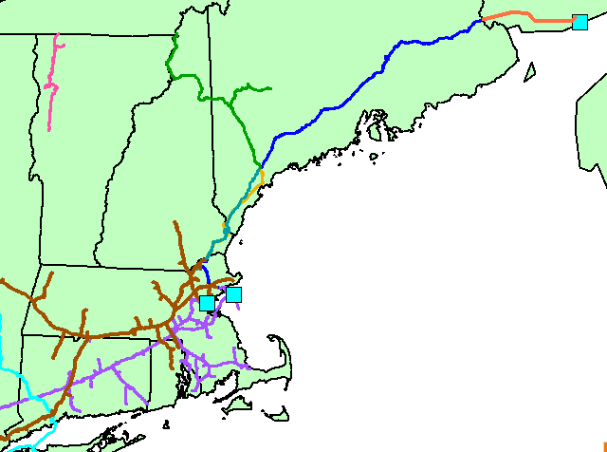
LNG Terminals Serving NE
Brunswick
Saint John LNG Terminal (previously Canaport)
Repsol holds 0.8 Bcf/d of North-to South-capacity on M&N
Constellation Distrigas
Also known as Everett Marine Terminal (EMT)
Purchased from ENGIE in 2018
Northeast Gateway
Offshore buoy system owned by Excelerate
Requires the use of a Floating Storage Regasification Unit (FSRU)
Excelerate’s FSRUs are committed to EU
Portland
(PNGTS)
Maritimes &
Northeast
(M&N)
Saint John
Vermont
Gas
M&N/PNGTS
Joint Facilities
Granite State
Northeast Gateway
Tennessee
(TGP)
Distrigas
Algonquin (AGT)
Natural gas pipeline
LNG import terminal
Iroquois (IGTS)

Slide 5
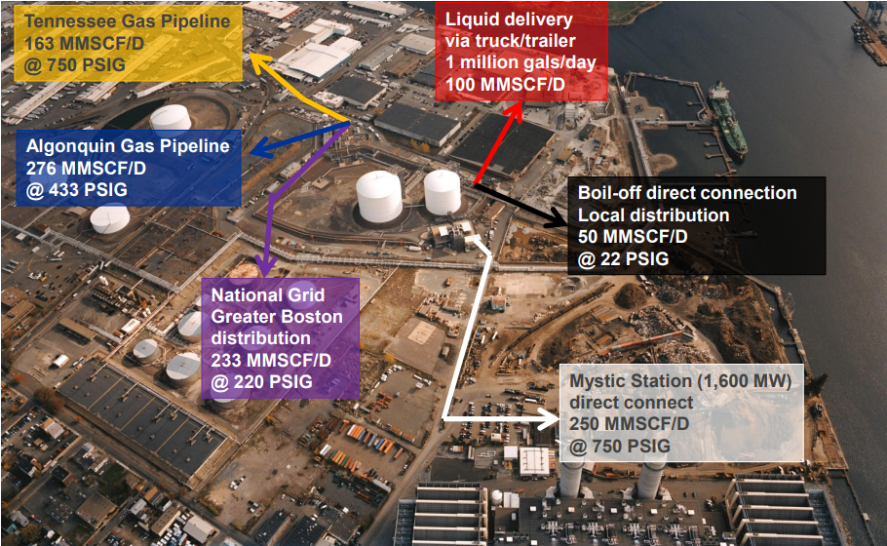
Distrigas Facility Capacity
3.4 BCF total storage
250 MMcf/d to Mystic
Pressure support on AGT and TGP
Truck-transported liquids to LDC satellite facilities
439 MMcf/d to AGT and TGP
Boil-off to NGrid

Slide 6
LNG Forecast Assumptions

Slide 7
LNG Forecast Assumptions
Stochastic forecast of LNG deliveries depends on many factors, including:
Contracting and scheduling practices of LNG terminals, LDCs and generators
Conditions in the global market for LNG
LNG terminals serving NE during the forecast period
Assumptions underlying FCA 16 (‘24/25) stochastic forecast for impact analysis
In this section we provide assumptions underlying FCA 16 (‘24/25) stochastic forecast for impact analysis and discuss how these assumptions may need to be updated before the forecast is updated for implementation in FCA 19 (‘27/28)

Slide 8
LNG Contracting and Delivery Scheduling
LNG tanker deliveries are scheduled well in advance to meet contractual commitments
“As evidenced this winter and winters past, Repsol will not arrange for cargoes without commitment from the market.”¹
“Constellation does not buy LNG speculatively. Rather, we buy LNG to meet our LNG commitments. … we seek to purchase the LNG we need to serve our customers quickly, typically contemporaneous with our agreement to sell the LNG”²
No such thing as just-in-time deliverability
Port infrastructure constraints limit availability of tankers capable of delivering to Distrigas
Jones Act precludes US Gulf Coast supplies
For two decades deliveries have been predominantly from Trinidad -- since 2016, over 95% of from Trinidad
Only 20 or so Distrigas-compliant LNG tankers exist³

Slide 9
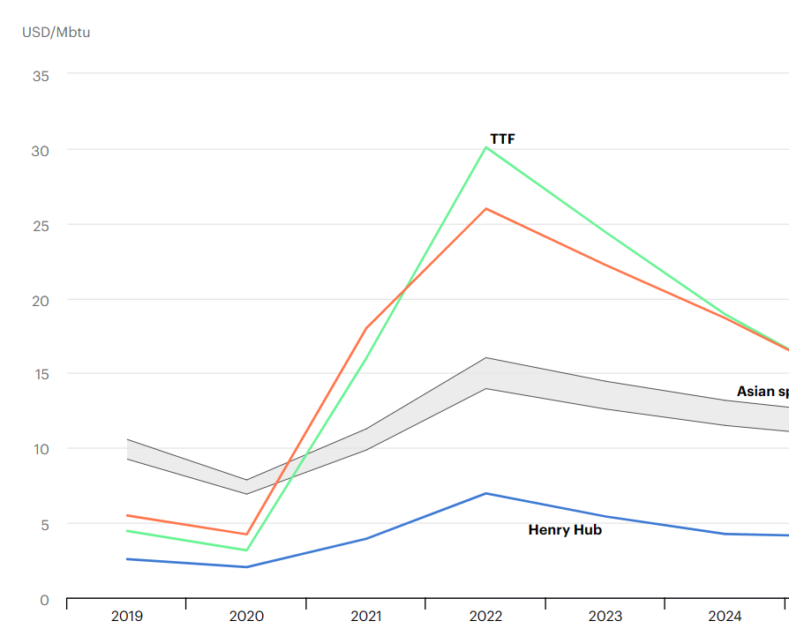
Geopolitical Issues
LNG deliveries to NE in 2024/25 depend on conditions in the world LNG market. LAI’s stochastic forecast assumes the following:
LNG markets will remain tight, and volatile, with prices elevated relative to Algonquin Citygates, through winter 2024/25
LNG prices rose dramatically in 2022 as EU replaced Russian NG imports with LNG
As a result, LNG prices are now higher than NE monthly NG prices, even in winter
EU faces a large supply deficit for 2023 in response to shutdown of Nordstream imports
Zero deliveries to Northeast Gateway due to absence of available floating storage and regasification units (FSRUs)
Germany and other EU countries have contracted all available FSRUs
IEA Natural Gas Price Assumptions

Slide 10
Distrigas and Mystic Status
LNG forecast for FCA 16 (‘24/25) assumes Distrigas continues operations and Mystic 8&9 retire
Mystic 8&9 retire in 2024
Distrigas availability in FCA 16 (‘24/25) uncertain without an anchor customer
No current evidence of LDC, genco or pipeline plans to contractually support continued Distrigas operations without Mystic
CLNG: In 2024, Mystic 8&9, “the anchor customer for [Distrigas] will retire, creating a need for a new anchor customer or customers, otherwise [Distrigas] is likely to cease operations which … will result in the permanent closure of the facility.”⁴
ISO-NE and LDCs: The continued operation of [Distrigas] will be needed for a finite period beyond 2024 to maintain gas and electric reliability ⁵
Updated stochastic forecast for FCA 19 (’28/29) will reflect new information regarding Distrigas retirement
LDCs may find alternative solutions, but sustainability of alternative truck transported fixes from QE and PA under review
Limited infra-regional mitigation vis-a-vis new satellite facilities and expanded daily liquefaction capability
Withdrawal of LDC financial support makes Distrigas economics unfavorable without Mystic

Slide 11
Assumed Level of Existing Generator LNG Contracts
In the RCA, resource MRI and QMRIC are calculated based on the resource mix, fuel availability and other assumptions in the RAA base case
Forecast for FCA 16 (’24-25) assumes zero generator firm fueling contracts with LNG terminals
Consistent with observed generator behavior, as NE generators do not contract for LNG firm fueling with rare exceptions
When Constellation and/or St. John contract to provide firm fueling services, the annual LNG requirement increases

Slide 12
Expected LNG Deliveries

Slide 13
Expected LNG Deliveries
The Stochastic forecast of deliveries to Distrigas for FCA 16 (‘24/25) is based on US LDC liquid LNG requirements
Requirement reflects historical LDC liquid LNG use
Adjusted for new or expanded LDC LNG liquefaction projects
Annual requirement for Saint John reflects
Canadian Maritime LDC and generation
NE LDCs for delivery at Dracut, MA via M&N

Slide 14
Annual LNG liquid requirement for US LDCs
Upon Mystic retirement, scheduled deliveries to Distrigas will be based on LDC requirements
Use ICF model of LDC satellite LNG sendout for recent winters (2010/11 to 2021/22)
Winter 2014/15 has highest estimated LDC satellite sendout (15 BCF)
Trucks are used to deliver liquid LNG from Distrigas to LDC satellite facilities
Zero liquid LNG from Saint John and Northeast Gateway

Slide 15
Adjustment for new or expanded LNG liquefaction projects
Distrigas annual LDC LNG requirement based on estimated satellite sendout for 2014/15 winter weather less adjustments for:
Northeast Energy Center (NEC) in Charlton MA
Roughly 21 MMcf/d of liquefaction capacity, 165 MMcf storage tank
NEC will be used to refill LDC satellite facilities
NGLNG Providence liquefaction
20 MMcf/d added to existing 2 Bcf Fields Point
Will be used to liquefy 2 Bcf/yr allowing the Providence tank to be refilled during the shoulder season without replenishment from Distrigas
Eversource’s Hopkinton LNG Liquefaction Replacement project
Project will add 4 MMcf/day of liquefaction capacity to existing facility, increasing capacity from 17 MMcf/day to 21 MMcf/day
Incremental capacity will be used to increase annual LNG production while reducing the length of the refill season

Slide 16
Annual requirement for Saint John
Saint John vapor sendout meets Canadian Maritime LDC and generation demand on cold days
Saint John also contracts with NE LDCs at Dracut, MA via M&N
We estimate annual requirement based on average annual deliveries since winter 2016/17
Shifting a small number of deliveries from Saint John to Distrigas will not impact results
Distrigas can replace Saint John pipeline sendout to NE customers

Slide 17
Number of Scheduled Deliveries
Distribution of tanker LNG delivery volumes for each terminal
Based on probability distribution functions (PDFs) of tanker delivery volumes for the Distrigas and Saint John LNG import terminals for 2H 2016 to 1H 2022
Number of tanker deliveries calculated as:
$$\# deliveries=\frac{Annual Requirement}{Average Delivery Volume}$$

Slide 18
LDC LNG Demand

Slide 19
Seasonal LDC LNG requirements
MARS load level forecast drives ICF sendout model
Implied HDDs are calculated using MARS load forecast for each load uncertainty level
Daily LDC satellite LNG sendout calculated using same Implied HDDs
LNG available to gas-only generators reflects LNG terminal imports less
Sendout of liquid LNG to LDCs – distribution
Saint John Canadian sendout – history & ICF
Vapor sendout to LDCs – contract review
Result is the distribution of LNG available to generators
Results to be provided in February

Slide 20
Conclusion

Slide 21
Conclusions
While LNG seasonal requirements are planned ahead of time, the exact volume of seasonal deliveries is inherently uncertain, resulting in a supply distribution
Observed weather and implied sendout to LDCs, carries a wider distribution for LNG demand
LNG forecast will be updated before FCA 19 to account for anticipated Distrigas retirement, newly announced LDC LNG liquefaction projects

Slide 22
Endnotes

Slide 23
Notes
Repsol, January 14-15, 2020, Presentation to ISO-NE MC Meeting, slide 6.
Comments of Constellation Energy Generation, LLC. Docket No. AD22-9, November 7, 2022, page 26.
Comments of Constellation Energy Generation, LLC. Docket No. AD22-9, November 7, 2022, page 9.
Comments of Constellation Energy Generation, LLC. Docket No. AD22-9, November 7, 2022, page 1.
Draft Problem Statement and Call to Action on LNG and Energy Adequacy, Docket No. AD22-9, September 2, 2022, page 1.

