Slide 1
NEPOOL Markets committee | April 11-13, 2023 | Westborough, MA
Resource Capacity Accreditation in the Forward Capacity Market
FCA16 Baseline Case Accreditation
Dane Schiro
Principal analyst
dschiro@iso-ne.com
413-540-4792

Slide 2
Resource Capacity Accreditation in the Forward Capacity Market
WMPP ID:
157
Proposed Effective Date: FCA 19
The Resource Capacity Accreditation (RCA) project proposes improvements to ISO-NE’s accreditation processes in the Forward Capacity Market (FCM) to further support a reliable, clean-energy transition by implementing methodologies that will more appropriately accredit resource contributions to resource adequacy as the resource mix transforms
The ISO has made a commitment to file the proposed improvements with FERC in time for FCA 19
At the February MC/RC meeting, the ISO provided updates on the impact assessment scenarios
This presentation summarizes FCA16 Baseline Case assumptions, provides directional insights into MRIs, and details capacity accreditation for the FCA16 Baseline Case

Slide 3
Resource Capacity Accreditation in the Forward Capacity Market
WMPP ID:
157
Proposed Effective Date: FCA 19
Outline of today’s discussion:
Review of Impact Analysis Plan (slides 4-7)
FCA16 Baseline Case Details (slides 8-11)
Understanding Class-Level Results (slides 12-20)
Results (slides 21-40)
Conclusion (slides 41-42)
Stakeholder Schedule (slides 43-50)
Appendices (slides 51-69)

Slide 4
Review of Impact analysis plan

Slide 5
Original Impact Analysis Phases
The original Impact Analysis proposal had two phases
  Resource Accreditation phase
    Focus: Resource capacity accreditation under the RCA design
  Capacity Market Impact phase
    Focus: FCA16 clearing results under RCA design
Given the relative priority of different results, it is proposed that the Resource Accreditation phase be divided into two parts: Baseline Case Accreditation and Resource Accreditation Sensitivity

Slide 6
New Impact Analysis Phases
The new Impact Analysis ordering has three phases
  FCA16 Baseline Case Accreditation phase (today)
  FCA16 Capacity Market Impact phase (May 2023)
  Resource Accreditation Sensitivity phase (starting June 2023)
    Focus: Resource capacity accreditation for sensitivity scenarios under the RCA design
This presentation summarizes resource accreditation results for the FCA16 Baseline Case, which applies RCA modeling enhancements to the historical FCA16 case

Slide 7
Today’s Presentation
Today’s presentation includes:
  Resource class-level results
    rMRI (FCA QC-weighted average)
    Seasonal MRI (Seasonal QC-weighted average)
    Total QMRIC
  Other results
    Risk split between summer and winter periods
    LOLH information
    Uniform derating factor for gas resources
    Net ICR

Slide 8
FCA16 Baseline case details

Slide 9
GE MARS Changes From Historical FCA16
Killingly Energy Center (632 MW) was removed from resource mix
FCA16-cleared imports (1,504 MW) were added to resource mix
  In production, previous FCA’s cleared imports will be used
All GE MARS modeling changes were included
  February 14, 2023 (ISO) and others
Gas availability for generators (pipeline + LNG) was modeled as described at the Markets and Reliability Committees
  January 11, 2023 (ISO)
  March 15, 2023 (ICF)
  March 15, 2023 (LAI)

Slide 10
Fuel Requirement Assumptions
Fuel requirements (to cover most stressed winter hours)
  Firm Daily Operations Requirement: 10 hours
  Firm Seasonal Operations Requirement: 110 hours
  Firm Oil Storage Requirement: 40 hours
Only existing fuel arrangements prior to FCA16 were considered
  Oil storage and firm transport
  For resources with shared oil storage, fuel was allocated so each resource had the same Firm Oil Storage Hours

Slide 11
Season Definitions
As described on February 8, 2023, months are grouped into the following seasons
  Summer: June – September
  Winter Period: December – February
  Winter Non-Gas Period: March – May, October, November

Slide 12
Understanding class-level Results

Slide 13
Impact Analysis Resource Classes
Results are provided for aggregate resource classes
A preliminary resource class proposal was presented at the September 2022 Joint MC/RC
  Extension of NERC Generating Unit Statistical Brochure
Based on RCA design developments, classes have been reformulated to closely align with qualified fuel type consistent with how GE MARS modeling changes have been presented at the Reliability Committee
High-level classes in this presentation
  Gas-only, Dual-fuel, Oil-only, Hybrid, Energy Storage, Fuel Cell, Other Non-IPR, IPR Wind, IPR PV, Other IPR, Passive DR, ADCR, Import
  Class assignment information is provided in Appendix B
  More granular classes will be used for new resource MRI assignment

Slide 14
Resource Properties Associated with Higher MRIs
Smaller capacity
  Reason: Forced outage of a small resource is less likely to cause loss of load
Lower Equivalent Demand Forced Outage Rate (EFORd)
  Reason: Resource is less likely to be on forced outage during loss of load
Longer storage duration
  Reason: More stored energy is available during loss of load events

Slide 15
Resource Properties Associated with Lower MRIs
Larger capacity
  Reason: Forced outage of a large resource is more likely to cause loss of load
Higher EFORd
  Reason: Resource is more likely to be on forced outage during loss of load
Shorter storage duration
  Reason: Less stored energy is available during loss of load events

Slide 16

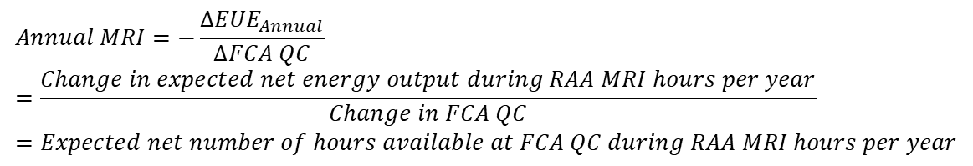



Refresher: Annual MRI Interpretation
Units
$$Annual MRI=−\frac{∆{EUE}_{Annual}}{∆FCA QC} \\ =\frac{Change in expected net energy output during RAA MRI hours per year}{Change in FCA QC}=Expected net number of hours available at FCA QC during RAA MRI hours per year$$
$$hour/year$$
$${Annual MRI}_{perfect}=Expected number of RAA MRI hours per year$$
$$hour/year$$
$$rMRI=\frac{Expected net number of hours available at FCA QC during RAA MRI hours per year}{Expected number of RAA MRI hours per year}$$
$$unitless$$
$$QMRIC=FCA QC ×rMRI=Expected net energy output in each RAA MRI hour$$
$$MW$$

Slide 17
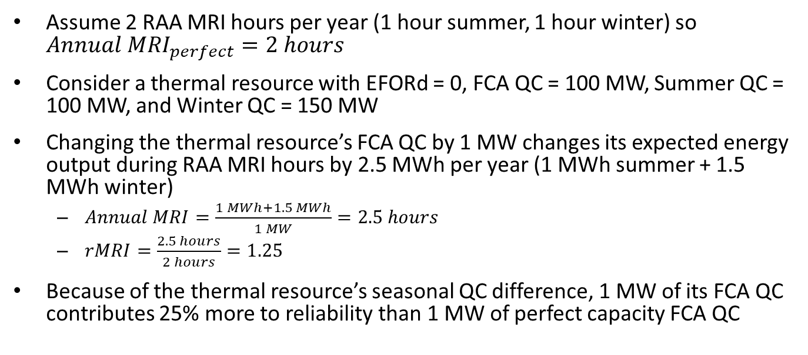
rMRI > 1 due to Different Seasonal QCs
Assume 2 RAA MRI hours per year (1 hour summer, 1 hour winter) so ${Annual MRI}_{perfect}=2 hours$
Consider a thermal resource with EFORd = 0, FCA QC = 100 MW, Summer QC = 100 MW, and Winter QC = 150 MW
Changing the thermal resource’s FCA QC by 1 MW changes its expected energy output during RAA MRI hours by 2.5 MWh per year (1 MWh summer + 1.5 MWh winter)
  $Annual MRI=\frac{1 MWh+1.5 MWh}{1 MW}=2.5 hours$
  $rMRI=\frac{2.5 hours}{2 hours}=1.25$
Because of the thermal resource’s seasonal QC difference, 1 MW of its FCA QC contributes 25% more to reliability than 1 MW of perfect capacity FCA QC

Slide 18
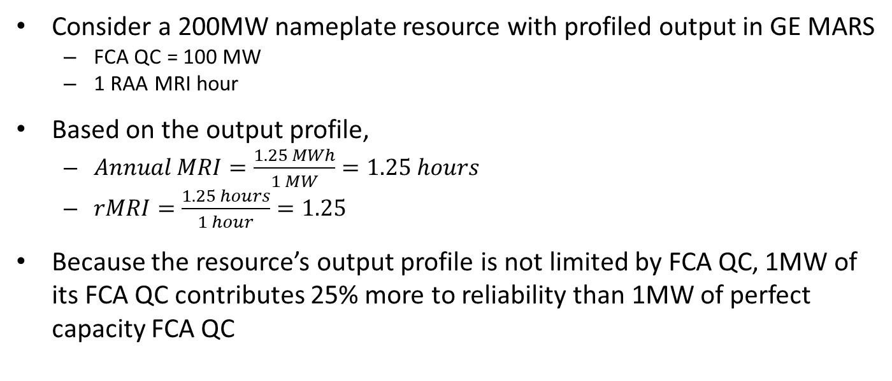
rMRI > 1 due to Profiled Output
Consider a 200MW nameplate resource with profiled output in GE MARS
  FCA QC = 100 MW
  1 RAA MRI hour
Based on the output profile,
  $Annual MRI=\frac{1.25 MWh}{1 MW}=1.25 hours$
  $rMRI=\frac{1.25 hours}{1 hour}=1.25$
Because the resource’s output profile is not limited by FCA QC, 1MW of its FCA QC contributes 25% more to reliability than 1MW of perfect capacity FCA QC
Expected output in RAA MRI hour
125 MW
100 MW
Output profile
FCA QC determination hour
RAA MRI hour

Slide 19
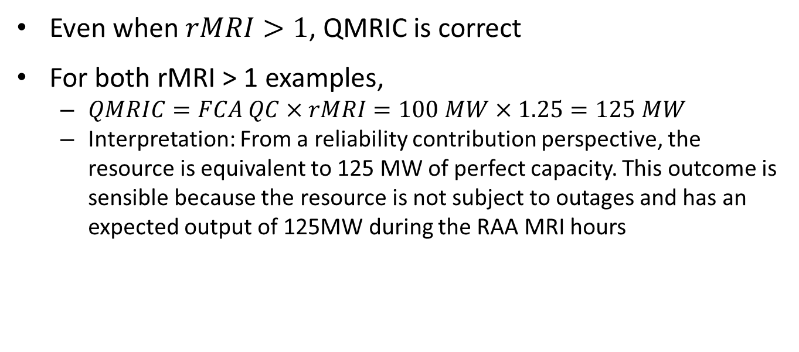
rMRI > 1 Does Not Imply an Inflated QMRIC
Even when $rMRI>1$, QMRIC is correct
For both rMRI > 1 examples,
  $QMRIC=FCA QC×rMRI=100 MW×1.25=125 MW$
  Interpretation: From a reliability contribution perspective, the resource is equivalent to 125 MW of perfect capacity. This outcome is sensible because the resource is not subject to outages and has an expected output of 125MW during the RAA MRI hours

Slide 20

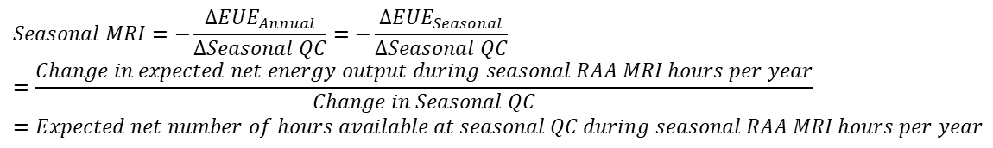
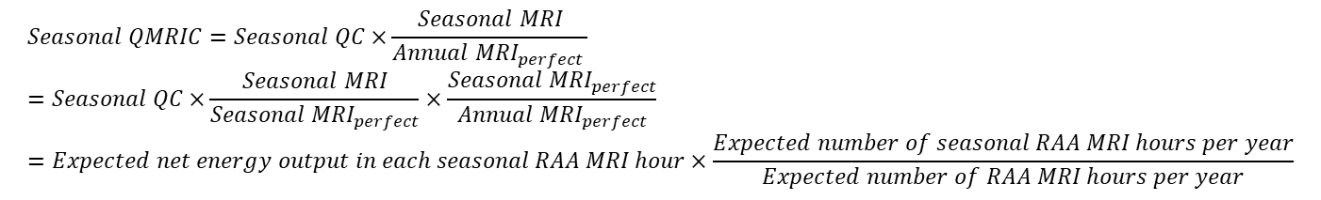


Refresher: Seasonal MRI Interpretation
Units
$$Seasonal MRI=−\frac{∆{EUE}_{Annual}}{∆Seasonal QC}=−\frac{∆{EUE}_{Seasonal}}{∆Seasonal QC} \\ =\frac{Change in expected net energy output during seasonal RAA MRI hours per year}{Change in Seasonal QC}=Expected net number of hours available at seasonal QC during seasonal RAA MRI hours per year$$
$$hour/year$$
$${Seasonal MRI}_{perfect}=Expected number of seasonal RAA MRI hours per year$$
$$hour/year$$
$$Seasonal QMRIC=Seasonal QC×\frac{Seasonal MRI}{{Annual MRI}_{perfect} } \\ =Seasonal QC×\frac{Seasonal MRI}{{Seasonal MRI}_{perfect}}×\frac{{Seasonal MRI}_{perfect}}{{Annual MRI}_{perfect}} \\ =Expected net energy output in each seasonal RAA MRI hour×\frac{Expected number of seasonal RAA MRI hours per year}{Expected number of RAA MRI hours per year}$$
$$MW$$
Note: The seasonal MRI of a profiled resource may exceed perfect capacity’s seasonal MRI (analogous to slide 18)

Slide 21
Results

Slide 22
Achieving Annual LOLE = 0.1 day/year
ALCC = 1,597MW
  Historical FCA16 ALCC = 1,663MW
Summer LOLH = 80.7%, Winter LOLH = 19.3%
  Historical FCA16 Summer LOLH = 100%
Summer LOLE = 70.6%, Winter LOLE = 29.4%
  Historical FCA16 Summer LOLE = 100%
Summer EUE = 89.6%, Winter EUE = 10.4%
  Historical FCA16 Summer EUE = 100%

Slide 23
LOLH Heat Map
LOLHs occurred in
  June through September
    Low July LOLH frequency due to mild 2021 July weather
  December through February
Hour Ending 18 was the most commonly lost hour, and evening hours were problematic in both seasons
The winter had a wider range of loss of load hours, with some December and January losses occurring during the morning ramp
LOLH Distribution

Slide 24
EUE Heat Map
Relative to loss of load hours, a greater percentage of EUE occurred in the summer
  Summer LOL events had more EUE per event than winter LOL events
EUE Distribution

Slide 25
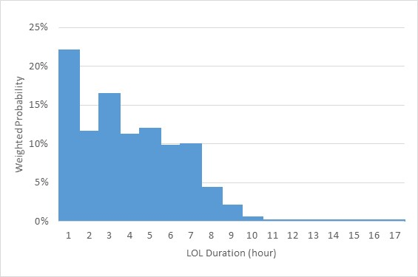
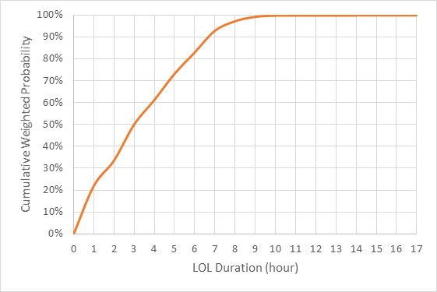
Annual LOL Duration
MRI is a function of EUE, which depends on load level probabilities
  EUE =
    ∑(Load level probability x Unserved energy for load level)/ 5000
  The EUE impact of 1MWh unserved energy is proportional to the associated load level probability
Because EUE is positively correlated with LOL duration, it is useful to summarize LOL durations using the same load level probabilities
  The impact of an LOL event’s duration is proportional to the associated load level probability
LOL events lasting over 7 hours were less frequent (7.1% frequency)
  Maximum duration = 17 hours

Slide 26
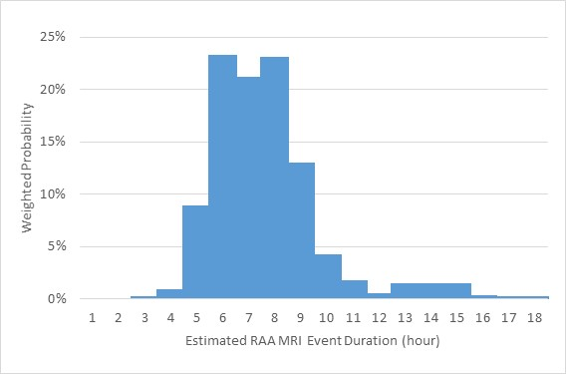
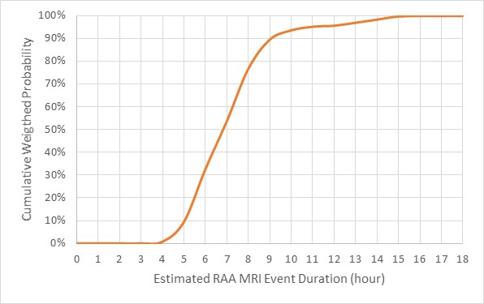
Estimated Annual RAA MRI Event Duration
Estimating the frequency of RAA MRI event durations (i.e., contiguous blocks of RAA MRI hours) shows more frequent long-duration events
  Difference caused by the removal of storage
  Recall that additional resource output when storage is discharging prior to an LOL event may increase MRI by allowing more stored energy to be carried into the LOL event

Slide 27
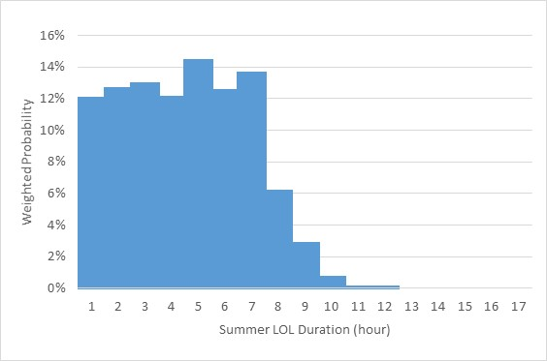
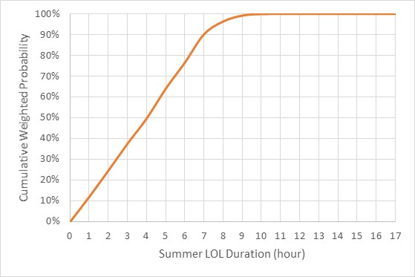
Summer LOL Duration
The frequency of summer LOL event durations was roughly uniform up to 7 hours
9.7% of LOL events lasted more than 7 hours
No summer LOL events were over 12 hours

Slide 28
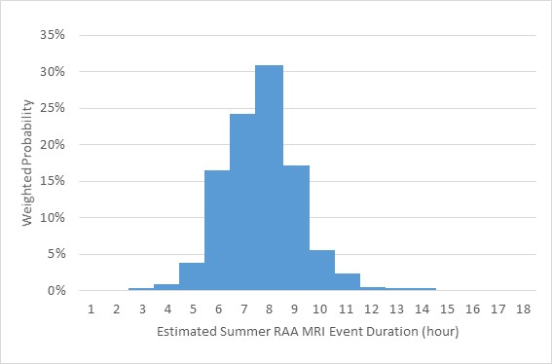
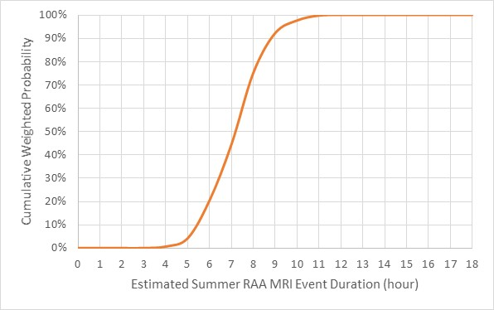
Estimated Summer RAA MRI Event Duration
The frequency distribution of Summer RAA MRI Event durations is roughly normal with a mean of 8 hours
  Difference caused by the removal of storage

Slide 29
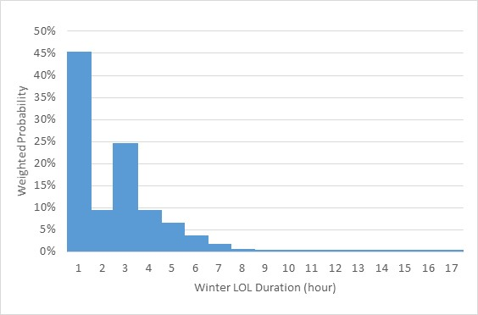
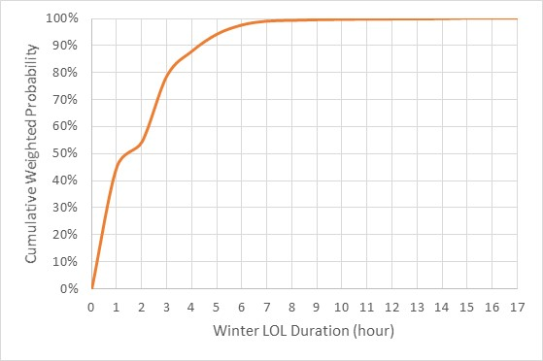
Winter LOL Duration
Winter LOL events were highly concentrated in short durations
While less frequent, LOL durations between 10 and 17 hours do occur (0.6% frequency)

Slide 30
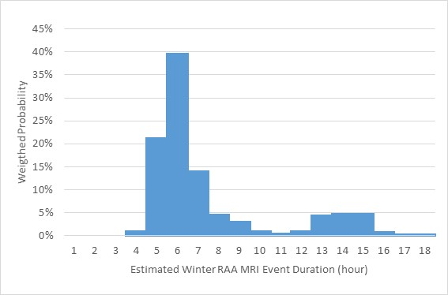
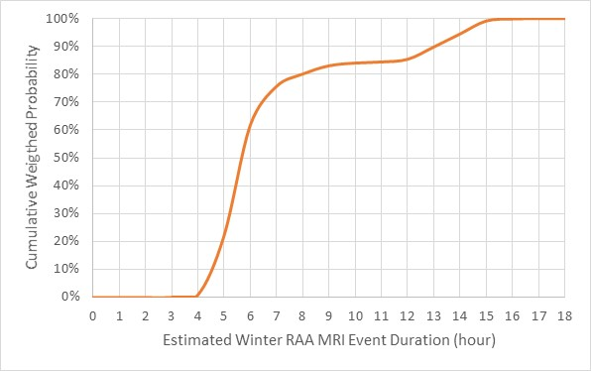
Estimated Winter RAA MRI Event Duration
The frequency distribution of Winter RAA MRI Event durations is bimodal and includes more frequent long duration events
  Difference caused by the removal of storage
Insight: Relatively flat 2013/14 winter load profile and dual-peak winter days contributes to long duration RAA MRI Events

Slide 31

Annual MRI Results
$$QMRIC=FCA QC×rMRI$$
Note: “Existing” means modeled in GE MARS.

Slide 32
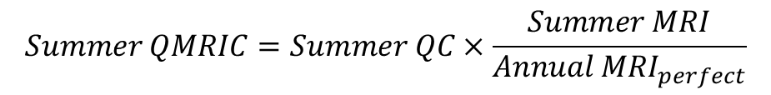
Summer MRI Results
$$Summer QMRIC=Summer QC×\frac{Summer MRI}{{Annual MRI}_{perfect}}$$
0.553 (slide 31)

Slide 33
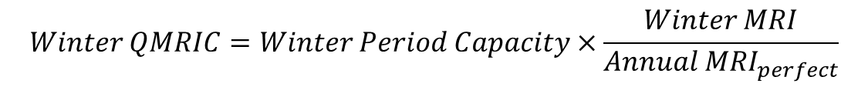
Winter MRI Results
$$Winter QMRIC=Winter Period Capacity×\frac{Winter MRI}{{Annual MRI}_{perfect}}$$
0.553 (slide 31)
† The equation $Winter QMRIC=Summer Capacity×\frac{Winter MRI}{{Annual MRI}_{perfect}}$ is used to calculate Winter MRI for IPR PV. Summer QC is used for weighting.

Slide 34
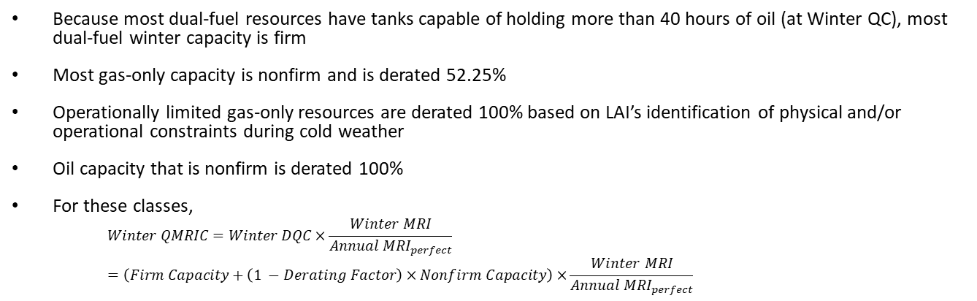
Classes Limited During Winter Period
Because most dual-fuel resources have tanks capable of holding more than 40 hours of oil (at Winter QC), most dual-fuel winter capacity is firm
Most gas-only capacity is nonfirm and is derated 52.25%
Operationally limited gas-only resources are derated 100% based on LAI’s identification of physical and/or operational constraints during cold weather
Oil capacity that is nonfirm is derated 100%
For these classes,
    $$Winter QMRIC=Winter DQC×\frac{Winter MRI}{{Annual MRI}_{perfect}} \\ =\left(Firm Capacity+\left(1 −Derating Factor\right)×Nonfirm Capacity\right)×\frac{Winter MRI}{{Annual MRI}_{perfect}}$$

Slide 35

Seasonal MRI Relative to Seasonal Perfect Capacity
$$Seasonal QMRIC=Seasonal Capacity×\frac{Seasonal MRI}{{Seasonal MRI}_{perfect}}×\frac{{Seasonal MRI}_{perfect}}{{Annual MRI}_{perfect}}$$
These values strip out the effects of the RAA MRI hour seasonal distribution
Most resource classes have similar summer and winter values, meaning that their output relative to perfect capacity is similar in both seasons
IPR classes have the largest changes due to seasonal output profile differences
* Winter value based on Winter DQC
† The equation $Winter QMRIC=Summer Capacity×\frac{Winter MRI}{{Annual MRI}_{perfect}}$ is used to calculate Winter MRI for IPR PV

Slide 36
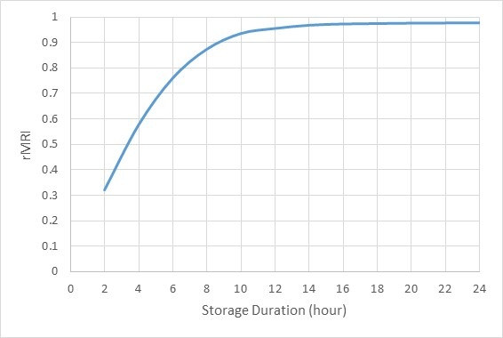
Indicative Storage rMRIs
This curve shows the rMRIs of hypothetical storage resources with different durations
rMRI increases with duration but is always less than 1
  Reason 1: Storage does not recharge storage
  Reason 2: Storage charging between LOL events may be limited by time and/or available energy

Slide 37
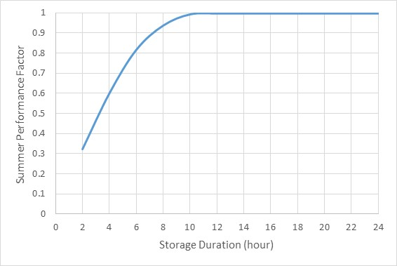
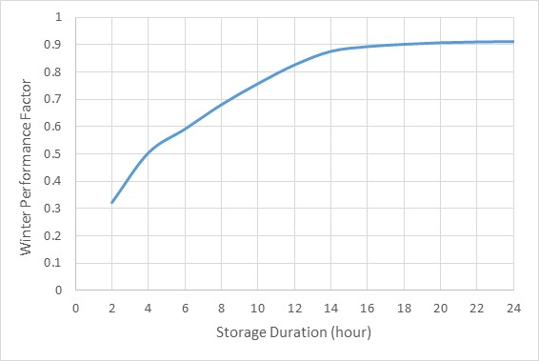
Seasonal Storage Analysis
The summer performance factor for 24-hour storage is 99.81%
  Estimated 0.15% reduction from Reason 1
  Estimated 0.05% reduction from Reason 2
    Recharging limits are very minor
The winter performance factor for 24-hour storage is 91.18%
  Estimated 4.98% reduction from Reason 1
  Estimated 3.84% reduction from Reason 2
    Recharging limits are more significant

Slide 38
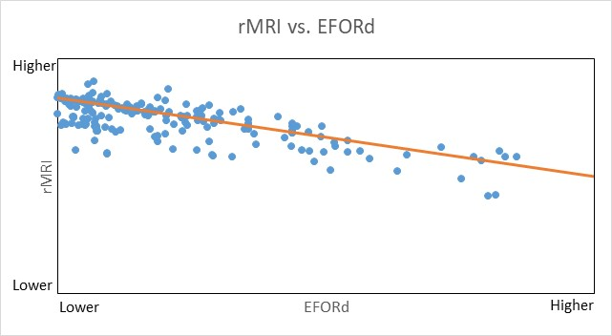
Relationship between EFORd and rMRI
This figure shows the relationship between EFORd and rMRI for thermal resources (excluding outliers)
  Gridlines have been removed to avoid revealing resource-specific rMRIs
Higher EFORd values are generally associated with lower rMRIs

Slide 39
Net ICR
QC-based Net ICR = 32,540MW
  Historical FCA16 had QC-based Net ICR = 31,645MW
  RCA increase of QC-based Net ICR: 2.8%
    Approximately 400MW (45%) of increase from improved GE MARS modeling
    Approximately 500MW (55%) of increase from identification of winter risk
QMRIC-based Net Capacity Requirement = 27,890MW
  Conversion factor = 0.857 (FCA QC-weighted rMRI of existing resources)

Slide 40
Net ICR Calculation
Total MW Breakdown | 2025-2026 FCA16 Baseline Case (Summer QC MW) | 2025-2026 FCA16 Historical ICR (Summer QC MW)
Generating Capacity Resources | 29,223 | 29,855
Demand Resources | 3,667 | 3,667
Import Capacity Resources | 1,504 | -
Tie Benefits | 1,830 | 1,830
OP-4 Actions 6 & 8 (Voltage Reduction) | 263 | 263
Minimum System Reserve | (700) | (700)
Total MW | 35,788 | 34,916
Other Details
Annual Peak | 28,025 | 28,025
ALCC | 1,597 | 1,663
Net ICR | 32,540 | 31,645

Slide 41
Conclusion

Slide 42
Conclusion
This presentation provided:
  Details for FCA16 Baseline Case
  Directional insights for MRIs
  Accreditation results for FCA16 Baseline Case

Slide 43
Stakeholder schedule

Slide 44
RCA Stakeholder Process
There are several broad phases laid out for this proposal in the stakeholder process:
  Background, Conceptual Design, & Education: June 2022 – January 2023
  Detailed Design: November 2022 – April 2023
  Finalize Design, Review Tariff Language, and Stakeholder Amendments: May 2023 – August 2023
  Voting: September 2023 (Technical Committees) and October 2023 (Participants Committee)
There are also several key dates for the impact assessment projected in the process:
  September 2022: Introduce proposed impact assessment approach
  February 2023: Review updated IA scenarios
  April 2023: Review initial results
  July 2023: Final report
 | 2022 |  |  |  |  |  |  | 2023 |  |  |  |  |  |  |  |  |  |  |  | 2024
 | Q2 | Q3 |  |  | Q4 |  |  | Q1 |  |  | Q2 |  |  | Q3 |  |  | Q4 |  |  | Q1
 | J | J | A | S | O | N | D | J | F | M | A | M | J | J | A | S | O | N | D | J | F | M
Current Schedule | Conceptual Design |  |  |  |  |  |  |  |  |  |  | Final Design, Review Tariff, and Amendments |  |  |  | MC/RC Vote | PC Vote | File |  |  | Eff. Date
 |  |  |  |  |  | Detail Design
Introduce
IA
Approach
Review
Updated
IA
Scenarios
Review
Initial IA
Results
Final IA
Report
FERC
Order

Slide 45
Stakeholder Schedule – Conceptual Design Phase
JUNE 2022 |  |  |  |  |  |  |  | Joint Markets and Reliability Committees MC Meeting Dates: June 7-8, 2022 (with joint RC during RCA components)(link to materials) Posting Materials Beginning: June 1, 2022 Topics: Review background and discuss opportunities for adjusting the way resources are accredited in the FCM to support a reliable, clean-energy transition
S | M | T | W | T | F | S
 |  |  | 1 | 2 | 3 | 4
5 | 6 | 7 | 8 | 9 | 10 | 11
12 | 13 | 14 | 15 | 16 | 17 | 18
19 | 20 | 21 | 22 | 23 | 24 | 25
26 | 27 | 28 | 29 | 30
JULY 2022 |  |  |  |  |  |  |  | Joint Markets and Reliability Committees MC Meeting Dates: July 12-14, 2022 (with joint RC during RCA components) (link to materials) Posting Materials Beginning: July 6, 2022 Topics: Discussion of ISO's design objectives and conceptual design. Stakeholders should submit additional clarifying questions on average and marginal approaches to the MC Secretary by June 24, 2022
S | M | T | W | T | F | S
 |  |  |  |  | 1 | 2
3 | 4 | 5 | 6 | 7 | 8 | 9
10 | 11 | 12 | 13 | 14 | 15 | 16
17 | 18 | 19 | 20 | 21 | 22 | 23
24 | 25 | 26 | 27 | 28 | 29 | 30
31
AUGUST 2022 |  |  |  |  |  |  |  | Joint Markets and Reliability Committees MC Meeting Dates: August 9-10, 2022 (with joint RC during RCA components) (link to materials) Posting Materials Beginning: August 3, 2022 Topics: Continue discussion of ISO's conceptual design. Stakeholders should submit additional clarifying questions on average and marginal approaches or the conceptual design to the MC Secretary by July 22, 2022
S | M | T | W | T | F | S
 | 1 | 2 | 3 | 4 | 5 | 6
7 | 8 | 9 | 10 | 11 | 12 | 13
14 | 15 | 16 | 17 | 18 | 19 | 20
21 | 22 | 23 | 24 | 25 | 26 | 27
28 | 29 | 30 | 31
SEPTEMBER 2022 |  |  |  |  |  |  |  | Joint Markets and Reliability Committees MC Meeting Dates: September 13-14, 2022 (with joint RC during RCA components) (link to materials) Posting Materials Beginning: September 7, 2022 Topics: Continue discussion of conceptual design and review proposed impact assessment approach. Stakeholders should submit remaining clarifying questions on average and marginal approaches or additional questions on the conceptual design to the MC Secretary by August 22, 2022
S | M | T | W | T | F | S
 |  |  |  | 1 | 2 | 3
4 | 5 | 6 | 7 | 8 | 9 | 10
11 | 12 | 13 | 14 | 15 | 16 | 17
18 | 19 | 20 | 21 | 22 | 23 | 24
25 | 26 | 27 | 28 | 29 | 30

Slide 46
Stakeholder Schedule – Conceptual/Detailed Design Phase
OCTOBER 2022 |  |  |  |  |  |  |  | Joint Markets and Reliability Committees MC Meeting Dates: October 12-13, 2022 (with joint RC during RCA components) (link to materials) Posting Materials Beginning: October 5, 2022 Topics: Continue discussion of conceptual design. Stakeholders should submit remaining clarifying questions on average and marginal approaches, additional questions on the conceptual design, and any feedback on the Impact Assessment to the MC Secretary by September 26, 2022 Additional Joint Markets and Reliability Committees RC Meeting Date: October 18, 2022 (with joint MC during RCA components) (link to materials) Posting Materials Beginning: October 12, 2022 Topics: Continue discussion on ISO's conceptual design and review proposed impact assessment scope and scenarios
S | M | T | W | T | F | S
 |  |  |  |  |  | 1
2 | 3 | 4 | 5 | 6 | 7 | 8
9 | 10 | 11 | 12 | 13 | 14 | 15
16 | 17 | 18 | 19 | 20 | 21 | 22
23 | 24 | 25 | 26 | 27 | 28 | 29
30 | 31
NOVEMBER 2022 |  |  |  |  |  |  |  | Joint Markets and Reliability Committees MC Meeting Dates: November 8-10, 2022 (with joint RC during RCA components) (link to materials) Posting Materials Beginning: November 2, 2022 Topic: Review design elements associated with MRI framework revisions
S | M | T | W | T | F | S
 |  | 1 | 2 | 3 | 4 | 5
6 | 7 | 8 | 9 | 10 | 11 | 12
13 | 14 | 15 | 16 | 17 | 18 | 19
20 | 21 | 22 | 23 | 24 | 25 | 26
27 | 28 | 29 | 30
DECEMBER 2022 |  |  |  |  |  |  |  | Joint Markets and Reliability Committees MC Meeting Dates: December 6-8, 2022 (with joint RC during RCA components; TC invited to participate in RCA discussions) (link to materials) Posting Materials Beginning: November 30, 2022 Topic: Review detailed design elements associated with MRI framework revisions. Introduce framework for integrating gas limitations into resource adequacy Reliability Committee RC Meeting Date: December 14, 2022 (MC invited to participate in RCA discussions) (link to materials) Posting Materials Beginning: December 8, 2022 Topic: Review detailed design elements associated with resource modeling enhancements
S | M | T | W | T | F | S
 |  |  |  | 1 | 2 | 3
4 | 5 | 6 | 7 | 8 | 9 | 10
11 | 12 | 13 | 14 | 15 | 16 | 17
18 | 19 | 20 | 21 | 22 | 23 | 24
25 | 26 | 27 | 28 | 29 | 30 | 31

Slide 47
Stakeholder Schedule – Conceptual/Detailed Design Phase
JANUARY 2023 |  |  |  |  |  |  |  | Joint Markets and Reliability Committees MC Meeting Dates: January 10-12, 2023 (with joint RC during RCA components) (link to materials) Posting Materials Beginning: January 4, 2023 Topic: Continue review of detailed design elements associated with MRI framework revisions, and review conceptual design for gas resource modeling and accreditation
S | M | T | W | T | F | S
1 | 2 | 3 | 4 | 5 | 6 | 7
8 | 9 | 10 | 11 | 12 | 13 | 14
15 | 16 | 17 | 18 | 19 | 20 | 21
22 | 23 | 24 | 25 | 26 | 27 | 28
29 | 30 | 31
FEBRUARY 2023 |  |  |  |  |  |  |  | Joint Markets and Reliability Committees MC Meeting Dates: February 7-9, 2023 (with joint RC during RCA components) (link to materials) Posting Materials Beginning: February 1, 2023 Topic: Continue review of detailed design elements associated with MRI framework revisions, continue review of the design for gas resource modeling and accreditation, and review updated impact assessment scenarios Reliability Committee RC Meeting Date: February 14, 2023 (MC invited to participate in RCA discussions) (link to materials) Posting Materials Beginning: February 8, 2023 Topic: Continue review of detailed design elements associated with resource modeling enhancements and winter gas limitations
S | M | T | W | T | F | S
 |  |  | 1 | 2 | 3 | 4
5 | 6 | 7 | 8 | 9 | 10 | 11
12 | 13 | 14 | 15 | 16 | 17 | 18
19 | 20 | 21 | 22 | 23 | 24 | 25
26 | 27 | 28
MARCH 2023 |  |  |  |  |  |  |  | Markets Committee MC Meeting Dates: March 7-9, 2023 (RC invited to participate in RCA discussions) (link to materials) Posting Materials Beginning: March 1, 2023 Topic: Continue review of detailed design elements associated with MRI framework revisions, and review detailed design elements for gas resource accreditation Reliability Committee RC Meeting Dates: March 14-15, 2023 (MC invited to participate in RCA discussions) (link to materials) Posting Materials Beginning: March 8, 2023 Topic: Continue review of detailed design elements associated with resource modeling enhancements and winter gas limitations Budget & Finance Subcommittee B&F Meeting Date: March 23, 2023 (MC invited to participate in RCA discussions) (link to materials) Posting Materials Beginning: March 16, 2023 Topic: Introduction of the Financial Assurance (FA) conforming changes associated with the RCA design
S | M | T | W | T | F | S
 |  |  | 1 | 2 | 3 | 4
5 | 6 | 7 | 8 | 9 | 10 | 11
12 | 13 | 14 | 15 | 16 | 17 | 18
19 | 20 | 21 | 22 | 23 | 24 | 25
26 | 27 | 28 | 29 | 30 | 31

Slide 48
Stakeholder Schedule – Detailed Design Phase
APRIL 2023 |  |  |  |  |  |  |  | Markets Committee MC Meeting Dates: April 11-13, 2023 (RC invited to participate in RCA discussions) Posting Materials Beginning: April 5, 2023 Topic: Continue review of detailed design elements associated with MRI framework revisions, review detailed design elements for gas resource accreditation, and review of initial impact assessment results Reliability Committee RC Meeting Date: April 18-19, 2023 (MC invited to participate in RCA discussions) Posting Materials Beginning: April 11, 2023 Topic: Continue review of detailed design elements associated with resource modeling enhancements Budget & Finance Subcommittee B&F Meeting Date: April 26, 2023 (MC invited to participate in RCA discussions) Posting Materials Beginning: April 19, 2023 Topic: Continue discussion on the Financial Assurance (FA) conforming changes associated with the RCA design
S | M | T | W | T | F | S
 |  |  |  |  |  | 1
2 | 3 | 4 | 5 | 6 | 7 | 8
9 | 10 | 11 | 12 | 13 | 14 | 15
16 | 17 | 18 | 19 | 20 | 21 | 22
23 | 24 | 25 | 26 | 27 | 28 | 29
30
MAY 2023 |  |  |  |  |  |  |  | Markets Committee MC Meeting Dates: May 9-11, 2023 (RC invited to participate in RCA discussions) Posting Materials Beginning: May 3, 2023 Topic: Review remaining design elements. Continue review of Impact Assessment results. By April 21, 2023, stakeholders interested in proposing conceptual amendments should contact the MC secretary for time on the agenda Reliability Committee RC Meeting Date: May 16, 2023 (MC invited to participate in RCA discussions) Posting Materials Beginning: May 10, 2023 Topic: Review remaining design elements. By April 28, 2023, stakeholders interested in proposing conceptual amendments should contact the RC secretary for time on the agenda Budget & Finance Subcommittee B&F Meeting Date: May 12, 2023 (MC invited to participate in RCA discussions) Posting Materials Beginning: May 5, 2023 Topic: Continue discussion on the Financial Assurance (FA) conforming changes associated with the RCA design and introduce initial Tariff redlines
S | M | T | W | T | F | S
 | 1 | 2 | 3 | 4 | 5 | 6
7 | 8 | 9 | 10 | 11 | 12 | 13
14 | 15 | 16 | 17 | 18 | 19 | 20
21 | 22 | 23 | 24 | 25 | 26 | 27
28 | 29 | 30 | 31

Slide 49
Stakeholder Schedule – Detailed Design Phase
JUNE 2023 |  |  |  |  |  |  |  | Markets Committee MC Meeting Dates: June 6-8, 2023 (RC invited to participate in RCA discussions) Posting Materials Beginning: May 31, 2023 Topic: Review refinements to the design and review Tariff redlines. Continue review of Impact Assessment results. Stakeholders interested in proposing amendments should contact the MC secretary for time on the agenda Reliability Committee RC Meeting Date: June 13, 2023 (MC invited to participate in RCA discussions) Posting Materials Beginning: June 7, 2023 Topic: Review refinements to the design and review Tariff redlines. Stakeholders interested in proposing conceptual amendments should contact the RC secretary for time on the agenda
S | M | T | W | T | F | S
 |  |  |  | 1 | 2 | 3
4 | 5 | 6 | 7 | 8 | 9 | 10
11 | 12 | 13 | 14 | 15 | 16 | 17
18 | 19 | 20 | 21 | 22 | 23 | 24
25 | 26 | 27 | 28 | 29 | 30
Note: Detailed information for the 2023 Q3 and Q4 NEPOOL stakeholder meetings will be provided starting in May 2023

Slide 51
Appendix A
Important Equations

Slide 52



MRI Calculation
Winter Non-Gas Period terms have been omitted (no EUE was observed in those months)
$Annual MRI=−\frac{∆{EUE}_{Annual}}{∆FCA QC}$ $=Summer MRI×\frac{Summer QC}{FCA QC}+Winter MRI×\frac{Winter Period Capacity}{FCA QC}$
$$−\frac{∆{EUE}_{Summer}}{∆Summer QC}$$
$$−\frac{∆{EUE}_{Winter Period}}{∆Winter Period Capacity}$$
$$FirmCapacity+NonFirmCapacity×(1−DeratingFactor) \text{if} \text{subject} \text{to} \text{derating} \\ 0 if operationally limited \\ Winter QC \text{otherwise}$$

Slide 53

rMRI Calculation
$$rMRI=\frac{Annual MRI}{{Annual MRI}_{perfect}}$$

Slide 54
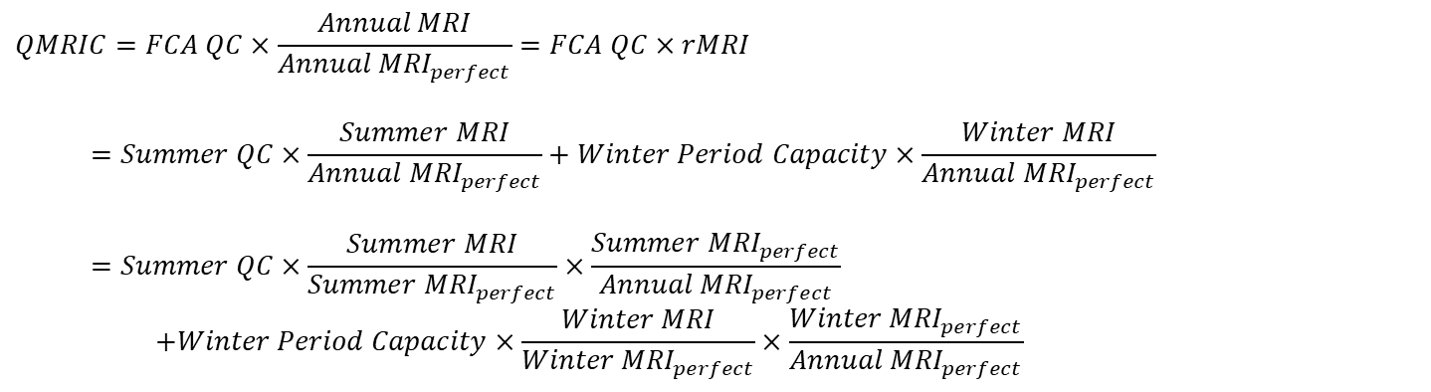
QMRIC Calculation
$$QMRIC=FCA QC×\frac{Annual MRI}{{Annual MRI}_{perfect}}=FCA QC×rMRI$$
$$=Summer QC×\frac{Summer MRI}{{Annual MRI}_{perfect}}+Winter Period Capacity×\frac{Winter MRI}{{Annual MRI}_{perfect}}$$
$$=Summer QC×\frac{Summer MRI}{{Summer MRI}_{perfect}}×\frac{{Summer MRI}_{perfect}}{{Annual MRI}_{perfect}} \\ +Winter Period Capacity×\frac{Winter MRI}{{Winter MRI}_{perfect}}×\frac{{Winter MRI}_{perfect}}{{Annual MRI}_{perfect}}$$

Slide 55
Appendix B
Class Assignment Information

Slide 56
Impact Analysis Resource Class Assignment Overview
Data used for class assignment
  ISO CELT report
    Tab 2.1 (Generator List)
    Tab 4.3 (Qualified & Cleared Capacity)
  FCA qualification details

Slide 57
Resource Class Assignment
Gas-only
  Prim Fuel Type = NG AND No Alt Fuel Type AND Gen Type ≠ FC
Dual-fuel
  Has Prim Fuel Type and Alt Fuel Type, one of which is NG
Oil-only
  Prim Fuel Type = DFO/RFO/KER/JF AND No Alt Fuel Type

Slide 58
Resource Class Assignment, continued
Hybrid
  Co-located facility participating as single FCM resource
Energy Storage
  Resource participating as storage OR Gen Type = PS
Fuel Cell
  Gen Type = FC
Other Non-IPR
  Intermittent = No AND Prim Fuel Type = WAT/LFG/WDS/MSW/NUC/BIT AND Gen Type ≠ PS

Slide 59
Resource Class Assignment, continued
IPR Wind
  Generating Fuel Type = Wind
IPR PV
  Intermittent = Yes AND Generating Fuel Type = Solar
Other IPR
  Intermittent = Yes AND Prim Fuel Type = WAT/LFG/WDS/MSQ/OBG
Passive DR
  DR Type = ON_PEAK/SEASONAL_PEAK
ADCR
  DR Type = REAL_TIME
Import
  Type = Import

Slide 60
More Granular Resource Class Assignment
Gas-primary
  Dual-fuel AND Prim Fuel Type = NG
Gas-secondary
  Dual-fuel AND Alt Fuel Type = NG
IPR Hydro
  Other IPR AND Prim Fuel Type = WAT
Non-Wind/PV/Hydro IPR
  Other IPR AND Prim Fuel Type ≠ WAT
DR On-peak
  DR Type = ON_PEAK
DR Season-peak
  DR Type = SEASONAL_PEAK
Location
  NorthernNE = Maine, New Hampshire, and Vermont load zones
  SouthernNE = All other load zones

Slide 61
Appendix C
More Detailed MRI Results

Slide 62
MRI Ranges
† The equation $Winter QMRIC=Summer Capacity×\frac{Winter MRI}{{Annual MRI}_{perfect}}$ is used to calculate Winter MRI for IPR PV.

Slide 63
More Granular MRI Results (Demand Response)

Slide 64
More Granular MRI Results (Classes Limited During Winter Period)

Slide 65
More Granular MRI Results (IPR)
† The equation $Winter QMRIC=Summer Capacity×\frac{Winter MRI}{{Annual MRI}_{perfect}}$ is used to calculate Winter MRI for IPR PV. Summer QC is used for weighting.

Slide 66
Appendix D
Estimation of Storage rMRI

Slide 67
Storage rMRI Estimation using Equation
$$rMRI=\frac{Expected net number of hours available at FCA QC during RAA MRI hours per year}{Expected number of RAA MRI hours per year}$$
To approximate the number of RAA MRI hours per year, consider the duration of LOL events inclusive of contiguous storage discharge hours
  Output during LOLHs directly decreases EUE
  Output during contiguous storage discharge hours can indirectly decrease EUE by allowing more stored energy to be carried into the LOL event

Slide 68
Storage rMRI Estimation using Equation, cont.
$$rMRI=\frac{Expected net number of hours available at FCA QC during RAA MRI hours per year}{Expected number of RAA MRI hours per year}$$
According to the table, the approximate number of RAA MRI hours per year is 0.755

Slide 69
Storage rMRI Estimation using Equation, cont.
$$rMRI=\frac{Expected net number of hours available at FCA QC during RAA MRI hours per year}{Expected number of RAA MRI hours per year}$$
Assume storage starts each event fully charged
  For each event, storage is available at FCA QC for the minimum of the event duration and its storage duration
Estimated 2-hour storage rMRI: 0.264
  Actual rMRI: 0.322
Estimated 8-hour storage rMRI: 0.929
  Actual rMRI: 0.873

