Slide 1
May 2, 2018 | Holyoke MA
PRD Timeline and Cutover
Information for Participants
Doug Smith
Technical manager | market operations

Slide 2
Purpose
Provide participants with an updated project timeline and important information related to the transition to fully integrated Price Responsive Demand on June 1, 2018

Slide 3
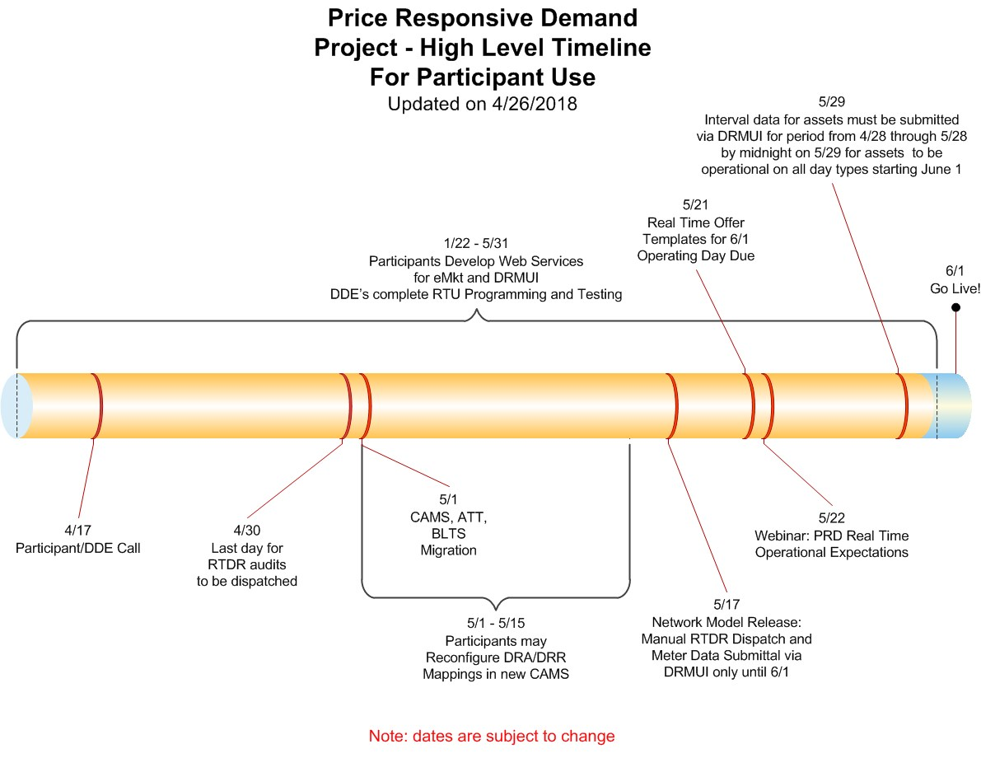

Slide 4
Transition Information – RTU
As of May 15, RTU communication will be disabled for the remaining days in May
Any needed OP-4 dispatch from May 15-31 would be performed manually via a phone call from the Operator to the DDE
All interval data for assets in the May communications model must be submitted via DRMUI for the remainder of May (by initial deadline)
The June 2018 DR communications model will be locked down a week earlier than normal
T-14 lockdown date is May 17
Participants should allow time for ISO review and approval of new registrations and mappings prior to the Model Cut

Slide 5
Transition Information – Data for June Model Assets
Interval data submission for all cutover and newly registered assets going into the June communications model must be performed via the DRMUI
Baselines will not be calculated for these assets as part of the daily sequence until June 1
The ‘daily’ sequence will be done twice a day starting in June to ensure all data corrections received by the initial deadline are factored into the biweekly settlements for energy
A manual process will be performed on May 30 to establish baselines for these assets for each day type

Slide 6
Transition Information – Data for June Model Assets (Cont.)
In order for these assets to have baselines for each day type going into June, specific data must be uploaded for the manual process to work
For weekdays, data from May 14 through May 25th must be submitted
For Saturday, data from April 28, May 5, 12, 19, and 26 is needed
For Sunday/Holiday, data from May 6,13, 20, 27, and 28 is needed
To cover all cases data can be submitted for the entire period of April 28-May 28
This must be submitted by midnight on May 29
We ask that DDEs make these submissions throughout May rather than waiting to do it all on May 29
Submissions for May 29, 30, and 31 must also be made via DRMUI as soon as possible following each day
After June 1, the system will calculate the first baseline for a given day type whenever there is enough data to do so
Assets can be in the communication model without a baseline built for a given day-type, but it can not contribute to its associated DRR unless it has one going into an operating day

Slide 7
Transition Information – Rounding issue for DRR electronic dispatch
We discovered a minor issue in testing RTU/CFE communications
The issue is that the limits we send during a dispatch are rounded to whole MW even though offers are made at the tenth of MW
This does not affect the DDP, only the limits we send
Example: DRR ZSWCT001 has a bid in Max Reduction of 0.2MW. We could dispatch them to .2 MWs and the DDP would reflect accordingly, however the limits we would be sending would be 0.
We plan to fix this issue later this summer

Slide 8
Transition Information – Co-Located Assets
With the new design of CAMS, the way we store location information for co-located assets has changed such that there is only one location record for co-located assets
This could be a DRA at the same facility as an On Peak or Seasonal Peak asset, or multiple On Peak or Seasonal Peak assets at the same facility
Because these assets could have different Participants, only ISO users can modify the location information for co-located assets
This would be done only after consultation with all Participants that have assets registered at the facility
Location information includes pNode, Facility Name, Address, Distribution Company, Latitude and Longitude, and Retail Account Number

