Slide 1
september 12-13, 2018 | westborough, MA
Opportunity Costs and Energy Market Offers (Phase 1)
ISO’s Proposal to Estimate Opportunity Costs for Oil and Dual-Fuel Resources with Inter-temporal Production Limitations
Jonathan Lowell
jlowell@iso-ne.com | 413-540-4658

Slide 2
Opportunity Costs and Energy Market Offers
(Phase 1)
WMPP ID:
131
Proposed Effective Date: December 2018
ISO is proposing implementation in December of a system to daily estimate energy opportunity costs for oil and dual-fuel resources with limitations on energy production over a 7-day horizon
No tariff changes are required – MR-1 Appendix A already provides for the inclusion of opportunity costs in energy offers
Todays presentation will provide:
  Background and context – what is motivating the ISO proposal?
  Implementation notes – what Participants should expect to see
  Four detailed, but still relatively simple, examples to explain the methodology and the factors that influence a generator’s estimated opportunity cost

Slide 3
Background and context
What factors are motivating the ISO opportunity cost proposal?

Slide 4
Background – Factors Motivating Opportunity Cost Enhancements
Extreme cold weather conditions during January 2018 and associated high gas prices created the possibility that oil-fired generation running in-merit would deplete fuel supplies before they could be replenished
At that time, the ISO did not have in place a methodology to calculate transparent, economically sound opportunity costs for generators with stored fuel limitations that could be used in the review of generators’ energy offers
If energy offers had included the opportunity cost of consuming the limited fuel early in the cold snap, economic commitment and dispatch could have preserved the limited fuel to be used in later periods with higher demand and higher energy prices.
When offers include energy opportunity costs, economic dispatch can reduce or eliminate the need for manual actions (i.e. posturing)

Slide 5
An Enhanced Ability to Estimate Appropriate Generator-specific Opportunity Costs Provides a Number of Benefits
Facilitates efficient use of fuel-constrained resources over multi-day time horizons
Improves both reliability and overall system cost-effectiveness
Improves price formation by reflecting the opportunity cost of energy supply limitations in market prices
Helps to avoid market dislocations and price distortions that can result from manual actions

Slide 6
Overview of proposed methodology
How the ISO plans to calculate estimated opportunity costs

Slide 7
How is Opportunity Cost Defined?
Think of the opportunity cost (OC) as the reduction in maximum Net Revenue (over the opportunity cost horizon) associated with a 1 MWH reduction in the available fuel supply
“Net Revenue” is the difference between energy revenue (LMP x MWH) and cost of production for each MWH
  Cost of production includes fuel cost, emission allowance costs, VOM
These concepts are defined more precisely in the accompanying memo:
“Energy Market Opportunity Costs for Oil and Dual-Fuel Resources with Inter-temporal Production Limitations”

Slide 8
How is Opportunity Cost Defined? (continued)
In the initial implementation of estimated opportunity costs the time horizon will be 7 days, and will ignore any planned future fuel replenishments during that period.
  This aligns opportunity cost estimates with the planning assumptions used by System Operations to guide reliability actions
This definition can and will be extended in the future to address any quantifiable factor or element that could restrict a resource’s ability to produce energy (e.g. allocated emission allowance, run hour limitations, river in-flows, etc.)
  ISO is depending on Participants to identify and support these limitations with sufficient detail to allow the constraints to be modeled and tracked
  The definition does not apply to intermittent resources with no control over “use-it-or-lose-it” source energy supply. These resources have no “inter-temporal production limits”
    Examples: wind and run-of-river hydro.

Slide 9
Important Input Assumptions to OC Calculations
Covering the 7-day OC Horizon
Hourly (zonal) electricity price projections
Daily fuel spot price projections
  Algonquin (non-G)
  Oil (#2, #6 1% S, #6 0.3% S, Jet (kerosene)
Emission allowance prices (SO2, NOx and RGGI CO2)
Temperature forecast

Slide 10
Opportunity Cost Model Design
The OC model solves an optimization problem to find the feasible generation schedule producing the maximum Net Revenue over the 7-day OC horizon
Fuel supply (inter-temporal production) limitations are modeled as constraints
Operating characteristics (EcoMin, EcoMax, Mid Run Time, etc.) are also modeled as constraints
The difference in Net Revenue when the fuel supply is reduced by 1 MWH is the estimated energy opportunity cost
The examples presented later illustrate the application of this design to increasingly complex scenarios

Slide 11
Notes on implementation
What can Participants expect?

Slide 12
Daily Timeline
Generator-specific Day-Ahead OC estimates will be calculated every morning and made available to Lead Participants via Internal Market Monitoring’s Asset Characteristics (IMMAC) interface by 9am
  This is where Participants can currently view their reference prices
A generator’s estimated OC will automatically be included in the generator’s reference price
If a generator has a separately determined OC for MA CO2 emission allowances, the final OC will be the greater of the two
Once OCs are incorporated in reference prices, the remainder of IMM’s offer review and mitigation process is unchanged

Slide 13
Anticipated Participant Impacts of OCs
Participants are not required to use the ISO estimated OC in energy offers
For this coming winter, OC published by 9am on Day 1 will be used to review offers for the Day 2 Day-Ahead Market, and real-time offers during the Day 2 Operating Day
  ISO is evaluating feasibility of updating real-time OCs within the Operating Day to reflect changes in key input assumptions as a future enhancement
ISO estimated OCs could increase, but never decrease, a generator’s reference price
Unless existing market power tests identify a generator as possessing market power, OCs will have no impact
If a generator is flagged as potentially having market power, the generator’s offer may be mitigated if the offer exceeds the reference price (which includes the OC)
Resulting LMPs may be higher when fuel supply limitations might otherwise lead to manual reliability actions
More cost-effective use by the system of limited fuel resources when OCs are reflected in energy offers should reduce the need for manual reliability actions and associated market dislocations

Slide 14
Opportunity cost examples
Description and Illustration of the Economic Principles that Underlie Energy Opportunity Costs

Slide 15
The Accompanying Memo Provides Important Additional Detail
The memo¹ that accompanies this presentation provides
  The mathematical formulation of the optimization problem
  A careful and detailed explanation of each of the examples that follow.
Each example illustrates an important aspect of how opportunity costs address and respond to increasingly complex real-world scenarios
The September version of the memo includes the following examples:
  Oil unit that is generally out of merit; adequate fuel inventory
  Oil unit frequently in-merit; insufficient fuel to run in all profitable hours
  Same as Example 2, but LMP forecast changes over time
  Oil unit with Min Run Time > 1hr and EcoMin > 0 MW
The examples will be expanded for the October Markets Committee meeting to address oil/gas dual-fuel generator cases
¹ “Energy Market Opportunity Costs for Oil and Dual-Fuel Resources with Inter-temporal Production Limitations”

Slide 16
Example 1: Oil unit generally out of merit; adequate fuel inventory (1)
Key Points to look for:
  When available fuel supply is adequate, a resource can run in every profitable hour
  Opportunity cost will be $0

Slide 17
Example 1: Oil unit generally out of merit; adequate fuel inventory (2)

Slide 18
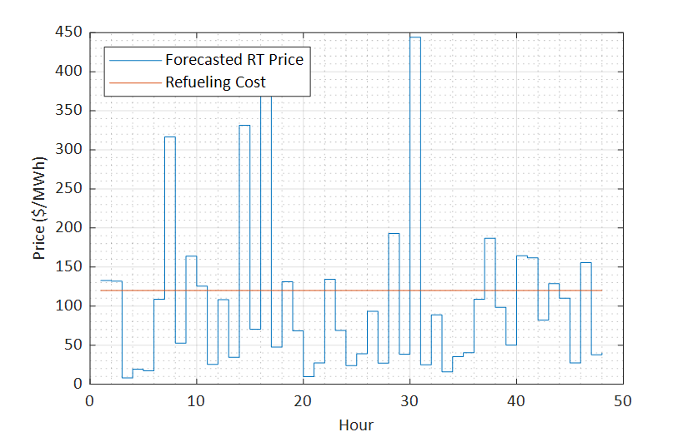
Example 1: Oil unit generally out of merit; adequate fuel inventory (3)
Observations
Electricity price greater than fuel cost in 16 of the 48 hours
Fuel required to run at EcoMax for 16 hours would be 16hr x 170 MW = 2720 MWH
Available fuel is 3000 MWH
The least profitable of the 16 hours is hour 10 with an LMP of $125.35

Slide 19
Example 1: Oil unit generally out of merit; adequate fuel inventory (4)
In the 48 hour period there are 16 hours in which projected LMP is greater than the replacement fuel cost of $120/MWH
There is sufficient fuel to run for 17.6 hours at EcoMax (= 3000 MWH / 170 MW)
Generator is able to run every hour when LMP exceeds dispatch price. Therefore, OC = $0/MWH
Note that some hours with prices < $50/MWH
are not shown to preserve readability

Slide 20
Example 2: Oil unit frequently in-merit; insufficient fuel to run in all profitable hours (1)
Key Points to look for:
  When available fuel supply prevents a resource from operating in all projected profitable hours over the OC horizon, including OC in the energy offer will allow economic dispatch to preserve fuel for when its use is most cost-effective to the system (displacing higher-cost alternatives)
  When OCs are calculated hourly, the future OC value can change as hours expire and fuel is consumed
Assumptions
  Unit characteristics same as Example 1
  Same fuel inventory as Example 1
  Same refueling cost and schedule as Example 1
  Electricity prices are generally higher than in Example 1

Slide 21
Example 2: Oil unit frequently in-merit; insufficient fuel to run in all profitable hours (2)

Slide 22
Example 2: Oil unit frequently in-merit; insufficient fuel to run in all profitable hours (3)
Initially, 20 of the 48 hours appear profitable
Unit has fuel for 17 hours, plus a bit of hour 18
Hour 16 is the 18th most profitable hour with a net revenue of $ 20.42 = (140.42 - $120.00)
The 19th hour appears profitable, but unit has insufficient fuel to operate

Slide 23
Example 2: Oil unit frequently in-merit; insufficient fuel to run in all profitable hours (4)
After hour 16, 1190 MWH of fuel remains in the tank for the remaining 32 hours of the OC horizon, equivalent to 7 hours at EcoMax. This will change the OC estimate going forward
Repeating the analysis for hours 17-48 (with same price forecast produces a new result
OC becomes = $183.17 = ($303.17 - $120.00)
Similarly, the OC estimate will continue to change (which in this example means “increase”) as we repeat the analysis for successive hours
Note that in this simple example, sorting and ranking was sufficient to easily determine maximum net revenue and OC. More complex examples with intertemporal unit constraints will require more explicit optimization methods.

Slide 24
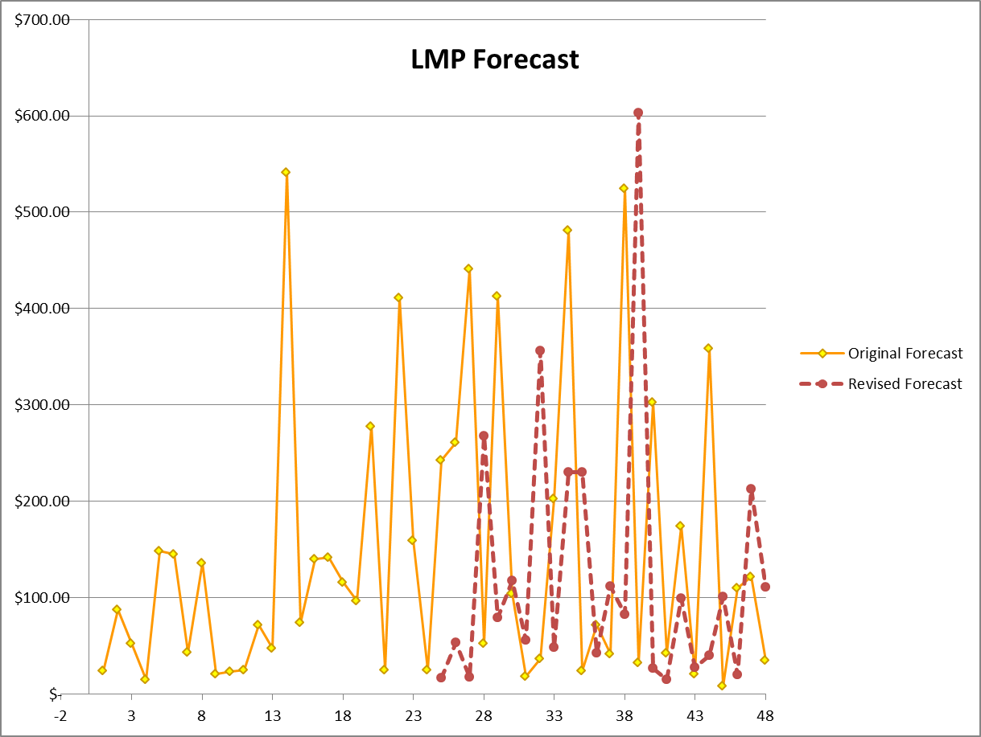
Example 3: Oil unit frequently in-merit; limited fuel; LMP forecast changes (1)
Key Points to look for:
    An updated LMP forecast part way through the OC horizon will impact the estimated OC
Assumptions
    Same initial LMP forecast as Example 2
    Revised LMP forecast for Day 2 that is lower on average
    Same fuel inventory as Example 2
    Same refueling cost and schedule as Example 2
    Same unit characteristics as Example 2

Slide 25
Example 3: Oil unit frequently in-merit; limited fuel; LMP forecast changes (2)

Slide 26
Example 3: Oil unit frequently in-merit; limited fuel; LMP forecast changes (3)
Initial estimate of OC using original LMP forecast is $20.42 = ($140.42 - $120.00)
Hours 8 & 47 appear profitable, but fuel supply is insufficient
Units runs at less than EcoMax in hour 16 to preserve fuel for more profitable hours in Day 2
1300 MWH of fuel consumed during Day 1
1700 MWH = (3000 MWH – 1300 MWH) remain at start of Day 2
Not all hours shown to preserve readability

Slide 27
Example 3: Oil unit frequently in-merit; limited fuel; LMP forecast for Day 2 changes (4)
With 1700 MWH of fuel, unit could run for 10 hours
Only 6 hours in the revised LMP forecast look profitable
The available fuel constraint is no longer binding. Reducing fuel supply by 1 MWH has no impact on net revenue.
Revise opportunity cost is therefore $0/MWh during Day 2

Slide 28
Example 4: Oil unit with operational constraints (Min Run Time & EcoMin) (1)
Key Points to look for:
  The addition of operational constraints, such as Min Run Time and EcoMin may require a generator to operate in some unprofitable hours to maximize net revenue
  This complicates the optimization, but does not change the concept of energy opportunity costs
Assumptions
  Min Run Time = 3 hr
  EcoMin = 30 MW
  Other characteristics and fuel assumptions unchanged
  LMP forecast same as Example 2

Slide 29
Example 4: Oil unit with operational constraints (Min Run Time & EcoMin) (2)

Slide 30
Example 4: Oil unit with operational constraints (Min Run Time & EcoMin) (3)
The optimal commitment and dispatch of the generator is determined using an optimization model that respects the unit’s EcoMin and Min Run Time restrictions
This causes unit to
  run in some unprofitable hours at EcoMin (e.g. hr 7)
  Not run in some profitable hours (e.g. hr 8)
The marginal hour is hour 16
If available fuel was less by 1 MWH, output in hour 16 would be reduced
OC = $20.42 = ($140.42 - $120.00)

Slide 31
Conclusion
Starting in December, ISO proposes to incorporate a daily estimate of opportunity cost into the reference price for oil and dual-fuel generators
The OC estimates will be available to Participants by 9am each day
Participants are encouraged to include opportunity costs in generators’ energy market offers
Doing so should improve reliability and the system’s cost-effectiveness during constrained fuel conditions
The ISO seeks information and comment from Participants to enhance the OC model to better address fuel and other real-world constraints that impact a generator’s ability to operate continuously at maximum output

Slide 32
Stakeholder Schedule
Stakeholder Committee and Date | Scheduled Project Milestone
Markets Committee August 3, 2018 | Discussed ISO’s plans for Opportunity Costs for the coming winter
Markets Committee September 12-13, 2018 | Discussion of OC proposal details and detailed examples for oil units
Markets Committee October 2018 | Further discussion of examples for dual-fuel units
Early/mid November 2018 | Webex training targeted to back-office personnel responsible for energy offer submission
December 2018 | Implementation of OC estimates included in oil/dual-fuel generator reference prices

Slide 34
Acronyms Used in this Presentation
IMMAC – Internal Market Monitor’s Asset Characteristics interface
CAMS – Customer Asset Management System
OC – opportunity cost
DAM – Day-Ahead Market
LMP – Locational Marginal Price
MRT – Minimum Run Time
SO2 – Sulfur Dioxide
NOx – Nitrogen Oxide
CO2 – Carbon Dioxide
RGGI – Regional Greenhouse Gas Initiative

